Slide 1
Data Engineering and Data Models

Slide 2
Data Science vs. Data Engineering
Data Engineering
Builds the data and computation infrastructure used by the data scientist.
Uses relational databases, streaming, cloud computing …
Data Science
Building models
Answering business questions
Uses Statistics / Machine learning
Expects data to be available and computation to be fast.

Slide 3
What data engineering we will cover
Will Cover
Hadoop File System
Data partitioning and partition balancing
Caching and persistence
Checkpointing
Will Not Cover
Data Cleaning
Spark Server configuration and optimization.
Creating scalable pipelines
Containerization

Slide 4
Three Data Models: Relations, Tensors and Dataframes
Data Scientists and Data Engineering communicate using these data models

Slide 5
Three Data Models (and languages)
name₁
name₂
…
name_{n}
name₁
name₂
…
name_{n}
type
type₁
type₂
…
type_{n}
type₁
type₂
…
type_{n}
1 … n
1 … n
1 … n
A_{mn}
Array of values
R_{n}
Set of tuples (rows)
(typed by column)
name₁
A_{mn}
Array of values (typed by column)
m … 1
…
m … 1
name_{m}
Matrix
Relation/ Table
Dataframe
Linear Algebra
Relational Algebra
?

Slide 6
Matrices
type
1 … n
A_{mn}
Array of values
m … 1
Matrix
A Rectangle of numbers
All numbers are of the same type
Can transpose (exchange rows and colummns)
Can add and multiply.
Typically small enough to reside in memory of one computer.

Slide 7
Tables
name₁
name₂
…
name_{n}
type₁
type₂
…
type_{n}
1 … n
R_{n}
Set of tuples (rows)
(typed by column)
Table
Row: A tuple – defines an entity
Column: a named property of the entity: each column has a type
Schema: a collection of related tables.
Keys: a special column (1 per table) that uniquely identifies
Can select a set of rows based on a condition (SQL)
Can be very large (TB) and reside on disk.
Disk Data Structures make retrieval much faster than flat files.

Slide 8
Why Use DataBases
We can do the same in python/C/Matlab
But only if they fit in memory
A Database can span many disks on many computers.
Disk Data Structures to make retrieval much faster than flat files.

Slide 9
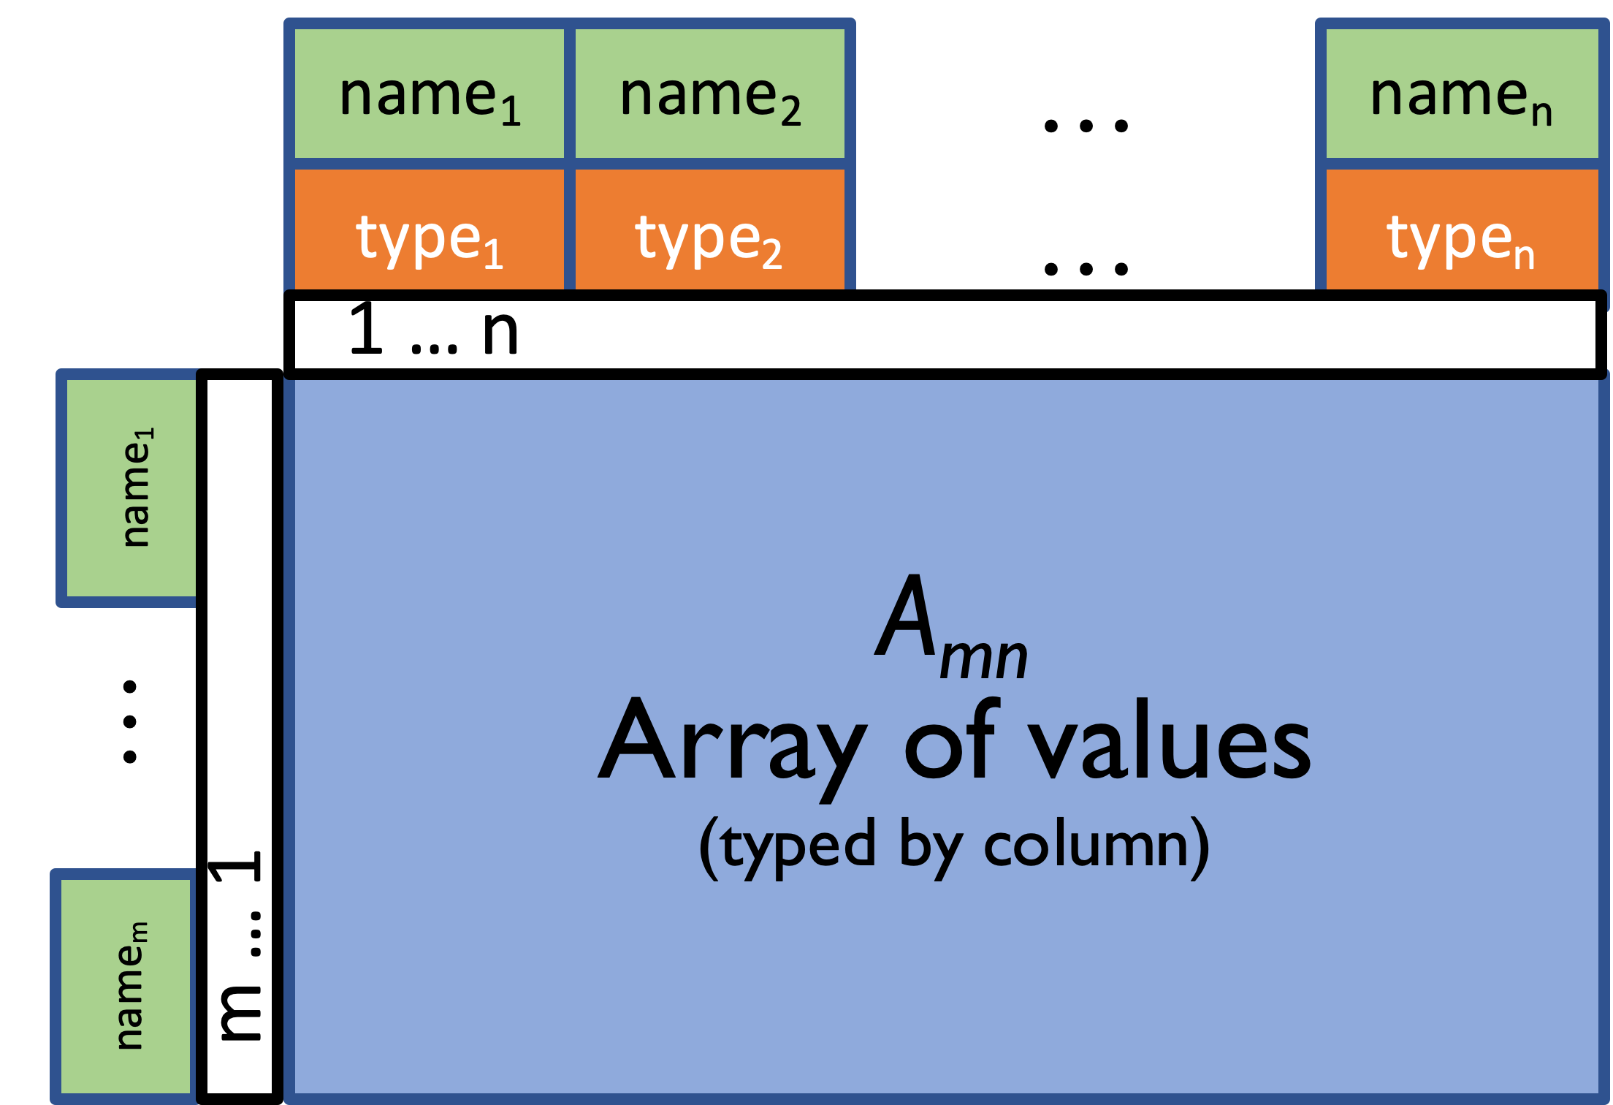
Dataframes
A blend of ideas from relations and matrices
Originally defined in the S language, which led to R
Ordered, named rows and columns.
But only columns have types.
Beware: there is not a standard definition of dataframes
Some define dataframes as relations with an ordering key. No transpose!
Two popular flavors: Pandas DataFrames and Spark DataFrames.

Slide 10
Summary
Data Science: Data analytics on large complex data.
Data Engineering: making the analytics scale on very large data.
Matrices are the basic data structure for linear algebra, Neural Networks.
Tables are the basic data structure for relational databases.
DataFrames are a compromise between tables and matrices.

