Slide 1
The RMSE Methodology
(Root Mean Square Error )

Slide 2

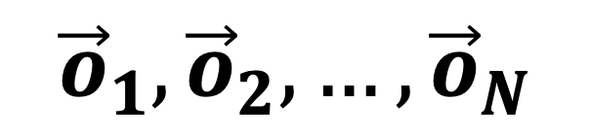
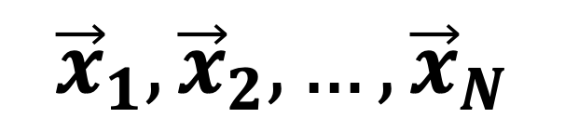
Real World
$${\vec{x}}_{1},{\vec{x}}_{2}, …,{\vec{x}}_{N}$$
Mathematical Model
$${\vec{o}}_{1},{\vec{o}}_{2}, …,{\vec{o}}_{N}$$

Slide 3
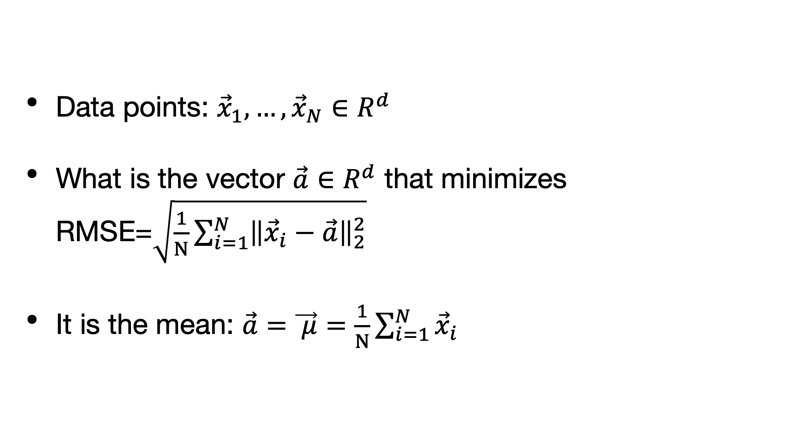
The best constant prediction is the mean
Data points: ${\vec{x}}_{1},…,{\vec{x}}_{N}∈R^{d}$
What is the vector $\vec{a}∈R^{d}$ that minimizes RMSE=$\sqrt{\frac{1}{N}\sum_{i=1}^{N}{{\left\|{\vec{x}}_{i}−\vec{a}\right\|}_{2}^{2}}}$
It is the mean: $\vec{a}=\vec{ μ}=\frac{1}{N}\sum_{i=1}^{N}{{\vec{x}}_{i}}$

Slide 4
PCA based prediction
o
x
x
o
o
x
x
o
o
x
o
x
x
o
o
x

Slide 5
Regression based Prediction
o
x
x
o
o
x
x
o
o
x
o
x
x
o
o
x

Slide 6
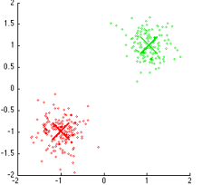
K-means clustering

Slide 7
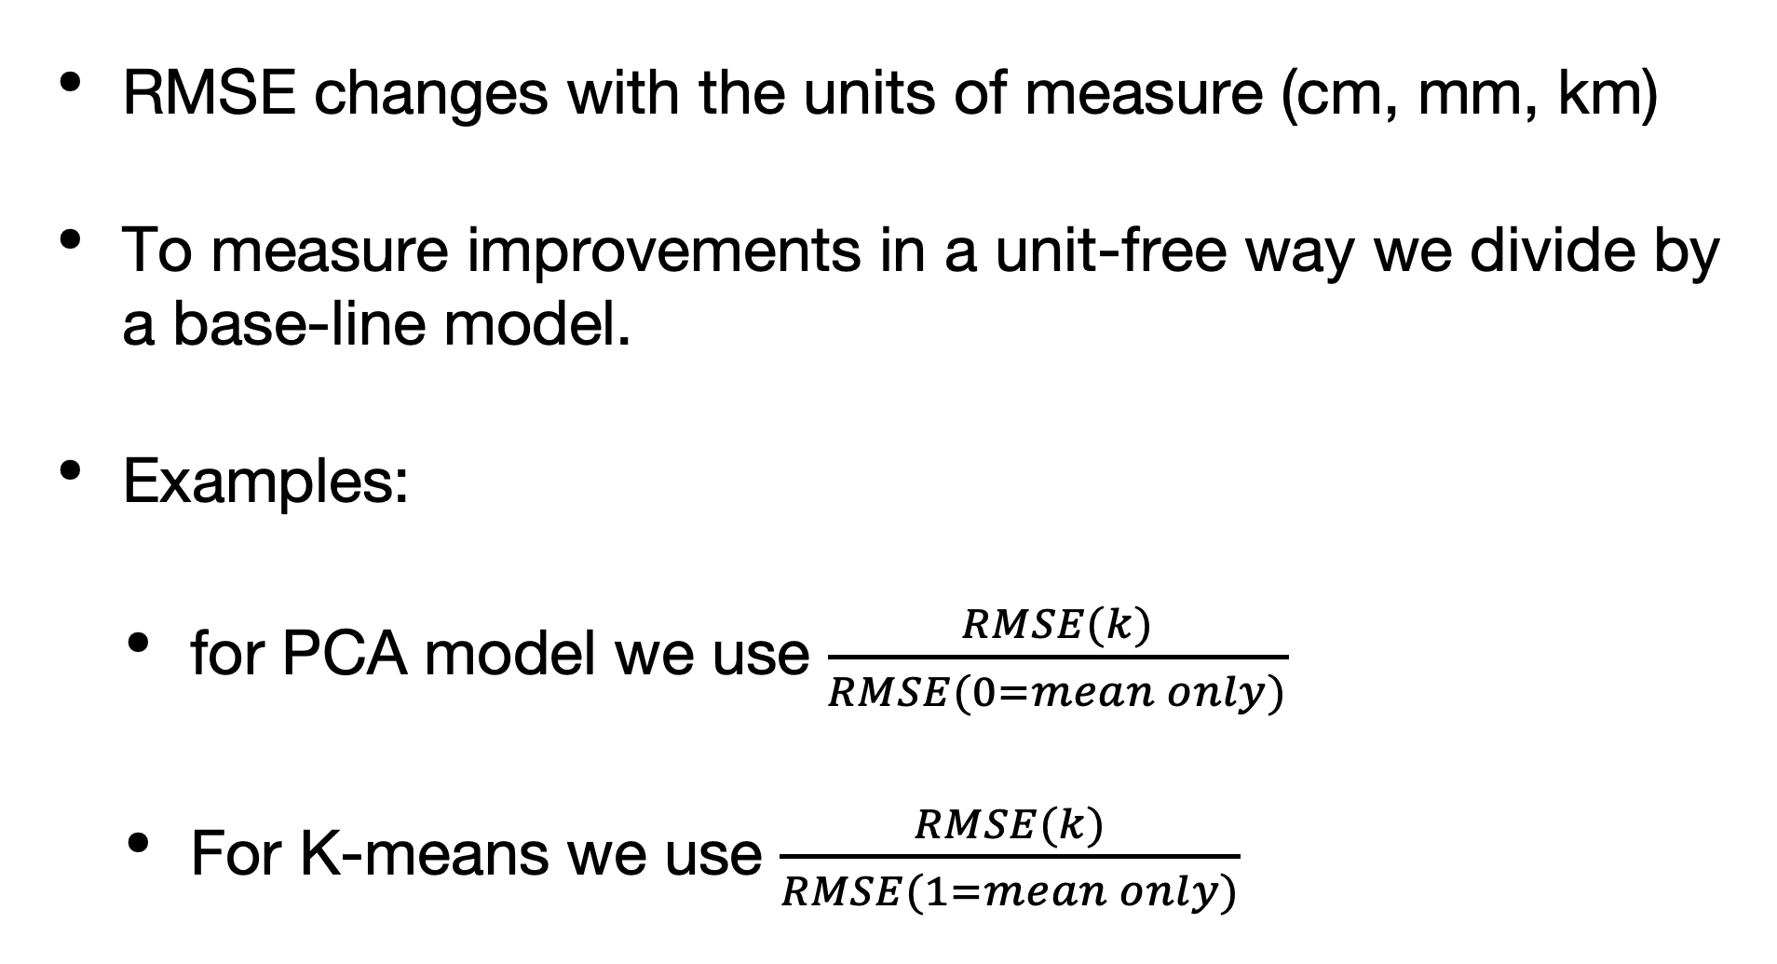
Percentage of variance explained
RMSE changes with the units of measure (cm, mm, km)
To measure improvements in a unit-free way we divide by a base-line model.
Examples:
for PCA model we use $\frac{RMSE(k)}{RMSE(0=mean only)}$
For K-means we use $\frac{RMSE(k)}{RMSE(1=mean only)}$

Slide 8
PCA block diagram
K Eigenvectors
Model
K vector coefficients
Approximate
Reconstruction
Of the vector
Squared error
Single year,station, measurement
vector

Slide 9
Spatial/temporal block diagram
Average per Year
Average per station
Fix measurement
Fix coefficient index
Model
Station
year
Estim. Coefficient i
Squared error
Station
Year
Value of Coefficient i

Slide 10
Model-based approximation block diagram
Learned Model Parameters
Some things are fixed
Model
Compressed
Representation
Of
Single Point
Approximate
Reconstruction
Squared error
Single Data Point

Slide 11
Extensive and Intensive properties
Extensive: size scales with size of data
Intensive: size does not scale with size of data
Learned Model Parameters
Model
Compressed
Representation
Of
Single Point
Approximate
Reconstruction
Squared error
Single Data Point

Slide 12
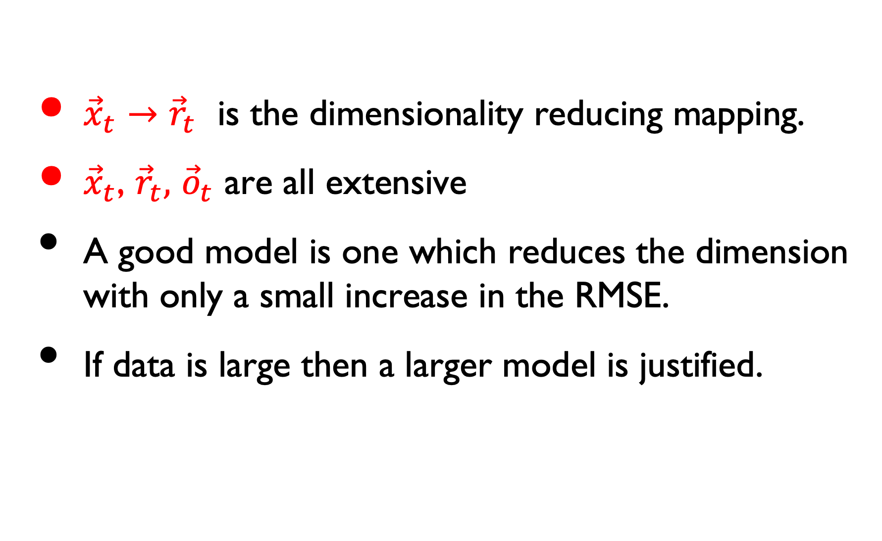
What is a good model?
${\vec{x}}_{t}→$ ${\vec{r}}_{t}$ is the dimensionality reducing mapping.
${\vec{x}}_{t}$, ${\vec{r}}_{t},$ ${\vec{o}}_{t}$ are all extensive
A good model is one which reduces the dimension with only a small increase in the RMSE.
If data is large then a larger model is justified.

Slide 13

Model-based approximation
Given d-dimensional data points. (here d=2)
Fit a simple model with few parameters. (Here Curve)
Each data point is approximated by the closest point on the curve.
The point on the curve is represented by a few numbers (dimensionality reduction)
The distance between the point and the approximation is the error.
We want the average root-mean-square-error (RMSE) or Percentage of Variance explained.
parameters:
$$α,β,γ$$
0
error
0.52
1

Slide 14
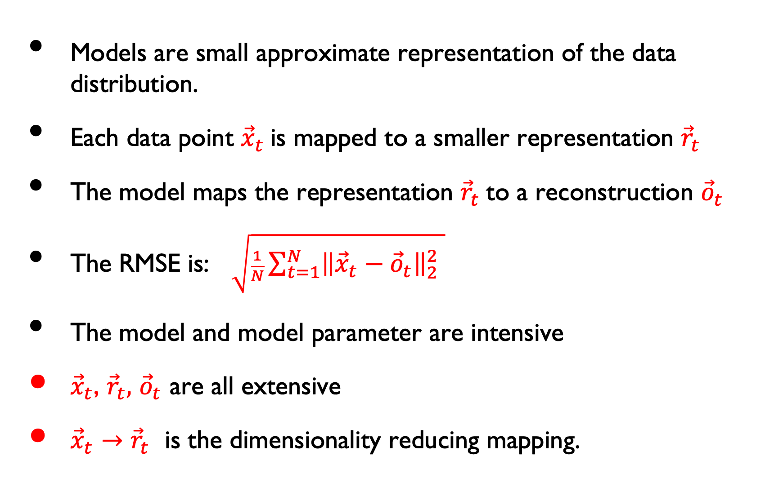
Summary
Models are small approximate representation of the data distribution.
Each data point ${\vec{x}}_{t}$is mapped to a smaller representation ${\vec{r}}_{t}$
The model maps the representation ${\vec{r}}_{t}$to a reconstruction ${\vec{o}}_{t}$
The RMSE is: $\sqrt{\frac{1}{N}\sum_{t=1}^{N}{{\left\|{\vec{x}}_{t}−{\vec{o}}_{t}\right\|}_{2}^{2} }}$
The model and model parameter are intensive
${\vec{x}}_{t}$, ${\vec{r}}_{t},$ ${\vec{o}}_{t}$ are all extensive
${\vec{x}}_{t}→$ ${\vec{r}}_{t}$ is the dimensionality reducing mapping.

Slide 15
Variations on a theme
different model geometric: lines, curves, points
different measures of error: distance from projection, distance from closest point fixing x, non-euclidean distances…

Slide 16
Different approaches to statistical modelling
Different Models for Different Goals
RMSE approach: Model maps each example to a simplified approximation.
Examples PCA, Regression, K-means
Performance measured using average reconstruction error (RMSE)
Other Goal: capture parameters of true distribution.
Generative approach: model is a generator of examples.
Examples: Mixture of Gaussians, HMMs
Generated distribution approximates true distribution.
Performance measured using likelihood.
Main Goal: capture parameters of true distribution.
Discriminative approach: model predicts output given input.
Examples: Perceptron, Decision trees, Neural Networks
Generated predictor approximated input -> output relationship.
Performance measured using average loss (RMSE, # of mistakes, …)
No Other Goal

Slide 17


Example of generative vs predictive modeling
Computer receives telephone call
Measures Pitch of voice
Decides gender of caller
Male
Human
Voice
Female

Slide 18


Generative modeling
mean1
mean2
Probability
var1
var2
Voice Pitch

Slide 19
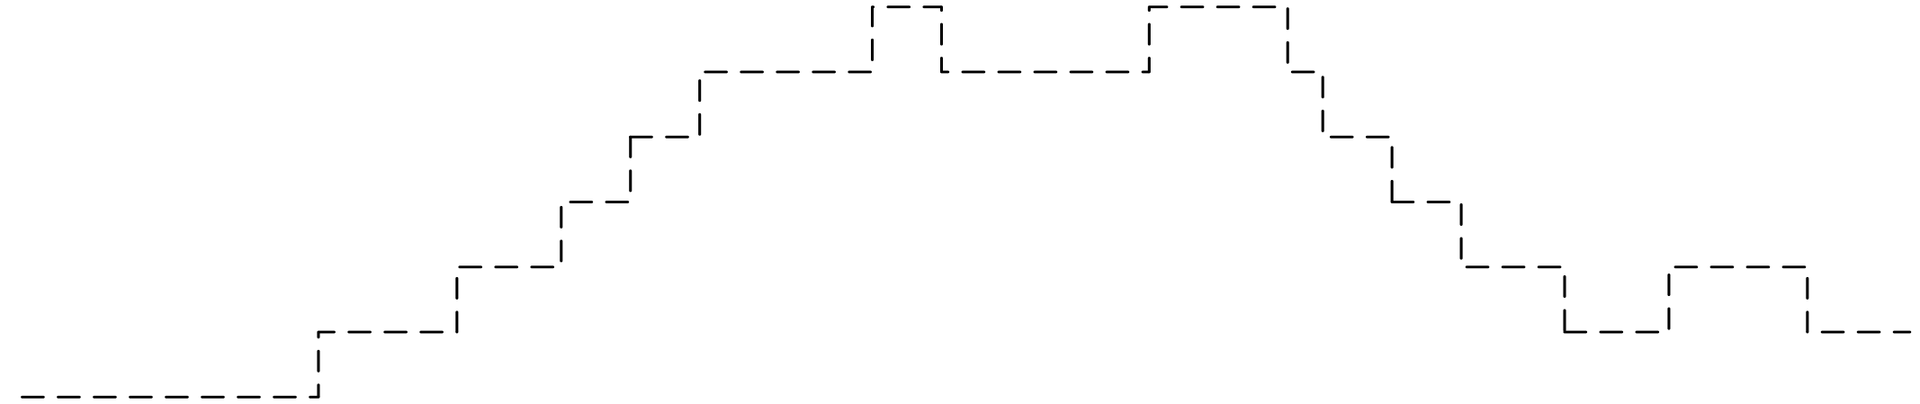
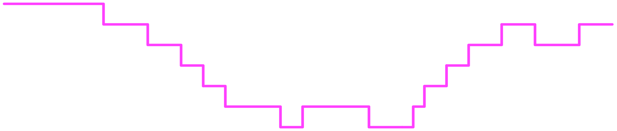
Discriminative approach
[Vapnik 85]
No. of mistakes
Voice Pitch

Slide 20
Well Behaved Data
Data for male/female generated according to normal distributions.
Estimated Mean and variance converge quickly to true values.
Generative method converges (much) faster than discriminative method.
Only viable method when number of training examples is small (<10,000).

Slide 21
Ill-behaved data
mean1
mean2
Probability
No. of mistakes
Voice Pitch

Slide 22
Traditional Statistics vs. Machine Learning
Machine Learning
Estimated
world state
Decision
Theory
Predictions
Actions
Data
Statistics

Slide 23
Deep Learning
In the discriminative family.
Claim: because we have many labeled training examples, we can use as many parameters as we want and never overfit.
Approach: Use models with many parameters, and train until training error 0.
Famous success cases: Alpha-Go, machine translation.
Problems:
Restricted labels: can we make use of unlabeled data (auto-encoders vs PCA)
Collecting a representative training set can be challenging.

Slide 24
Back To Kmeans

