Slide 1
Decision trees

Slide 2
Decision Trees / Discrete Features
Where and when do you have fun?
Location
Season | Location | Fun?
summer | prison | -1
summer | beach | +1
Winter | ski-slope | +1
Winter | beach | -1
Prison
Beach
Ski Slope
-1
Season
+1
Winter
Summer
-1
+1

Slide 3
Decision Trees / Continuous Features
Will bomb explode?
Mass | Temperature | explosion
1 | 100 | -1
3.4 | 945 | -1
10 | 32 | -1
11.5 | 1202 | +1
Mass>8
yes
no
-1
Temperature>500
yes
no
-1
+1

Slide 4
Decision Trees
Y
X>3
+1
no
yes
5
-1
Y>5
-1
no
yes
-1
-1
+1
X
3

Slide 5
Decision trees
Popular because very flexible and easy to interpret.
Learning a decision tree = finding a tree with small error on the training set.
Start with the root node.
At each step split one of the leaves
Repeat until a termination criterion.

Slide 6
Which node to split?
We want the children to be more “pure” than the parent.
Example:
Parent node is 50%+, 50%-.
Child nodes are (90%+,10%-),(10%+,90%-)
How can we quantify improvement in purity?

Slide 7
Naive approach: minimize training error
A good case
Parent node is 55%+, 45%-.
Predict + always: Error = 45%
Child nodes are (90%+,10%-),(10%+,90%-)
Predict + on left, - on right: Error = 10%
Clear Improvement

Slide 8
Naive approach: minimize training error
A bad case
Parent node is 80%+, 20%-.
Predict + always: Error = 20%
Child nodes are (90%+,10%-),(70%+,30%-)
Predict + always: Error = 20%
No improvement in training error!

Slide 9
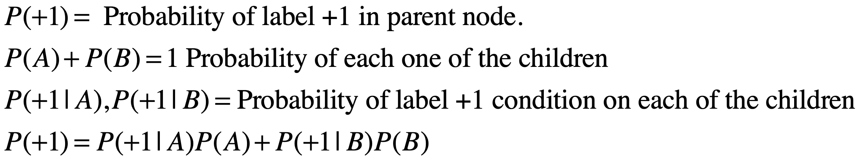
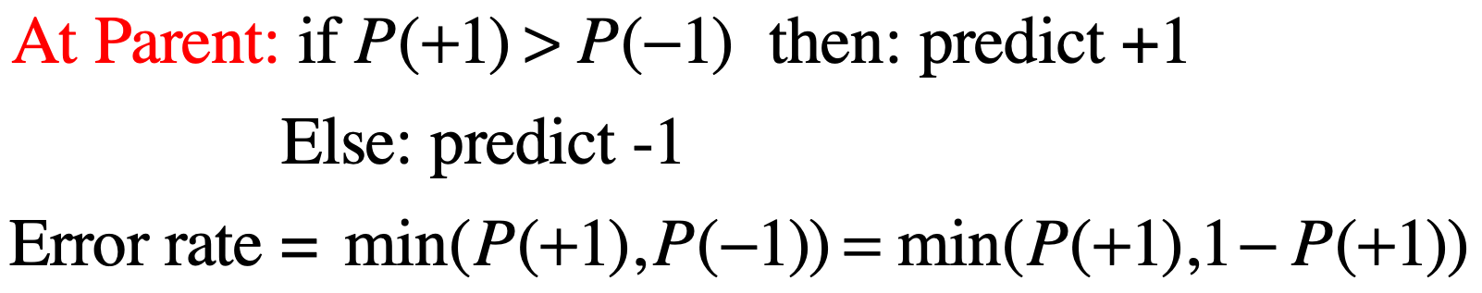
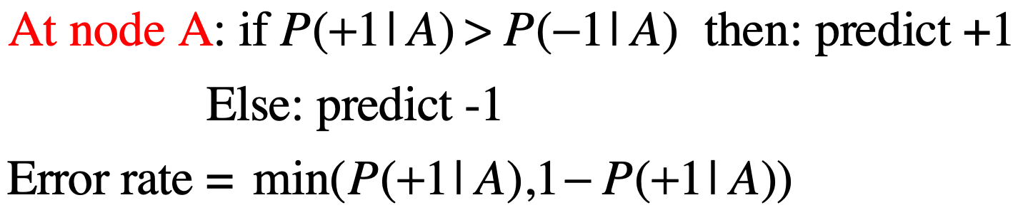

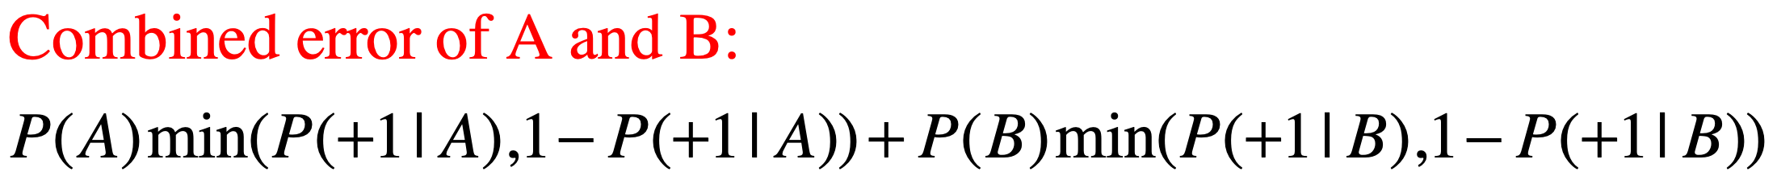
First approach: minimize error
Parent
no
yes
A
B

Slide 10
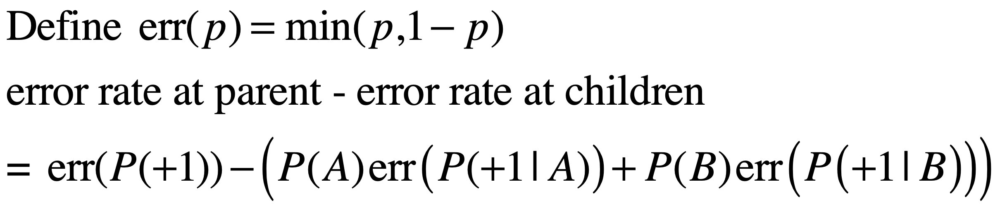
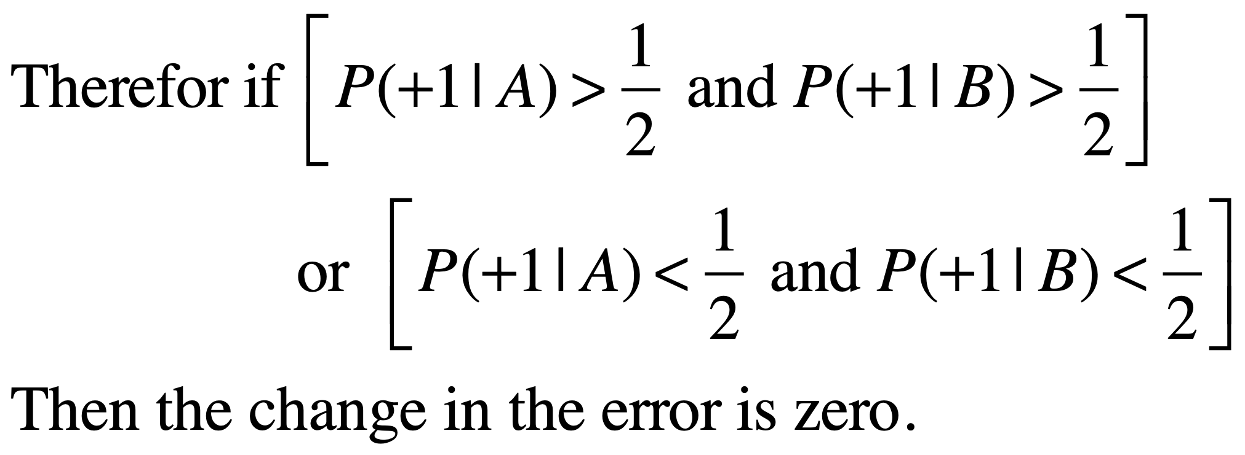
The problem with classification error.

Slide 11
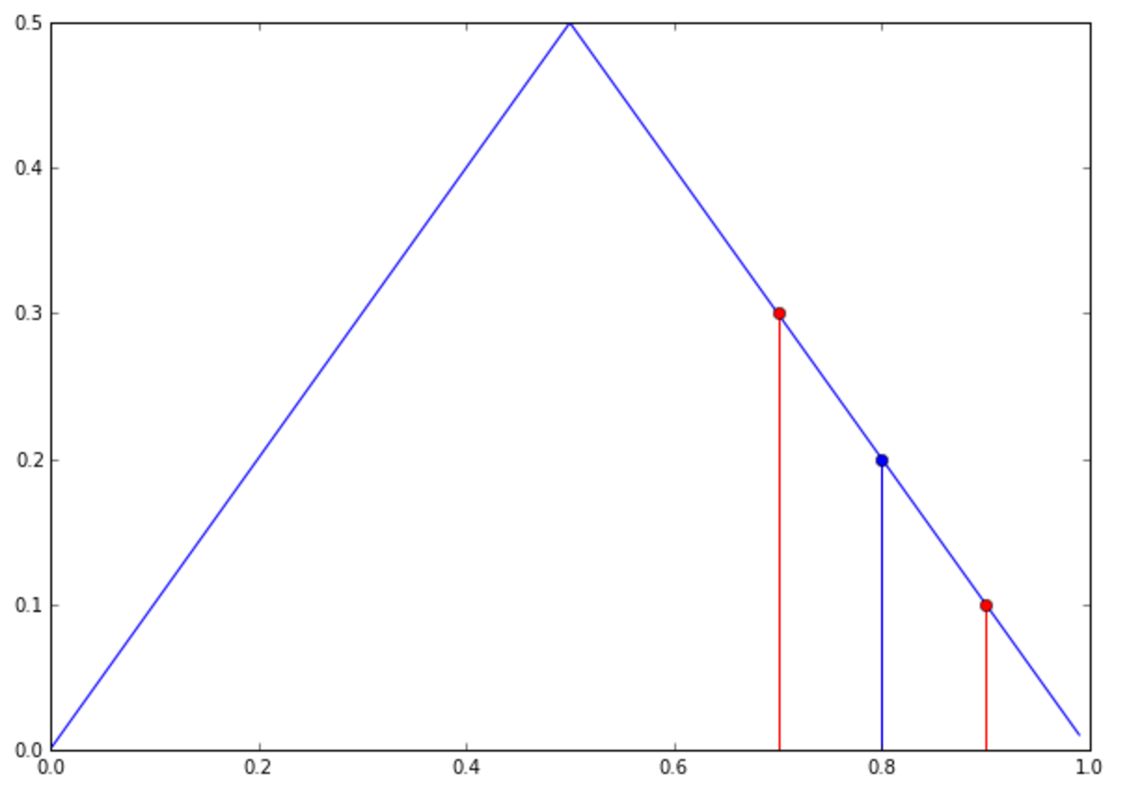
The problem with classification error (pictorially)

Slide 12
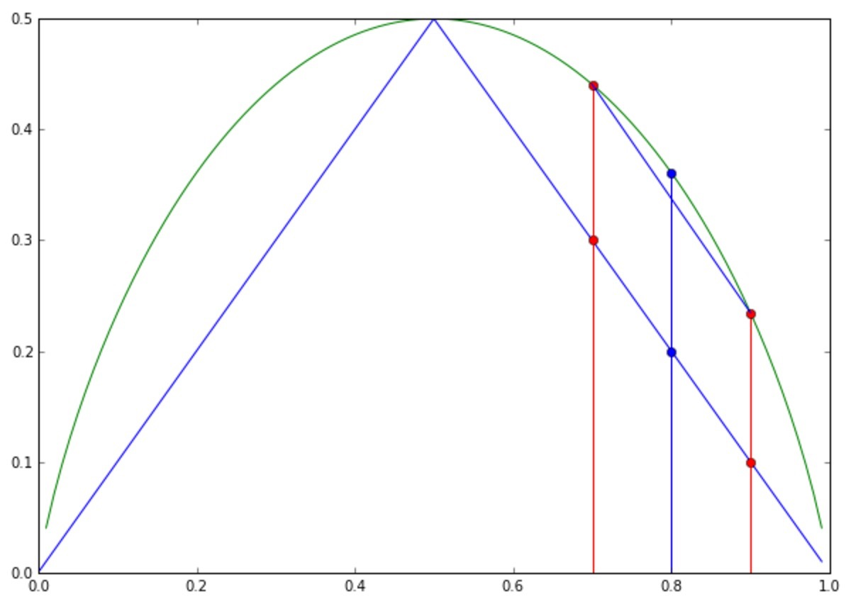
Fixing the problem

Slide 13
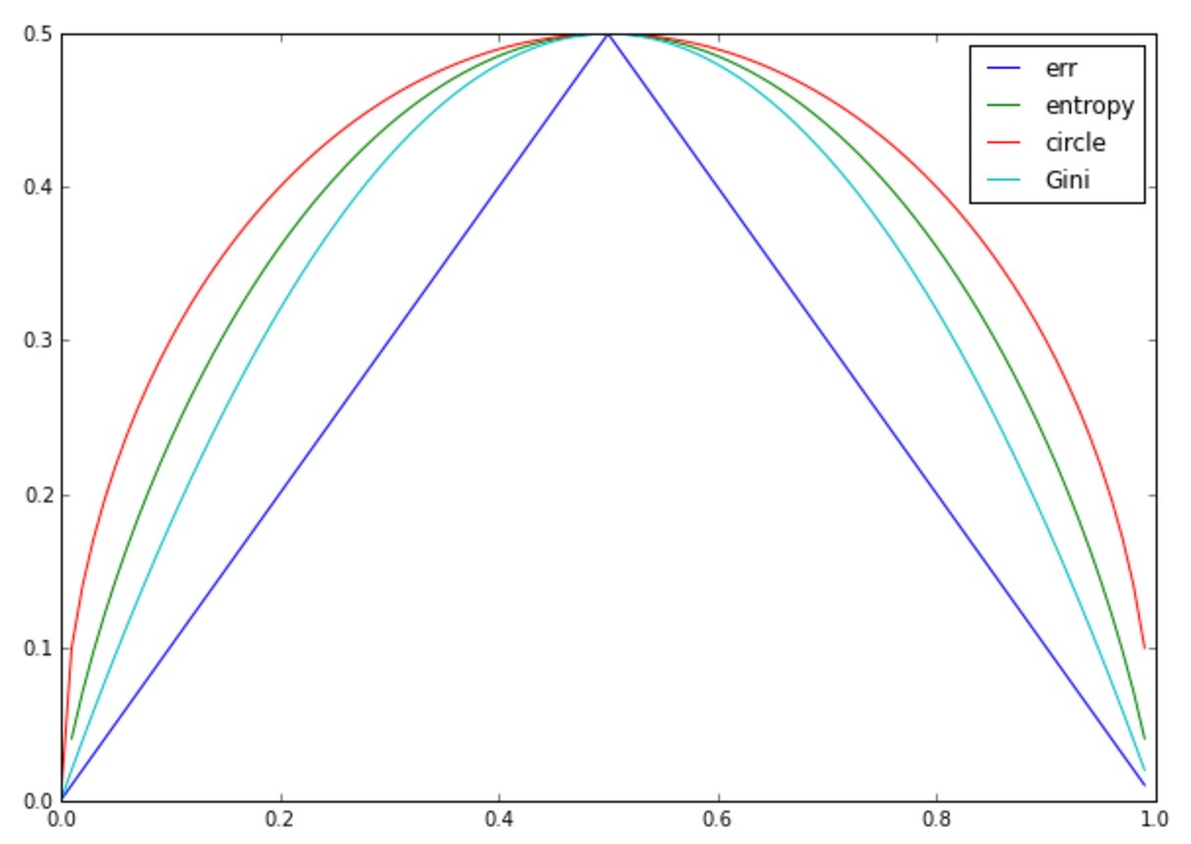
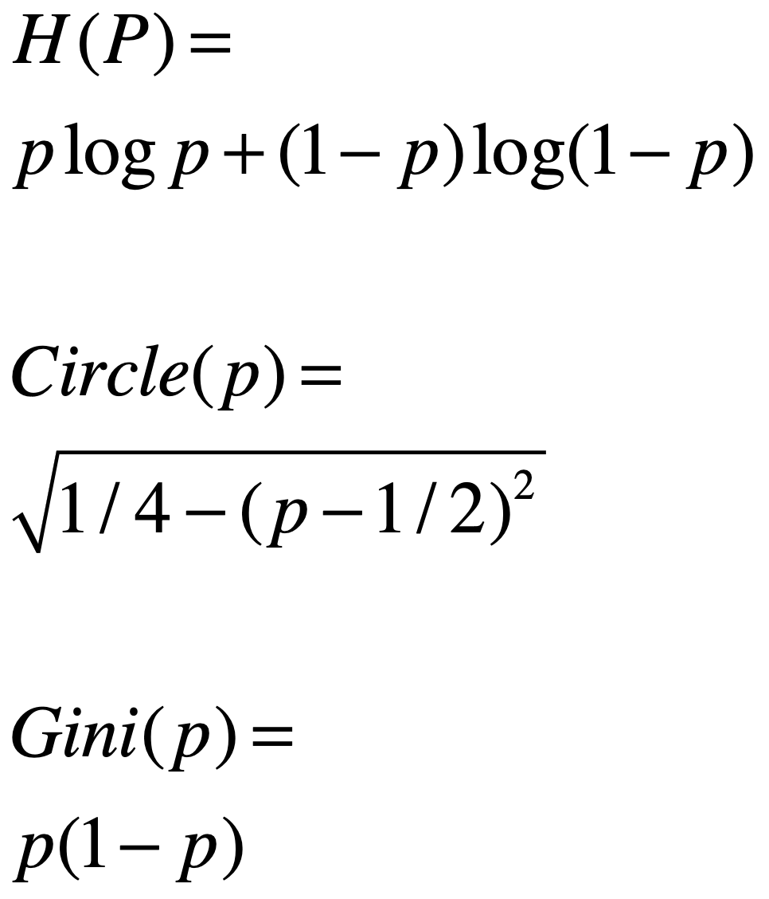
Any strictly concave function can be used

Slide 14
Which of the following is strictly concave?

Slide 15
Decision tree learning algorithm
Learning a decision tree = finding a tree with small error on the training set.
Start with the root node.
At each step split one of the leaves
Repeat until a termination criterion.
Next, How do we search for a splitting rule.

Slide 16
The splitting step
Given: current tree.
For each leaf and each feature,
find all possible splitting rules (finite because data is finite).
compute reduction in entropy
find leaf X feature X split rule the minimizes entropy.
Add selected rule to split selected leaf.

Slide 17
Enumerating splitting rules
If feature has a fixed, small, number of values. then either:
Split on all values (Location is beach/prison/ski-slope)
or Split on equality to one value (location = beach)
If feature is continuous (temperature) then either:
Sort records by feature value and search for best split.
or split on parcentiles: 1%,2%,….,99%

Slide 18

Splitting on percentiles
Suppose data is in an RDD with 100 million examples.
sorting according to each feature value is very expensive.
Instead: use Sample(false,0.00001).collect() to get a sample of about 10,000 examples.
sort the sample (small, sort in head node).
pick examples at location 100,200,… as boundaries. Call those feature values T1,T2,T3,… ,T99
Broadcast boundaries to all partitions.
Each partition computes it’s contribution to

Slide 19
Summary
The splitting criteria is a strictly concave function that bounds the training error.
The search for a splitting rule tests all possible splits of current tree.
When the feature is continuous and the data large - split on percentiles instead of splitting on each example.
Next, Performance on the test set and reducing over-fitting .

Slide 20
Trees are unstable
Trees are very flexible.
A “fully grown” tree is one where all leaves are “pure”, i.e. each leaf contains all + labeled examples or all - labeled examples.
A fully grown tree has training error zero.
If the tree is large and the data is limited, the test error of the tree is likely to be high = the tree overfits the data.
Statisticians say that trees are “high variance” or “unstable”

Slide 21
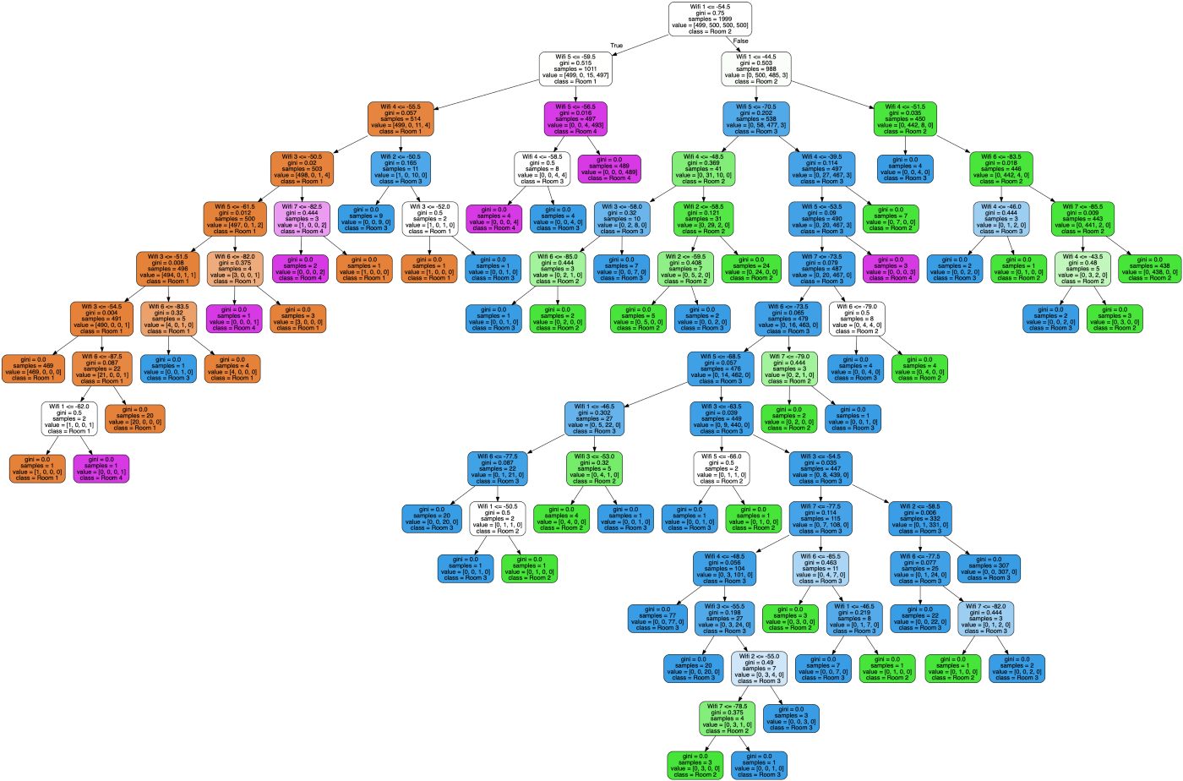
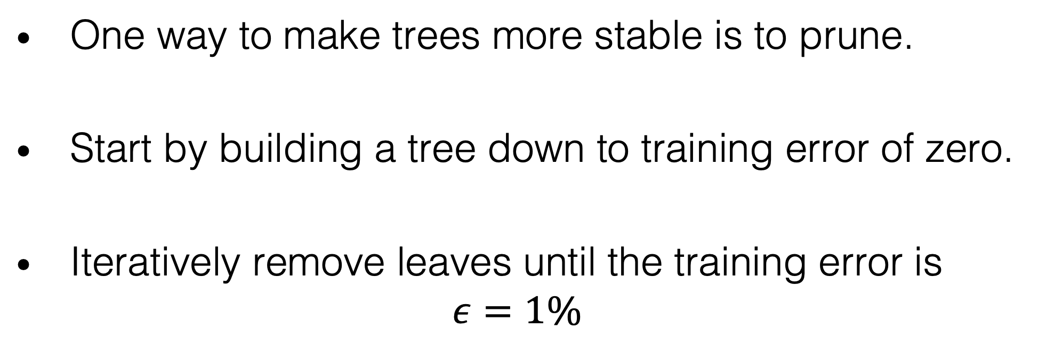
Pruning Trees
One way to make trees more stable is to prune.
Start by building a tree down to training error of zero.
Iteratively remove leaves until the training error is $ε=1\%$

Slide 22
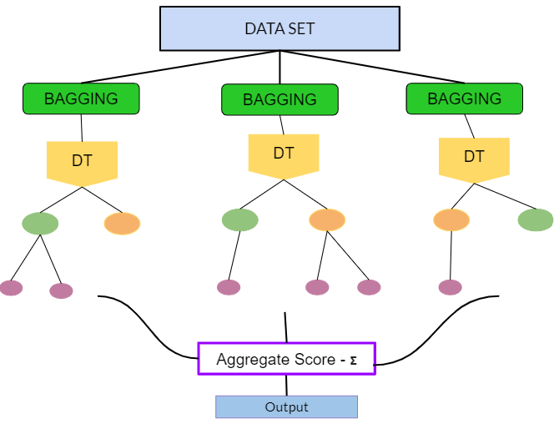
Bagging Trees
Bagging, invented by Leo Breiman in the 90s, is a different way to reduce the variance of trees.
Instead of pruning the tree, we generate many trees, using randomly selected subsets of the training data.
We predict using the majority vote over the trees.
Related to RANDOM FORESTS and to Boosted Trees/XGBoost. Will describe next.

Slide 23
Summary
Decision trees are a simple and intuitive representation.
Fully grown trees over-fit the data.
Two ways to reduce over-fitting:
Pruning: remove leaves to make the tree smaller.
Bagging, Boosting: take the majority vote over many trees.

Slide 24
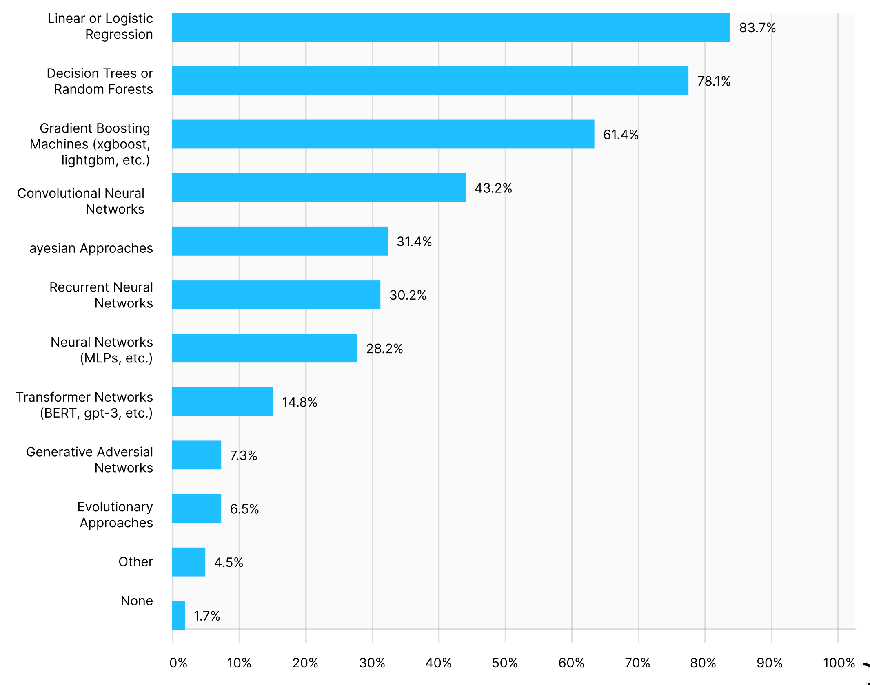
Are methods based on decision tree still relevant at the age of Deep Neural Networks?
Kaggle Survey of most popular learning algorithms (2020)

