Slide 1
Ensembles

Slide 2
What are ensembles
Ensembles are predictors defined as an average/vote over “base” or “weak” predictors.
Weak learner is faced with a variant of the original prediction problem.
Ensembles come in two main flavors:
Boosting based Ensembles
Bootstrap based Ensembles.

Slide 3

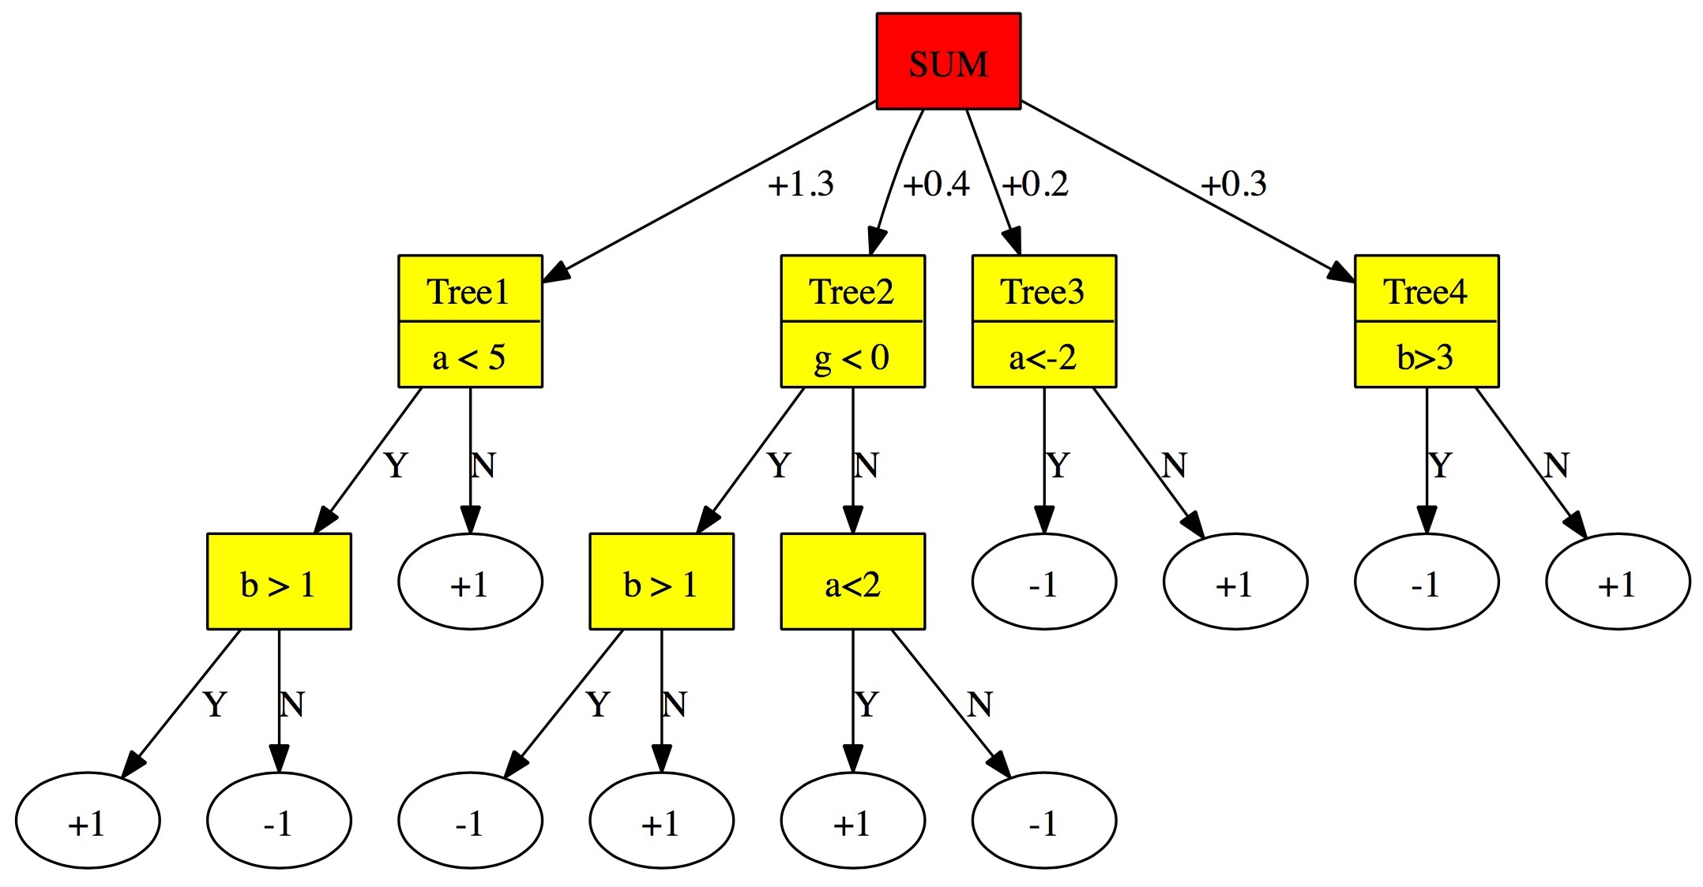
An Ensemble of trees
+1/-1

Slide 4
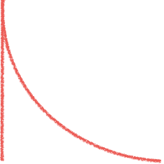
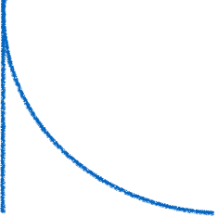
Stability of statistics
Quantities we want to estimate: mean, std, median, min, max
Stable estimator: varies little from sample to sample.
Median is the most stable, mean is less stable, std still less.
The variation of max depends on the distribution.
Direct estimation of stability: use several independent datasets. (requires a lot of data).
p(x)
p(x)
max
unstable
max
stable
x
x

Slide 5
The Bootstrap
A method for estimating out-of-sample variation
Instead of collecting truly independent samples, we create semi-independent samples from the given sample.
S : Original sample of size N.
Bootstrap sample: select N examples from S independently at random with replacement.
Use bootstrap samples as if they were independent samples.
p(x)
p(x)
max
unstable
max
stable
x
x

Slide 6
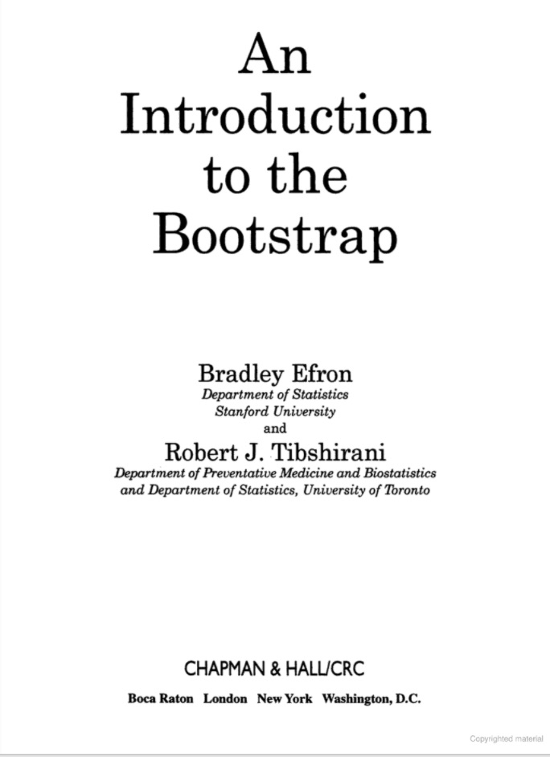
1990

Slide 7
Bagging = bootstrap aggregation
Decision trees have high data variation.
i.e. the generated tree is sensitive to small changes in the training set.
To reduce the variation, we take a majority vote over several runs, each using an independent random resample of the training data.
Bootstrap: Running an algorithm over random resampling.
Trees can be learned in parallel
The result is a reduction in variation with no increase in the bias.

Slide 8
Random Forests
Based on bagging trees.
Additional randomization: before choosing which leaf to split and how, choose a random subset of the features.
Decreases the correlation between different trees.
Speeds up the learning process.
All trees get equal weight (1.0)
All trees can be learned in parallel.

Slide 9
Gradient Tree Boosting
The trees are trained sequentially, one after the other.
Each tree is trained using a weighted training set. The weights represent the gradient of the loss function.
Each tree receives a different weight.
Stochastic gradient boosting: use random resampling of the training set a.k.a. Bagging.

Slide 10
The value of admitting you don’t know
Ensemble methods compute a (weighted) sum of the base predictions. (prediction score)
If one class gets significantly more predictions than the others we can be confident of the prediction.
Otherwise, we should output “I don’t know”.
Effect of saying I don’t know:
Take default action (do no harm)
Escalate decision to a more sophisticated algorithm. (prediction cascade)
Escalate decision to a human.

Slide 11
Active Learning using ensembles
Labeling is expensive
Passive learning: label a random sample
Active learning: allow the computer to choose which examples to label.
Using ensembles: The computer queries the label on examples on which it would output “I don’t know”

Slide 12
Summary
Ensemble learning in Spark ML
Bagging = Bootstrap Aggregation
Random Forests
Boosted Gradient trees.

