Slide 1
An overview of Boosting

Slide 2
Plan of talk
Generative vs. non-generative modeling
Boosting
Alternating decision trees
Boosting and over-fitting
Applications

Slide 3
Generative vs. Discriminative vs. Robust discriminative Models

Slide 4


Toy Example
Computer receives telephone call
Measures Pitch of voice
Decides gender of caller
Male
Human
Voice
Female

Slide 5


Generative modeling
mean1
mean2
var1
var2
Probability
Voice Pitch

Slide 6
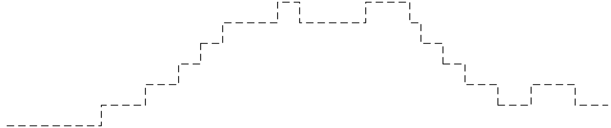

Discriminative approach
[Vapnik 85]
No. of mistakes
Voice Pitch

Slide 7
Ill-behaved data
mean1
mean2
Probability
No. of mistakes
Voice Pitch

Slide 8
Traditional Statistics vs. Machine Learning
Machine Learning
Estimated
world state
Decision
Theory
Predictions
Actions
Data
Statistics

Slide 9
Comparison of methodologies
Model | Generative | Discriminative
Goal | Probability estimates | Classification rule
Performance measure | Likelihood | Misclassification rate
Mismatch problems | Outliers | Misclassifications

Slide 10
Summary
Generative models: goal is to explain how data is generated.
Discriminative models: goal is to predict a property of the data (such as label)
Generative models are more accurate when they are correct.
Discriminative models are more robust against poor modeling or outliers.

Slide 11
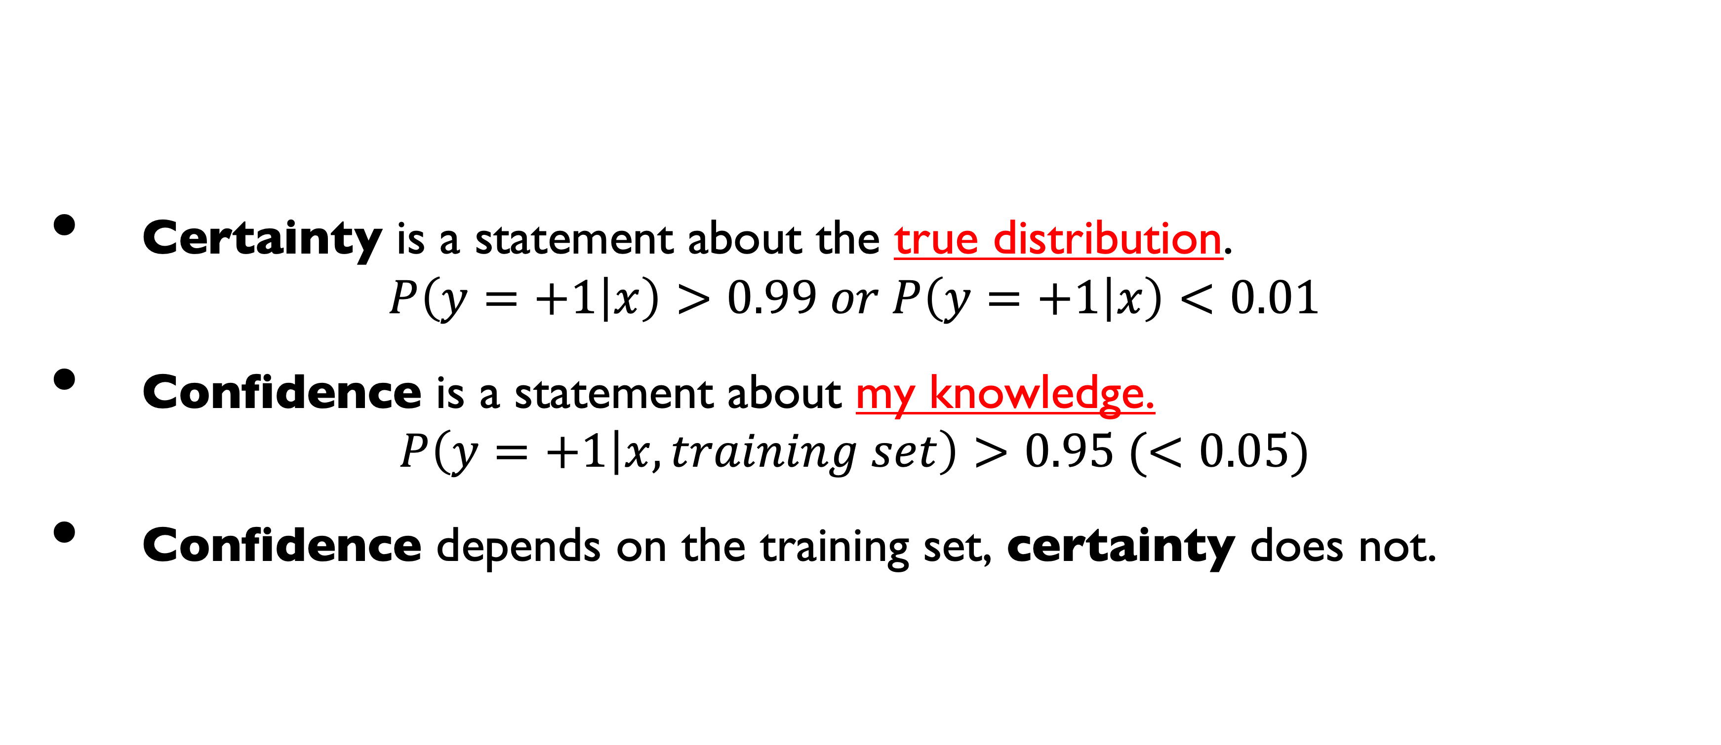
Confidence vs. Certainty
Certainty is a statement about the true distribution. $P\left(y=+1 | x\right)>0.99 or P\left(y=+1 | x\right)<0.01$
Confidence is a statement about my knowledge.
$$P\left(y=+1 | x, training set\right)>0.95 (<0.05)$$
Confidence depends on the training set, certainty does not.

Slide 12
Generative vs. Discriminative vs. Robust discriminative
Generative: Data is generated by model
Discriminative: there is a model whose error rate is low.
Robust discriminative:
There are many models whose error rate is small. (the good set)
Easy Examples: most of the good set predicts the same way.

Slide 13
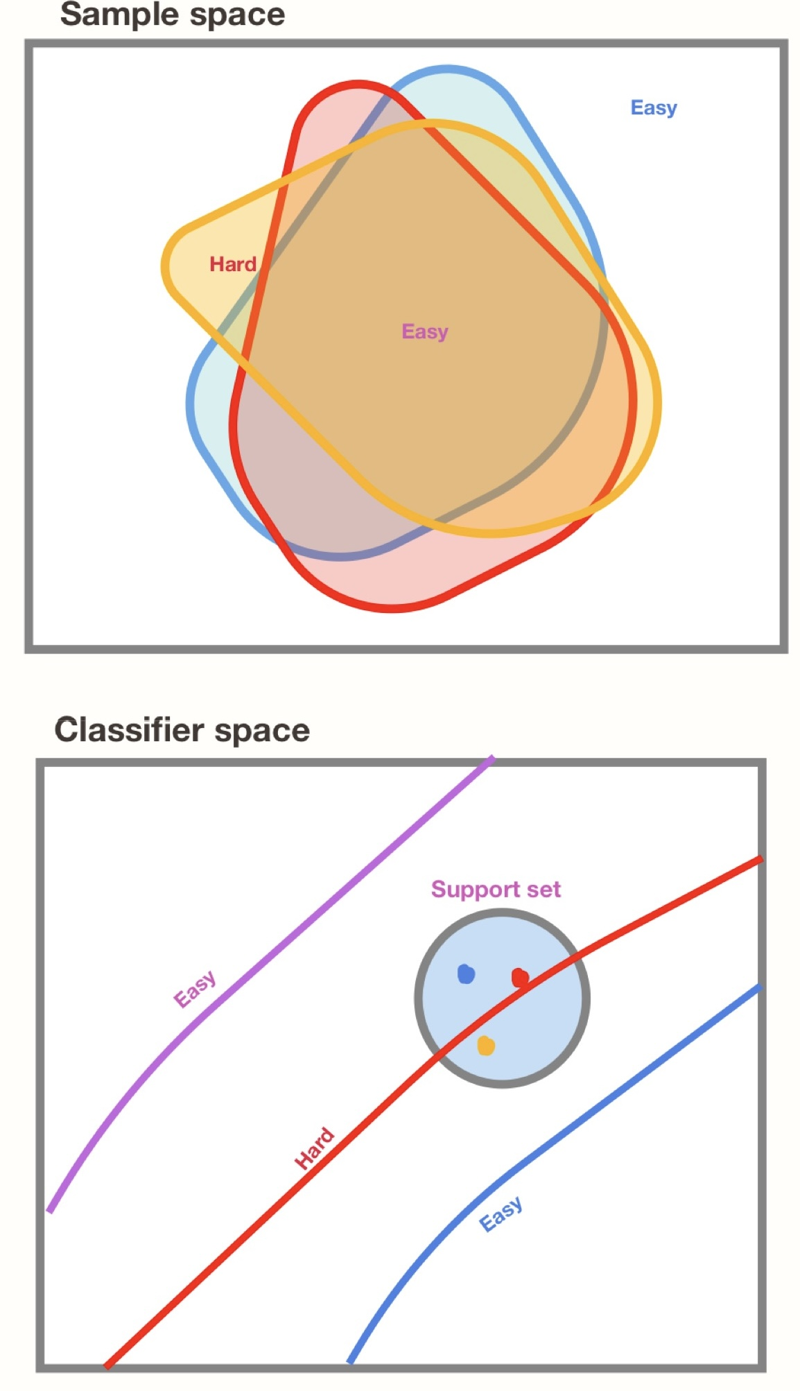
Classifiers vs. Examples

Slide 14

confidence $≠$ certainty
High Certainty and high confidence:
The sun will rise tomorrow.
This spring quarter will be over in June
There will be new common variant of covid in the coming year.
Low certainty but high Confidence:
You go fishing in a new location. You know nothing about the probability of catching a a fish: low confidence.
You go fishing for 100 days. You have high confidence that your probability of catching a fish is larger than 5%

Slide 15
More examples of high confidence, low certainty
Poker: deciding whether to raise or fold: need to decide correctly more than your opponent.
Medical Diagnosis: ”In my experience, the majority of patients who present symptoms X suffer from condition Y”
Sport: read the body language of your opponent, don’t let your opponent read your body language.

Slide 16
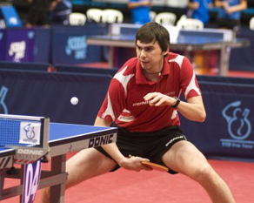
Prediction in sports

Slide 17
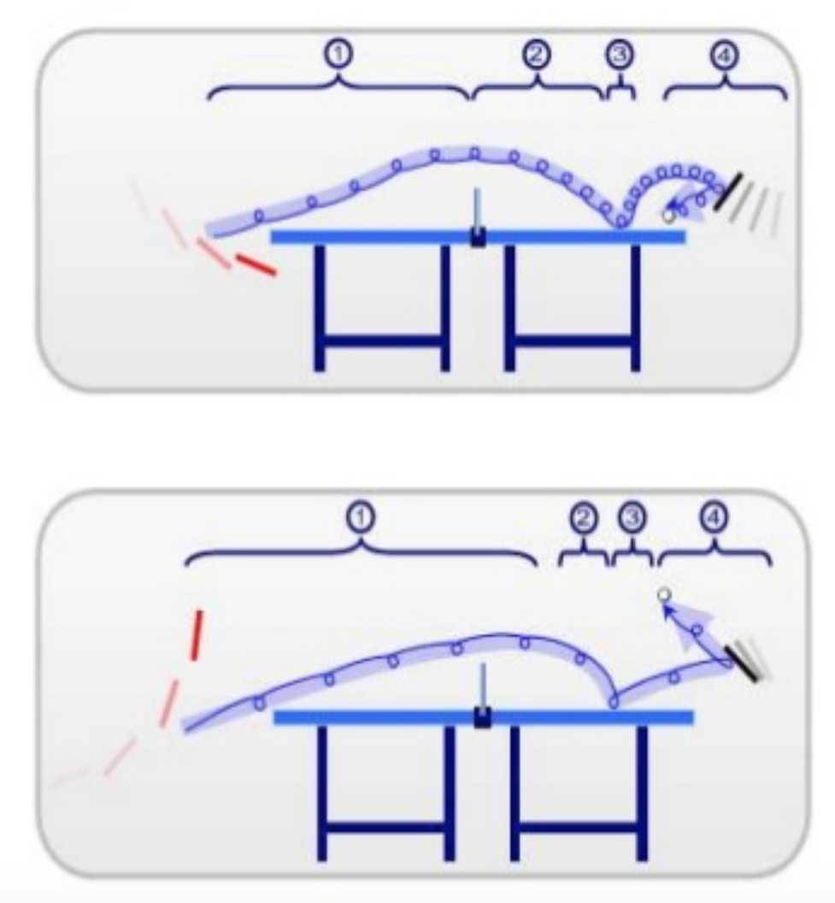
Prediction of spin in table tennis
Backspin
To respond correctly, we need to predict whether the ball has backspin or topspin.
By the time the ball is hit, it is too late.
We predict from body posture, from experience with individual player,…
Definite action according to prediction.
Prediction has to be correct more often than incorrect
Topspin

Slide 18


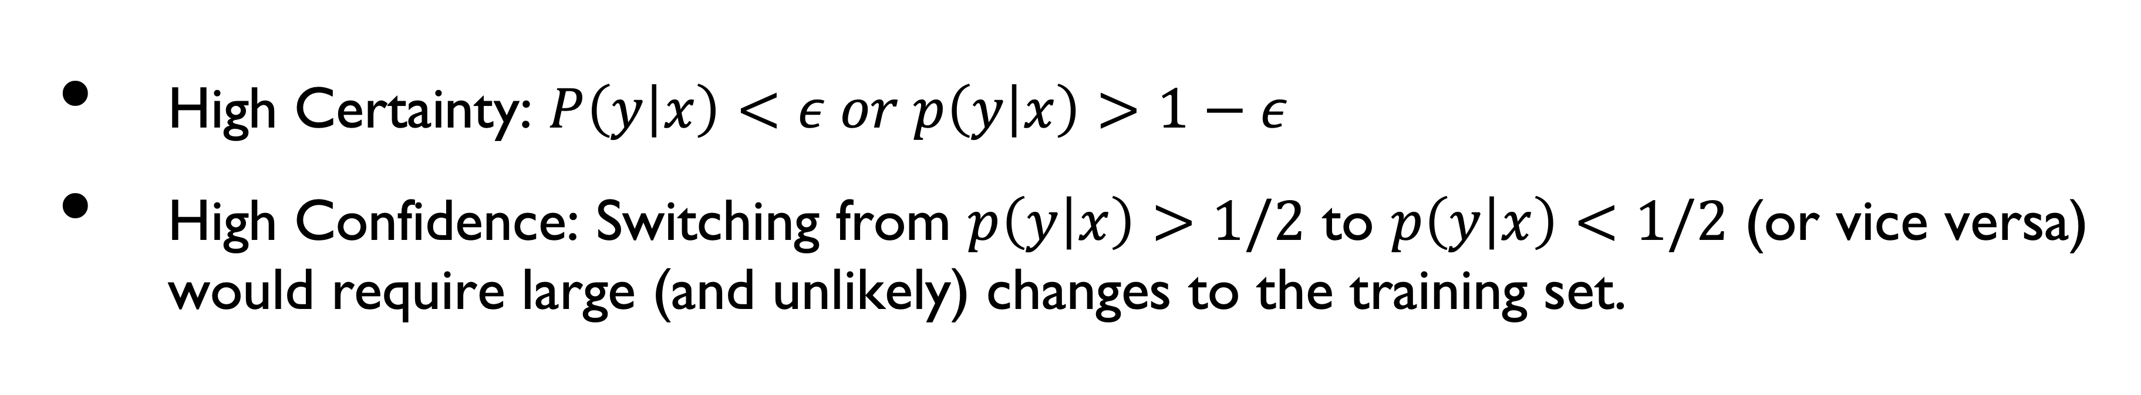
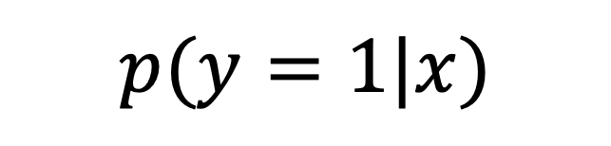
Confidence in classification
High Certainty: $P\left(y | x\right)<ε or p\left(y | x\right)>1−ε$
High Confidence: Switching from $p\left(y | x\right)>1/2$ to $p\left(y | x\right)<1/2$ (or vice versa) would require large (and unlikely) changes to the training set.
X
Classifier
Training set
Training set
Learning algorithm
$$p(y=1|x)$$

Slide 19
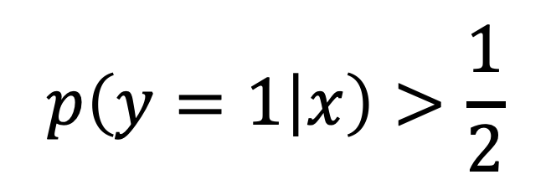
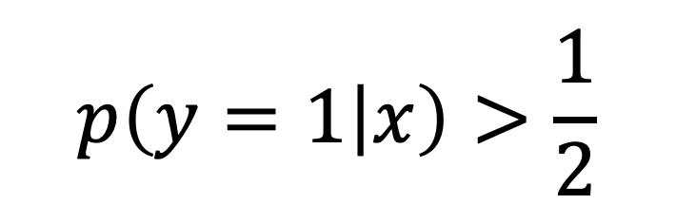
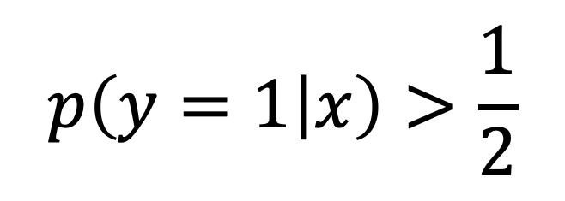
Bootstrap Ensemble
X
Classifier 1
$$p\left(y=1 | x\right)>\frac{1}{2}$$
Bootstrap 1
Learning algorithm
Training set
$$p\left(y=1 | x\right)>\frac{1}{2}$$
Classifier 2
…
Learning algorithm
Bootstrap 2
Training set
…
$$p\left(y=1 | x\right)>\frac{1}{2}$$
Classifier n
Training set
Learning algorithm
Bootstrap n

Slide 20
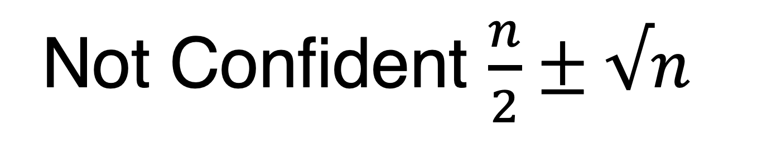
Degrees Of Confidence
Votes
No of +1 | No of -1
n | 0
… | …
… | ….
… | ….
n/2 | n/2
… | ….
… | ….
… | ….
0 | n
Confident positive
Easy positive
Hard / I don’t know
Not Confident $\frac{n}{2}±√n$
Confident negative
Easy negative

Slide 21
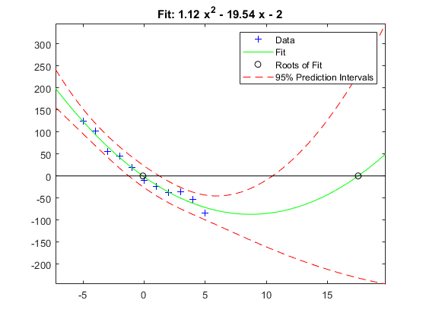
Confidence Intervals

Slide 22
Multi-label classification
Example CIFAR100: 100 classes
Most common measure of performance: fraction of time top score is correct
Common Variant: fraction of time correct is among the top 5 scores.
Alternative: the algorithm outputs a set of labels A we consider two measures of performance:
Fraction of time the correct label is in the set.
Distribution of the size of the set.
A refinement of the “I don’t know” in the binary case

Slide 23
Easy and hard examples in the multilabel case
The prediction on easiest examples is a set of size one.
Larger prediction sets indicates harder examples.
Example: distinguishing between dogs and cats is easier than distinguishing between subspecies.
A prediction set that contains all labels == IDK

Slide 24
Does IDK matter?
Not if
correct prediction = gain of $1,
Incorrect prediction = loss of $1
Yes if
IDK = no gain or loss.
Correct prediction = gain of $1
Incorrect prediction = loss of $10

