Slide 1
Final HW

Slide 2
The dataset
Task: identify poor vs. rich areas from satellite images.
23 countries.
~20,000 images
Each image 224x224x8, last layer is night-light.
Urban wealth >> Rural wealth.
Binary classification “poor” vs “rich”
Threshold on wealth is -0.5 for rural , 1.2 for urban

Slide 3
Train-Test partition
Country test: select 25% of rows such that they contain all in country.
Random test: select 25% (out of remaining 75%) by selecting rows at random.
The rest is training data.
You have access to all images.
You don’t have access to the labels on the test sets.

Slide 4
Competition
On-going competition your grade is determined by your last submission.
Competition and leaderboard is managed using gradescope
https://github.com/yoavfreund/Poverty_Analysis/blob/main/autograder/readme.md

Slide 5
Competitions:
Random Test
Country test
Symmetric loss: fraction of errors
Assymetric loss
0 -> 0 loss
1 -> 1 if correct -2 if incorrect
-1 -> 1 if correct -2 if incorrect

Slide 6
Starting points
A solution based on Kdtrees and Boosting
Two solutions based on DNNs
All available from github.

Slide 7
Stability, Margins and specialization

Slide 8
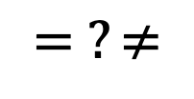
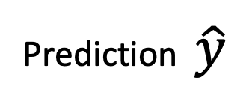
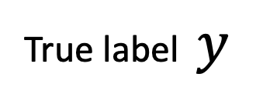
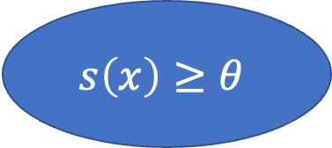
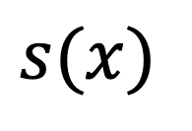
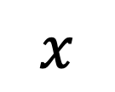
Binary classifiers based on a scoring function
$$x$$
Training Data
Learning Algorithm
Scoring Function
$$s\left(x\right)≥θ$$
True label $y$
$$= ?≠$$
Prediction $\hat{y}$
$$s(x)$$

Slide 9
Stability with respect to training set.
perturbation
$$x$$
Training Data
Learning Algorithm
Scoring Function
$$s\left(x\right)≥θ$$
True label $y$
$$= ?≠$$
Prediction $\hat{y}$
$$s(x)$$

Slide 10
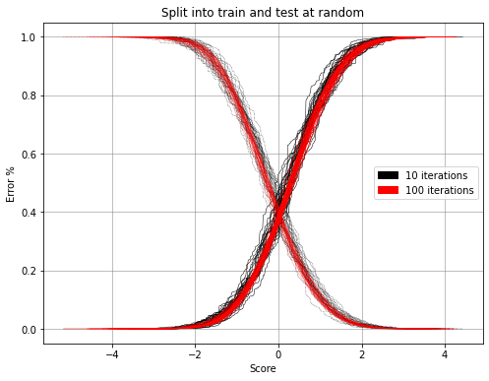
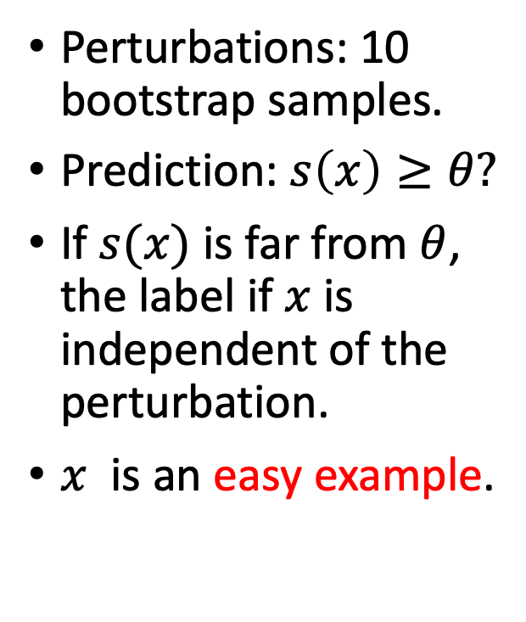


The score distribution
Perturbations: 10 bootstrap samples.
Prediction: $s\left(x\right)≥θ?$
If $s(x)$ is far from $θ$, the label if $x$ is independent of the perturbation.
$x$ is an easy example.
$$s\left(x\right)$$
$$θ$$

Slide 11
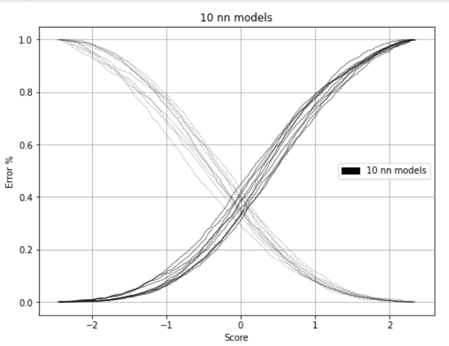
Score distribution for boosting vs. NN

Slide 12
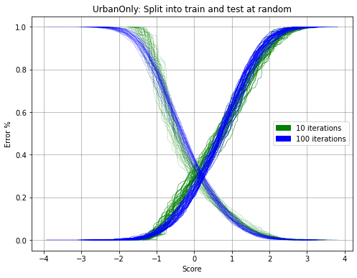
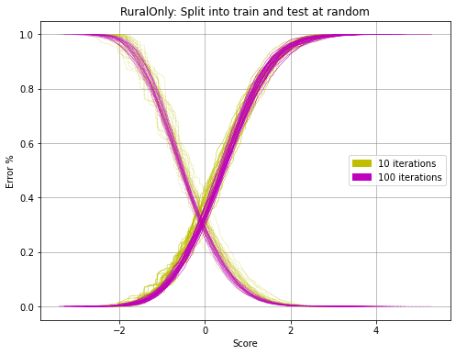
Comparing training on urban only to training on all.
Urban only
Rural only

Slide 14
Perturbing examples vs unstable classifiers
Adversarial examples : a small change to the example changes the label.
Unstable classifiers: A small perturbation of the training set changes the classification of many examples.

Slide 15
Most classification algorithms generate a scoring function
Unstable
Stable
Decision trees
Deep Neural Networks
Logistic Regression
Bagging
Random Forests
Boosting
SVM
K Nearest Neighbors (for large k)

Slide 16
Model robustness
Perturbation: the same task with unimportant (nuisance) variables changed.
Splitting dataset randomly into train and test.
Bootstrap on training data
Augmentation
Splitting dataset by domains (countries)
Using different sensors (calibration is used to counteract)

Slide 17
Ensembles
Train several models under perturbations
Easy examples: all classifiers in the ensemble agree.

