Slide 1
Latency, Throughput And the memory Hierarchy

Slide 2
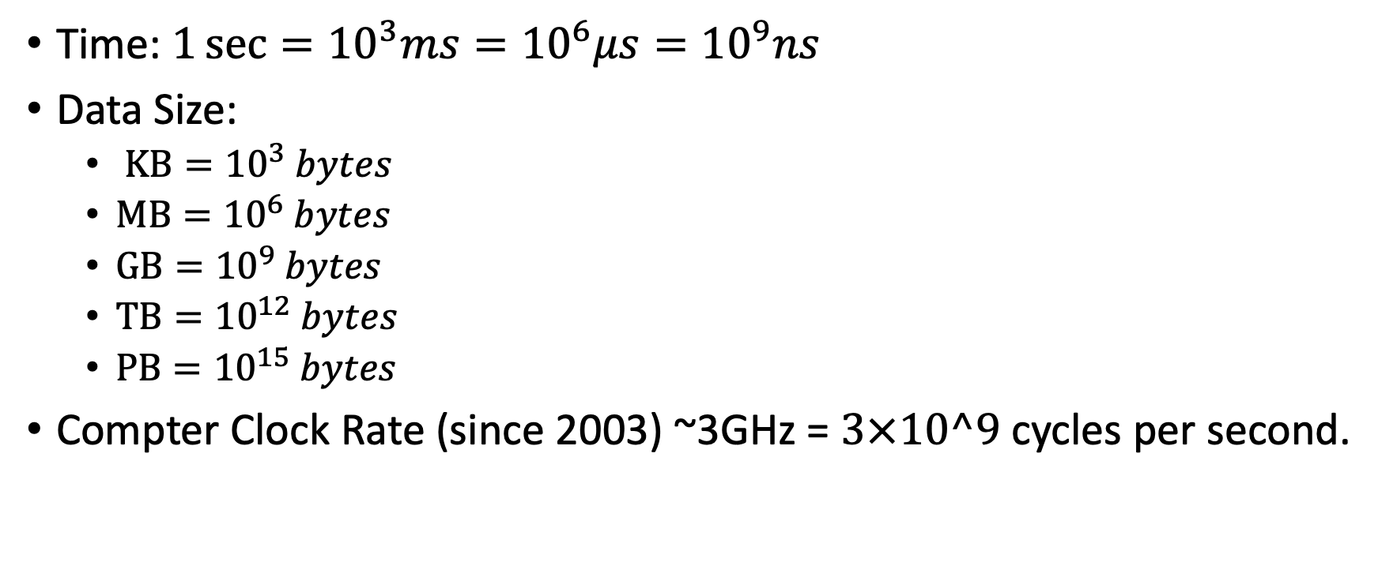
Some numbers

Slide 3

Example of Latency vs. throughput
Latency: time between joining the line and leaving the cashier.
Throughput: Number of people coming out of the store per minute.
Minimal latency: Time at Cashier.
Customer cares about latency.
Store cares mostly about throughput (dollars per minute) and to some degree latency (customer happier).

Slide 4
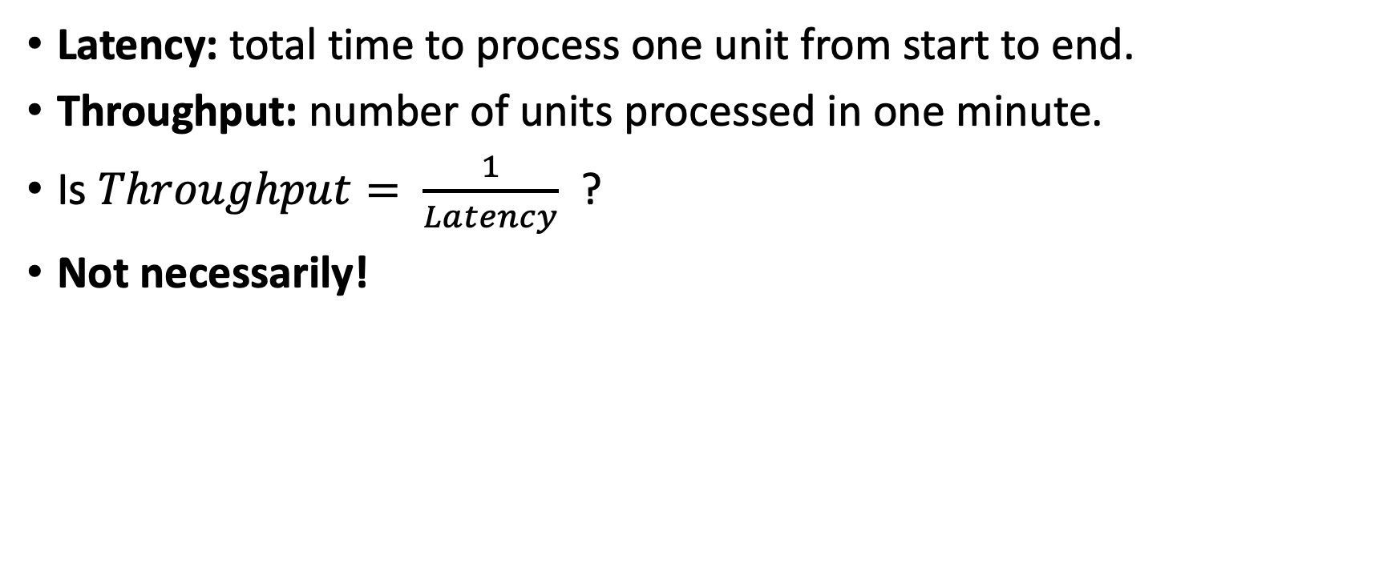
Definitions

Slide 5


Wholesale vs. retail
Wholesale
(water cache)
Costco
Retail
Buying water in costco and driving the truck to it’s stand:
2 hours
10 cents / bottle
Walking to the truck and buying a water bottle: ½ minute
1$ / bottle

Slide 6
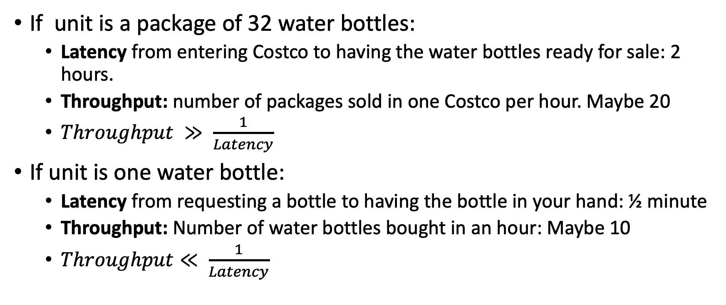
Different latencies for different units

Slide 7

Sequential execution
Latency = ½ sec
Throughput = 2 byte/sec
½ sec
CPU 1
byte
byte
byte
byte
byte
Parallel execution
½ sec
byte
byte
byte
byte
byte
Latency = ½ sec
Throughput = 8 byte/sec
CPU 1
CPU 2
byte
byte
byte
byte
byte
CPU 3
byte
byte
byte
byte
byte
CPU 4
byte
byte
byte
byte
byte

Slide 8
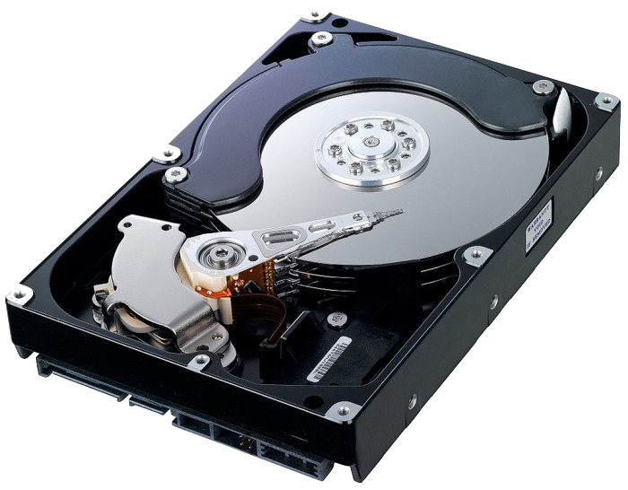
Reading data blocks from disk
The latency for reading a random block from a spinning Disk is 10ms.
Why? Because of the mechanics of moving the reading head.
Instead of reading one byte, read a whole block!
If all of the data in the block is useful:
Latency: 10ms (100Byte/sec for random access)
Throughput: 100MB/sec (for sequential access)
Caching: a method for achieving low latency by predicting access.
byte
byte
byte
byte
byte
byte
byte
byte
byte
byte
byte
byte
byte
byte
byte

Slide 9
When do we need low latency?
When interacting with our cell phone or laptop.
When playing games online: https://tetris.com/play-tetris
When checking in to a flight.
Anything interactive – working on a jupyter notebook.
Running javascript inside a browser
Latency = reaction time < 100ms

Slide 10
When do we need high throughput
When we have a large amount of data to process (50TB),
we care about throughput – number of seconds to process 1TB
we don’t care about latency = processing one record,
Example: transfer 50TB of data to the cloud.
Regular home line: upload speed 6Mbps = 6/8 MBps -> 771 days ~ 2 years
Fast University line: upload speed 100Mbps = 100/8 MBps -> 46 days
Dedicated fiber: upload speed 10Gbps = 10/8 GBps -> 11 hours
Dedicated fiber costs 10-100K$ per year.

Slide 11

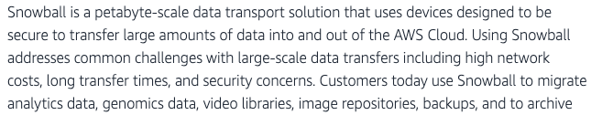
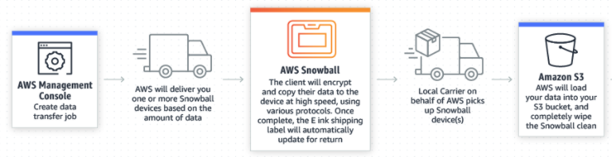
The fastest and cheapest option: Fedex
Latency: 24 hour
Throughput using 50TB snowball: 50TB / 24 hours.
Cost ~ 200$

Slide 12
Summary for part 1
When providing an interactive experience, we care more about latency than throughput.
When processing TB, we care more about throughput than about latency.
Transmitting TB through the internet is slow and expensive.
Sending a physical disk through Fedex is cheap and high bandwidth.

