Slide 1
2: Storage Latency

Slide 2
CPU
Storage
A
A
C
C
=
*
B
B

Slide 3
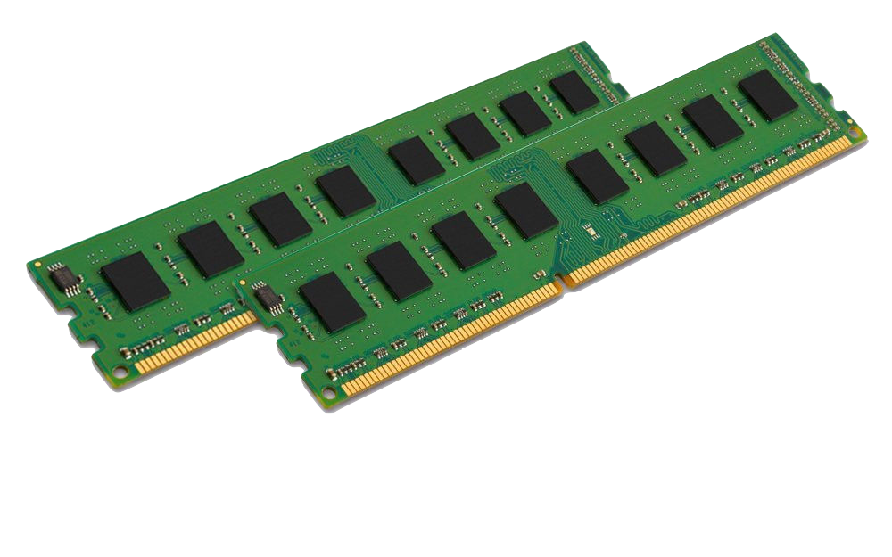
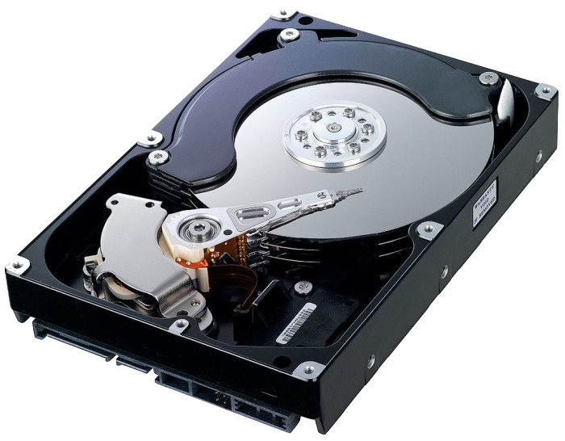
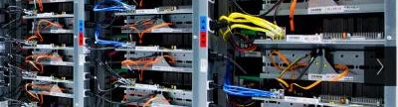
Latencies
Storage Types
Read A
Read B
C=A*B
Write C
With big data, most of the latency is memory latency (1,2,4), not computation (3)
Main Memory (RAM)
Spinning disk
Remote computer
Latency 1
Total Latency
Latency 2
TIME
Latency 3
Latency 4

Slide 4
Summary for part 2
The major source of latency in data analysis is reading and writing to storage
Different types of storage offer different latency, capacity and price.
Big data analytics revolves around methods for organizing storage and computation in ways that maximize speed while minimizing cost.
Next, storage locality.

Slide 5
3: Caching
Notes:
Zoom: In the previous video we saw how locality can speed up the processing of large arrays.
However, I did not say *why* locality of access is important.
In this video I will tell you how caches work, what is the memory Heirarchy, and how all that is related to memory locality.

Slide 6
Latency, size and price of computer memory
Given a budget, we need to trade off
$10: Fast & Small
$10: Slow & Large

Slide 7
Cache: The basic idea
Slow & Large
Fast & Small
Memory
0 | 1 | 2 | 3 | 4 | 5 | 6 | 7 | 8 | 9
10 | 11 | 12 | 13 | 14 | 15 | 16 | 17 | 18 | 19
20 | 21 | 22 | 23 | 24 | 25 | 26 | 27 | 28 | 29
30 | 31 | 32 | 33 | 34 | 35 | 36 | 37 | 38 | 39
40 | 41 | 42 | 43 | 44 | 45 | 46 | 47 | 48 | 49
50 | 51 | 52 | 53 | 54 | 55 | 56 | 57 | 58 | 59
60 | 61 | 62 | 63 | 64 | 65 | 66 | 67 | 68 | 69
70 | 71 | 72 | 73 | 74 | 75 | 76 | 77 | 78 | 79
Cache
cpu
12 | 67
50 | 51
52 | 53
32 | 33

Slide 8
Cache Hit
Memory
0 | 1 | 2 | 3 | 4 | 5 | 6 | 7 | 8 | 9
10 | 11 | 12 | 13 | 14 | 15 | 16 | 17 | 18 | 19
20 | 21 | 22 | 23 | 24 | 25 | 26 | 27 | 28 | 29
30 | 31 | 32 | 33 | 34 | 35 | 36 | 37 | 38 | 39
40 | 41 | 42 | 43 | 44 | 45 | 46 | 47 | 48 | 49
50 | 51 | 52 | 53 | 54 | 55 | 56 | 57 | 58 | 59
60 | 61 | 62 | 63 | 64 | 65 | 66 | 67 | 68 | 69
70 | 71 | 72 | 73 | 74 | 75 | 76 | 77 | 78 | 79
Cache
cpu
Cache Hit
12 | 67
50 | 51
52 | 53
32 | 33

Slide 9
Cache Miss
Memory
0 | 1 | 2 | 3 | 4 | 5 | 6 | 7 | 8 | 9
10 | 11 | 12 | 13 | 14 | 15 | 16 | 17 | 18 | 19
20 | 21 | 22 | 23 | 24 | 25 | 26 | 27 | 28 | 29
30 | 31 | 32 | 33 | 34 | 35 | 36 | 37 | 38 | 39
40 | 41 | 42 | 43 | 44 | 45 | 46 | 47 | 48 | 49
50 | 51 | 52 | 53 | 54 | 55 | 56 | 57 | 58 | 59
60 | 61 | 62 | 63 | 64 | 65 | 66 | 67 | 68 | 69
70 | 71 | 72 | 73 | 74 | 75 | 76 | 77 | 78 | 79
Cache
cpu
12 | 67
50 | 51
52 | 53
32 | 33

Slide 10
Cache Miss Service: 1) Choose byte to drop
Memory
0 | 1 | 2 | 3 | 4 | 5 | 6 | 7 | 8 | 9
10 | 11 | 12 | 13 | 14 | 15 | 16 | 17 | 18 | 19
20 | 21 | 22 | 23 | 24 | 25 | 26 | 27 | 28 | 29
30 | 31 | 32 | 33 | 34 | 35 | 36 | 37 | 38 | 39
40 | 41 | 42 | 43 | 44 | 45 | 46 | 47 | 48 | 49
50 | 51 | 52 | 53 | 54 | 55 | 56 | 57 | 58 | 59
60 | 61 | 62 | 63 | 64 | 65 | 66 | 67 | 68 | 69
70 | 71 | 72 | 73 | 74 | 75 | 76 | 77 | 78 | 79
Cache
cpu
12 | 67
50 | 51
52 | 53
32 | 33
67

Slide 11
Cache Miss Service: 2) write back
Memory
0 | 1 | 2 | 3 | 4 | 5 | 6 | 7 | 8 | 9
10 | 11 | 12 | 13 | 14 | 15 | 16 | 17 | 18 | 19
20 | 21 | 22 | 23 | 24 | 25 | 26 | 27 | 28 | 29
30 | 31 | 32 | 33 | 34 | 35 | 36 | 37 | 38 | 39
40 | 41 | 42 | 43 | 44 | 45 | 46 | 47 | 48 | 49
50 | 51 | 52 | 53 | 54 | 55 | 56 | 57 | 58 | 59
60 | 61 | 62 | 63 | 64 | 65 | 66 | 67 | 68 | 69
70 | 71 | 72 | 73 | 74 | 75 | 76 | 77 | 78 | 79
Cache
cpu
12
50 | 51
52 | 53
32 | 33
67

Slide 12
Cache Miss Service: 3) Read In
Memory
0 | 1 | 2 | 3 | 4 | 5 | 6 | 7 | 8 | 9
10 | 11 | 12 | 13 | 14 | 15 | 16 | 17 | 18 | 19
20 | 21 | 22 | 23 | 24 | 25 | 26 | 27 | 28 | 29
30 | 31 | 32 | 33 | 34 | 35 | 36 | 37 | 38 | 39
40 | 41 | 42 | 43 | 44 | 45 | 46 | 47 | 48 | 49
50 | 51 | 52 | 53 | 54 | 55 | 56 | 57 | 58 | 59
60 | 61 | 62 | 63 | 64 | 65 | 66 | 67 | 68 | 69
70 | 71 | 72 | 73 | 74 | 75 | 76 | 77 | 78 | 79
Cache
cpu
12
50 | 51
52 | 53
32 | 33
47

Slide 13
Summary of part 3
Cache is much faster than main memory
Cache hit = the needed value is already in the cache
Cache miss = the needed value is not in the cache – needs to be brought in from memory
If there is no space in cache:
need to make space
If dirty, need to write value back to memory first.
Cache miss – latency is much bigger than cache miss.

Slide 14
4: Locality of storage access

Slide 15
Access Locality
The cache is effective If most accesses are hits.
Cache Hit Rate is high.
Cache effectiveness depends on patterns (statistics) of memory access.
Temporal Locality: Multiple accesses to same address within a short time period
Spatial Locality: Multiple accesses to near-by addresses within a short time period

Slide 16
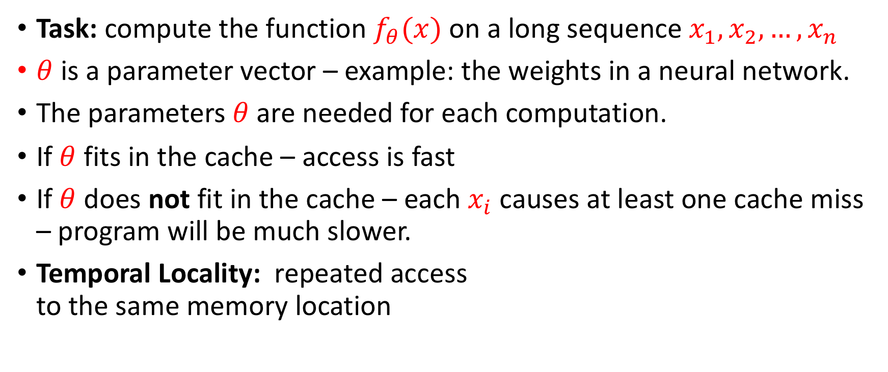
Temporal Locality

Slide 17
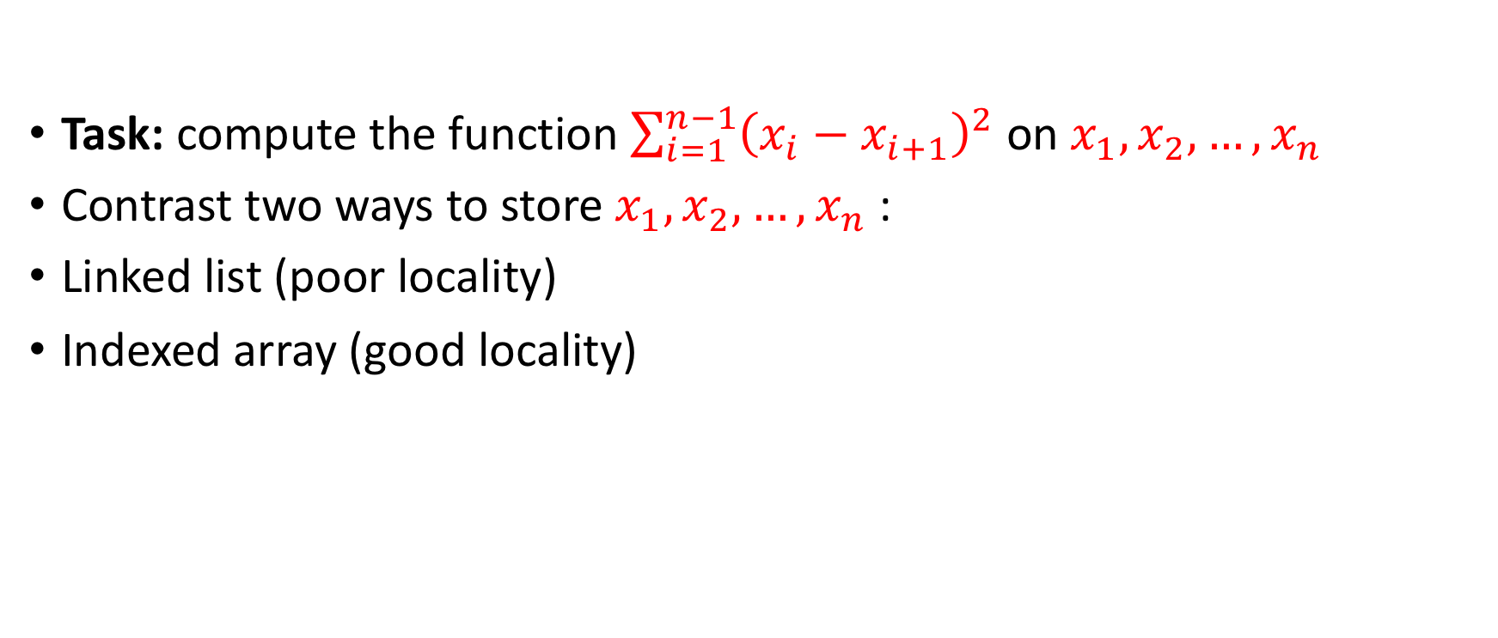
Spatial locality

Slide 18
Linked List
Page 1 |  |  |  |  | Page 2 |  |  |  |  | Page3 |  |  |  |  | Page4
 | 6 |  | 3 |  | 2 |  |  |  | 5 |  |  |  |  | 4 |  |  | 1
Traversal of 6 elements touches 4 pages

Slide 19
array
Page 1 |  |  |  |  | Page 2 |  |  |  |  | Page3 |  |  |  |  | Page4
 |  |  |  |  |  |  | 1 | 2 | 3 | 4 | 5 | 6
Traversal of 6 elements touches 2 pages

Slide 20
Summary of Part 4
Caching Is effective when memory access is local
Temporal locality: accessing the same location many times in a short period of time.
Spatial locality: accessing close-by locations many times in a short period of time.
Hardware and compilers have a symbiotic relationship: success if compiler generates machine code that has good locality.

Slide 21
Word Count
Task: given a (large) text
Count the number of times each word
Output (word,count) sorted in decreasing order by Count.

Slide 22
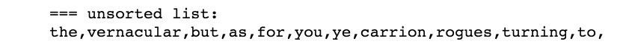
Unsorted word count / poor locality
Dict={}
For word in list:
if word in Dict:
Dict[word]+=1
else:
Dict[word]=1
Suppose
len(list)=1,000,000
len(Dict) = 100,000
Access to list: spatially local
Access to Dict: random

Slide 23
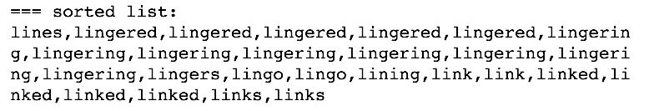
sorted word count / good locality
Suppose
len(list)=1,000,000
len(Dict) = 100,000
Access to list: spatially local
Access to Dict: Spatially local
But what about the sort step?
Sorting can be done in time O(n)
Efficient in distributed setup
Dict={}
Sort(list)
For word in list:
if word in Dict:
Dict[word]+=1
else:
Dict[word]=1

Slide 24
Summary
Improved memory locality reduces run-time
Why?
Because computer memory is organized in pages.
And caching retrieves a page at a time.

