Slide 1
5: The memory Hierarchy

Slide 2
The Memory Hierarchy
Real systems have a several levels storage types:
Top of hierarchy: Small and fast storage close to CPU
Bottom of Hierarchy: Large and slow storage further from CPU
Caching is used to transfer data between neighboring levels of the hierarchy.
To the programmer / compiler does not need to know
The hardware provides an abstraction : memory looks like like a single large array.
Performance depends on locality of program memory access.

Slide 3
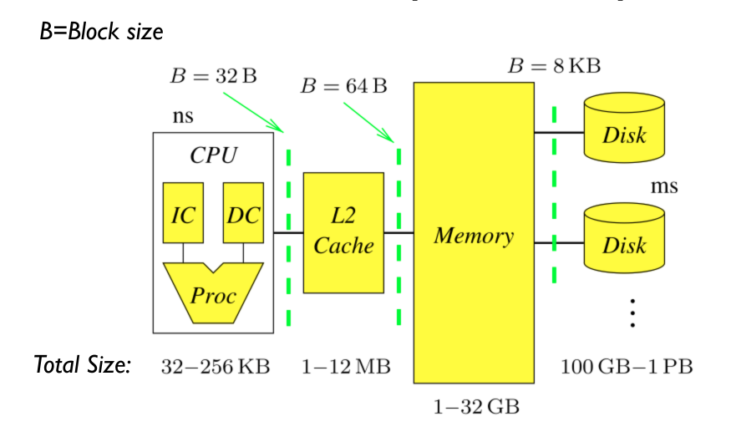
The Memory Hierarchy

Slide 4
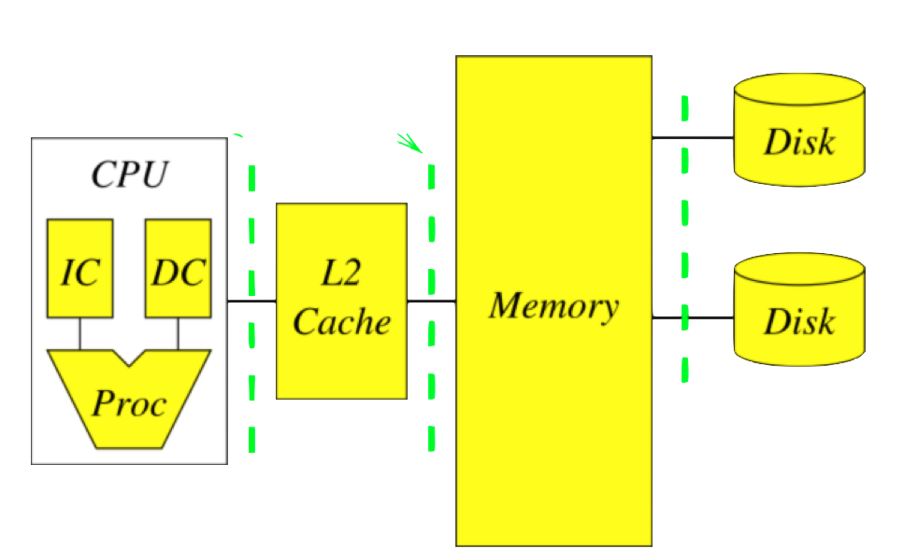
Computer clusters extend the memory hierarchy
A data processing cluster is simply many computers linked through an ethernet connection.
Storage is shared
Locality: Data to reside on the computer this will use it.
“Caching” is replaced by “Shuffling”
Abstraction is spark RDD.
Ethernet

Slide 5
Sizes and latencies in a typical memory hierarchy.
 | CPU (Registers) | L1 Cache | L2 Cache | L3 Cache | Main Memory | Disk Storage | Local Area Network
Size (bytes) | 1KB | 64KB | 256KB | 4MB | 4-16GB | 4-16TB | 16TB – 10PB
Latency | 300ps | 1ns | 5ns | 20ns | 100ns | 2-10ms | 2-10ms
Block size | 64B | 64B | 64B | 64B | 32KB | 64KB | 1.5-64KB
12 orders of magnitude
6 orders of magnitude

Slide 6
Summary of part 5
Memory Hierarchy: combining storage banks with different latencies.
Clusters: multiple computers, connected by ethernet, that share their storage.

