Slide 1
6: Heavy Tail Distributions

Slide 2
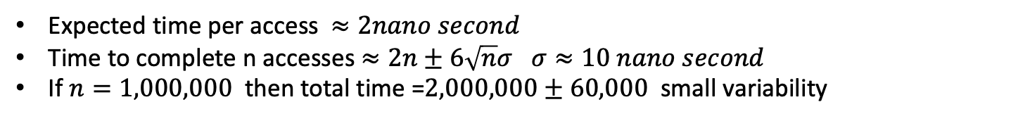
Caching effect on sequential computation
Cache hit
Cache hit: 1ns
Cache miss 100ns
Cache miss occurs 1% of the time
Sequential execution
Cache miss
Sequential execution
Time

Slide 3
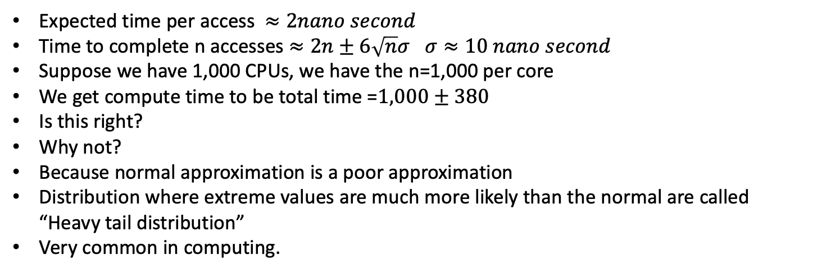
Caching effect on parallel computation
Parallel execution
Time

Slide 4
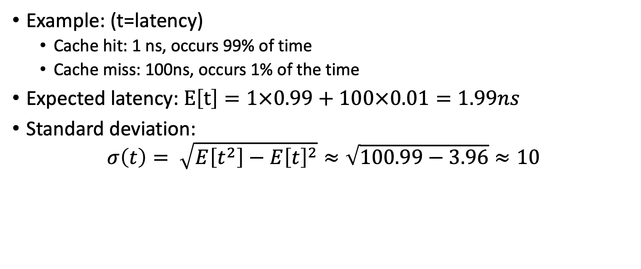
Distribution of access latencies

Slide 5
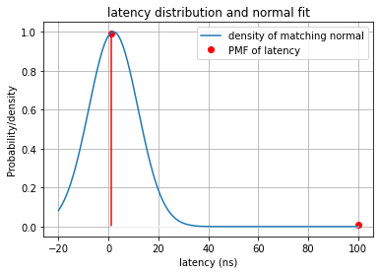
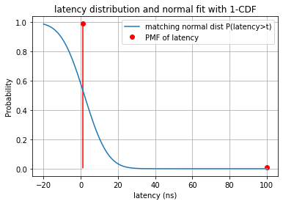
Heavy tails are hard to visualize
Both the normal density and the probability look very close to zero for latency=100
Problem 1:
The distribution of the latencies is a point-mass-function (PMF)
The distribution defined by the normal is a density (PDF)
The two are incomparable.

Slide 6
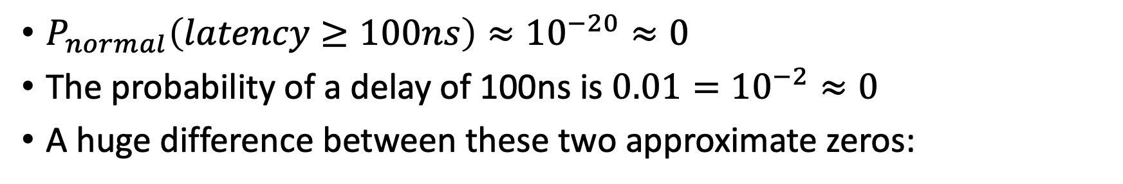
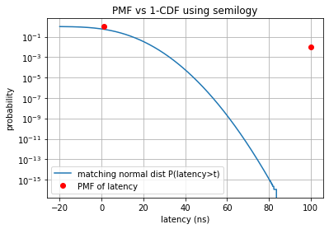
Using log scale to compare small probabilities
Heavy tail
Light/exponential tail

Slide 7
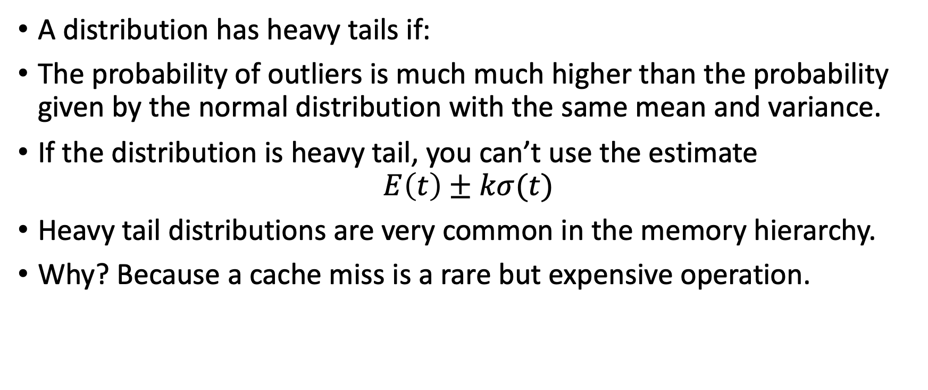
Summary: heavy tail distribution

Slide 8
A heavy tails example
Example: A program’s run time is
1 second with probability 99.9%
300 sec (5 minutes) with probability 0.1%
Mean=1.3sec, std=9.5sec
You run the program in parallel on 1000 dataset, 1000 computers
You wait until all of the runs finish.
The laggard problem: the slowest run determines the overall running time. More than half the time we need to wait 300 seconds.

Slide 9
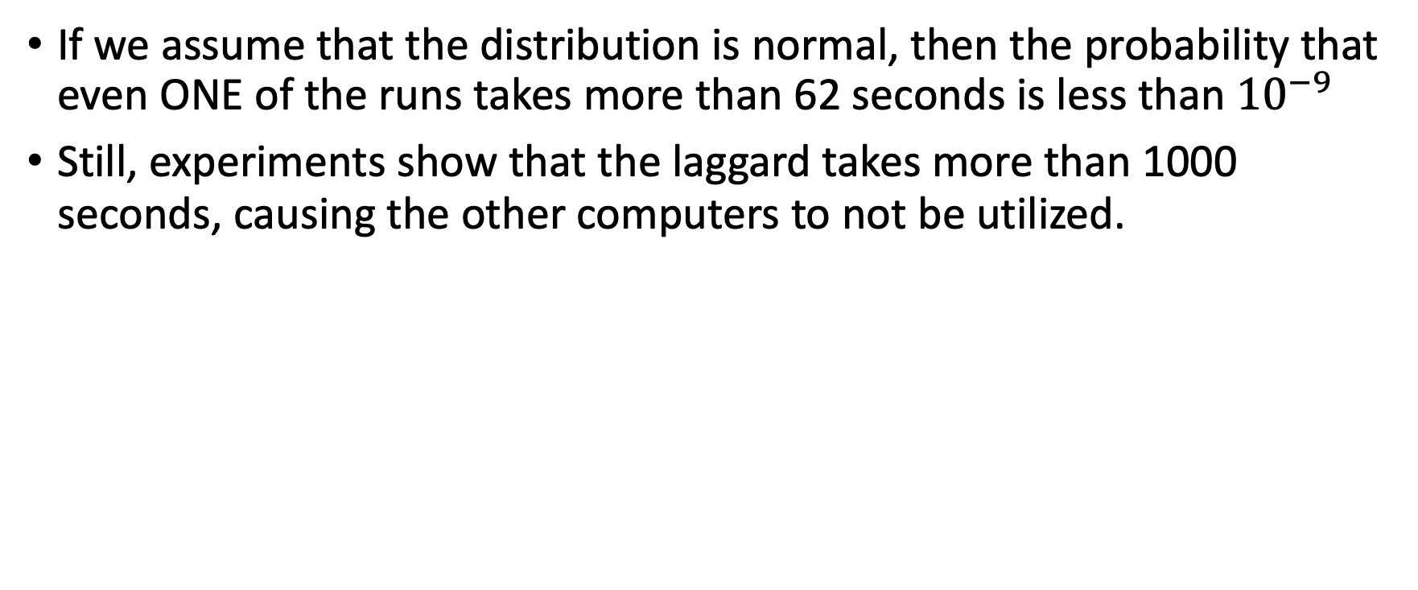
The latency of the task is not normal

Slide 10
The reason:
With probability 99.9%, the run finishes in 0.5 second
With probability 0.1%, the run finish in 1000 seconds
When you have 1000 computers, there is a large probability that one of the machines will take 1000 seconds. Causing the fast machines to waste 999.5 seconds.

Slide 11
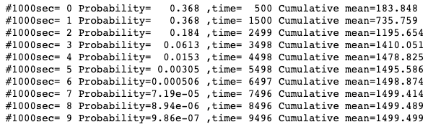
What about just one machine?
Using just one machine.
Run the jobs sequentially
We are interested in the sum, not the max
Very rarely more than 6500 sec
Mean is 1500 Sec (it was about 1000 for 1000 machines!)
The distribution has exponential (= light tails)

Slide 12
Problem in HW
Estimate the fraction of 1’s in a large RDD
Distribution of a single sample: 1 with prob p, 0 with probability 1-p
Distribution of number of 1’s: binomial distribution
Binomial approaches normal for number of samples ~>100
We can bound the probability of a the tail using the normal distribution.

