Slide 1
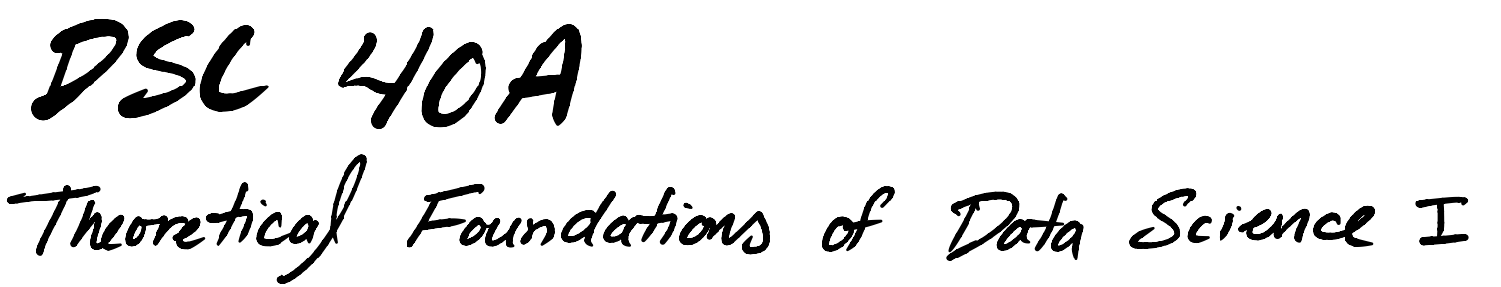

Slide 2
Announcements
Homework 6 due today
Homework 5 grades released
Homework 7 will be released Wednesday 11/27 and due 12/6.

Slide 3
Question
Answer at q.dsc40a.com
Remember, you can always ask questions at q.dsc40a.com!
If the direct link doesn't work, click the "Lecture Questions" link in the top right corner of dsc40a.com.

Slide 4
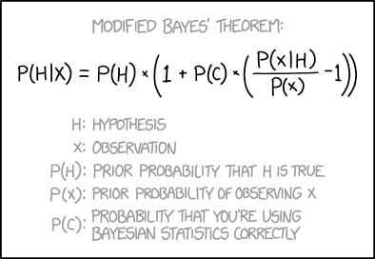
Agenda
Bayes Theorem
Naïve Bayes Classifier
Source: xkcd

Slide 5
Bayes Theorem

Slide 6
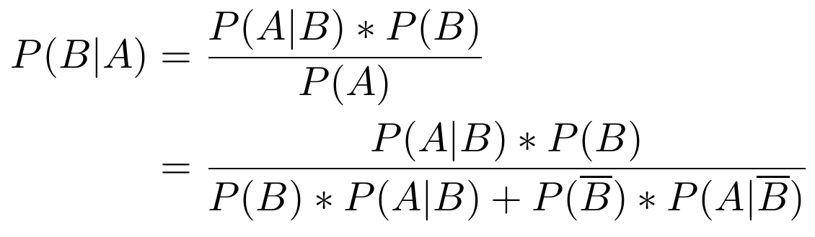
Last Week
We defined Bayes’ Theorem:
Bayes’ Theorem describes how to update the probability of one event given that another has occurred.

Slide 7
Bayes' Theorem
Bayes’ Theorem follows from the multiplication rule, or conditional probability.
Bayes’ Theorem:
not
B

Slide 8
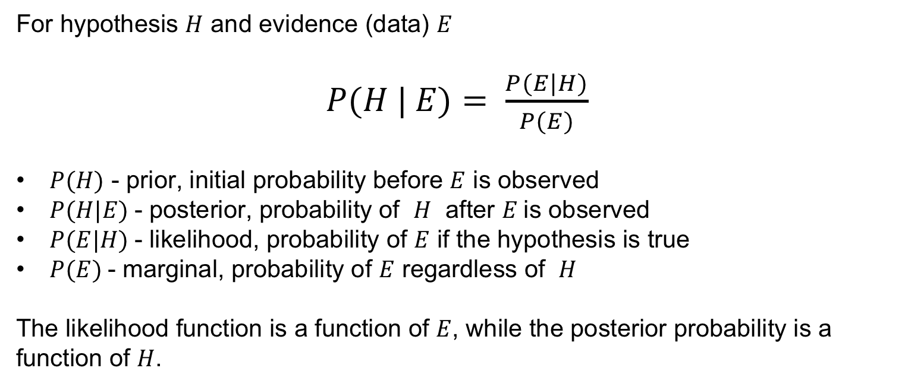
Bayes' Theorem
For hypothesis $H$ and evidence (data) $E$
$P(H | E)= \frac{P(E|H)}{P(E)}$
$P(H)$ - prior, initial probability before $E$ is observed
$P(H|E)$- posterior, probability of $H$ after $E$is observed
$P(E|H)$- likelihood, probability of $E$ if the hypothesis is true
$P(E)$- marginal, probability of $E$ regardless of $H$
The likelihood function is a function of $E$, while the posterior probability is a function of $H$.

Slide 9

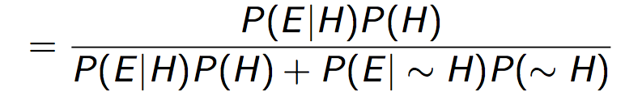
Bayes' Theorem: Example
A manufacturer claims that its drug test will detect steroid use 95% of the time. What the company does not tell you is that 15% of all steroid-free individuals also test positive (the false positive rate). 10% of the Tour de France bike racers use steroids. Your favorite cyclist just tested positive. What’s the probability that he used steroids?
What is your first guess?
Close to 95%
Close to 85%
Close to 40%
Close to 15%

Slide 10
Bayes' Theorem: Example
A manufacturer claims that its drug test will detect steroid use 95% of the time. What the company does not tell you is that 15% of all steroid-free individuals also test positive (the false positive rate). 10% of the Tour de France bike racers use steroids. Your favorite cyclist just tested positive. What’s the probability that he used steroids?
Now, calculate it and choose the best answer.
Close to 95%
Close to 85%
Close to 40%
Close to 15%

Slide 11
Bayes' Theorem: Example
A manufacturer claims that its drug test will detect steroid use 95% of the time. What the company does not tell you is that 15% of all steroid-free individuals also test positive (the false positive rate). 10% of the Tour de France bike racers use steroids. Your favorite cyclist just tested positive. What’s the probability that he used steroids?
Solution:
H: used steroids
E: tested positive

Slide 12
Bayes' Theorem: Example
A manufacturer claims that its drug test will detect steroid use 95% of the time. What the company does not tell you is that 15% of all steroid-free individuals also test positive (the false positive rate). 10% of the Tour de France bike racers use steroids. Your favorite cyclist just tested positive. What’s the probability that he used steroids?
Solution:
H: used steroids
E: tested positive
Despite manufacturer’s claims, only 41% chance that cyclist used steroids.

Slide 13
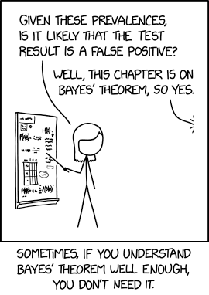
Bayes' Theorem: Example
Example
1% of people have a certain genetic defect
90% of tests accurately detect the gene (true positives).
7% of the tests are false positives.
If Olaf gets a positive test result, what are the odds he actually has the genetic defect?

Slide 14
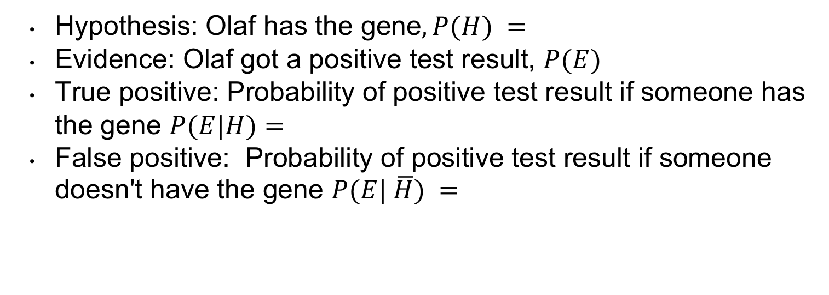
Bayes' Theorem: Example
Hypothesis: Olaf has the gene$, P(H) =$
Evidence: Olaf got a positive test result, $P(E)$
True positive: Probability of positive test result if someone has the gene $P(E|H)=$
False positive: Probability of positive test result if someone doesn't have the gene $P(E| \overline{H}) =$

Slide 15
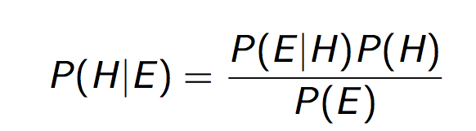
Bayes' Theorem: Example
Calculate
The probability that Olaf has the gene is only _______ despite the positive test result!

Slide 16

Bayes' Theorem: Example
What happens if there are less false positives?
Consider $P(E|\overline{H}) = 0.02$:
The probability that Olaf has the gene is now __________.

Slide 17

Bayes' Theorem: Example
What happens if there are more true positives?
Consider $P(E|H) = 0.$95:
Improving the accuracy of true positives raised the probability that Olaf has the gene to ____.

Slide 18
Naïve Bayes Classifier

Slide 19
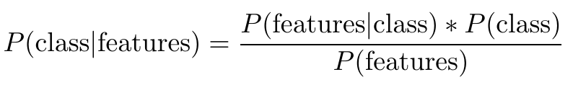
Preview: Bayes' Theorem for Classification
Bayes’ Theorem is very useful for classification problems, where we want to predict a class based on some features.
B = belonging to a certain class A = having certain features

Slide 20
Classification
Making predictions based on examples (training data)
Response variable is categorical
Categories are called classes
Examples:
decide whether patient has kidney disease
identify handwritten digits
determine whether an avocado is ripe
predict whether credit card activity is fraudulent

Slide 21
Example
Color | Ripeness
bright green | unripe
green-black | ripe
purple-black | ripe
green-black | unripe
purple-black | ripe
bright green | unripe
green-black | ripe
purple-black | ripe
green-black | ripe
green-black | unripe
purple-black | ripe
You have a green-black avocado. Based on this data, would you predict that your avocado is ripe or unripe?
Which class would you predict?
ripe
unripe
Notes:
sample of avocados from a larger population of all avocados
the more data we have, the better predictions we’ll be able to make
law of large numbers: larger samples better approximate the population
need labeled data

Slide 22
Example
Color | Ripeness
bright green | unripe
green-black | ripe
purple-black | ripe
green-black | unripe
purple-black | ripe
bright green | unripe
green-black | ripe
purple-black | ripe
green-black | ripe
green-black | unripe
purple-black | ripe
You have a green-black avocado. Based on this data, would you predict that your avocado is ripe or unripe?
Strategy: Calculate two probabilities:
P(ripe | green-black)
P(unripe | green-black)
Then choose the class according to the larger of these two probabilities.

Slide 23
Bayes' Theorem for Classification
Bayes’ Theorem gives another strategy for predicting the class given features.
B = belonging to a certain class
A = having certain features

Slide 24
Bayes' Theorem for Classification
Bayes’ Theorem gives another strategy for predicting the class given features.
B = belonging to a certain class
A = having certain features
Can all be estimated from the training data

Slide 25
Avocado Ripeness
Color | Ripeness
bright green | unripe
green-black | ripe
purple-black | ripe
green-black | unripe
purple-black | ripe
bright green | unripe
green-black | ripe
purple-black | ripe
green-black | ripe
green-black | unripe
purple-black | ripe
You have a green-black avocado. Based on this data, would you predict that your avocado is ripe or unripe?

Slide 26
Avocado Ripeness
Color | Ripeness
bright green | unripe
green-black | ripe
purple-black | ripe
green-black | unripe
purple-black | ripe
bright green | unripe
green-black | ripe
purple-black | ripe
green-black | ripe
green-black | unripe
purple-black | ripe
You have a green-black avocado. Based on this data, would you predict that your avocado is ripe or unripe?

Slide 27
Avocado Ripeness
Color | Ripeness
bright green | unripe
green-black | ripe
purple-black | ripe
green-black | unripe
purple-black | ripe
bright green | unripe
green-black | ripe
purple-black | ripe
green-black | ripe
green-black | unripe
purple-black | ripe
You have a green-black avocado. Based on this data, would you predict that your avocado is ripe or unripe?
Shortcut: Both probabilities have same denominator. To find larger one, choose one with larger numerator.
P(ripe | green-black)
P(unripe | green-black)

Slide 28
More Features
Color | Softness | Variety | Ripeness
bright green | firm | Zutano | unripe
green-black | medium | Hass | ripe
purple-black | firm | Hass | ripe
green-black | medium | Hass | unripe
purple-black | soft | Hass | ripe
bright green | firm | Zutano | unripe
green-black | soft | Zutano | ripe
purple-black | soft | Hass | ripe
green-black | soft | Zutano | ripe
green-black | firm | Hass | unripe
purple-black | medium | Hass | ripe
You have a firm green-black Zutano avocado. Based on this data, would you predict that your avocado is ripe or unripe?
Notes:
sample of avocados from a larger population of all avocados
the more data we have, the better predictions we’ll be able to make
law of large numbers: larger samples better approximate the population
need labeled data

Slide 29
Avocado Ripeness
Color | Softness | Variety | Ripeness
bright green | firm | Zutano | unripe
green-black | medium | Hass | ripe
purple-black | firm | Hass | ripe
green-black | medium | Hass | unripe
purple-black | soft | Hass | ripe
bright green | firm | Zutano | unripe
green-black | soft | Zutano | ripe
purple-black | soft | Hass | ripe
green-black | soft | Zutano | ripe
green-black | firm | Hass | unripe
purple-black | medium | Hass | ripe
You have a firm green-black Zutano avocado. Based on this data, would you predict that your avocado is ripe or unripe?
Strategy: Calculate two probabilities:
P(ripe | firm, green-black, Zutano)
P(unripe | firm, green-black, Zutano)
Then choose the class according to the larger of these two probabilities.
Notes:
issue: you’ve never seen an avocado with those features

Slide 30
Avocado Ripeness
Color | Softness | Variety | Ripeness
bright green | firm | Zutano | unripe
green-black | medium | Hass | ripe
purple-black | firm | Hass | ripe
green-black | medium | Hass | unripe
purple-black | soft | Hass | ripe
bright green | firm | Zutano | unripe
green-black | soft | Zutano | ripe
purple-black | soft | Hass | ripe
green-black | soft | Zutano | ripe
green-black | firm | Hass | unripe
purple-black | medium | Hass | ripe
You have a firm green-black Zutano avocado. Based on this data, would you predict that your avocado is ripe or unripe?
Problem: We have not seen an avocado with all these features. Both probabilities will be undefined.
P(ripe | firm, green-black, Zutano)
P(unripe | firm, green-black, Zutano)
Notes:
issue: you’ve never seen an avocado with those features

Slide 31
Avocado Ripeness
Color | Softness | Variety | Ripeness
bright green | firm | Zutano | unripe
green-black | medium | Hass | ripe
purple-black | firm | Hass | ripe
green-black | medium | Hass | unripe
purple-black | soft | Hass | ripe
bright green | firm | Zutano | unripe
green-black | soft | Zutano | ripe
purple-black | soft | Hass | ripe
green-black | soft | Zutano | ripe
green-black | firm | Hass | unripe
purple-black | medium | Hass | ripe
You have a firm green-black Zutano avocado. Based on this data, would you predict that your avocado is ripe or unripe?
Solution: Use Bayes’ Theorem, plus a simplifying assumption, to calculate the two numerators.
Notes:
issue: you’ve never seen an avocado with those features

Slide 32
Avocado Ripeness
Color | Softness | Variety | Ripeness
bright green | firm | Zutano | unripe
green-black | medium | Hass | ripe
purple-black | firm | Hass | ripe
green-black | medium | Hass | unripe
purple-black | soft | Hass | ripe
bright green | firm | Zutano | unripe
green-black | soft | Zutano | ripe
purple-black | soft | Hass | ripe
green-black | soft | Zutano | ripe
green-black | firm | Hass | unripe
purple-black | medium | Hass | ripe
You have a firm green-black Zutano avocado. Based on this data, would you predict that your avocado is ripe or unripe?
Simplifying assumption: Within a given class, the features are independent.
P(firm, green-black, Zutano | ripe) =
P(firm | ripe)*P(green-black | ripe)*P(Zutano | ripe)
Notes:
sample of avocados from a larger population of all avocados
the more data we have, the better predictions we’ll be able to make
law of large numbers: larger samples better approximate the population
need labeled data

Slide 33

Conditional Independence
Recall that A and B are independent if
A and B are conditionally independent given C if
Given that C occurs, this says that A and B are independent of one another.

Slide 34
Avocado Ripeness
Color | Softness | Variety | Ripeness
bright green | firm | Zutano | unripe
green-black | medium | Hass | ripe
purple-black | firm | Hass | ripe
green-black | medium | Hass | unripe
purple-black | soft | Hass | ripe
bright green | firm | Zutano | unripe
green-black | soft | Zutano | ripe
purple-black | soft | Hass | ripe
green-black | soft | Zutano | ripe
green-black | firm | Hass | unripe
purple-black | medium | Hass | ripe
You have a firm green-black Zutano avocado. Based on this data, would you predict that your avocado is ripe or unripe?
Notes:
sample of avocados from a larger population of all avocados
the more data we have, the better predictions we’ll be able to make
law of large numbers: larger samples better approximate the population
need labeled data

Slide 35
Avocado Ripeness
Color | Softness | Variety | Ripeness
bright green | firm | Zutano | unripe
green-black | medium | Hass | ripe
purple-black | firm | Hass | ripe
green-black | medium | Hass | unripe
purple-black | soft | Hass | ripe
bright green | firm | Zutano | unripe
green-black | soft | Zutano | ripe
purple-black | soft | Hass | ripe
green-black | soft | Zutano | ripe
green-black | firm | Hass | unripe
purple-black | medium | Hass | ripe
You have a firm green-black Zutano avocado. Based on this data, would you predict that your avocado is ripe or unripe?
Assuming conditional independence of features given the class, calculate P(firm, green-black, Zutano | unripe).
0
1/4
3/16
1 - (1/7*3/7*2/7)
Notes:
sample of avocados from a larger population of all avocados
the more data we have, the better predictions we’ll be able to make
law of large numbers: larger samples better approximate the population
need labeled data

Slide 36
Avocado Ripeness
Color | Softness | Variety | Ripeness
bright green | firm | Zutano | unripe
green-black | medium | Hass | ripe
purple-black | firm | Hass | ripe
green-black | medium | Hass | unripe
purple-black | soft | Hass | ripe
bright green | firm | Zutano | unripe
green-black | soft | Zutano | ripe
purple-black | soft | Hass | ripe
green-black | soft | Zutano | ripe
green-black | firm | Hass | unripe
purple-black | medium | Hass | ripe
You have a firm green-black Zutano avocado. Based on this data, would you predict that your avocado is ripe or unripe?
Notes:
sample of avocados from a larger population of all avocados
the more data we have, the better predictions we’ll be able to make
law of large numbers: larger samples better approximate the population
need labeled data

Slide 37
Naïve Bayes Algorithm
Bayes’ Theorem shows how to calculate P(class | features).
Rewrite the numerator, using the naïve assumption of conditional independence of features given the class.
Estimate each term in the numerator based on the training data.
Select class based on whichever has the larger numerator.

Slide 38
Summary
The Naïve Bayes algorithm gives a strategy for classifying data according to its features.
It relies on an assumption of conditional independence of the features.
Next time: application to text classification

Slide 40
Agenda
How can we use naïve Bayes to classify text?

Slide 41
Last Time
Classification is the problem of predicting a categorical variable.
The Naïve Bayes algorithm gives a strategy for classifying data according to its features.
It is naïve because it relies on an assumption of conditional independence of the features, for a given class.

Slide 42
Naive Bayes Algorithm
Bayes’ Theorem shows how to calculate P(class | features).
Rewrite the numerator, using the naïve assumption of conditional independence of features given the class.
Estimate each term in the numerator based on the training data.
Select class based on whichever has the larger numerator.

Slide 43
Naïve Bayes Classifier for Text Classification

Slide 44
Bayes’ Theorem for Text Classification
Text classification problems include:
sentiment analysis
positive and negative customer reviews
determining genre
news articles, blog posts, etc.
email foldering
promotions tab in Gmail
spam filtering
separating spam from ham (good, non-spam email)

Slide 45
Features
Represent an email as a vector or array of features
(x₁, x₂, x₃, ... , x_{n})
where i is an index into a dictionary of n possible words, and
x_{i} = 1 if word i is present in the email
x_{i} = 0 otherwise

Slide 46

Features
Called the “bag of words” model:
Ignores location of words within the email, and the frequency of words
Example:
usually n = 10,000 to 50,000 words in practice

Slide 47
Naïve Bayes Spam Classifier
To classify an email, we will use Bayes’ Theorem to calculate the probability of it belonging to each class:
P(spam | features) and P(ham | features)
Then choose the class according to the larger of these two probabilities.

Slide 48
Naïve Bayes Spam Classifier
Observe: the formulas for P(spam | features) and P(ham | features) have the same denominator, P(features).
We can find the larger of the two probabilities by just comparing numerators.
P(features | spam)*P(spam) vs. P(features | ham)*P(ham)

Slide 49
Naive Bayes Spam Classifier
To use Bayes’ Theorem, need to determine four quantities:
P(features | spam)
P(features | ham)
P(spam)
P(ham)
Which of these probabilities should add to 1?
i, ii
iii, iv
both A and B
neither A nor B

Slide 50
Estimating Parameters with Training Data
P(spam) # spam emails in training set
size of training set
P(ham) # ham emails in training set
size of training set
P(features | spam)
P(features | ham)
parameter:
estimate:
parameter:
estimate:
harder to estimate

Slide 51
Assumption of Conditional Independence
To estimate P(features | spam) and P(features | ham), we assume that the probability of a word appearing in an email of a given class is not affected by other words in the email.
P(x₁=0 and x₂=1 and x₃=1 and ... | spam) = assumed equal
P(x₁=0 | spam)*P(x₂=1 | spam)*P(x₃=1 | spam)*...
Is this a reasonable assumption?

Slide 52
Estimating Parameters with Training Data
P(x₁=0 and x₂=1 and x₃=1 and ... | spam) = assumed equal
P(x₁=0 | spam)*P(x₂=1 | spam)*P(x₃=1 | spam)*...
P(x₁=0 | spam)
# spam emails in training set not containing the first word in the dictionary
# spam emails in training set
parameter:
estimate:

Slide 53
Estimating Parameters with Training Data
P(x₁=0 and x₂=1 and x₃=1 and ... | spam) = assumed equal
P(x₁=0 | spam)*P(x₂=1 | spam)*P(x₃=1 | spam)*...
P(x₂=1 | spam)
# spam emails in training set containing the second word in the dictionary
# spam emails in training set
parameter:
estimate:

Slide 54
Estimating Parameters with Training Data
P(x₁=0 and x₂=1 and x₃=1 and ... | spam) = assumed equal
P(x₁=0 | spam)*P(x₂=1 | spam)*P(x₃=1 | spam)*...
P(x₃=1 | spam)
# spam emails in training set containing the third word in the dictionary
# spam emails in training set
parameter:
estimate:
Can term-by-term estimate P(features|class)

Slide 55
Naïve Bayes Spam Classifier: Recap
Bayes’ Theorem shows how to calculate P(spam | features) and P(ham | features).
Rewrite the numerator, using the naive assumption of conditional independence of words given the class.
Estimate each term in the numerator based on the training data.
Select class based on whichever has the larger numerator.

Slide 56
Modifications and Extensions
features are pairs (or longer sequences) of words rather than individual words
better captures dependencies between words
less naïve
much bigger feature space
n words → n² pairs of words
features are the number of occurrences of each word
captures low-frequency vs. high-frequency words
smoothing
better handling of previously unseen words

Slide 57
Smoothing
P(x₁=0 and x₂=1 and x₃=1 and ... | spam) =
P(x₁=0 | spam)*P(x₂=1 | spam)*P(x₃=1 | spam)*...
Dictionary
a
aardvark
abacus
abandon
abate
...
Suppose you are classifying an email containing the word “abacus,” which does not appear in any emails in your training data. For this new email’s features, what is P(features | spam) according to a naive Bayes classifier?
P(features | spam) = undefined
P(features | spam) = 0
P(features | spam) = 1/n
P(features | spam) = 1

Slide 58
Smoothing
P(x₁=0 and x₂=1 and x₃=1 and ... | ham) =
P(x₁=0 | ham)*P(x₂=1 | ham)*P(x₃=1 | ham)*...
Dictionary
a
aardvark
abacus
abandon
abate
...
Suppose you are classifying an email containing the word “abacus,” which does not appear in any emails in your training data. For this new email’s features, what is P(features | ham) according to a naïve Bayes classifier?
P(features | ham) = undefined
P(features | ham) = 0
P(features | ham) = 1/n
P(features | ham) = 1

Slide 59
Smoothing
P(features | spam) = 0 and P(features | ham) = 0
Tiebreaker: randomly select one of the classes?

Slide 60
Smoothing
P(features | spam) = 0 and P(features | ham) = 0
Tiebreaker: randomly select one of the classes?
Better solution: make sure probabilities can’t be zero
Key idea: just because you’ve never seen something happen doesn’t mean it’s impossible

Slide 61
Estimating Parameters with Training Data
Without Smoothing
With
Smoothing
P(spam) #spam #spam + 1
#spam + #ham #spam + 1 + #ham + 1
P(ham) #ham #ham + 1
#spam + #ham #spam + 1 + #ham + 1
parameter:
estimate:
parameter:
estimate:

Slide 62
Estimating Parameters with Training Data
parameter:
P(x_{i}=1 | spam)
#spam containing word i
#spam containing word i + #spam not containing word i
(#spam containing word i) + 1
(#spam containing word i) + 1 + (#spam not containing word i) + 1
Similarly for other parameters P(x_{i}=0 | spam), P(x_{i}=1 | ham), P(x_{i}=1 | ham).
estimate:
Without Smoothing
With
Smoothing

Slide 63
Smoothing
P(x₁=0 and x₂=1 and x₃=1 and ... | ham) =
P(x₁=0 | ham)*P(x₂=1 | ham)*P(x₃=1 | ham)*...
Dictionary
a
aardvark
abacus
abandon
abate
...
Suppose you are classifying an email containing the word “abacus,” which does not appear in any emails in your training data. What is P(x₃= 1 | ham) according to a naive Bayes classifier with smoothing?
Suppose you are classifying an email containing the word “abacus,” which does not appear in any emails in your training data. What is P(x₃= 1 | ham) according to a naïve Bayes classifier with smoothing?
P(x₃= 1 | ham) = 0
P(x₃= 1 | ham) = 1/2
P(x₃= 1 | ham) = 1/(total #ham +1)
P(x₃= 1 | ham) = 1/(total #ham + 2)
P(x₃= 1 | ham) = 1/(total #ham + total #spam+ 2)

Slide 64
Smoothing
Suppose your training set includes only six emails, all of which are ham. For a new email, how will we estimate P(ham)
without smoothing? with smoothing?
P(ham) = 0 P(ham) = 1/8
P(ham) = 0 P(ham) = 6/7
P(ham) = 1 P(ham) = 1/8
P(ham) = 1 P(ham) = 6/7
P(ham) = 1 P(ham) = 7/8

Slide 65
Smoothing
Suppose your training set includes only six emails, all of which are ham. For a new email, how will we estimate P(ham)
without smoothing? with smoothing?
P(ham) = 0 P(ham) = 1/8
P(ham) = 0 P(ham) = 6/7
P(ham) = 1 P(ham) = 1/8
P(ham) = 1 P(ham) = 6/7
P(ham) = 1 P(ham) = 7/8
Is it still true that P(ham) + P(spam) = 1 with smoothing?

Slide 66
Summary
The Naive Bayes algorithm is useful for text classification.
The bag of words model treats each word in a large dictionary as a feature.
Smoothing is one modification that allows for better predictions when there are words that have never been seen before.

