Slide 1
DSC 80 Discussion
Dylan Stockard

Slide 2
Reminders
Read the syllabus
Fill out the welcome survey on the dsc80 home page
Lecture tomorrow on zoom
There will be a pre-lecture reading released on the homepage for tomorrow
Lab 01 due Wednesday 5:00 PM, no slip days

Slide 3
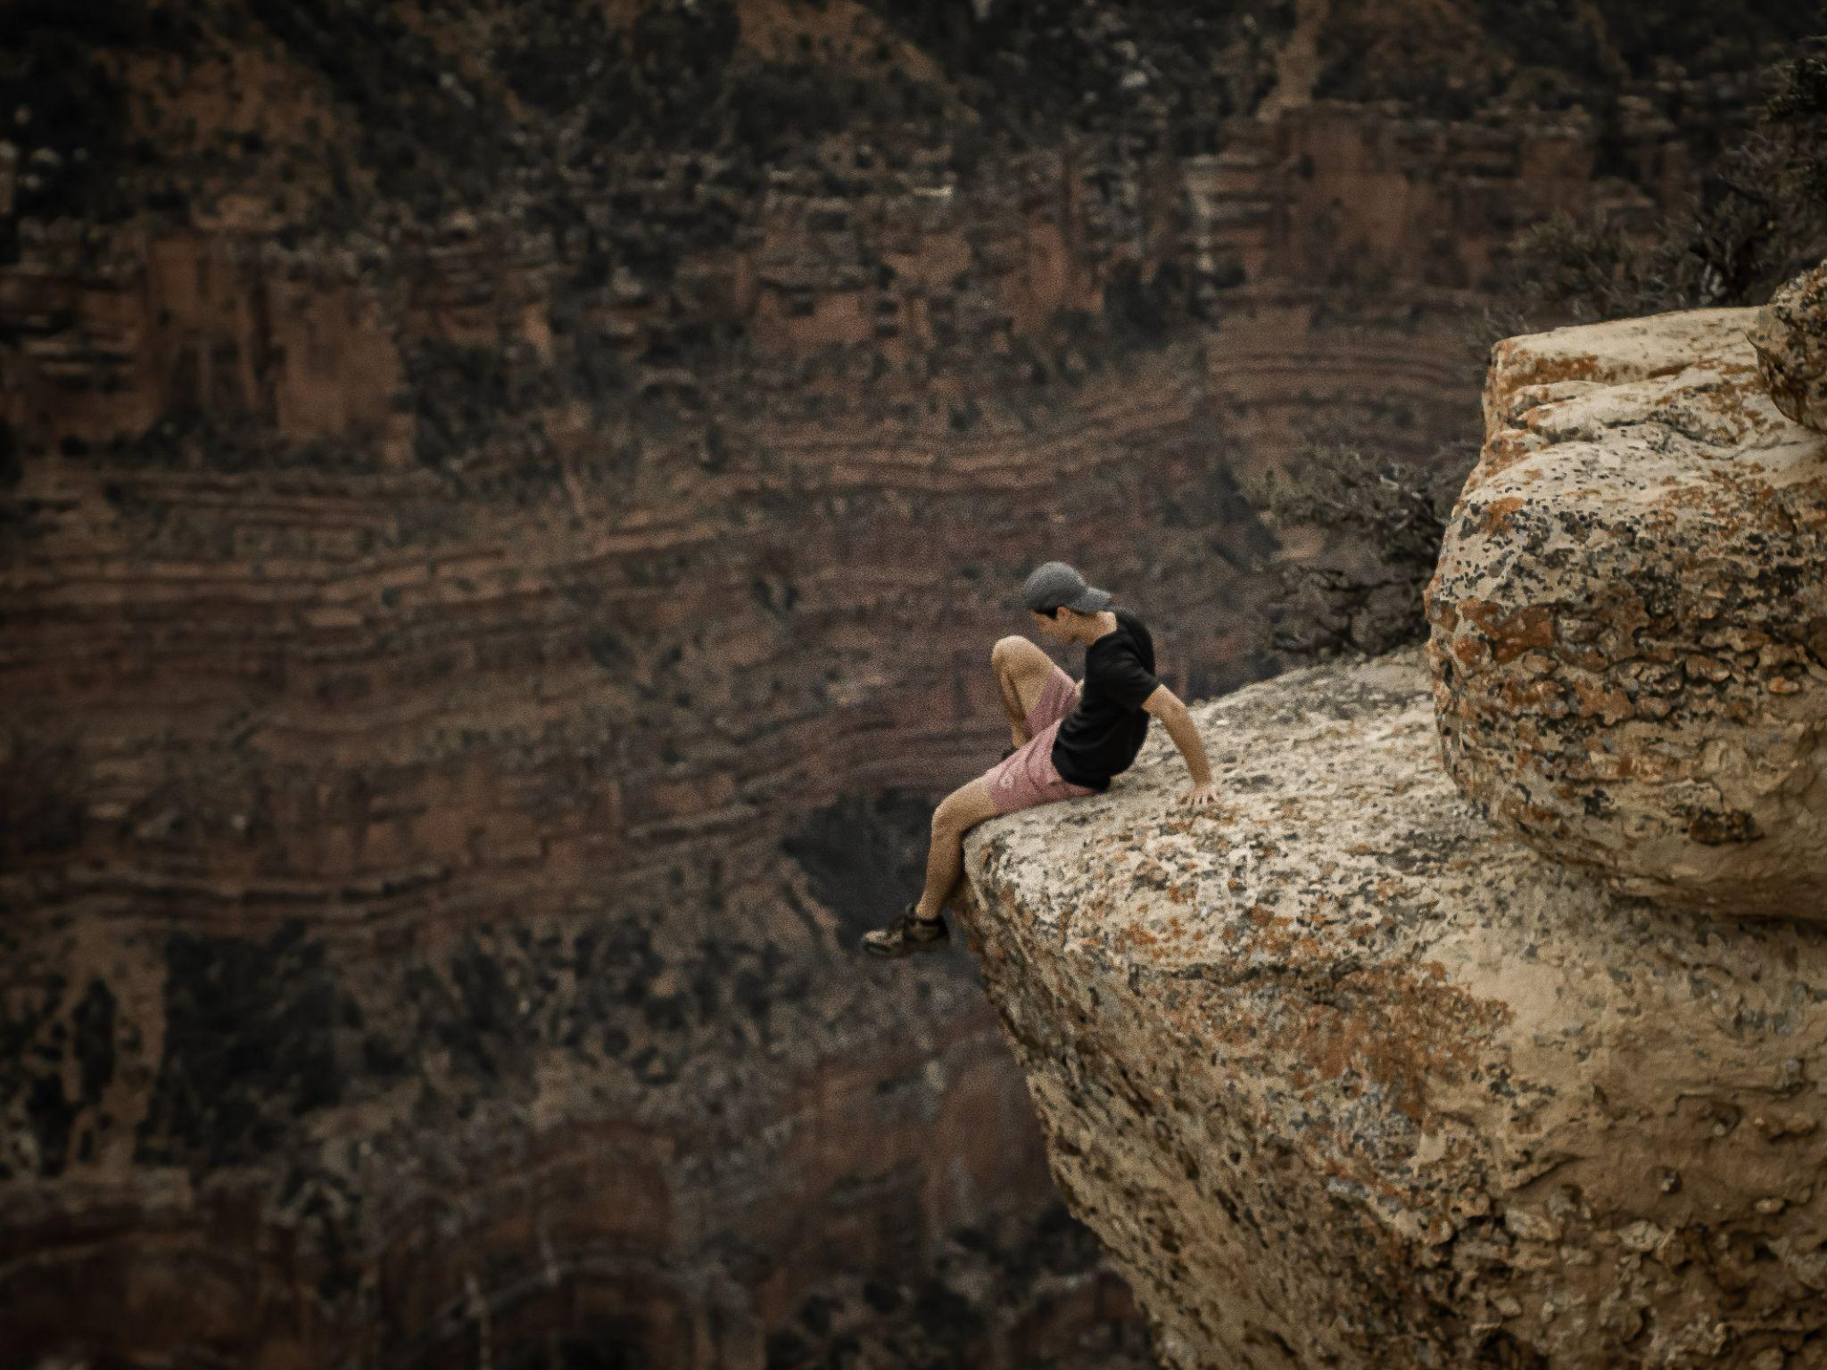
Hi I’m Dylan!
WA state native
2nd year MS in Data Science
MMA, hiking, road trips
What not to do at the Grand Canyon

Slide 4
Your Turn!
Name
Hometown
Hobby(s)
Favorite building or art installation on campus

Slide 5
Discussion Overview
Usual Discussion
Go over the prior week’s lab
Discuss learning objectives of the lab
Explore different implementations of the solution.
After discussion, a reflection form is available on Gradescope to be completed by Thursday at midnight.
0.20% of extra credit will be awarded to those who submit the lab, attend discussion section, and complete the reflection form.

Slide 6
Discussion Overview
Usual Discussion
Go over the prior week’s lab
Discuss learning objectives of the lab
Explore different implementations of the solution.
After discussion, a reflection form is available on Gradescope to be completed by Thursday at midnight.
0.20% of extra credit will be awarded to those who submit the lab, attend discussion section, and complete the reflection form.
Today’s Discussion
Introductions
Command line/terminal crash course
Environment setup
Instructions under the “Tech Support” page of the course website for setup

Slide 7
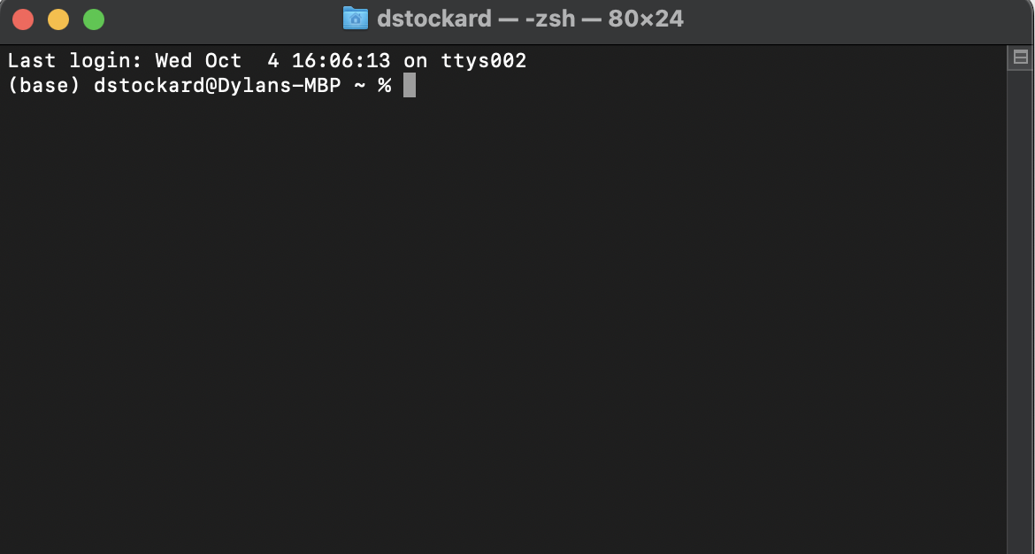
Command Line/Prompt/Terminal
A way to talk with your computer using “bash” to manage files, run scripts, and more
We will not be testing you on your skills here, but you may need them for logistics in this class.

Slide 8
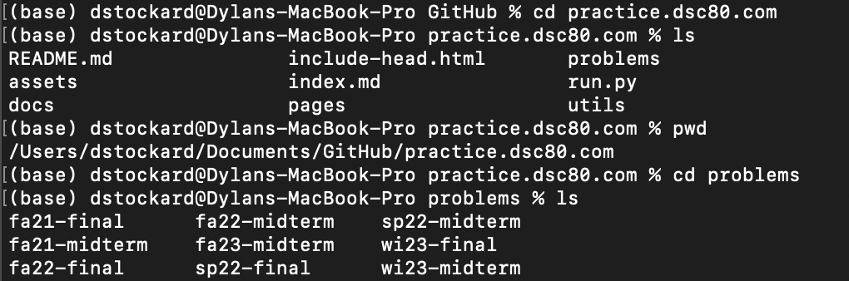
Bash
ls – List directory contents
cd – Change directory
pwd – Print working directory
cat – read, create, and concatenate files
vi - visual editor
Most commands have options you can specify (like function parameters), so documentation is your friend here!

Slide 9
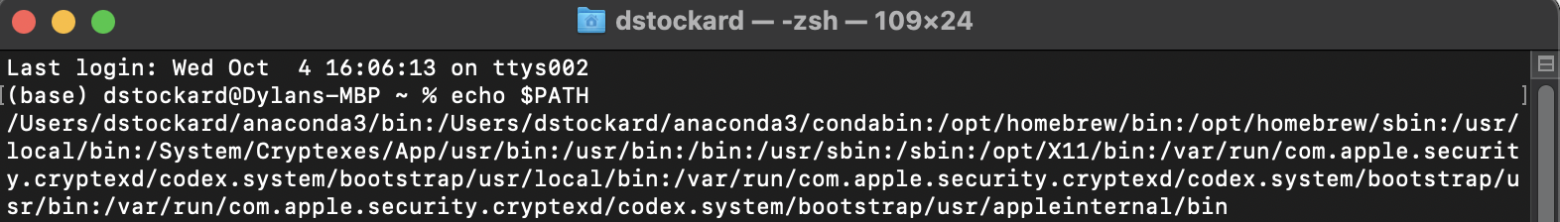
What is your PATH?
A list of directories that tells your system where to run executables from

Slide 10
What is your PATH?
A list of directories that tells your system where to run executables (like pip) from

Slide 11

Dylan 🙋💬:
Laptop 💻👀 :
Laptop 💻🔎:
Note: You can see where the first executable in your path is by prompting “which {executable name}”

Slide 12
Environments
Python has a lot of useful libraries that make life easier…
Numpy
Pandas
Matplotlib
These libraries are constantly updating, but not at the same time.
However, these libraries often rely on certain versions of one another.
We use a specific versions for this class so our code is all consistent.

Slide 13
Base environment
Python 3.11.5
Numpy 1.24.3
Matplotlib 3.7.2
DSC80 environment
Python 3.8.18
Numpy 1.21.2
Matplotlib 3.5.1
Otter
MAMBA ACTIVATE/
DEACTIVATE

Slide 14
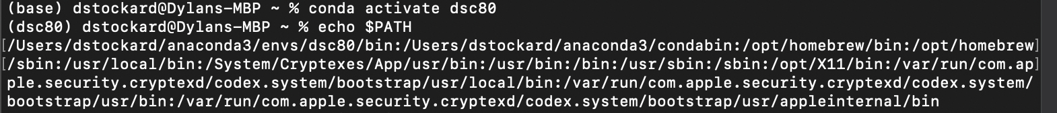
DSC80 Environment PATH

Slide 15
DSC80 Environment PATH

Slide 16
DSC80 Environment PATH
Dsc80 environment PATH
Base environment PATH

Slide 17
Base environment
Python 3.11.5
Numpy 1.24.3
Matplotlib 3.7.2
DSC80 environment
Python 3.8.18
Numpy 1.21.2
Matplotlib 3.5.1
MAMBA ACTIVATE/
DEACTIVATE

Slide 18

Quick note…
This class distributes assignments and lecture notebooks through our github repository
dsc80-2024-wi
To set up, run
To get new material that we release, cd to dsc80-2024-wi and run

Slide 19
Labs
Once you pull a lab from the github repo, you will have three files to use.
lab.py: This is what you will submit. Do not change function names, put your final solutions in here.
lab.ipynb: This is what you work in. It will have assignment details and is easier to work in while you’re developing your solutions.
lab-validation.py: This is what you test in. There are tests in the notebook as well, but this file will test your lab.py file to make sure it is what you expect before submitting to Gradescope.

Slide 20
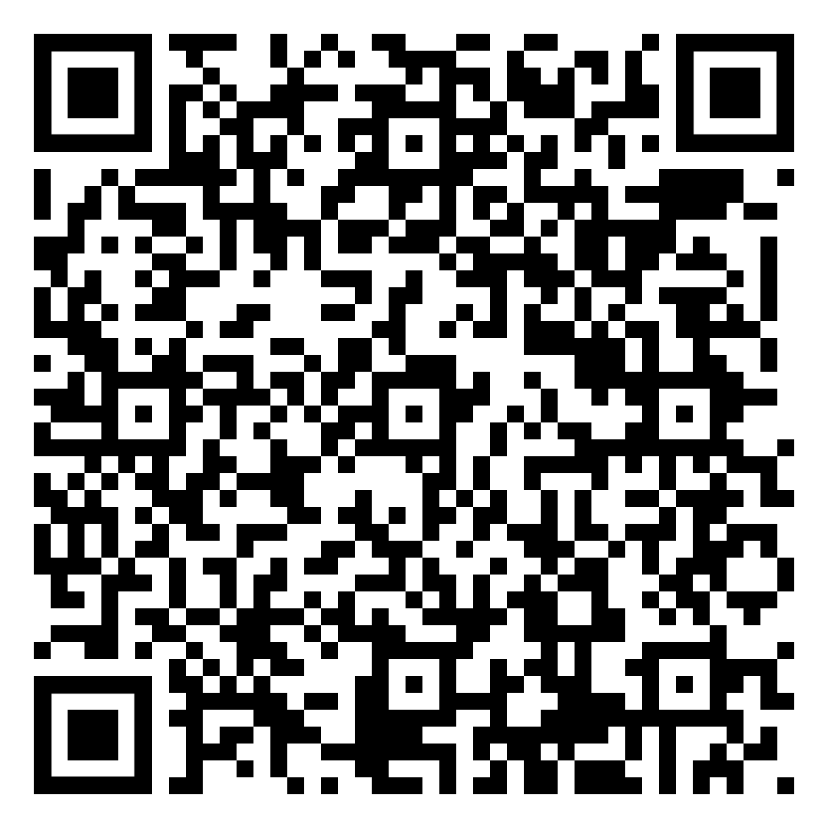
Before you leave…
Happy Wednesday!
Go to dsc80.com and follow the instructions on the “Tech Support” page to set up your environment and clone the github.
You are good to go once you have ran the first cell of lab 1 with no errors AND filled out the below QR code google form for attendance

