Slide 1
DSC40B: Theoretical Foundations of Data Science II
Lecture 9: Hashing and Hash table
Instructor: Yusu Wang

Slide 2
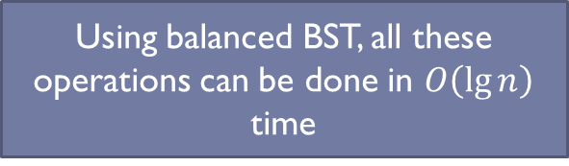
Recall: (Dynamic) set operations
Imagine you are maintaining a database indexed by some keys (real values), and you hope to support the following operations:
Search
Maximum
Minimum
Successor
Predecessor
Insert
Delete
Extract-Max
Increase-key
Using balanced BST, all these operations can be done in $O\left(\lg{n}\right)$ time

Slide 3
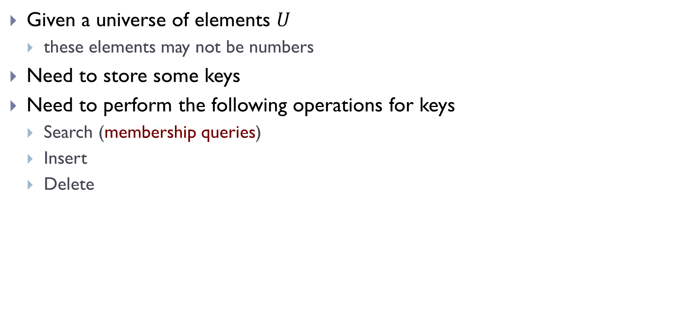
Dictionary operations
Given a universe of elements $U$
these elements may not be numbers
Need to store some keys
Need to perform the following operations for keys
Search (membership queries)
Insert
Delete
We can use balanced BST for this purpose if keys can be compared.
But we can have even lighter weight data structure to handle these

Slide 4
Today
Hashing in general
Hash table
For dictionary operations

Slide 5
Part A: The idea of Hashing

Slide 6
Hashing
An important idea used commonly in practice
Many uses:
Fast queries on a large data set.
Verifying message integrity.
Identify if file has changed in version control.

Slide 7
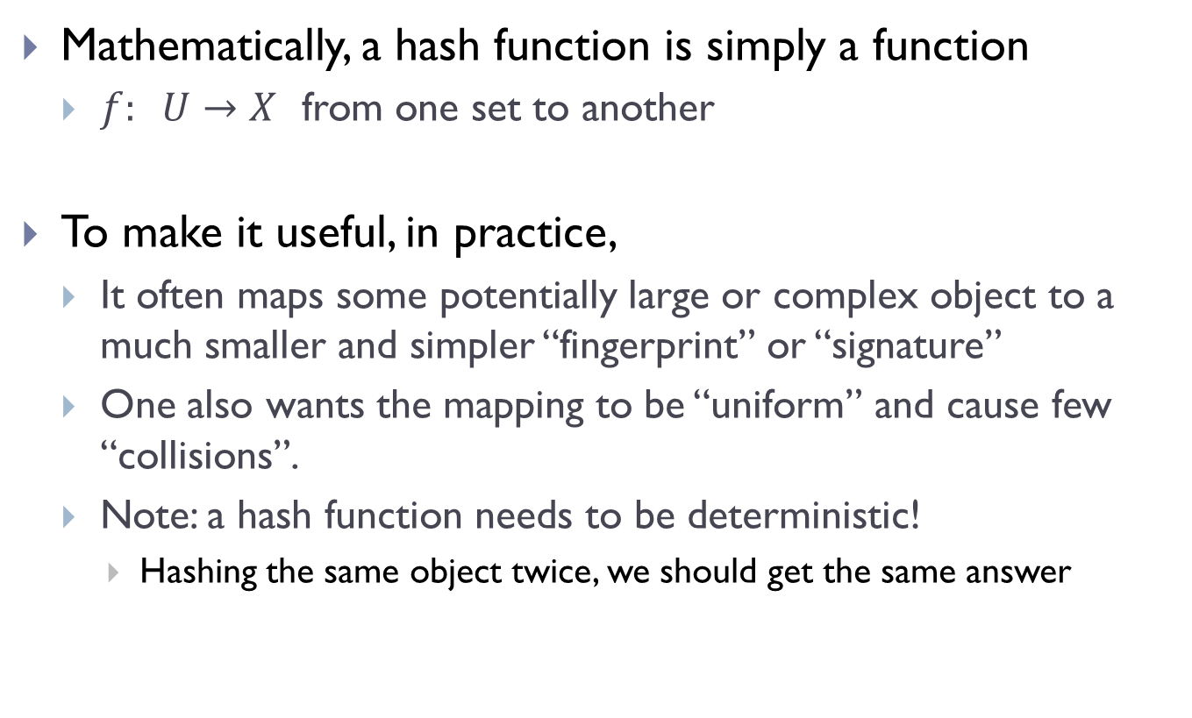
Hash function
Mathematically, a hash function is simply a function
$f: U→X$ from one set to another
To make it useful, in practice,
It often maps some potentially large or complex object to a much smaller and simpler “fingerprint” or “signature”
One also wants the mapping to be “uniform” and cause few “collisions”.
Note: a hash function needs to be deterministic!
Hashing the same object twice, we should get the same answer

Slide 8
Some examples
A cryptographic hash function:
maps data of arbitrary size into an often fixed-sized output of much smaller size
e.g, MD5: maps it to a 128-bit value
hard to “reverse engineer” input from hash.
two similar input could and should lead to very different hash values

Slide 9
Some examples
A cryptographic hash function:
maps data of arbitrary size into an often fixed-sized output of much smaller size
e.g, MD5: maps it to a 128-bit value
hard to “reverse engineer” input from hash.
two similar input could and should lead to very different hash values
> echo ”My name is Justin” | md5
a741d8524a853cf83ca21eabf8cea190
> echo ”My name is Justin!” | md5
f11eed2391bbd0a5a2355397c089fafd
> md5 slides.pdf
e3fd4370fda30ceb978390004e07b9df

Slide 10
A cryptographic hash function
Why?
I release a piece of software.
I host it on Google Drive.
Someone (Google, US Gov., etc.) decides to insert extra code into software to spy on users.
A user has no way of knowing.

Slide 11
A cryptographic hash function
Why?
I release a piece of software.
I host it on Google Drive.
Someone (Google, US Gov., etc.) decides to insert extra code into software to spy on users.
A user has no way of knowing.
What do I do?
I release a piece of software and publish the hash
I host it on Google Drive.
Someone inserts extra code into software to spy on users.
You download the software and hash it. If hash is different, you know the file has been changed!

Slide 12
Some examples
Want to place images into 100 bins.
How do we decide which bin an image goes into?
Hash function!
Takes in an image.
Outputs a number in {1, 2, …, 100}

Slide 13
Part B: Hash Table

Slide 14
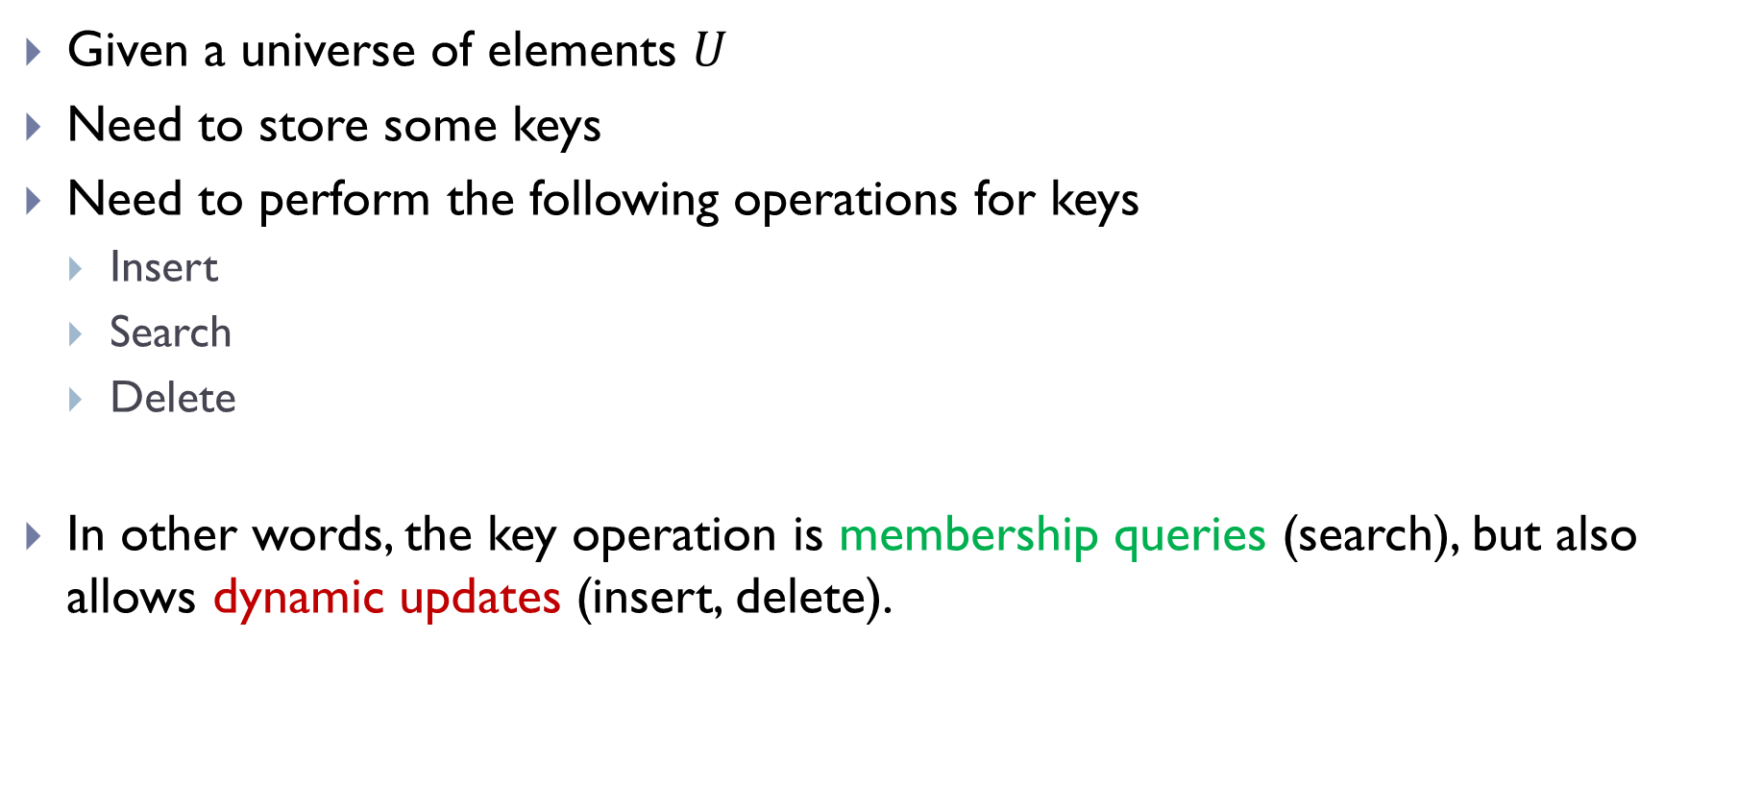
Dictionary operations
Given a universe of elements $U$
Need to store some keys
Need to perform the following operations for keys
Insert
Search
Delete
In other words, the key operation is membership queries (search), but also allows dynamic updates (insert, delete).

Slide 15
Approach 0
Use an array to organize all the keys
We could pre-sort the array.
Preprocessing time:
Search:
Insert / Delete:

Slide 16
Approach 1
Organize all keys in a doubly-linked list
Pre-processing: None
Insert:
Delete
Search:

Slide 17
Approach 2
Organize all keys in a balanced BST
Search:
Insert:
Delete

Slide 18
Approach 3
Direct address tables (DAT)

Slide 19
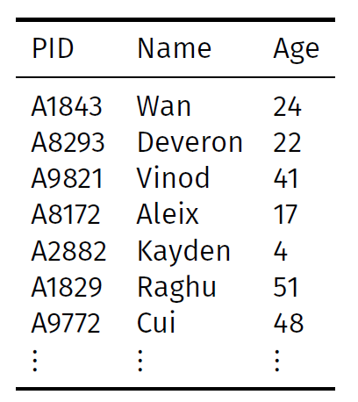
Example: Query for age
Is there any student whose age is 17 ?

Slide 20
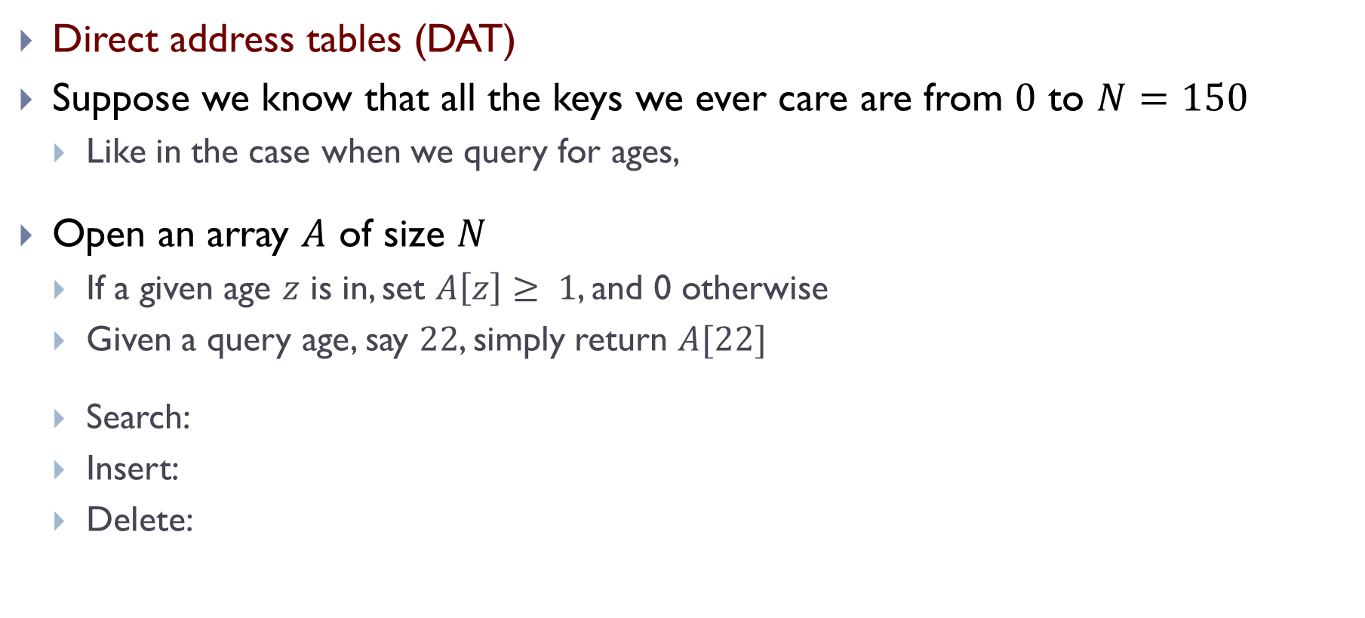
Approach 3
Direct address tables (DAT)
Suppose we know that all the keys we ever care are from $0$ to $N=150$
Like in the case when we query for ages,
Open an array $A$ of size $N$
If a given age $z$ is in, set $A\left[z\right]≥ 1$, and 0 otherwise
Given a query age, say $22$, simply return $A[22]$
Search:
Insert:
Delete:

Slide 21
What’s the problem of DAT approach?
DAT (directed address tables) very efficient
However
Require the keys to be integers
Require the keys to be a fixed range
Require a size as large as this range – which makes it hard to use for a huge universe (of keys)

Slide 22
How about checking for names?
Did the name Smith appear in the student database?

Slide 23
What’s the problem of DAT approach?
DAT (directed address tables) very efficient
However
Require the keys to be integers
Require the keys to be a fixed range
Require a size as large as this range – which makes it hard to use for a huge universe (of keys)
Hash Table:
A way to use DAT idea, but allowing to use much more general universe through the “hash” map.

Slide 24
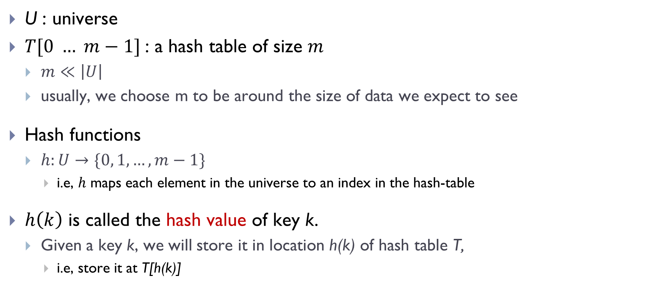
Use Hash Table!
U : universe
$T[0 … m−1]$: a hash table of size $m$
$m≪\left|U\right|$
usually, we choose m to be around the size of data we expect to see
Hash functions
$h:U→\{0, 1, …, m−1\}$
i.e, $h$ maps each element in the universe to an index in the hash-table
$h\left(k\right)$ is called the hash value of key k.
Given a key k, we will store it in location h(k) of hash table T,
i.e, store it at T[h(k)]

Slide 25
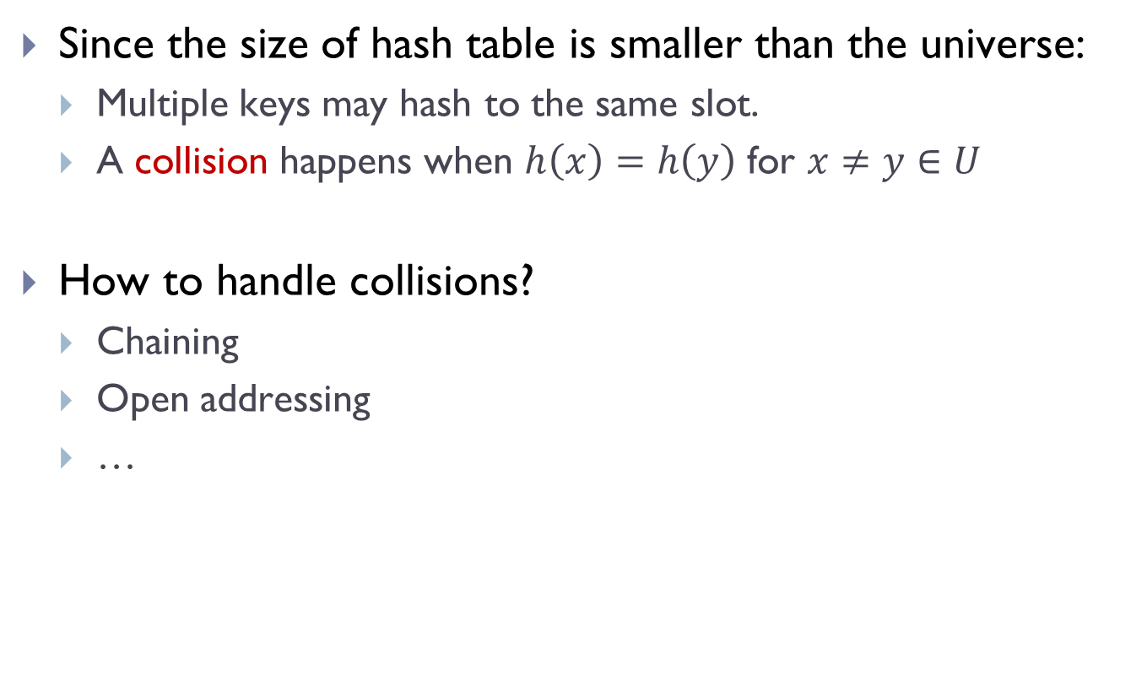
Collision
Since the size of hash table is smaller than the universe:
Multiple keys may hash to the same slot.
A collision happens when $h\left(x\right)=h\left(y\right)$ for $x≠y∈U$
How to handle collisions?
Chaining
Open addressing
…

Slide 26
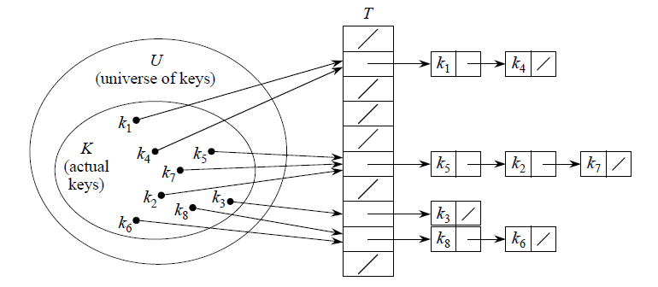
Collision Resolved by Chaining
T[j]: a pointer to the head of the linked list of all stored elements that hash to j
Nil otherwise

Slide 27
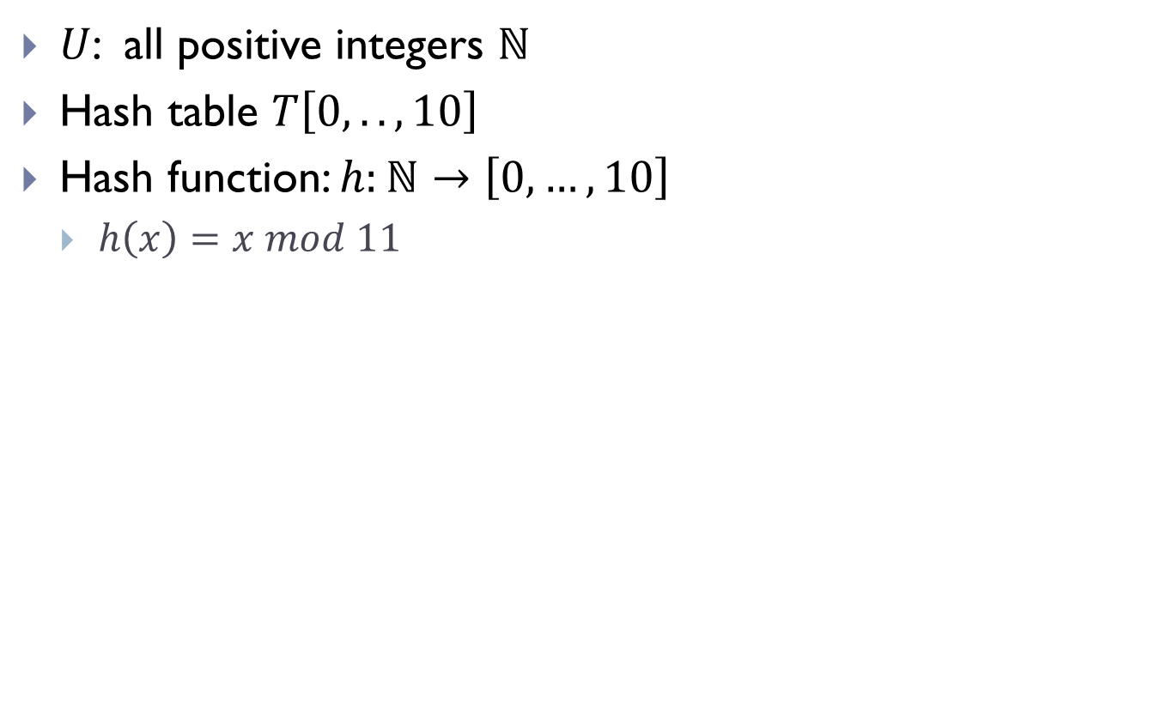
A simple example
$U$: all positive integers $ℕ$
Hash table $T\left[0, .., 10\right]$
Hash function: $h:ℕ→\left[0, …, 10\right]$
$h\left(x\right)=x mod 11$

Slide 28
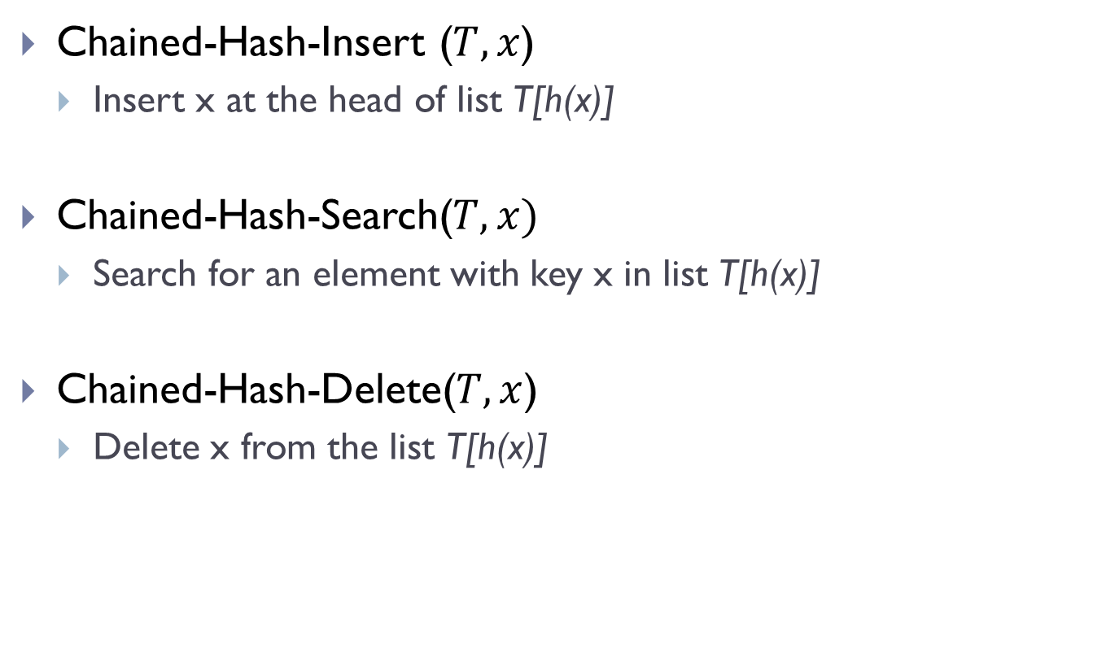
Dictionary operations
Chained-Hash-Insert ($T, x$)
Insert x at the head of list T[h(x)]
Chained-Hash-Search($T, x)$
Search for an element with key x in list T[h(x)]
Chained-Hash-Delete($T, x$)
Delete x from the list T[h(x)]

Slide 29
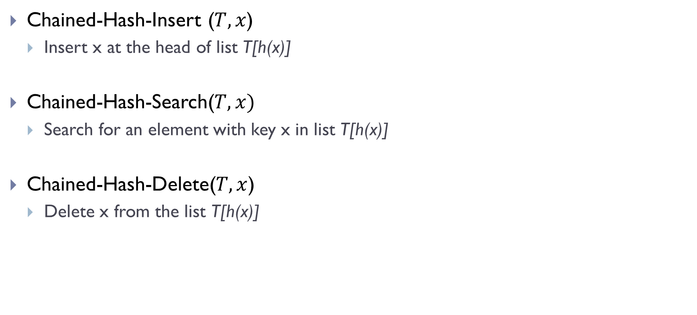
Dictionary operations
Chained-Hash-Insert ($T, x$)
Insert x at the head of list T[h(x)]
Chained-Hash-Search($T, x)$
Search for an element with key x in list T[h(x)]
Chained-Hash-Delete($T, x$)
Delete x from the list T[h(x)]
O(1)
O(length(T[h(x)])
O(length(T[h(x)])

Slide 30
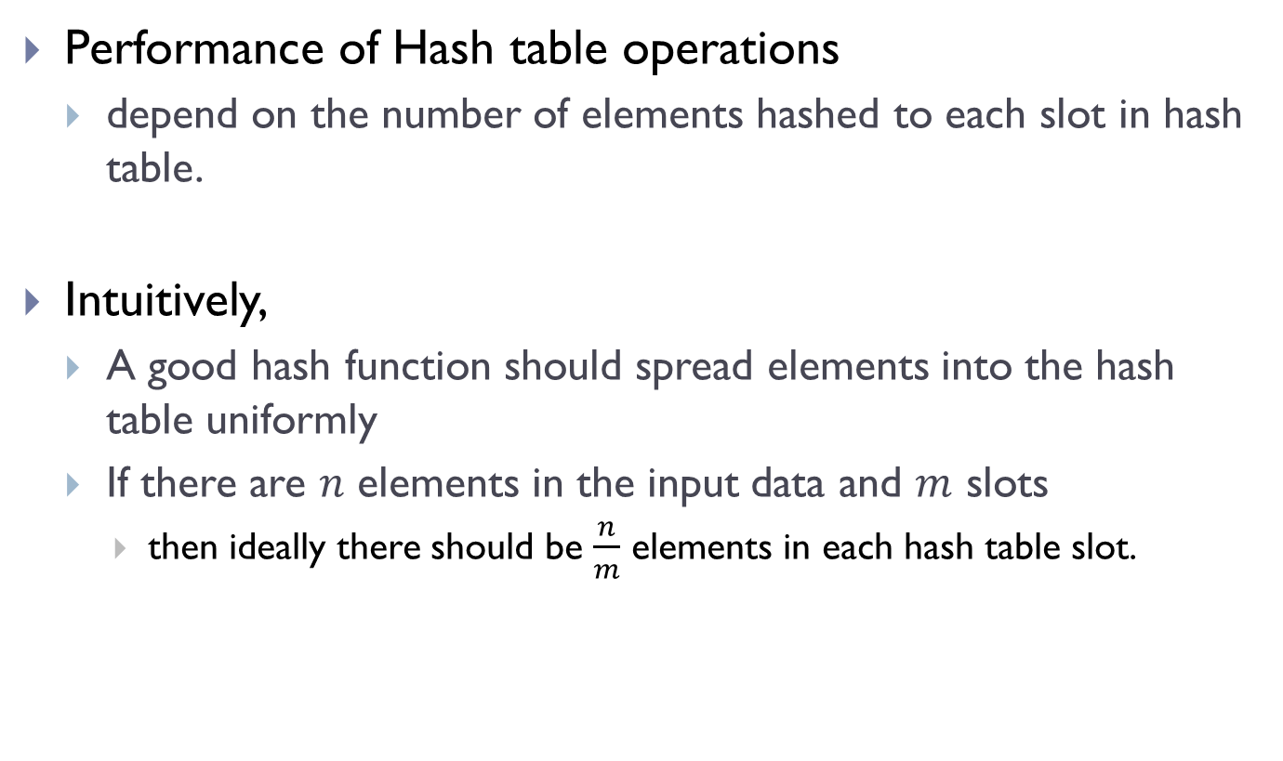
Good Hash Function
Performance of Hash table operations
depend on the number of elements hashed to each slot in hash table.
Intuitively,
A good hash function should spread elements into the hash table uniformly
If there are $n$ elements in the input data and $m$ slots
then ideally there should be $\frac{n}{m}$ elements in each hash table slot.

Slide 31
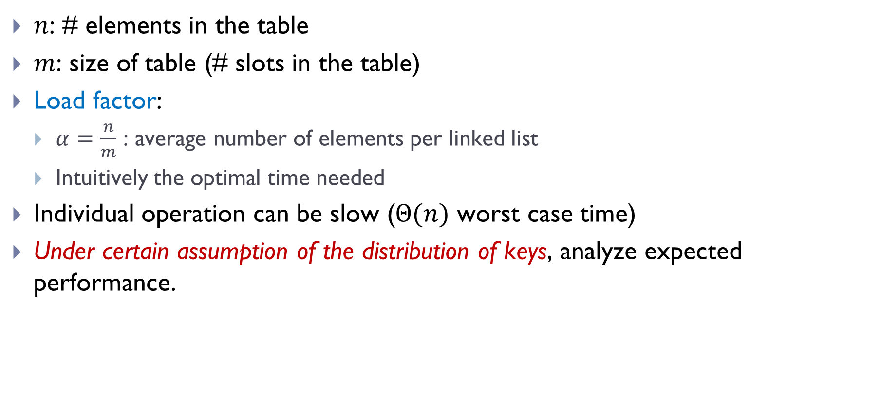
Average case analysis
$n$: # elements in the table
$m$: size of table (# slots in the table)
Load factor:
$α=\frac{n}{m}$ : average number of elements per linked list
Intuitively the optimal time needed
Individual operation can be slow ($Θ(n)$ worst case time)
Under certain assumption of the distribution of keys, analyze expected performance.

Slide 32
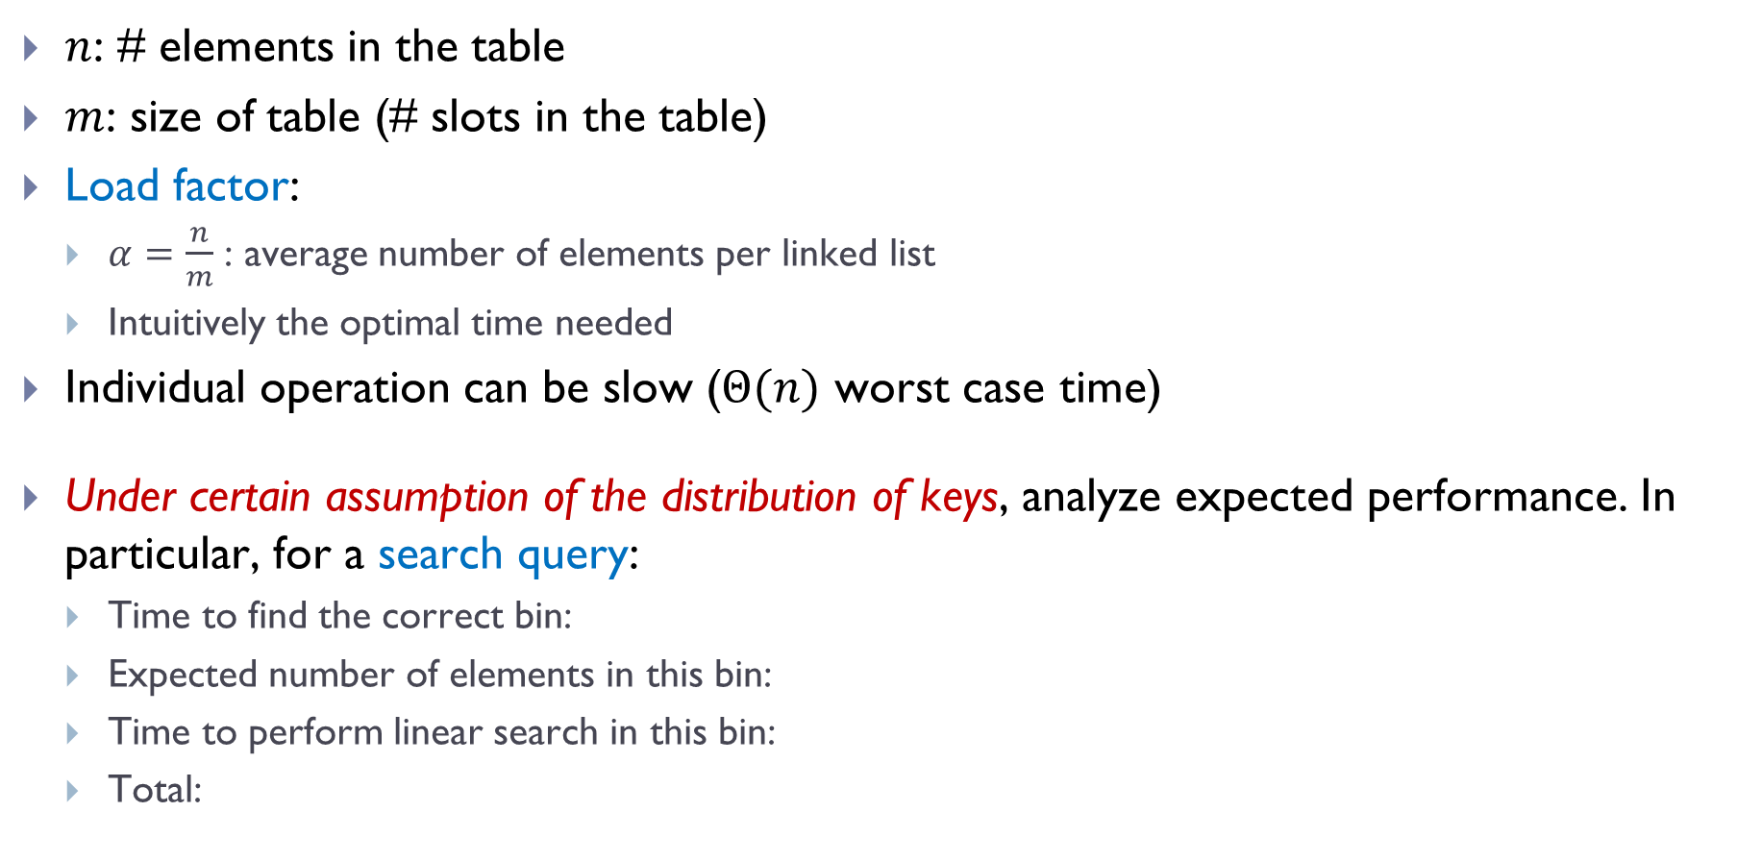
Average case analysis
$n$: # elements in the table
$m$: size of table (# slots in the table)
Load factor:
$α=\frac{n}{m}$ : average number of elements per linked list
Intuitively the optimal time needed
Individual operation can be slow ($Θ(n)$ worst case time)
Under certain assumption of the distribution of keys, analyze expected performance. In particular, for a search query:
Time to find the correct bin:
Expected number of elements in this bin:
Time to perform linear search in this bin:
Total:

Slide 33
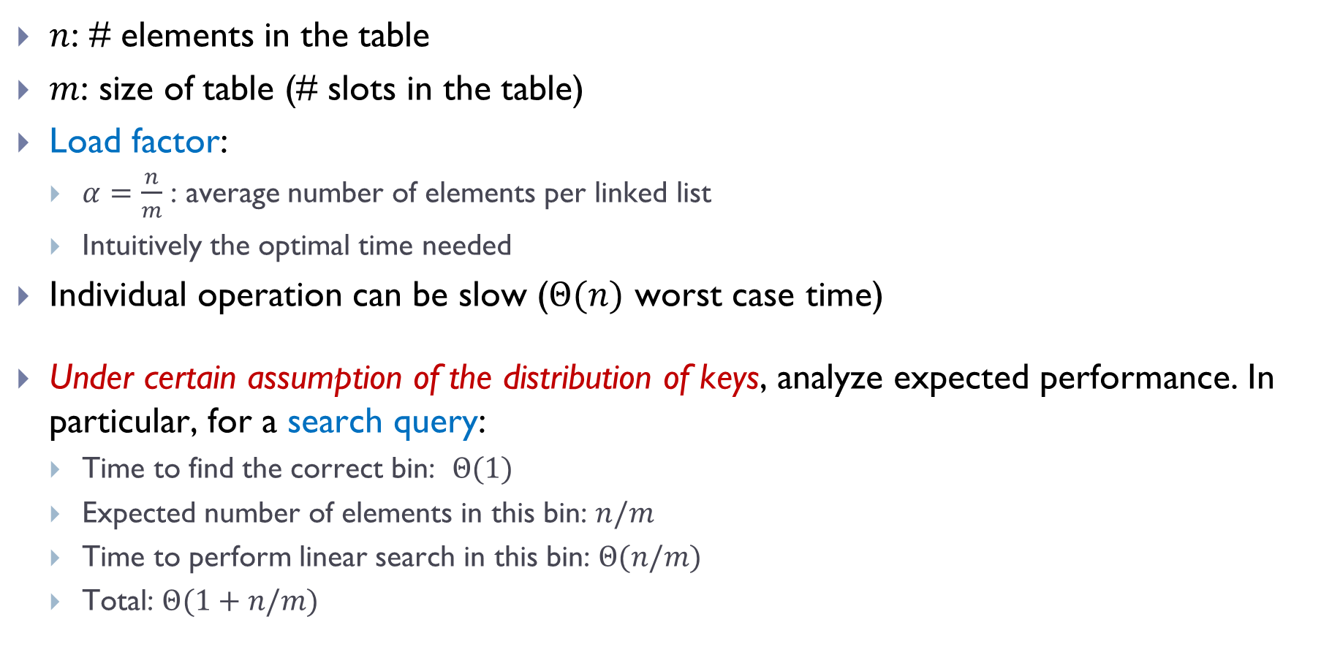
Average case analysis
$n$: # elements in the table
$m$: size of table (# slots in the table)
Load factor:
$α=\frac{n}{m}$ : average number of elements per linked list
Intuitively the optimal time needed
Individual operation can be slow ($Θ(n)$ worst case time)
Under certain assumption of the distribution of keys, analyze expected performance. In particular, for a search query:
Time to find the correct bin: $Θ(1)$
Expected number of elements in this bin: $n/m$
Time to perform linear search in this bin: $Θ(n/m)$
Total: $Θ(1+n/m)$

Slide 34
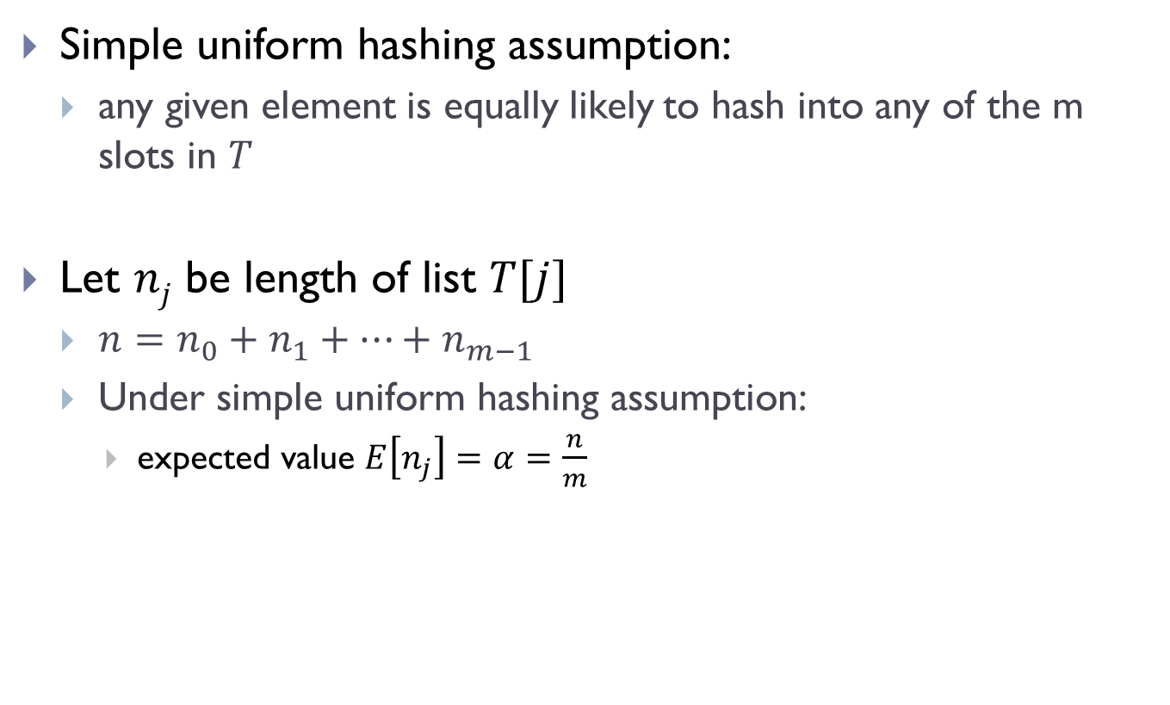
Simple uniform hashing assumption
Simple uniform hashing assumption:
any given element is equally likely to hash into any of the m slots in $T$
Let $nj$ be length of list $T[j]$
$n=n_{0}+n_{1}+⋯+n_{m−1 }$
Under simple uniform hashing assumption:
expected value $E\left[n_{j}\right]=α=\frac{n}{m}$
Why?

Slide 35

Why
Let $\left\{k_{1}, k_{2},…, k_{n}\right\}$be the set of keys
Goal: estimate $E(nj)$
Let $X_{i}=1$if $h\left(k_{i}\right)=j$
0 otherwise
Note: $n_{j}=\sum_{i=1}^{n}{X_{i}}$ !
$E\left[X_{i}\right]=\operatorname{Pr}\left[h\left(k_{i}\right)=j\right]$= $\frac{1}{m}$
Hence $E\left[ n_{j}\right]=E\left[\sum_{i=1}^{n}{X_{i}} \right]=\sum_{i=1}^{n}{E\left[X_{i}\right] = }\sum_{i=1}^{n}{\frac{1}{m}}=\frac{n}{m}$

Slide 36

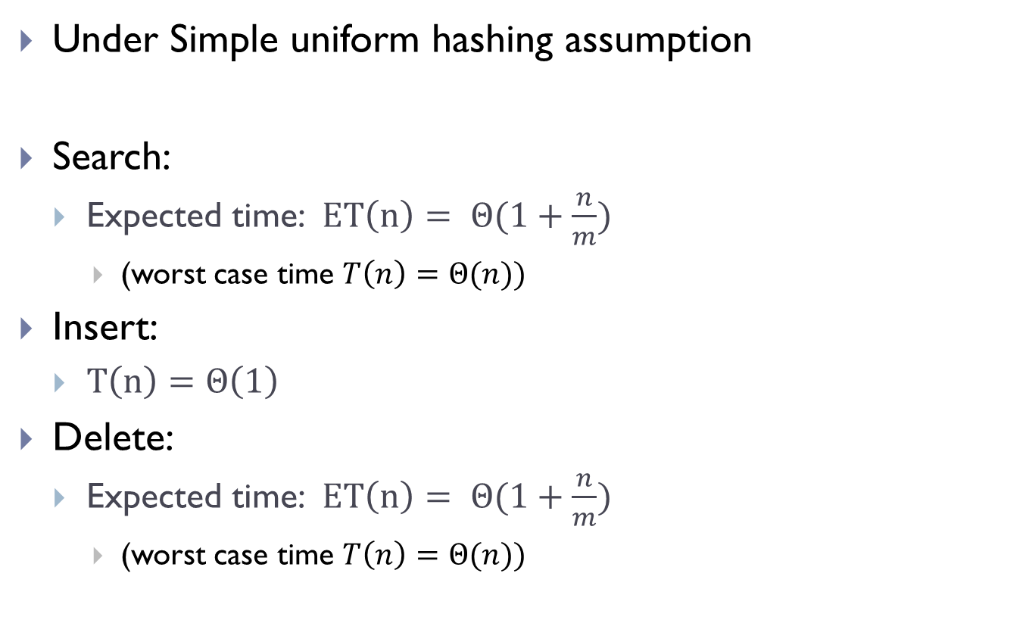
Expected running time
Under Simple uniform hashing assumption
Search:
Expected time: $ET\left(n\right)= Θ(1+\frac{n}{m})$
(worst case time $T\left(n\right)=Θ(n))$
Insert:
$T\left(n\right)=Θ\left(1\right)$
Delete:
Expected time: $ET\left(n\right)= Θ(1+\frac{n}{m})$
(worst case time $T\left(n\right)=Θ(n))$
Key message:
if the load factor $α=\frac{n}{m}=Θ\left(1\right)$
then $Θ\left(1\right)$expected time for these operations!

Slide 37
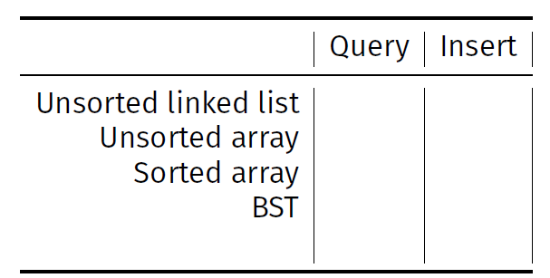
In summary
How fast can we query / insert with these data structures?
Hash Table (expected time)

Slide 38
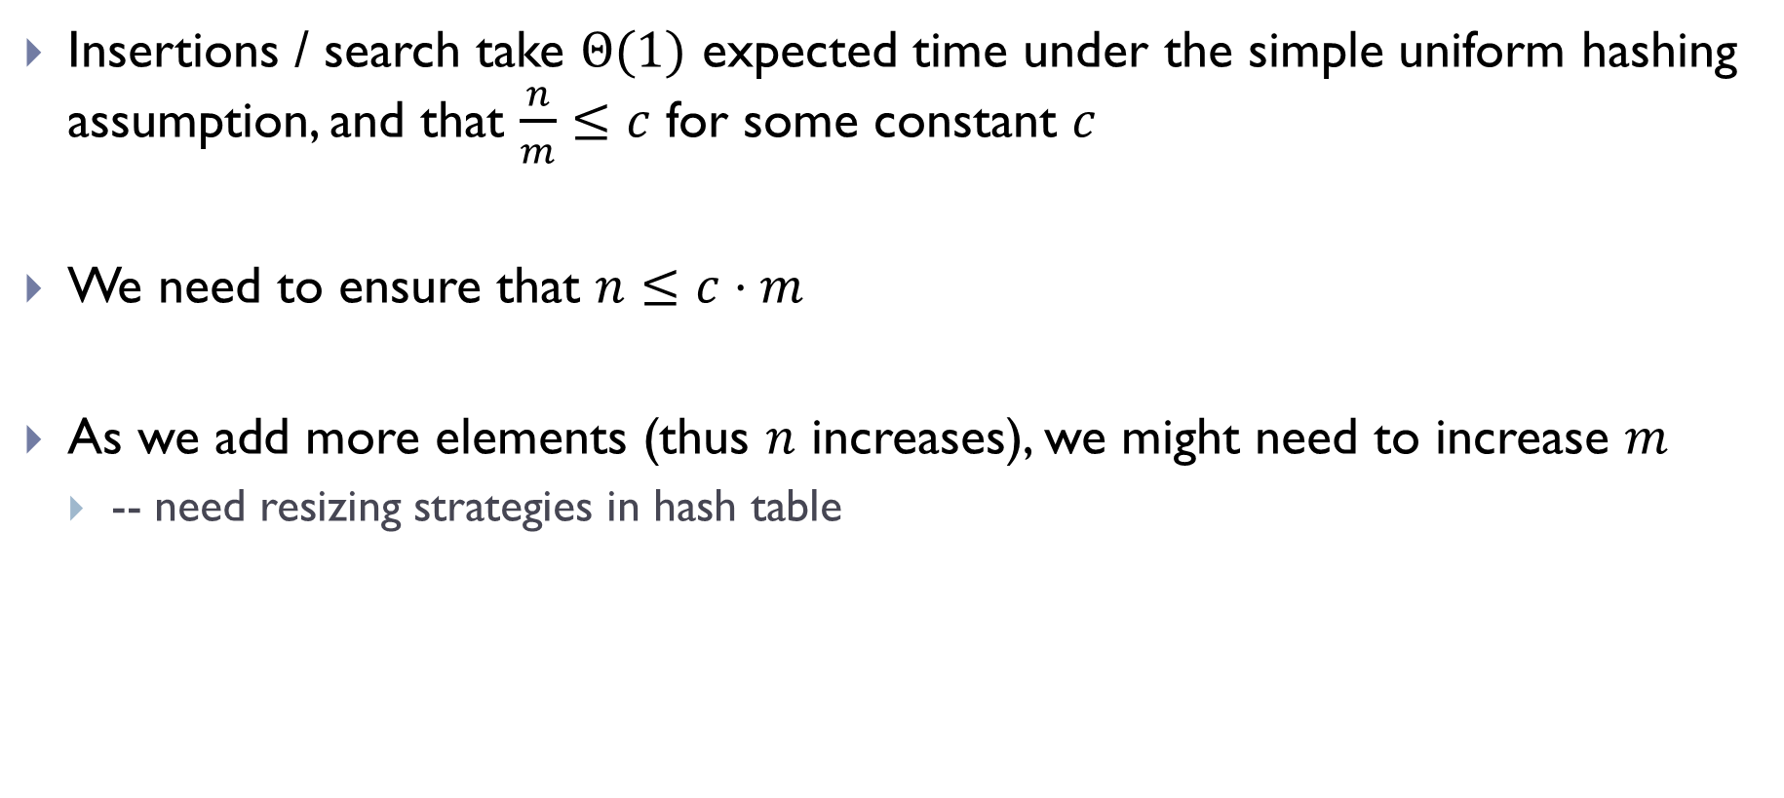
Growing the Hash Table
Insertions / search take $Θ(1)$ expected time under the simple uniform hashing assumption, and that $\frac{n}{m}≤c$ for some constant $c$
We need to ensure that $n≤c⋅m$
As we add more elements (thus $n$ increases), we might need to increase $m$
-- need resizing strategies in hash table

Slide 39
Hashing in Python
dict and set implement hash tables
set : stores only a set of values
dict : stores a set of (key, value) pairs, and query is on “key”
Querying is done using in:
>>> # make a set
>>> L = {3, 6, -2, 1, 7, 12}
>>> 1 in L # Theta(1)
False
>>> 7 in L # Theta(1)
True

Slide 40
Part C: Some examples of using hash tables and downsides of hash tables

Slide 41
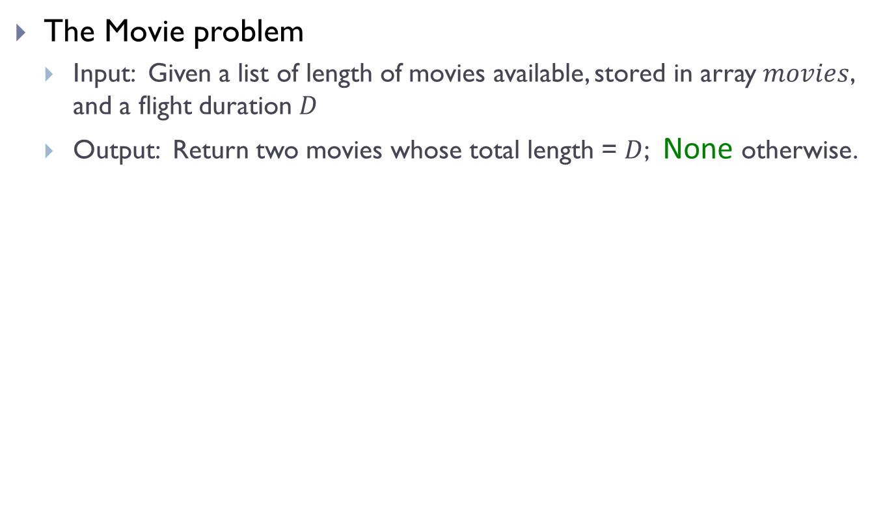
Recall the movie problem
The Movie problem
Input: Given a list of length of movies available, stored in array $movies$, and a flight duration $D$
Output: Return two movies whose total length = $D$; None otherwise.

Slide 42
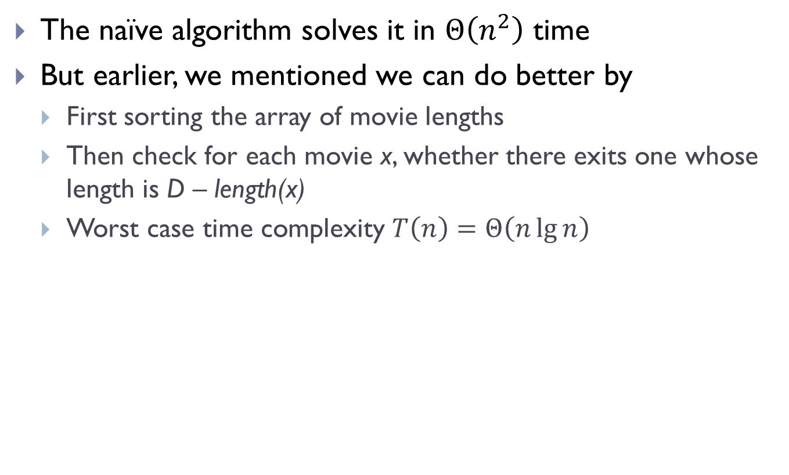
Recall
The naïve algorithm solves it in $Θ\left(n^{2}\right)$ time
But earlier, we mentioned we can do better by
First sorting the array of movie lengths
Then check for each movie x, whether there exits one whose length is D – length(x)
Worst case time complexity $T\left(n\right)=Θ\left(n\lg{n}\right)$

Slide 43
New approach via Hashing
Use Hash table, and frame this as a membership query problem
def optimize_entertainment_hash(times, D):
hash_table = dict()
for i, time in enumerate(times):
hash_table[time] = i
for i, time in enumerate(times):
target = D - time
if target in hash_table:
return i, hash_table[target]
return None

Slide 44

New approach via Hashing
Use Hash table, and frame this as a membership query problem
def optimize_entertainment_hash(times, D):
hash_table = dict()
for i, time in enumerate(times):
hash_table[time] = i
for i, time in enumerate(times):
target = D - time
if target in hash_table:
return i, hash_table[target]
return None
Expected time?
$Θ(n)$

Slide 45
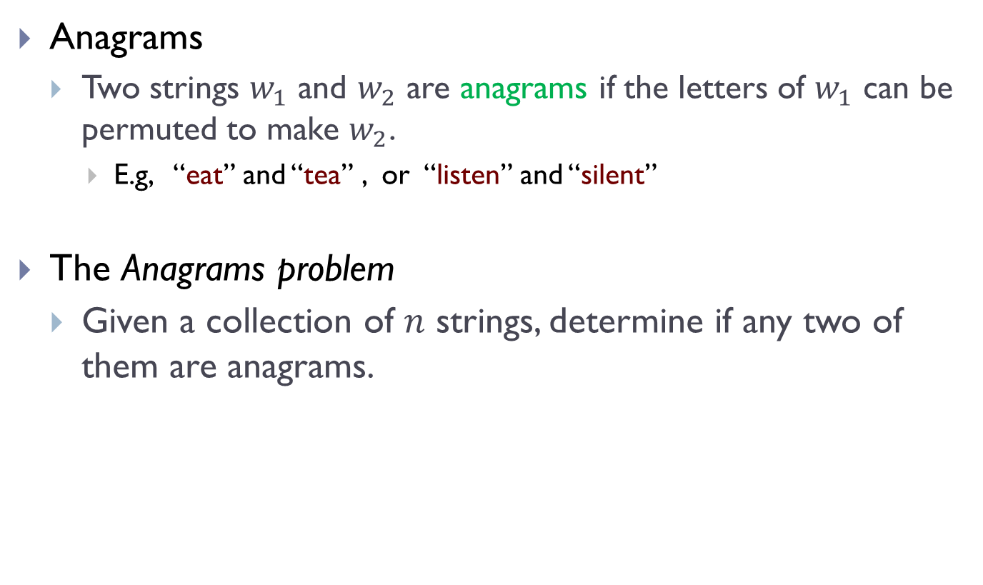
Another example
Anagrams
Two strings $w_{1}$ and $w_{2}$ are anagrams if the letters of $w_{1}$ can be permuted to make $w_{2}$.
E.g, “eat” and “tea” , or “listen” and “silent”
The Anagrams problem
Given a collection of 𝑛 strings, determine if any two of them are anagrams.

Slide 46

Using Hash table
Observation:
two strings are anagrams if their sorted lists are equal
sorted(w_1) == sorted(w_2)
def any_anagrams(words):
seen = set()
for word in words:
w = sorted(word)
if w in seen
return True
else:
seen.add(w)
return False
Expected time?
$Θ(n)$

Slide 47
Hashing Downsides
Only support dictionary queries
i.e, membership queries + insert / delete
Example 1: cannot be used to query for the two movies whose total time is closest to D
Example 2: cannot be used for performing a range query in a list of numbers
Say report the number of numbers fall within range [a, b]
Cannot be used for min / max / median / order statistics etc
BST wins when “order” type of query is important

Slide 48
Hashing Downsides
Only support dictionary queries
i.e, membership queries + insert / delete
No locality: similar items map to very different bins
Necessarily so for the performance of hashing in most cases!
But, in practice, we often query similar objects continuously
May result in many cache misses, slow

Slide 49
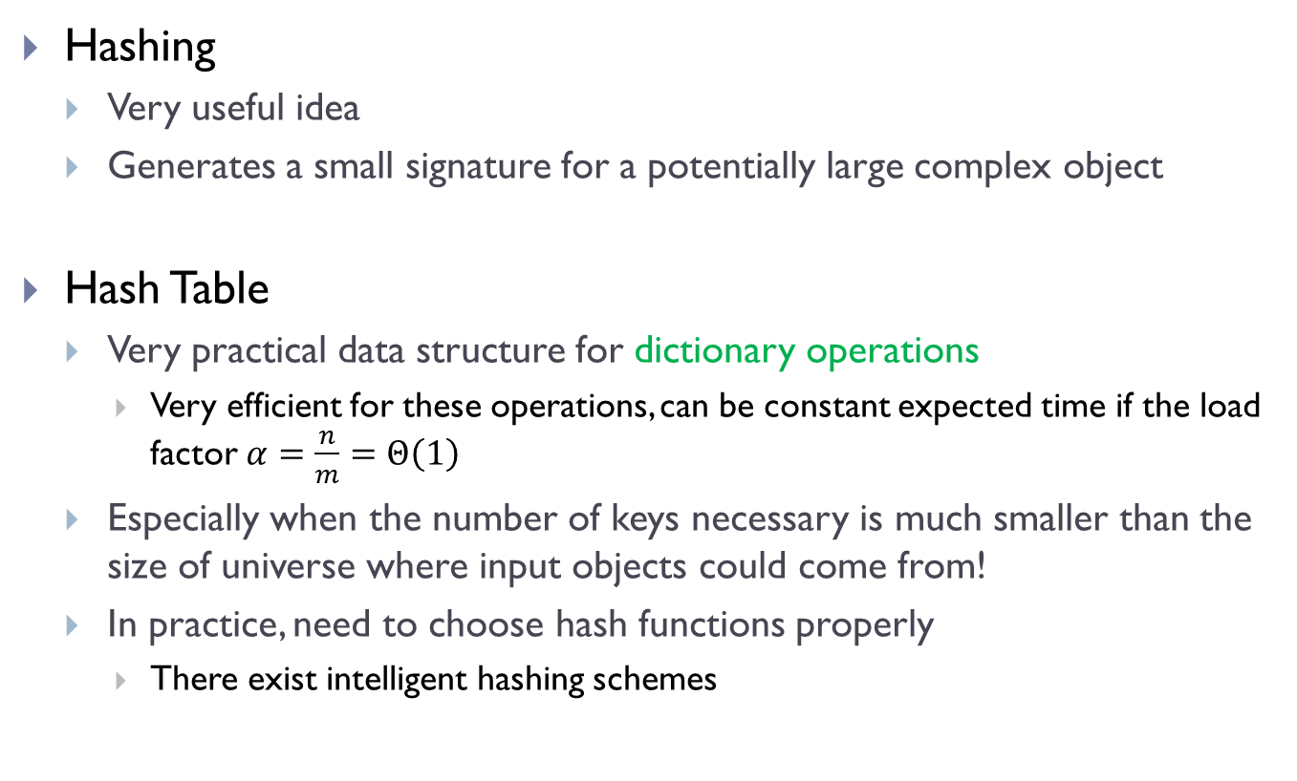
Summary
Hashing
Very useful idea
Generates a small signature for a potentially large complex object
Hash Table
Very practical data structure for dictionary operations
Very efficient for these operations, can be constant expected time if the load factor $α=\frac{n}{m}=Θ\left(1\right)$
Especially when the number of keys necessary is much smaller than the size of universe where input objects could come from!
In practice, need to choose hash functions properly
There exist intelligent hashing schemes

Slide 50
FIN

