Slide 1
DSC40B: Theoretical Foundations of Data Science II
Lecture 8: Binary search tree
Instructor: Yusu Wang

Slide 2
(Dynamic) Set operations
Imagine you are maintaining a database indexed by some keys (real values), and you hope to support the following operations:
Search
Maximum
Minimum
Successor
Predecessor
Insert
Delete
Extract-Max
Increase-key

Slide 3
(Dynamic) Set operations
Imagine you are maintaining a database indexed by some keys (real values), and you hope to support the following operations:
Search
Maximum
Minimum
Successor
Predecessor
Insert
Delete
Extract-Max
Increase-key
Static operations!
Dynamic operations!

Slide 4

(Dynamic) Set operations
Imagine you are maintaining a database indexed by some keys (real values), and you hope to support the following operations:
Search
Maximum
Minimum
Successor
Predecessor
Insert
Delete
Extract-Max
Increase-key
First approach: sort the array of keys
$Θ\left(\lg{n}\right)$
$Θ\left(1\right)$
$Θ\left(1\right)$
$Θ\left(1\right)$
$Θ\left(1\right)$
$Θ\left(n\right)$
$Θ\left(n\right)$

Slide 5
(Dynamic) Set operations
Imagine you are maintaining a database indexed by some keys (real values), and you hope to support the following operations:
Search
Maximum
Minimum
Successor
Predecessor
Insert
Delete
Extract-Max
Increase-key
First approach: sort the array of keys
$Θ\left(\lg{n}\right)$
$Θ\left(1\right)$
$Θ\left(1\right)$
$Θ\left(1\right)$
$Θ\left(1\right)$
$Θ\left(n\right)$
$Θ\left(n\right)$
Using a sorted array can handle all static operations efficiently
How to have a good data structure so we can support all these operations efficiently?

Slide 6
(Dynamic) Set operations
Imagine you are maintaining a database indexed by some keys (real values), and you hope to support the following operations:
Search
Maximum
Minimum
Successor
Predecessor
Insert
Delete
Extract-Max
Increase-key
First approach: sort the array of keys
$Θ\left(\lg{n}\right)$
$Θ\left(1\right)$
$Θ\left(1\right)$
$Θ\left(1\right)$
$Θ\left(1\right)$
$Θ\left(n\right)$
$Θ\left(n\right)$
Using a sorted array can handle all static operations efficiently
Static operations!
How to have a good data structure so we can support all these operations efficiently?
Dynamic operations!

Slide 7
Today
Binary search tree
support all the operations from previous slide
in time proportional to height of tree
(Review): how to implement key operations, and time complexity
search, insert (and delete)
Extension to balanced binary search tree
Select query: augmenting data structure
median, order statistics

Slide 8
Part A: What is binary search tree?

Slide 9
First: Binary tree
A binary tree is a rooted tree
where each node has at most 2 children
Represented by a linked data structure
Each node contains at least fields:
Key
Left
Right
Parent
3
2
4

Slide 10

Example
From root, following left pointers, we will visit
$13, 6, 3, 2, Nil$ (None in python)
13
6
18
3
7
17
20
13
2
4
9

Slide 11
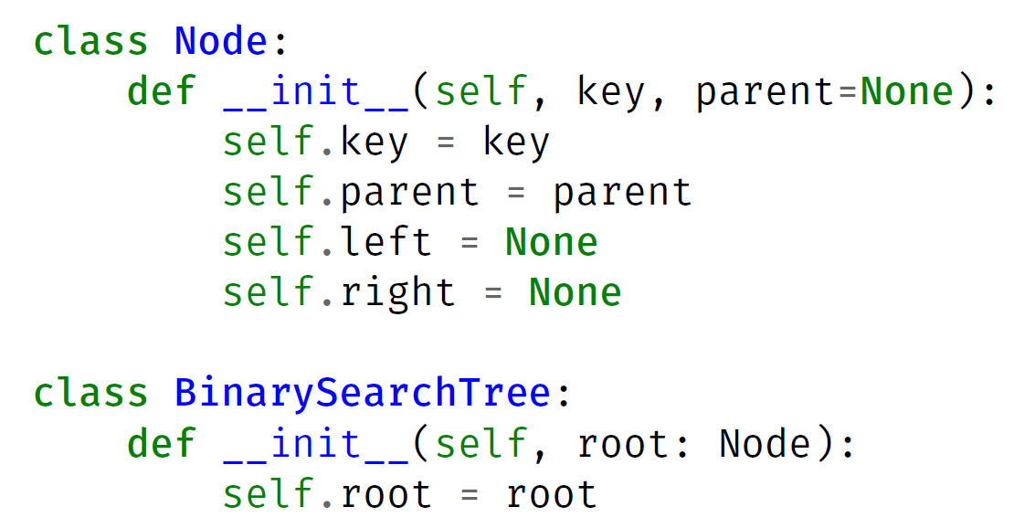
Create a single node tree in Python

Slide 12
Binary tree
A binary tree is a rooted tree where
each node has at most 2 children
A node is the root of the tree
if its parent is Nil
A node is a leaf
if both children are Nil
Left sub-tree, right sub-tree
A complete binary tree is a binary tree
where each node has two children other than leaves
and each level (except possibly last level) is filled, and all nodes are as left as possible.
3
2
4
5
12
1
6

Slide 13
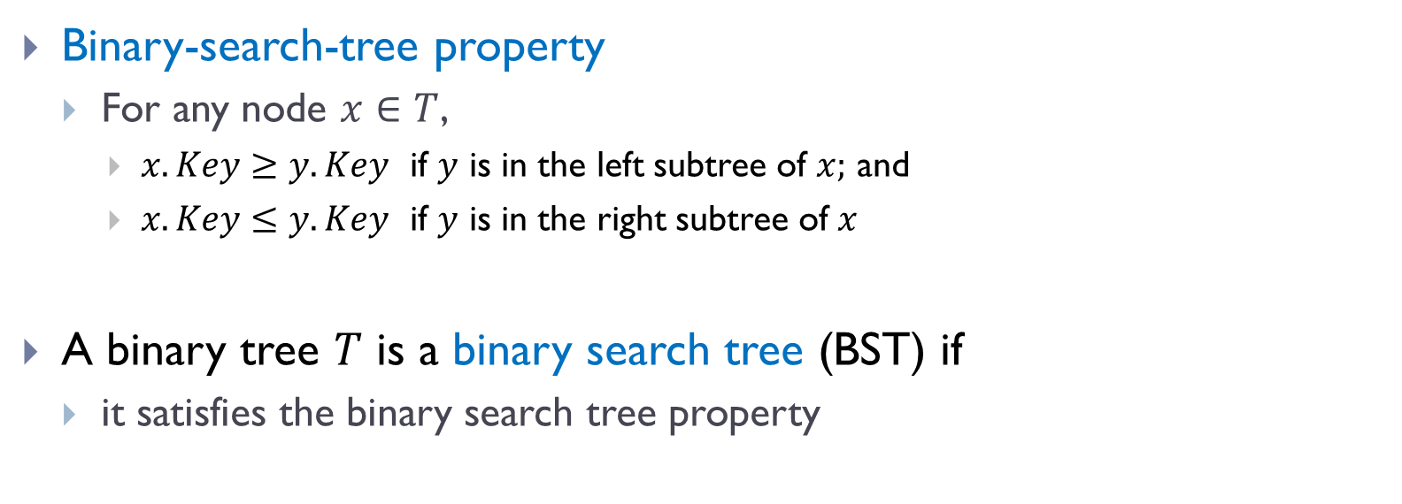
Binary search tree (BST)
Binary-search-tree property
For any node $x∈T$,
$x.Key≥y.Key$ if $y$ is in the left subtree of $x;$ and
$x.Key≤y.Key$ if $y$ is in the right subtree of $x$
A binary tree $T$ is a binary search tree (BST) if
it satisfies the binary search tree property

Slide 14
Example
A valid BST
13
6
18
3
7
17
20
13
2
4
9

Slide 15
Example
?
13
6
18
3
7
19
20
13
2
8
9

Slide 16

Properties
Given the same set of elements
there are many possible BSTs over them
Given $n$nodes,
Tallest possible BST tree has height $h= __________$
Shortest possible BST tree has height $h=__________$
6
3
7
2
4
9
Notes:
Ask about three nodes, what is the easiest

Slide 17


Properties
Given the same set of elements
there are many possible BSTs over them
Given $n$nodes,
Tallest possible BST tree has height $h= __________$
Shortest possible BST tree has height $h=__________$
$$n$$
$$\log_{2}{n=Θ(\lg{n)}}$$
6
3
7
2
4
9
Notes:
Ask about three nodes, what is the easiest

Slide 18

Properties
Given the same set of elements
there are many possible BSTs over them
Given $n$nodes,
Tallest possible BST tree has height $h= __________$
Shortest possible BST tree has height $h=__________$
Minimum?
Does it have to be a leaf?
Maximum?
$$n$$
$$\log_{2}{n=Θ(\lg{n)}}$$
6
3
7
2
4
9
Notes:
Ask about three nodes, what is the easiest

Slide 19
Properties
Given the same set of elements
there are many possible BSTs over them
Minimum?
Does it have to be a leaf?
6
3
7
2
4
9
Notes:
Ask about three nodes, what is the easiest

Slide 20



Properties
Given the same set of elements
there are many possible BSTs over them
Minimum?
Does it have to be a leaf?
Maximum?
Given $n$nodes,
Tallest possible BST tree has height $h= __________$
Shortest possible BST tree has height $h=__________$
6
3
8
4
7
9
$$n$$
$$\log_{2}{n=Θ(\lg{n)}}$$
Notes:
Ask about three nodes, what is the easiest

Slide 21
Part B: Operations in BST

Slide 22
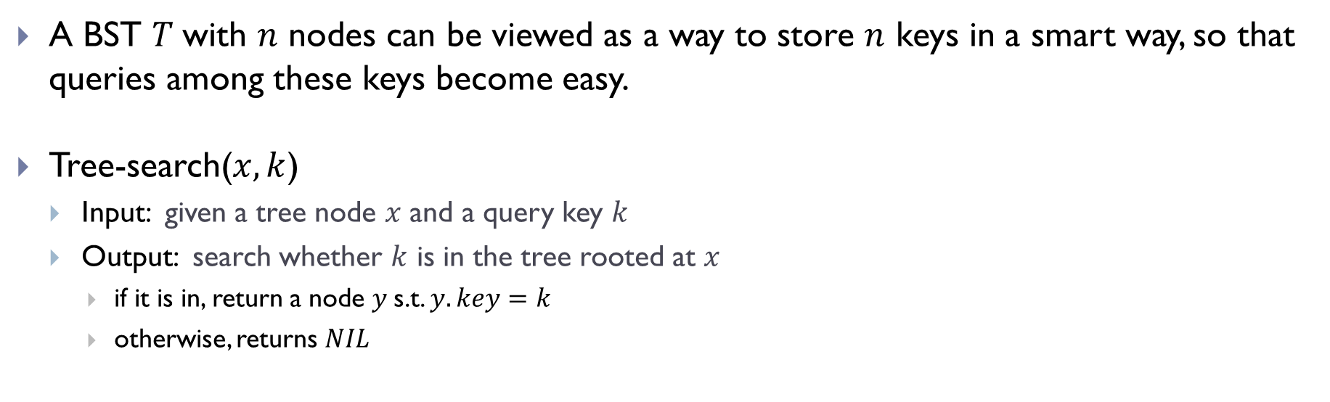

Search operation
A BST $T$with $n$ nodes can be viewed as a way to store $n$ keys in a smart way, so that queries among these keys become easy.
Tree-search($x, k$)
Input: given a tree node $x$ and a query key $k$
Output: search whether $k$ is in the tree rooted at $x$
if it is in, return a node $y$s.t. $y.key=k$
otherwise, returns $NIL$
6
$$x$$
3
8
4
7
9

Slide 23





Search operation
A BST $T$with $n$ nodes can be viewed as a way to store $n$ keys in a smart way, so that queries among these keys become easy.
Tree-search($x, k$)
Input: given a tree node $x$ and a query key $k$
Output: search whether $k$ is in the tree rooted at $x$
if it is in, return a node $y$s.t. $y.key=k$
otherwise, returns $NIL$
6
$$x$$
Tree-search($x, 8$)
3
8
Tree-search($x, 4$)
Tree-search($x, 5$)
4
7
9

Slide 24

Tree-search algorithm, recursive version
Tree-search ( x, k)
if x is None:
return False
if x.key == k
return x
elif k < x.key
return Tree-search( x.left, k )
else:
return Tree-search( x.right, k )
6
3
8
4
7
9
Given an input tree $T$ and a key $k$
we will start by calling Tree-search($T.$root$, k$)

Slide 25
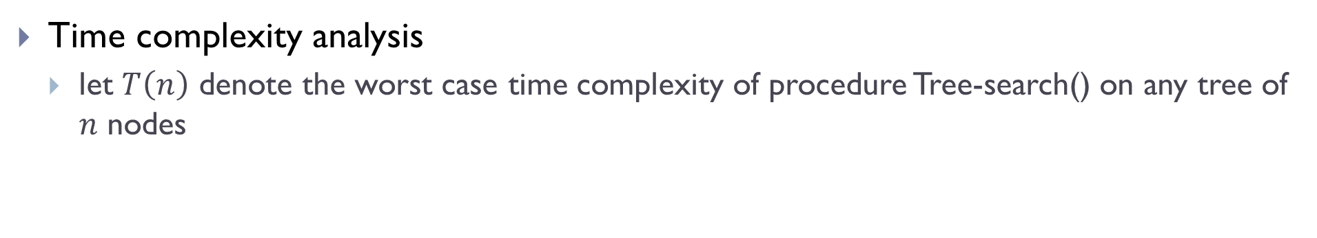
Tree-search algorithm, recursive version
Tree-search ( x, k)
if x is None:
return False
if x.key == k
return x
elif k < x.key
return Tree-search( x.left, k )
else:
return Tree-search( x.right, k )
6
3
8
4
7
9
Time complexity analysis
let $T\left(n\right)$ denote the worst case time complexity of procedure Tree-search() on any tree of $n$ nodes

Slide 26
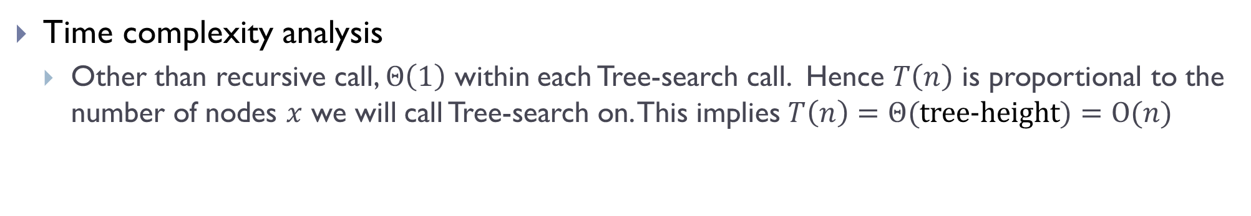
Tree-search algorithm, recursive version
Tree-search ( x, k)
if x is None:
return False
if x.key == k
return x
elif k < x.key
return Tree-search( x.left, k )
else:
return Tree-search( x.right, k )
6
3
8
4
7
9
Time complexity analysis
Other than recursive call, $Θ\left(1\right)$ within each Tree-search call. Hence $T\left(n\right)$ is proportional to the number of nodes $x$ we will call Tree-search on. This implies $T\left(n\right)=Θ($tree-height$)=O(n)$

Slide 27
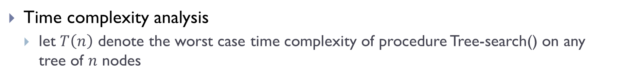
Tree-search algorithm, recursive version
Tree-search ( x, k)
if x = Nil or k = x.key
then return x
if k < x.key
then return Tree-search( x.left, k )
else return Tree-search( x.right, k )
6
3
8
4
7
9
Time complexity analysis
let $T\left(n\right)$ denote the worst case time complexity of procedure Tree-search() on any tree of $n$ nodes

Slide 28
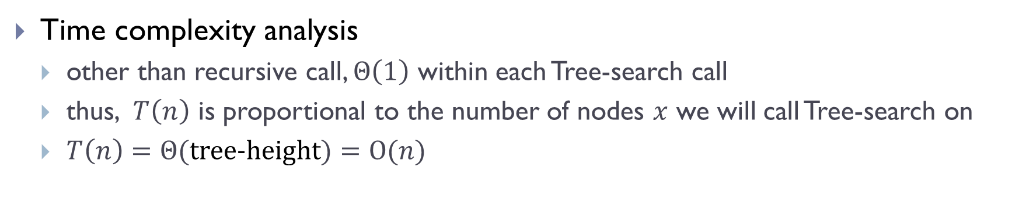
Tree-search algorithm, recursive version
Tree-search ( x, k)
if x = Nil or k = x.key
then return x
if k < x.key
then return Tree-search( x.left, k )
else return Tree-search( x.right, k )
6
3
8
4
7
9
Time complexity analysis
other than recursive call, $Θ\left(1\right)$ within each Tree-search call
thus, $T\left(n\right)$ is proportional to the number of nodes $x$ we will call Tree-search on
$T\left(n\right)=Θ($tree-height$)=O(n)$

Slide 29
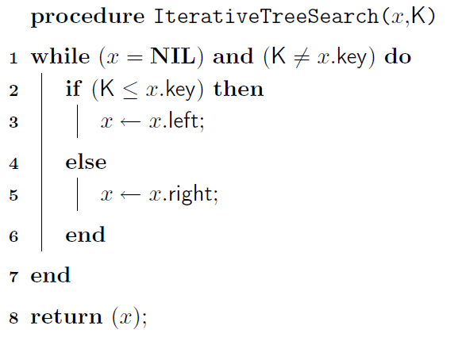
Tree-search: Pseudo-code of the iterative version

Slide 30

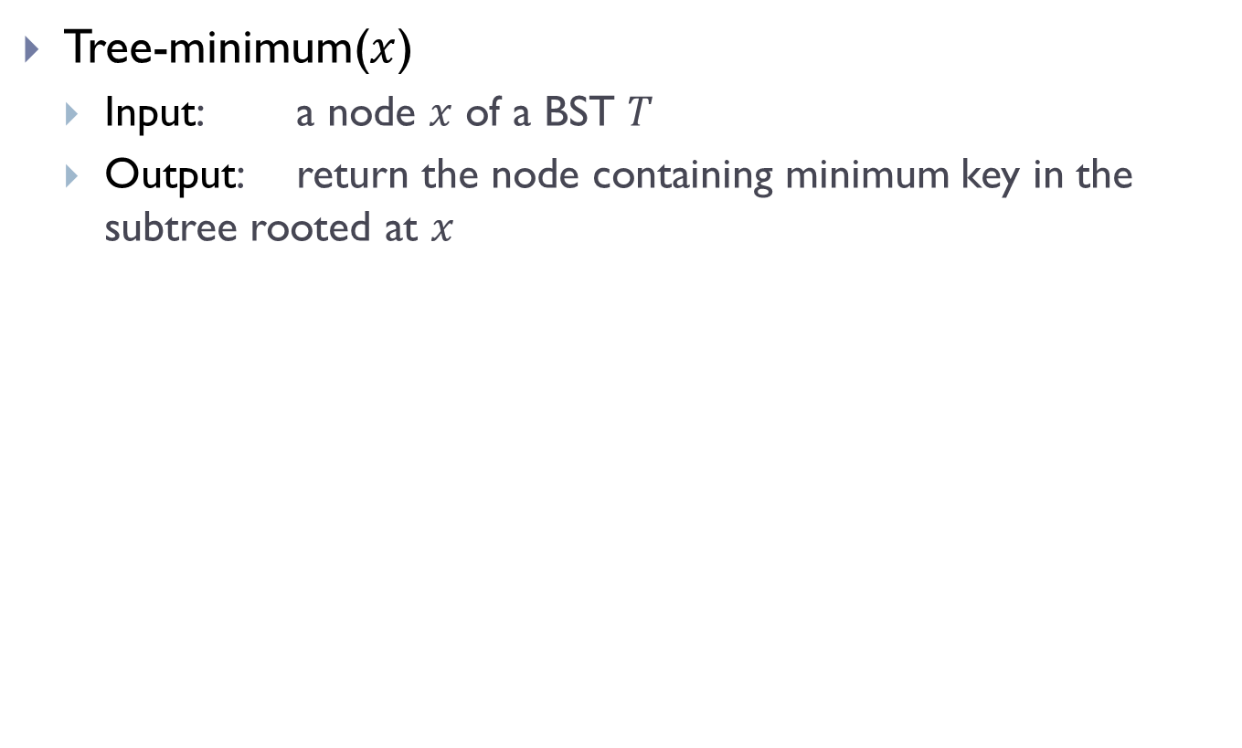

Minimum / Maximum
Tree-minimum($x$)
Input: a node $x$ of a BST $T$
Output: return the node containing minimum key in the subtree rooted at $x$
$$x$$
6
$$y$$
3
8
4
7
9

Slide 31
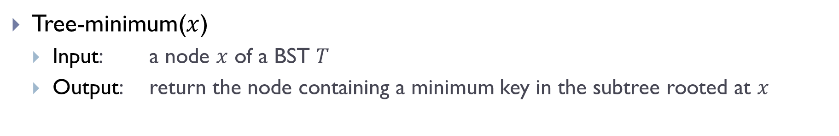
Minimum / Maximum
Tree-minimum($x$)
Input: a node $x$ of a BST $T$
Output: return the node containing a minimum key in the subtree rooted at $x$
Tree-minimum(x)
while x.left is not None
x = x.left;
return x;
6
3
8
4
7
9

Slide 32
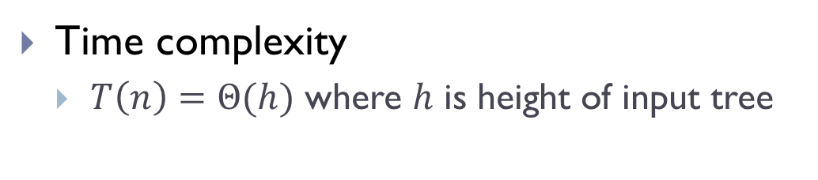

Minimum / Maximum
Tree-minimum($x$)
Input: a node $x$ of a BST $T$
Output: return the node containing a minimum key in the subtree rooted at $x$
Tree-minimum(x)
while x.left is not None
x = x.left;
return x;
6
3
8
Time complexity
$T\left(n\right)=Θ(h)$ where $h$ is height of input tree
4
7
9

Slide 33
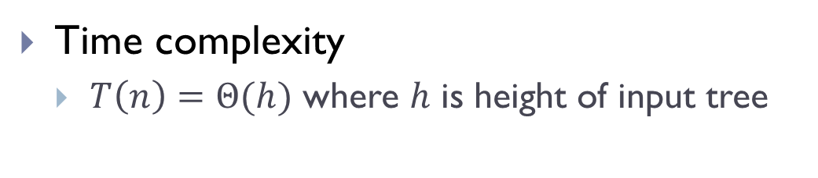
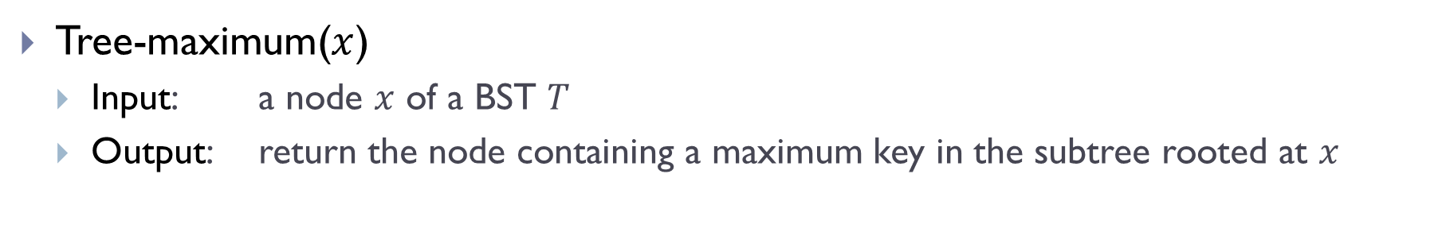
Minimum / Maximum
Tree-maximum($x$)
Input: a node $x$ of a BST $T$
Output: return the node containing a maximum key in the subtree rooted at $x$
Tree-maximum(x)
while x.right is not None
x = x.right;
return x;
6
3
8
Time complexity
$T\left(n\right)=Θ(h)$ where $h$ is height of input tree
4
7
9

Slide 34
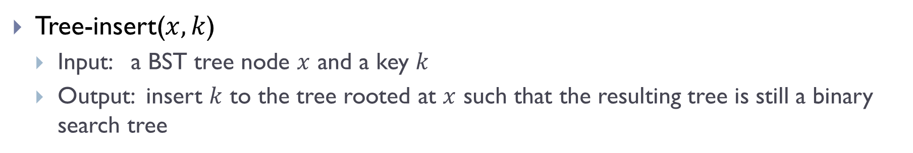
Tree-insert
Tree-insert($x, k$)
Input: a BST tree node $x$ and a key $k$
Output: insert $k$ to the tree rooted at $x$ such that the resulting tree is still a binary search tree

Slide 35
Examples
T.root
15
6
Tree-Insert(T.root, 8)
3
7
Tree-Insert(T.root, 6.5)
2
4
13
9

Slide 36
Examples
T.root
15
6
Tree-Insert(T.root, 8)
3
7
Tree-Insert(T.root, 6.5)
2
4
13
9
Use tree-search !

Slide 37
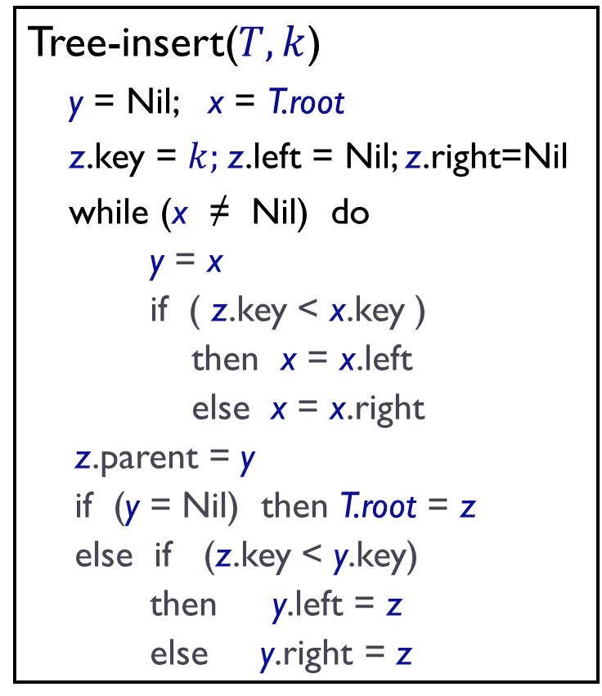
Pseudo-code of Tree-insert
Tree-insert($T, k$)
y = Nil; x = T.root
z.key = $k;$z.left = Nil; z.right=Nil
while (x ≠ Nil) do
y = x
if ( z.key < x.key )
then x = x.left
else x = x.right
z.parent = y
if (y = Nil) then T.root = z
else if (z.key < y.key)
then y.left = z
else y.right = z

Slide 38

Tree-insert
Tree-insert($T, k$)
y = Nil; x = T.root
z.key = $k;$z.left = Nil; z.right=Nil
while (x ≠ Nil) do
y = x
if ( z.key < x.key )
then x = x.left
else x = x.right
z.parent = y
if (y = Nil) then T.root = z
else if (z.key < y.key)
then y.left = z
else y.right = z
z is the new node to be inserted
Locate potential parent y of z.
Set up z as appropriate child of y

Slide 39

Tree-insert
Tree-insert($T, k$)
y = Nil; x = T.root
z.key = $k;$z.left = Nil; z.right=Nil
while (x ≠ Nil) do
y = x
if ( z.key < x.key )
then x = x.left
else x = x.right
z.parent = y
if (y = Nil) then T.root = z
else if (z.key < y.key)
then y.left = z
else y.right = z
Time complexity
$T\left(n\right)=Θ(h)$, where $h$ is height of input tree

Slide 40
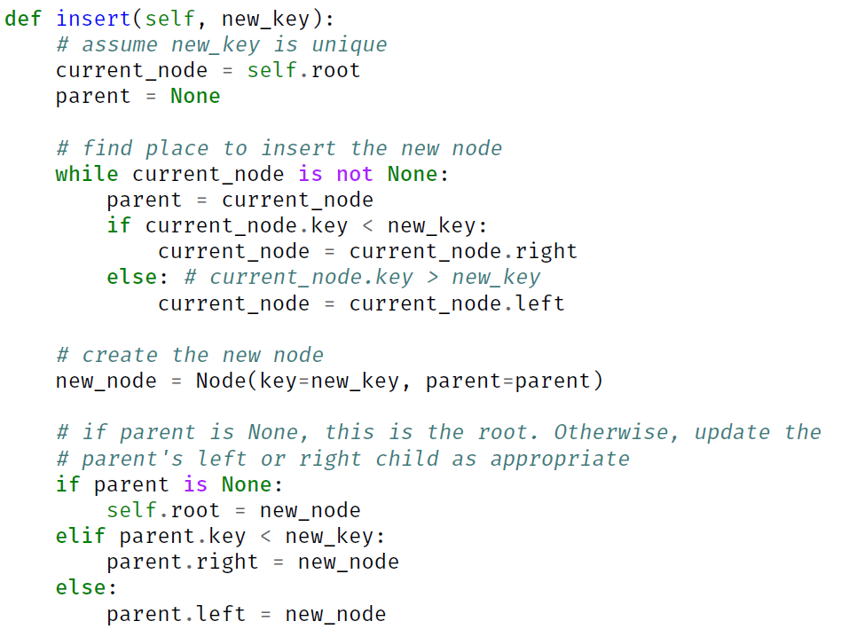
Tree Insert Python Code

Slide 41

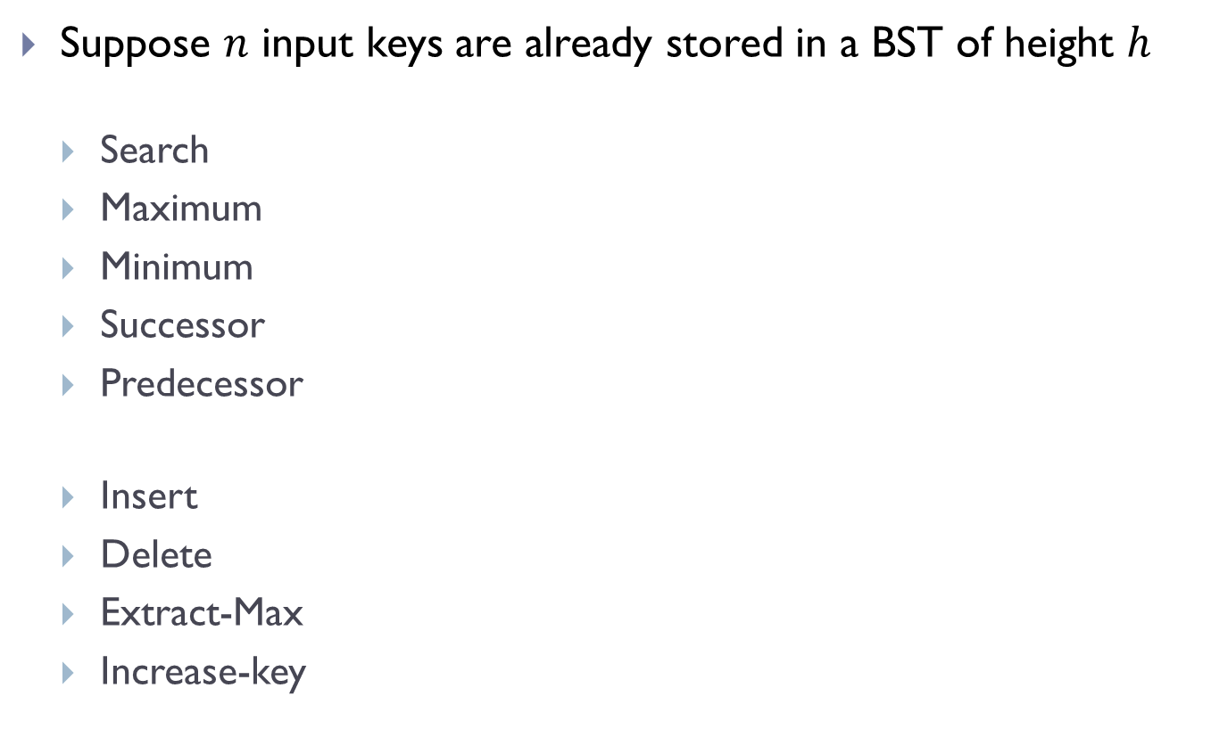

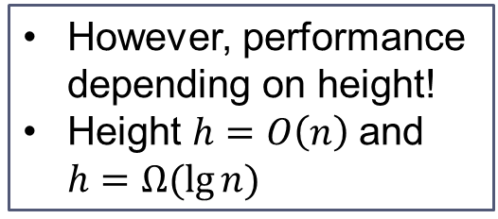






Summary: BST is good for both static and dynamic operations
Suppose $n$ input keys are already stored in a BST of height $h$
Search
Maximum
Minimum
Successor
Predecessor
Insert
Delete
Extract-Max
Increase-key
Time complexity
$$Θ(h)$$
$$Θ(h)$$
However, performance depending on height!
Height $h=O\left(n\right)$and $h=Ω(\lg{n)}$
$$Θ(h)$$
$$Θ(h)$$
$$Θ(h)$$
To have good performance, we want to keep the tree height low!
$$Θ(h)$$
$$Θ(h)$$
$$Θ(h)$$
$$Θ(h)$$

Slide 42









Summary: BST is good for both static and dynamic operations
Suppose $n$ input keys are already stored in a BST of height $h$
Search
Maximum
Minimum
Successor
Predecessor
Insert
Delete
Extract-Max
Increase-key
Time complexity
$$Θ(h)$$
$$Θ(h)$$
$$Θ(h)$$
$$Θ(h)$$
$$Θ(h)$$
$$Θ(h)$$
$$Θ(h)$$
$$Θ(h)$$
$$Θ(h)$$

Slide 43
Part C: Balanced binary search tree

Slide 44
Good tree
13
6
18
3
7
17
20
13
19
2
4
6
9

Slide 45
Bad Tree

Slide 46
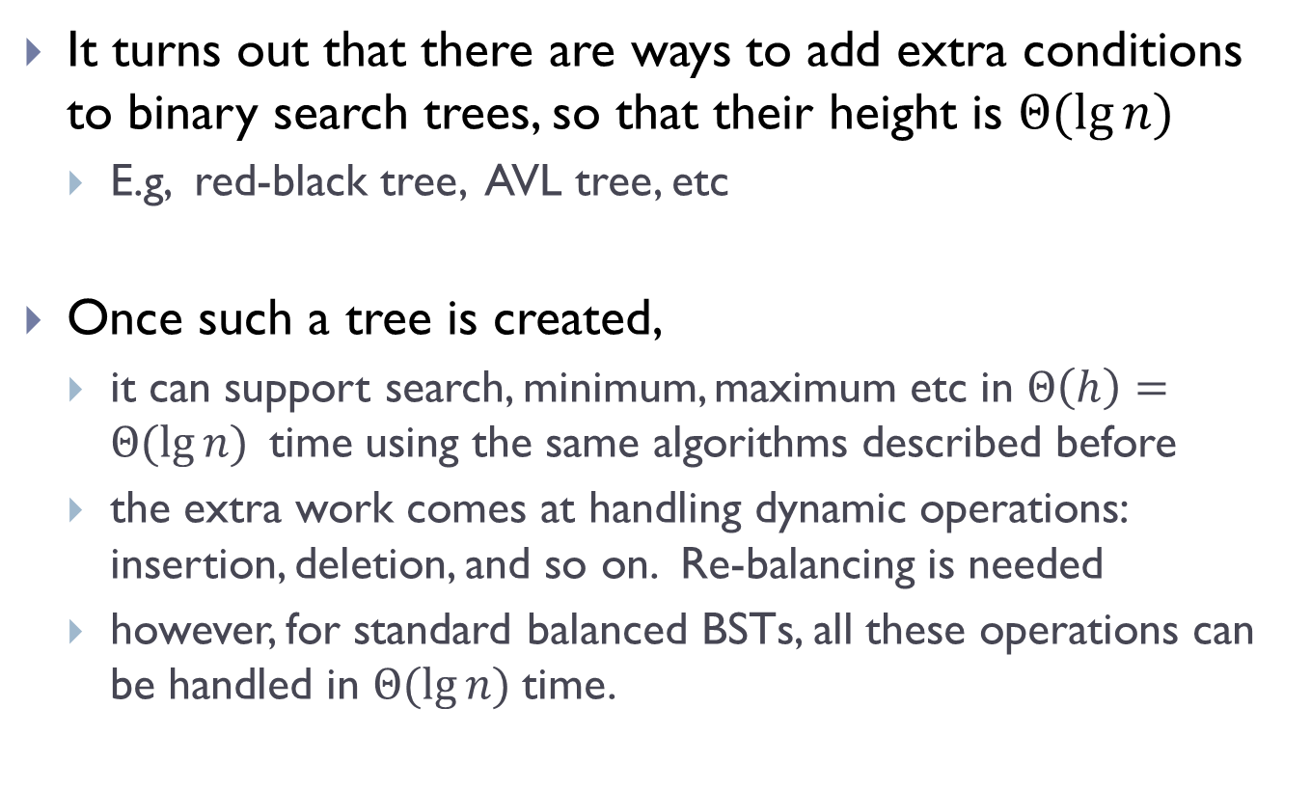
Balanced binary search tree
It turns out that there are ways to add extra conditions to binary search trees, so that their height is $Θ(\lg{n)}$
E.g, red-black tree, AVL tree, etc
Once such a tree is created,
it can support search, minimum, maximum etc in $Θ\left(h\right)=Θ(\lg{n) }$time using the same algorithms described before
the extra work comes at handling dynamic operations: insertion, deletion, and so on. Re-balancing is needed
however, for standard balanced BSTs, all these operations can be handled in $Θ(\lg{n) }$time.

Slide 47
Rotation operation
Left rotation or Right rotation to keep tree height low
x
y
y
right rotation
x
C
A
left rotation
A
B
B
C

Slide 48



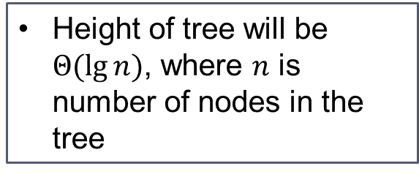






With balanced BST
Suppose $n$ input keys are already stored in a balanced BST
Search
Maximum
Minimum
Successor
Predecessor
Insert
Delete
Extract-Max
Increase-key
Time complexity
$$Θ(\lg{n})$$
$$Θ(\lg{n})$$
$$Θ(\lg{n})$$
$$Θ(\lg{n})$$
Height of tree will be $Θ(\lg{n)}$, where $n$ is number of nodes in the tree
$$Θ(\lg{n})$$
$$Θ(\lg{n})$$
$$Θ(\lg{n})$$
$$Θ(\lg{n})$$
$$Θ(\lg{n})$$

Slide 49
Part D: Select queries augmenting data structure

Slide 50
What if we also want to perform Select operation
BST-Select ( x, k ):
Given a list of records whose keys are stored in a tree rooted at x, return the node whose key has rank k.
We can use QuickSelect to do this in linear time.. Why are we not satisfied?

Slide 51
What if we also want to perform Select operation
BST-Select ( x, k ):
Given a list of records whose keys are stored in a tree rooted at x, return the node whose key has rank k.
We can use QuickSelect to do this in linear time.. Why are we not satisfied?
What if we have to do it many times?
Sort it first

Slide 52
What if we also want to perform Select operation
BST-Select ( x, k ):
Given a list of records whose keys are stored in a tree rooted at x, return the node whose key has rank k.
We can use QuickSelect to do this in linear time.. Why are we not satisfied?
What if we have to do it many times?
Sort it first
But what if we also have dynamic changes?
Need a data structure that can support Select under dynamic changes

Slide 53
BST
13
6
18
3
7
17
20
13
19
2
4
6
9

Slide 54
How to perform Select operation over BST?
BST-Select ( x, k ):
Given a list of records whose keys are stored in a tree rooted at x, return the node whose key has rank k.
We can do linear search to find it. But can we do better?
Goal:
Augment the binary search tree data structure so as to support Select ( x, k ) efficiently

Slide 55
In particular,
BST-Select ( x, k )
Goal:
Augment the binary search tree data structure so as to support BST-Select ( x, k ) efficiently
Ordinary binary search tree T
O(h) time for BST-Select(T.root, k) where h is height of tree T
Using balanced search tree)
O(lg n) time for BST-Select(T.root, k)

Slide 56
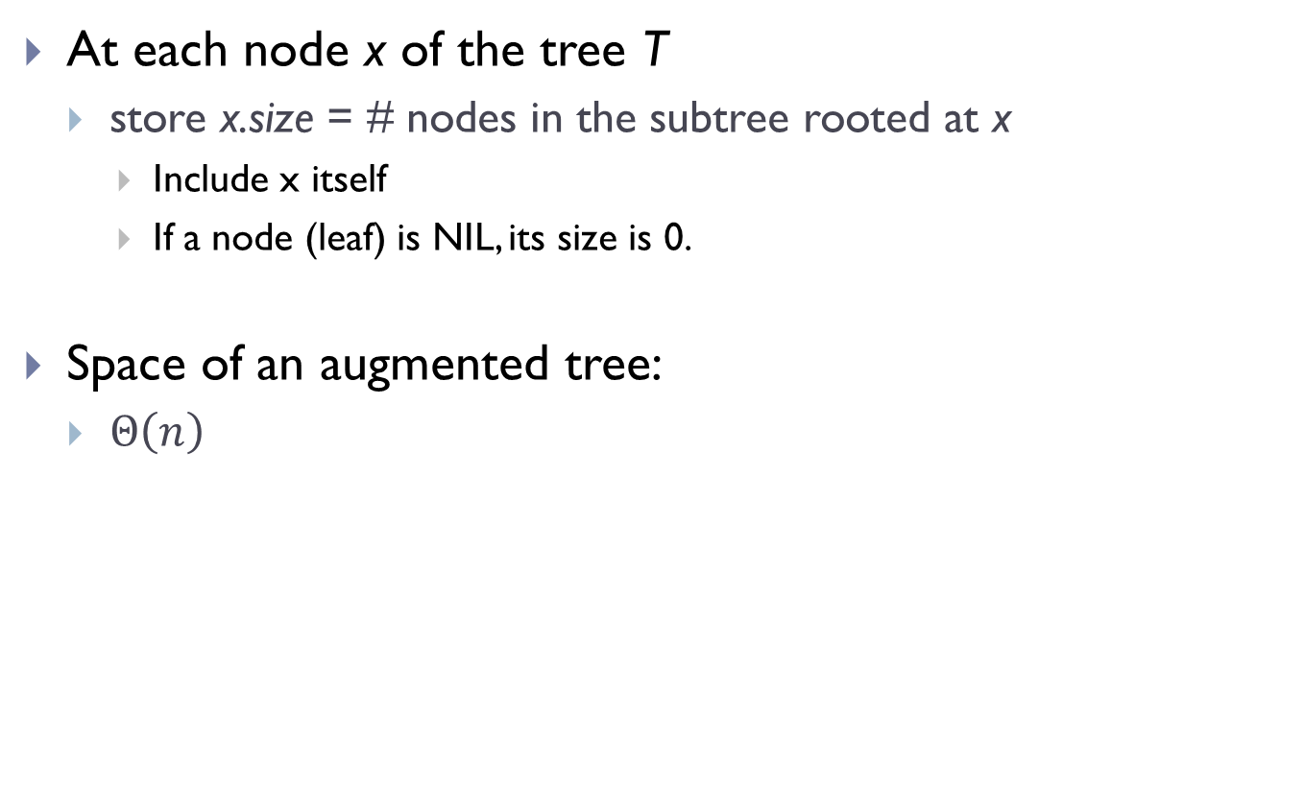
How do we augment a BST T?
At each node x of the tree T
store x.size = # nodes in the subtree rooted at x
Include x itself
If a node (leaf) is NIL, its size is 0.
Space of an augmented tree:
$Θ\left(n\right)$

Slide 57
An example
M
9
C
5
P
3
F
3
T
2
A
1
D
1
H
1
Q
1

Slide 58
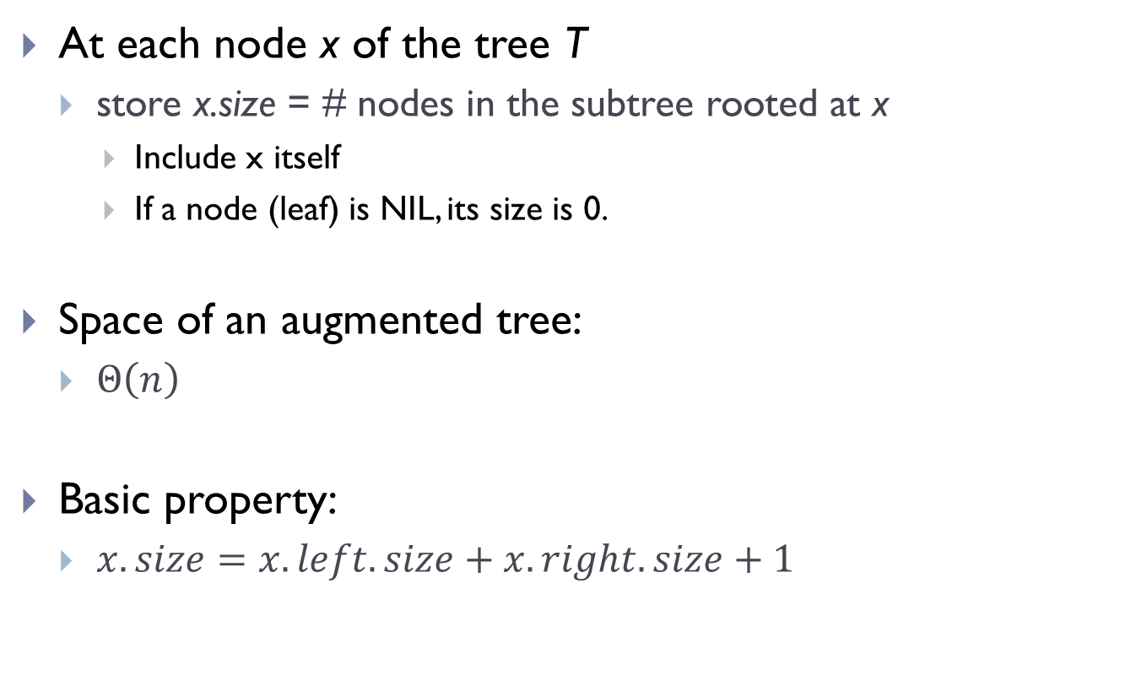
How do we augment a BST T?
At each node x of the tree T
store x.size = # nodes in the subtree rooted at x
Include x itself
If a node (leaf) is NIL, its size is 0.
Space of an augmented tree:
$Θ\left(n\right)$
Basic property:
$x.size=x.left.size+x.right.size+1$

Slide 59
How to set up size information ?
M
9
C
5
P
3
F
3
T
2
A
1
D
1
H
1
Q
1

Slide 60
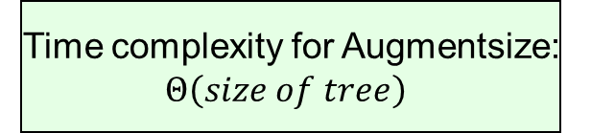

How to setup size information?
procedure AugmentSize( $treenode x$ )
If ($x$ is not Nil) then
$Lsize$ = AugmentSize( $x.left$);
$Rsize$ = AugmentSize( $x.right$);
$x.size=Lsize+Rsize+1$;
Return( $x.size$ );
end
Return ($0$);
Postorder traversal
of the tree !
Time complexity for Augmentsize:
$Θ\left(size of tree\right)$

Slide 61

How to setup size information?
procedure AugmentSize( $treenode x$ )
If ($x≠NIL$) then
$Lsize$ = AugmentSize( $x.left$);
$Rsize$ = AugmentSize( $x.right$);
$x.size=Lsize+Rsize+1$;
Return( $x.size$ );
end
Return ($0$);

Slide 62
How to perform select with aug-BST?
M
9
Select element
with rank 3?
Select element
with rank 7?
C
5
P
3
Select element
with rank 6?
F
3
T
2
A
1
D
1
H
1
Q
1

Slide 63
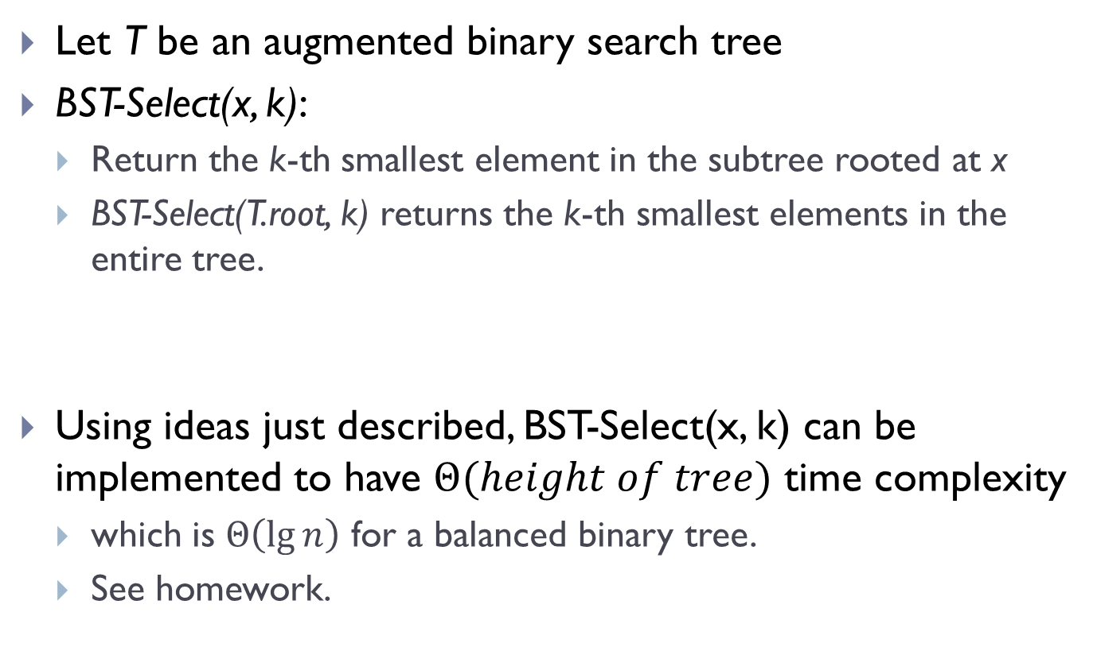
Let T be an augmented binary search tree
BST-Select(x, k):
Return the k-th smallest element in the subtree rooted at x
BST-Select(T.root, k) returns the k-th smallest elements in the entire tree.
Using ideas just described, BST-Select(x, k) can be implemented to have $Θ(height of tree)$ time complexity
which is $Θ\left(\lg{n}\right)$ for a balanced binary tree.
See homework.

Slide 64
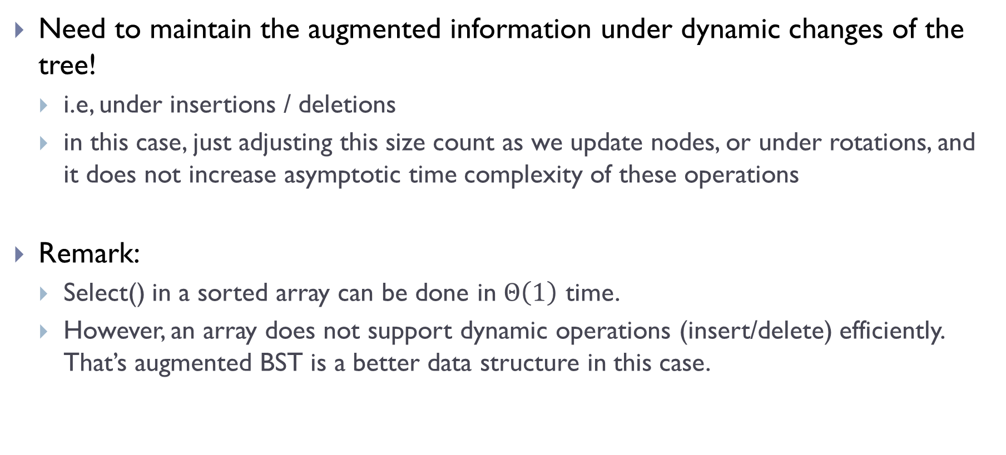
Are we done?
Need to maintain the augmented information under dynamic changes of the tree!
i.e, under insertions / deletions
in this case, just adjusting this size count as we update nodes, or under rotations, and it does not increase asymptotic time complexity of these operations
Remark:
Select() in a sorted array can be done in $Θ\left(1\right)$ time.
However, an array does not support dynamic operations (insert/delete) efficiently. That’s augmented BST is a better data structure in this case.

Slide 65
Summary
Simple example of augmenting data structures
In general, the augmented information can be quite complicated
Can be a separate data structure!
Need to consider how to maintain such information under dynamic changes

Slide 66
FIN

