Slide 1
PolarGrid and FutureGrid
State IT Conference Panel
October 1, 2009, Indianapolis
Geoffrey Fox
gcf@indiana.edu www.infomall.org
School of Informatics and Computing
and Community Grids Laboratory,
Digital Science Center
Pervasive Technology Institute
Indiana University

Slide 3
FutureGrid
FutureGrid is part of TeraGrid – NSF’s national network of supercomputers – and is aimed at providing a distributed testbed of ~9 clusters for both application and computer scientists exploring
Clouds
Grids
Multicore and architecture diversity
Testbed enabled by virtual machine technology including virtual network
Dedicated network connects allowing experiments to be isolated
Modest number of cores (5000) but will be relatively large as a Science Cloud

Slide 4
Add 768 core Windows Server at IU and Network Fault Generator

Slide 5
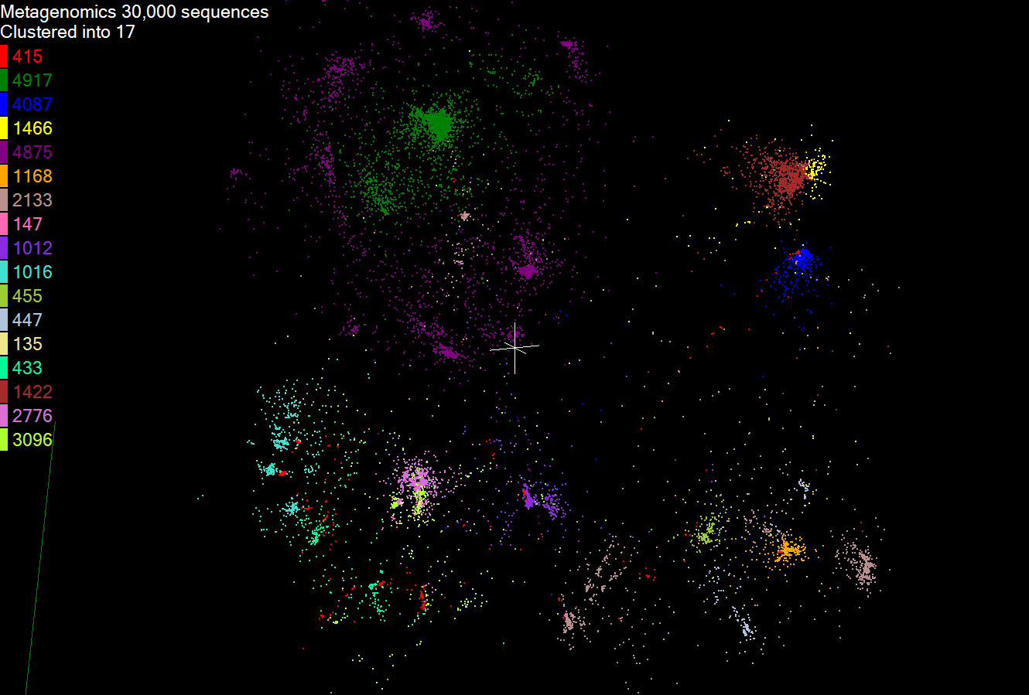

Slide 6
Pairwise Clustering 30,000 Points on Tempest

