Slide 1

Developer
Student Clubs- KIET
Powered by Google Developers

Slide 2
What is Developer Student Clubs?
Google collaborates with university students who are passionate about growing developer communities and support them with starting student clubs on their campuses.

Slide 3
Hello!
I am Aakash Goel
DSC Lead, KIET Group of Institutions
You can find me at @goelaakash79

Slide 4
Mission of Developer Student Club

Slide 5
The prime target of this community will be to provide training to college students, who face difficulties to convert their academic knowledge to build something in real life.
We will be guiding such students, by organizing workshops, meetups, coding challenges, hackathons, training sessions.

Slide 6
Meanwhile, we will be helping out the KIET community by delivering them with real time projects. Not only KIET, but we are also planning to help NGOs to automate their work process by providing them with the necessary tools.
As a DSC Lead, I promise to deliver with my best and I ensure the KIET community, that from here, down the line, KIET students will get help with this Google recognised body.

Slide 7
Opportunities with DSC

Slide 8
Grow your knowledge on developer technologies and more through peer to peer workshops and events.
Gain relevant industry experience by solving problems for local organizations with technology based solutions.
Showcase your prototypes and solutions to your local community and industry leaders.

Slide 9
Benefits of Developer Student Club

Slide 10
There are many NGOs and local businesses, whom we can help to scale and innovate.
We will be guiding students to participate in open source projects, and Google Developer events.
Google also organizes special workshops and events for girls.
We will be helping students, getting Internships.

Slide 11
Congratulations
KIET is the second College selected for Developer Student Clubs in Ghaziabad and now we are officially recognised by Google

Slide 12
Need some Motivation?

Slide 13
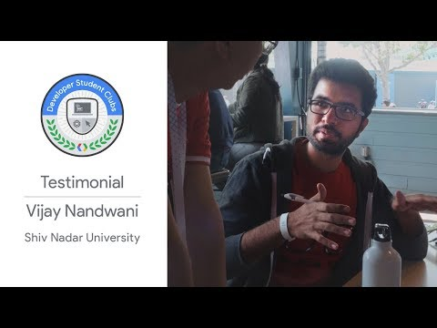

Slide 14
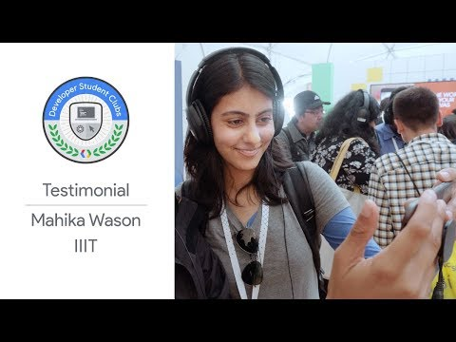

Slide 15
For more,
Please visit us at:
https://dsckiet.github.io
http://fb.com/dsckiet
https://github.com/dsckiet

Slide 16
Thanks!
ANY QUESTIONS?
You can find me at
@goelaakash79
goelaakash79@gmail.com

