Slide 1
Xfinity FAQ Spider
Vinay Paratala, Bidit Pakrashi, Saravanan Kannappan, Omera Ezike

Slide 2
Introduction and Purpose of Dataset
Many companies that have customer facing products have support pages where customers can seek help on using their products, but it is often hard to find relevant information in these pages quickly
Knowledge Spider seeks to address the problem of by scraping the support pages and compiling the information into a standardized dataset which will serve as the knowledge base for a bot that will take questions in natural language and provide concise and targeted answers from the knowledge base

Slide 3



Potential Users and Applications
Management and Experience designers
A quick solution to provide a superior automated support experience to customers
Engineering Organizations
A ready-to-implement platform to scrape and build a Q&A bot agnostic of business domain and hosting
End Users
An easy-to-use natural language-based Q&A tool that provides relevant information in one click

Slide 4
Source of Data
Knowledge Spider will acquire data from the websites that host the support information for their customers
For this implementation, we are sourcing the data from Xfinity Support’s FAQ pages

Slide 5
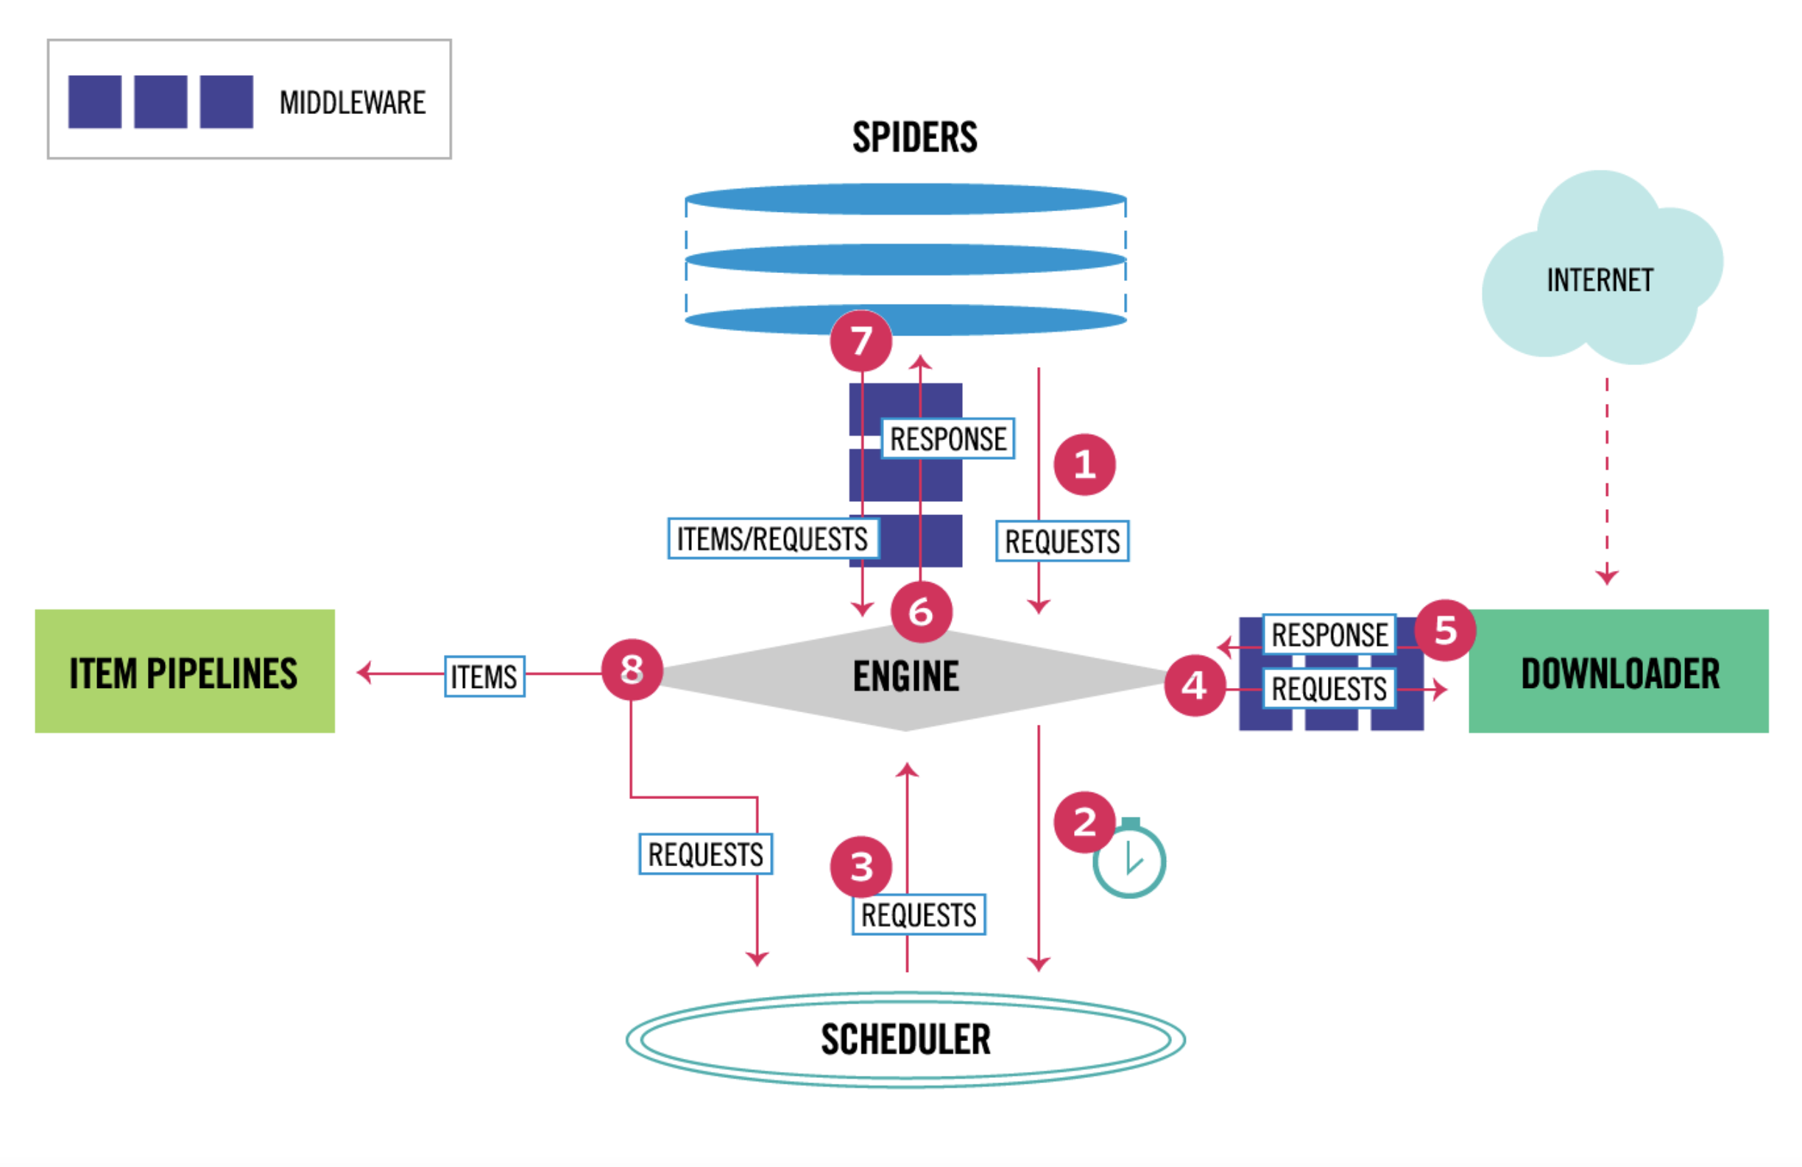
Architecture
Engine
Spiders
Downloader
Pipeline
Scheduler
Orchestrate the entire data acquisition process
Logic for crawling through a particular family of support pages
Logic to retrieve the relevant information from the web pages
Functionality to line up and trigger spiders at specific intervals
Functionality to clean up acquired data and then write to data store

Slide 6
Architecture
Framework Discussion
Data Acquisition and Processing is implemented using the Scrapy Framework
Scrapy is an industry standard open-source Python based data mining framework that is in active development and enhancements
Configuration based tweaking allows fine-grained control of the scraping process

Slide 7
Approach to Acquiring the Data
Engine
Start spider and orchestrate the flow of information between the spiders, downloaders and scheduler
Spiders
Process and define appropriate acquisition paths based on rules scheduled for the website being processed
Downloader
Execute the logic to scrape the information from the webpage and return that data to the engine for further processing

Slide 8
Approach to Preprocessing Data
Engine
Co-ordinate the flow downloaded data from Downloader to Pipeline(s)
Downloader
Execute the logic to scrape the information from the webpage and return that data to the engine for further processing
Pipeline(s)
Perform the extraction of the data from the raw HTMLs, clean up the HTML tags, irrelevant characters, etc.,

Slide 9


Distribution Approach
Spider Framework
Responsible for acquisition of data from websites and processing it for storage
Datastore
Repository of the scraped and preprocessed data
Middleware
Webservice Responsible for exposing the data as required for rendering to the user
Q&A Bot
Web Application that displays the the UI and the presentation layer
Spider Framework
Q&A Bot
Questions
Answers
Processed Data
Processed Data
Datastore
Distribution Middleware

Slide 10
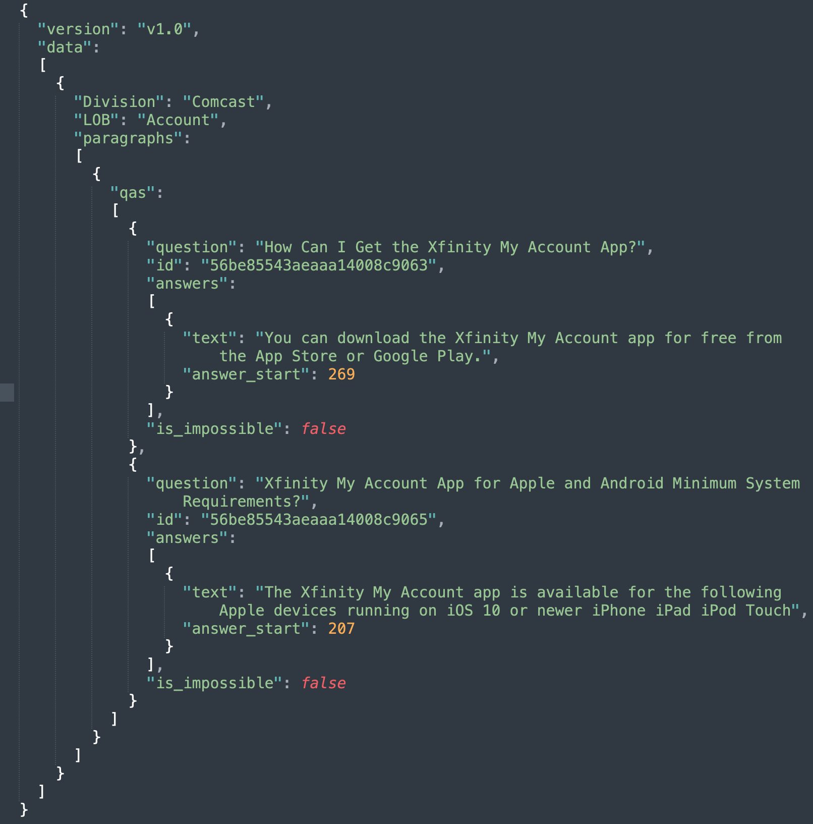
Distribution Approach
Sample Dataset
Based on the Stanford Question-Answer Dataset format
Standardized formats will help us implement more well-researched concepts as the framework evolves
Some special attributes are included to support the Comcast business model

Slide 11
Discussion of Access Rights
Knowledge Spider aims to scrape only the data available in public domain and hence we do not anticipate any access rights issues
This also allows Knowledge Spider to be easily implemented across any company whose data is publicly available

Slide 12
Issues and Limitations
Issues
Web pages generated by Javascript are harder to scrape. Resolved by implementing Splash and Selenium in addition to the built-in frameworks
Limitations
Data acquisition is limited by what is available on the public domain
Horizontal scalability needs to be worked on as we expand into larger websites and data sets
Scrapy framework is meant to run in a distributed environment but we are limited by resources available at this time
Many web pages implement IP and bot blockers. Resolved this by introducing timer driven triggers

Slide 13
Team and Contributions
Bidit Pakrashi
Ideation and Framework Research and Architecture
Engine, Spiders and Downloader
Saravanan Kannappan
Downloader development
Vinay Paratala
E2E architecture
Pipeline development
Splash and Selenium implementation
Project Management and Presentation
Omera Ezike
Knowledge and research of of Xfinity Support Pages
Development of Distribution Middleware

