Slide 1
TBD.
Notes:
To be done.
Aren’t we all?

Slide 2
a work in progress by nuno job. human being. likes computers, dinosaurs & funny hats. hates periods in the end of sentences, and punctuation in general. made to the sound of dylan, with inspiration from many great friends Im lucky enough to know. thank you.
Notes:
This is me, person, like you. Programmer, like you.
Super glad to be presenting to such great people in such a great event.

Slide 3
s/art|graffiti/open-source/g
Notes:
This talk is about the good open source and bad open source.
This talk is about how marketeers and advertisers are targeting us developers,
disrupting our thoughts by sugar coating their products with things we love.
Open source.
Javascript.
This talk has a lot of quotes from well known graffiti artist banksy.
I want to show you how much the worries and thoughts of this artist can resemble our own.
If they don’t, I think they should.
There bad actors in our scene sell you “silly” ideas like “startup life”, “webscale”,
and normally use FUD as a main argument.
ACID doesn’t scale!
They own (or at least want to own) the communication channels you use everyday.
(Anyone here using hackernews?)
They are cashing in on you, they are selling your info,
they are selling the ownership of your free thinking and passions.

Slide 4
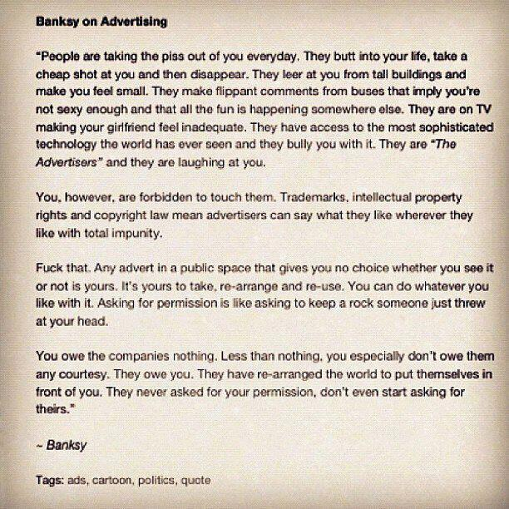
Notes:
For me this talk started some weeks, maybe months ago,
when Jan shared this quote from banksy book on twitter.
It says that you have no choice whether or not your see an advertisement in a public space hence it belongs to you.
He concludes that asking for permission to change it is like asking to keep a rock someone just threw at your head.
What grabbed my attention though was something different. How much the marketers are daily flooding us with notions they want to sell that most of us then takes as “truth”.
Soul mates.
Glamorous Air Travel.
Cool clothes.
Heck, Santa Claus.
Today, more than ever, this applies to us developers.
And the favorite word of these bad players is open-source.

Slide 5
open-source
community, curiosity & serendipity.
Notes:
This is what open source projects are for me.
A project that is community lead,
where curiosity drives innovation
and serendipity is the natural instrument for learning and the growth of the community.
A project that doesn’t take pull requests is not open source.
It’s a marketing vehicle to get you, the product.

Slide 6
the people who run our cities don’t understand graffiti because they think nothing has the right to exist unless it makes a profit...
– banksy
Notes:
Or like Banksy would put it.

Slide 7
story #1 couchdb & the public key guy.
Notes:
Let me tell you a story. I was in working for a great closed source company called MarkLogic, they do a document database that is like 10 years in the future. You can think of it as a database that shares the best traits of CouchDB and the best benefits on ElasticSearch.
I been wanting to share how MarkLogic worked with the open-source community, mostly to incentivize innovation and see if we could get something like it as an open-source product.
When I was invited to give a talk about it at Berlin Buzzwords I was super happy to share the internals of the product with the community.
The talk was great and in the end I was hanging out with some pals from CouchDB, Dale and Volker. I love CouchDB, it’s a great open source product and I use it everyday. Then a guy approaches us and introduces himself with a piece of paper with some hexadecimal stuff on it. “It’s my public key” he says.
After talking a bit, this person starts giving me grief for working in a closed source solution. I asked him what database solution he used. He happened to use a GPL licensed open source database on which the company that owns the trademark has all the commits. It’s read only open source.
Not going into specifics, but this shows the power of Marketing. That product is only open source because it helped them drive adoption.
While I was there to try to share the advances produced in a lesser known, closed source database, I got grief from this kid that didn’t even knew what he was using. He just knew it was opensource, & webscale.

Slide 8
The Art we look at is made by only a select few. A small group create, promote, purchase, exhibit and decide the success of Art.
– banksy
Notes:
We are to blame for this.
As developers we perpetuate the cruel joke that marketers pull on us.
We recommend open source projects blindly based on authors, and we promote our own shit when its broken.
Yes, make people know what your stuff can solve. But also explain what it is not designed to do. Don’t be a bullshiter.
Stop idolizing and wanting to work in company X Y or Z. Focus on the stuff you are doing instead.
You don’t need an invitation to do open-source, you are already invited.

Slide 9
story #2 stay humble. promote change not brands.
Notes:
Brings me to story #2.
At Mikeal Bachelor party a bunch of the greatest people I know where there. I remember I was hacking with Paolo and getting to know some serious nodejs when Ryan, the guy that invented node, walks by on skype with some friends.
He shows us to his friends, and one of his friends asks if we are “smart”.
His answer was amazing, he said “It’s not like we work at Google or Facebook, we are just programmers”
I don’t think anyone in that would have a problem getting a job at a large tech company, but I was always humbled by his answers.
Which brings me to the conclusion that ryan taught me:
Stay humble, promote change not brands.

Slide 10
open-source is community.
Notes:
A bunch of us creates consulting companies, conferences, and above all an education to how we should behave to be good for ourselves, as a community.
These are the nice people,
And you are not the product.
Join them. Organize meetups, create alternative business with fair business models.
Buy their products, donate to their screencasts.
Stop going to the bad players because of FUD and insurance

Slide 11
A lot of people never use their initiative, because no-one told them to.
– banksy
Notes:
Banksy said people don’t use initiative because no one told them to
So I came here to tell you to.

Slide 12
Speak softly, but carry a big can of paint.
– banksy
Notes:
There’s no need for negativity, worse yet trolling. but carry a big can on paint
exercise critical thinking, always.
thank you.

Slide 13
time for some nodejs ?

