Slide 1

getting started with

Slide 2

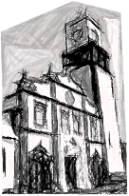
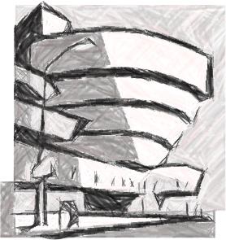

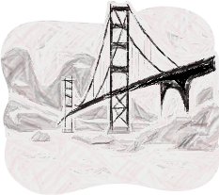





portugal new york toronto san francisco london
83
08
09
10
11
H E L L O
my name is
nuno
inquisitive mind, hacker
@dscape
stuff I like

Slide 4


Slide 5


Slide 6
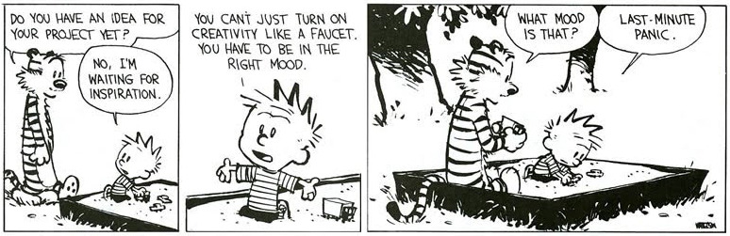

Slide 7



node.js clouds? that sounds fun
open-source
flatiron.js hook.io haibu, jitsu, etc…
turtles all the way down
features
web-socket support
infrastructure opacity
auto-scaling
multiple node versions
jitsu deploy
one line solution for your
node.js deployment needs
!!
stop working your app’s setup
start building it
snapshots,custom domains, https, coffee script, image magick, etc…

Slide 8
“You cannot take a car, grow it 10 times and expect to get a mining truck.”
Ivan Pepelnjak @ioshints

Slide 9
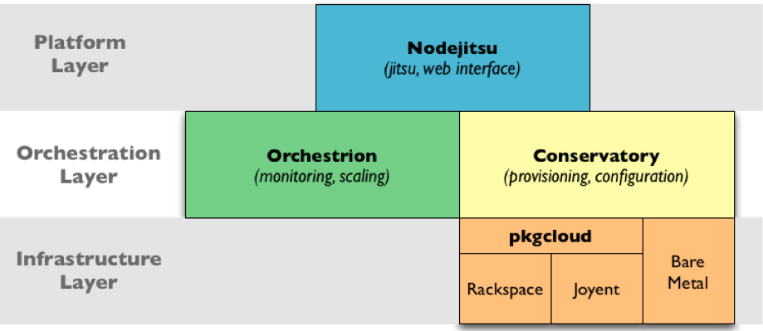
nodejitsu architecture overview
jitsu
quill
baton

Slide 10


Slide 11
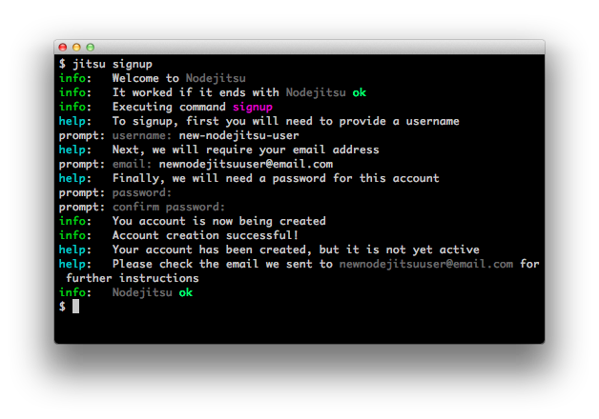

Slide 12
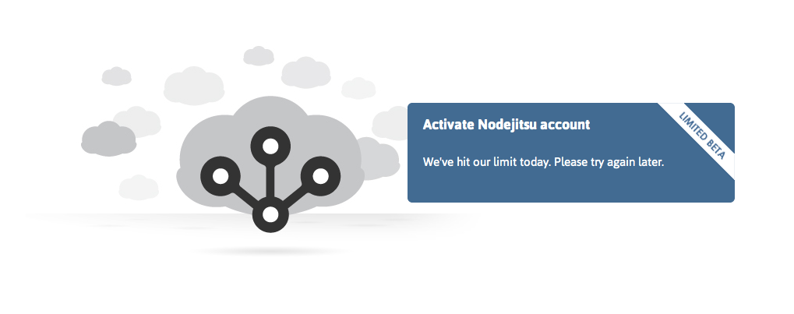

Oh noes!

Slide 13
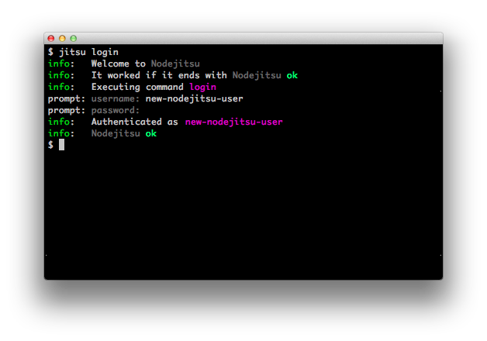

Slide 14
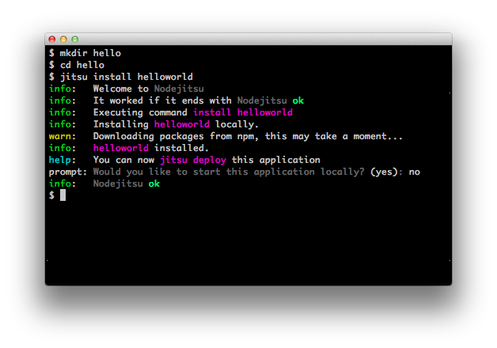

Slide 15
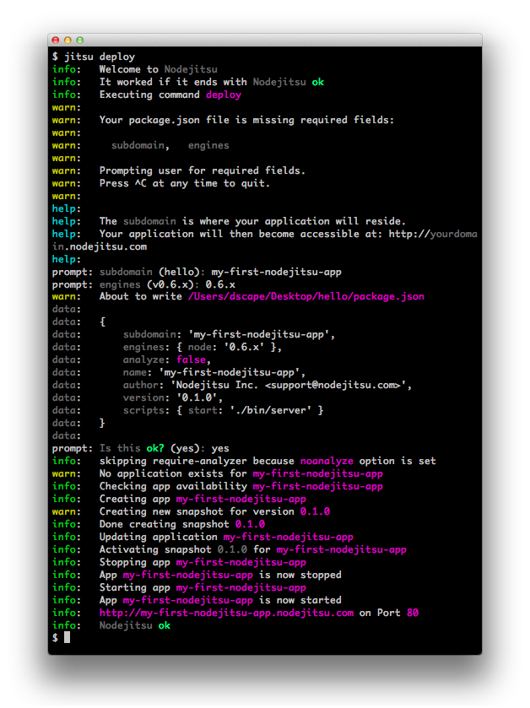

Slide 16
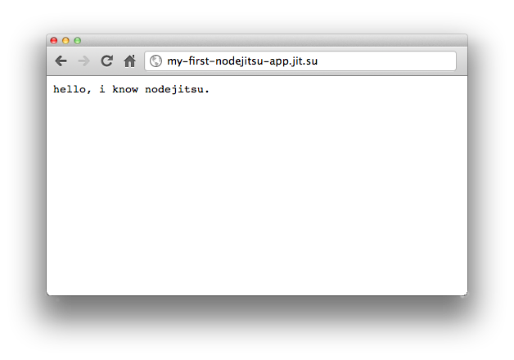

Slide 17
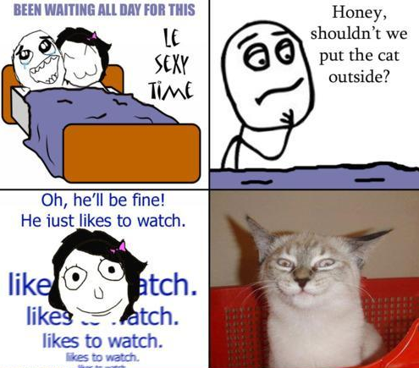
let’s do some code

