Slide 1
ADS CAPSTONE – BATTLE OF THE NEIGHBORHOODS
Miami Neighborhoods
with
Coffee Shop and Park

Slide 2
Topics
Introduction
Data
Methodology
Results
Discussion and Observations
Conclusion

Slide 3
Introduction
A client planning to visit Miami, Florida, has solicited assistance in identifying neighborhoods; further identifying those within half mile radius that have both a coffee shop and a park. Ideally, this information will be displayed on map with markers.

Slide 4
Data
Miami, Florida neighborhood data with coordinates was retrieved from Wikipedia. This data can be found on here​.
Using the neighborhood coordinates from Wikipedia data, venue information was obtained from Foursquare location data.

Slide 5
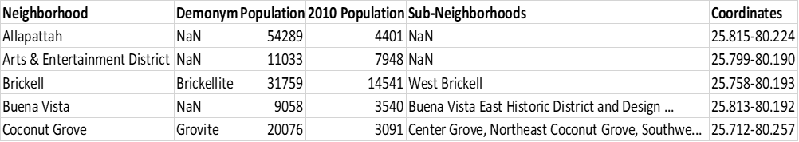
Methodology
Utilizing Pandas, Miami neighborhood data was extracted from Wikipedia page and loaded into dataframe using Pandas as shown in table below.

Slide 6
Methodology
Data was then cleansed to result in only the data needed for mapping the neighborhoods as shown below.

Slide 7
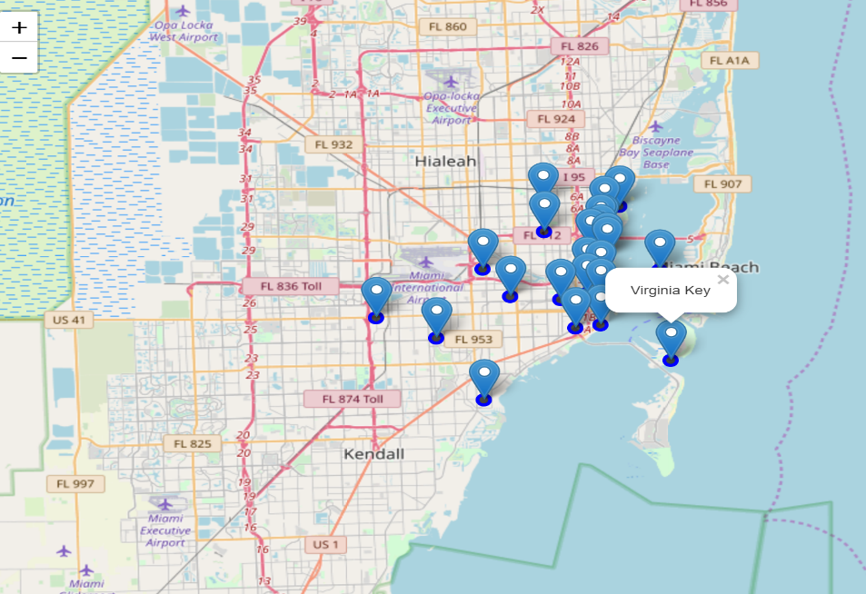
Methodology
After data was extracted and cleansed, Geocoder Nominatum was used to extract coordinates for the city of Miami. Folium was utilized to create feature group to draw map and create markers with neighborhood depicted in popup text when marker is clicked.

Slide 8
Methodology
Foursquare API was used to get neighborhood venues within half mile radius of Miami. This resulted in 1143 venues, an example of data returned is shown in below.

Slide 9
Methodology
Since we are only interested in neighborhoods with coffee shops and parks, neighborhoods that did not have both were dropped and only the venues for the remaining neighborhoods was retained. The resulting dataset consisted of 10 neighborhoods and 28 venues.

Slide 10
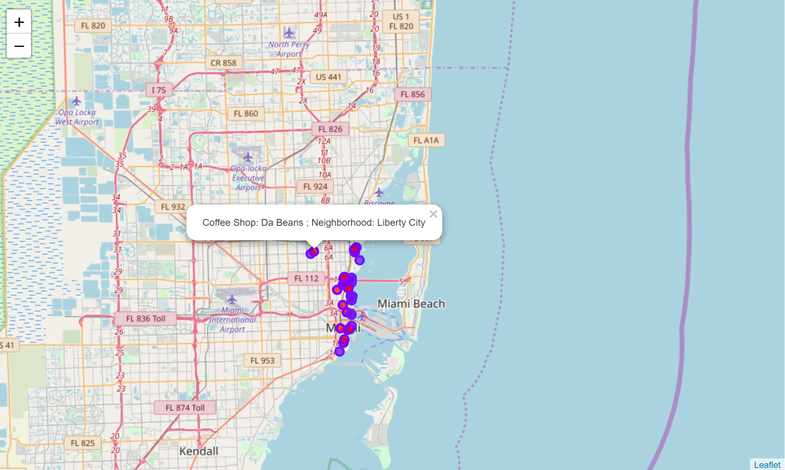
Results
Dataset containing venues for neighborhoods that had a coffee shop and a park was created resulting in 28 unique venues in 10 neighborhoods.
These venues were mapped and depicted by markers and pop up text as shown on map.

Slide 11
Discussion and Observations
The neighborhood with the highest number of coffee shops (6) was Midtown while the one with highest number of parks (4) was Buena Vista.
In comparison, Liberty City has only one coffee shop and one park. Other neighborhoods with only one park were Midtown, Downtown and Brickell although each had multiple coffee shops.

Slide 12
Conclusion
The data clearly shows there are neighborhoods in Miami where our client, and others, can easily grab their favorite cup of coffee and enjoy it while taking a stroll in the park.

