Slide 1
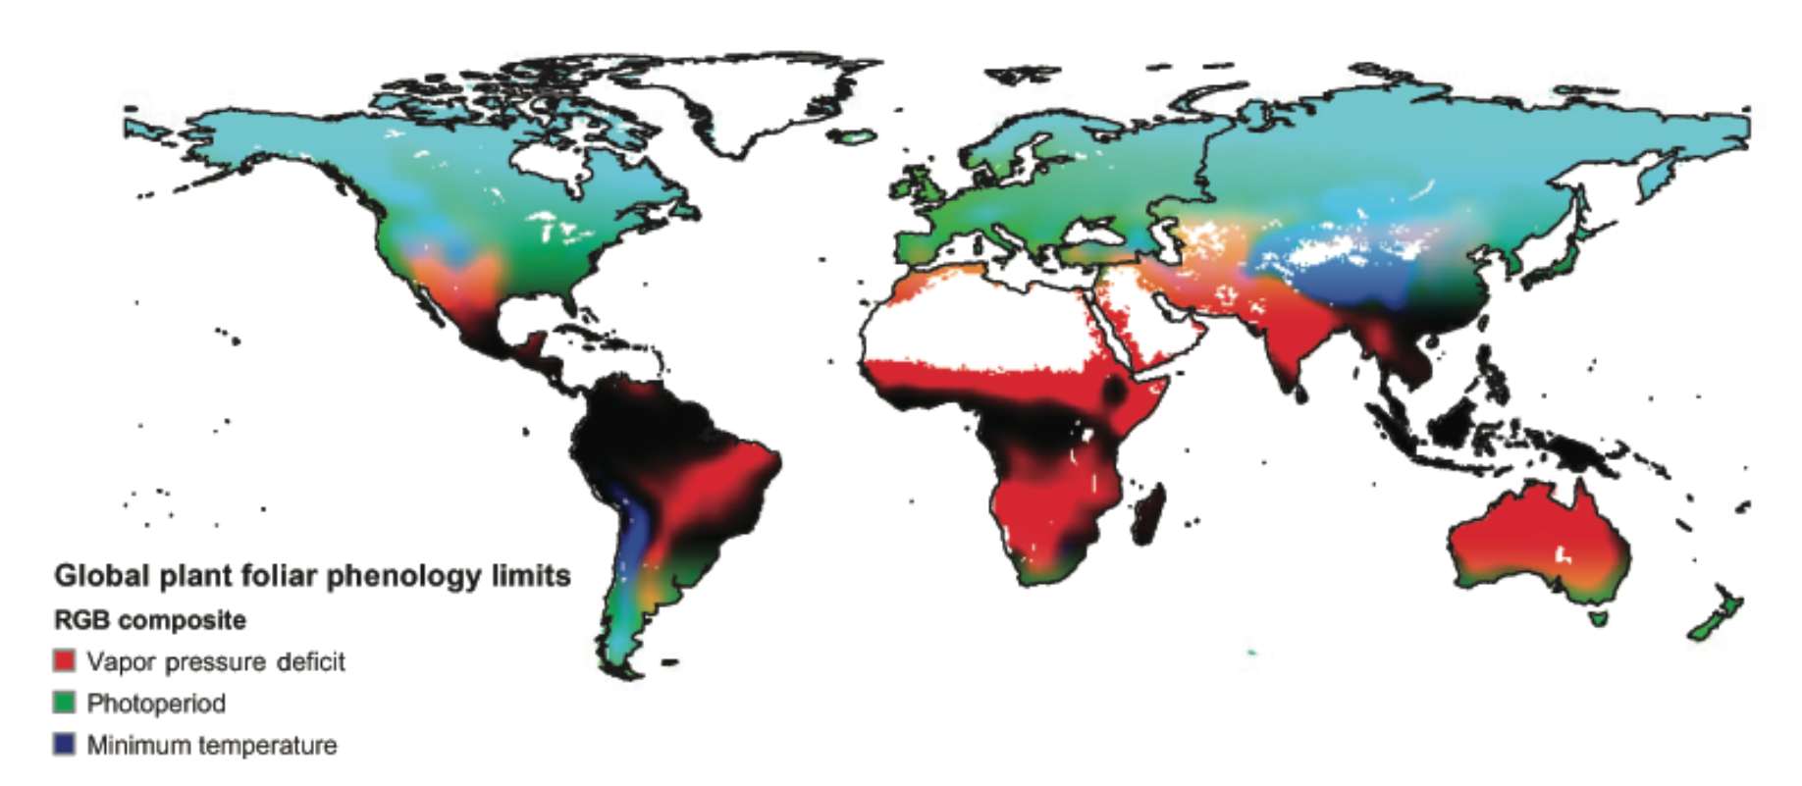
Assessing the impact of climatic controls on global changes in land surface phenology
Jolly 2005
MSc Concept Presentation David Schenkel
UZH – Remote Sensing Laboratories
17 December 2014

Slide 2
Contents
Introduction
Materials & Methods
Expected Results
Challenges
Timetable

Slide 3
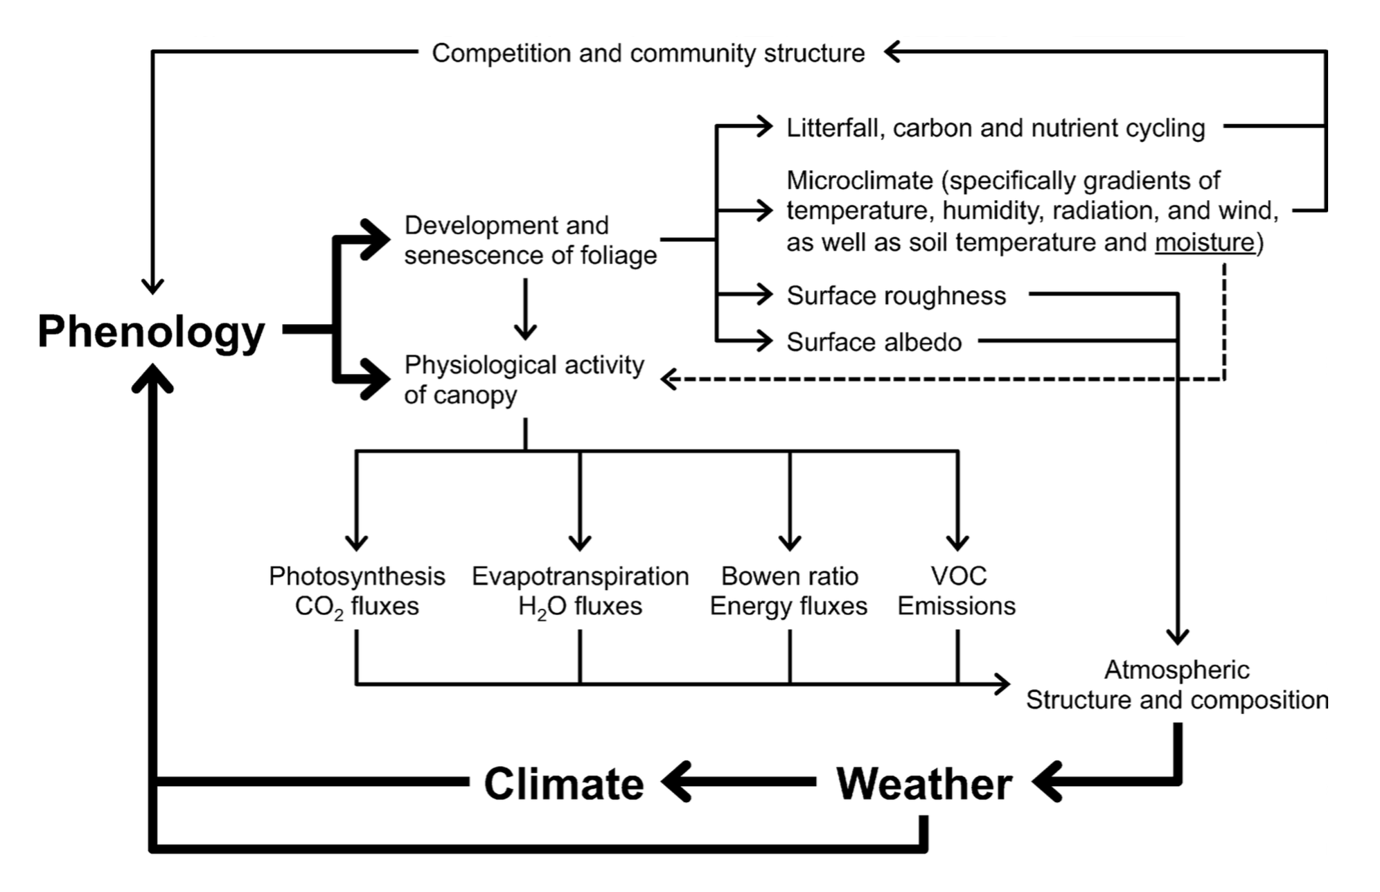
Phenology
Introduction | Materials & Method | Expected Results | Limitations & Challenges | Timetable
Introduction | Materials & Method | Expected Results | Challenges | Timetable
Phenology important driver for ecosystems
Mainly influenced by weather and climate
Richardson et al. 2013

Slide 4
Quantifying Phenology
Introduction | Materials & Method | Expected Results | Limitations & Challenges | Timetable
Introduction | Materials & Method | Expected Results | Challenges | Timetable
Phenology can be measured
Time series analysis (NDVI, LAI)
Phenology can be modelled
Based on climatic controls

Slide 5
Phenology and Climatic Controls
Introduction | Materials & Method | Expected Results | Limitations & Challenges | Timetable
Introduction | Materials & Method | Expected Results | Challenges | Timetable
What are limiting climatic factors for phenology?
Jolly 2005

Slide 6
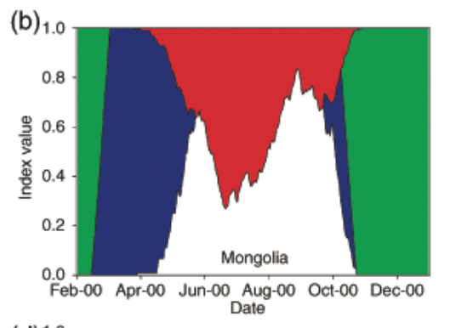
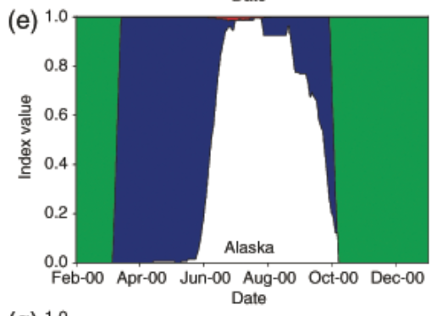
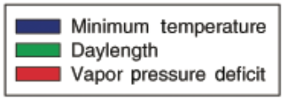
Climatic Controls
Introduction | Materials & Method | Expected Results | Limitations & Challenges | Timetable
Introduction | Materials & Method | Expected Results | Challenges | Timetable
Influence of climatic control changes over time
Intra-annually
Over the years?
Jolly 2005

Slide 7
Research Questions
Introduction | Materials & Method | Expected Results | Limitations & Challenges | Timetable
Introduction | Materials & Method | Expected Results | Challenges | Timetable
How does a modelled LAI compare to a remotely sensed LAI? Where do they differ?
Does the regional impact of climatic controls change over time?
Do changes in LSP depend on changes in climatic controls?

Slide 8
Contents
Introduction
Materials & Methods
Expected Results
Challenges
Timetable

Slide 9
Data & Data Pre-Processing
Introduction | Materials & Method | Expected Results | Limitations & Challenges | Timetable
Introduction | Materials & Method | Expected Results | Challenges | Timetable
Available data over 30 years:
LAI3g
Measured
15-day composite LAI data
spatial resolution: ¹/₁₂ degree
LAI-re
Modelled
daily LAI and climatic control data
spatial resolution: ½ degree

Slide 10
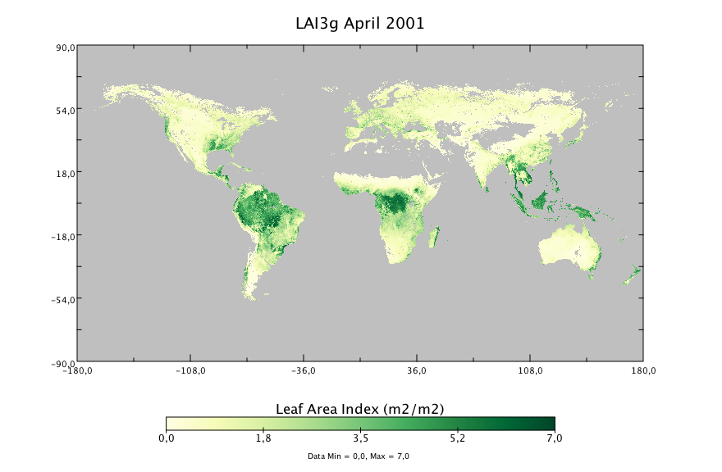
Measured LAI: LAI3g
Introduction | Materials & Method | Expected Results | Limitations & Challenges | Timetable
Introduction | Materials & Method | Expected Results | Challenges | Timetable
Based on GIMMS/AVHRR NDVI3g
Trained with MODIS LAI

Slide 11
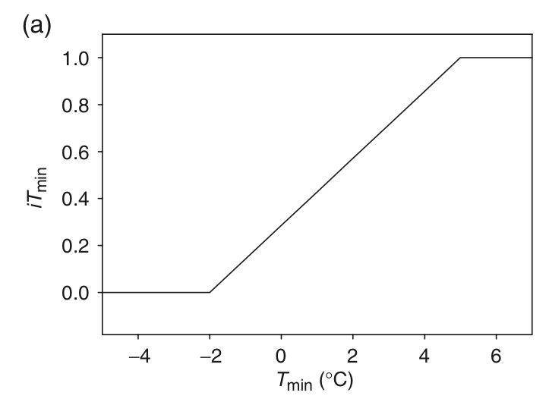
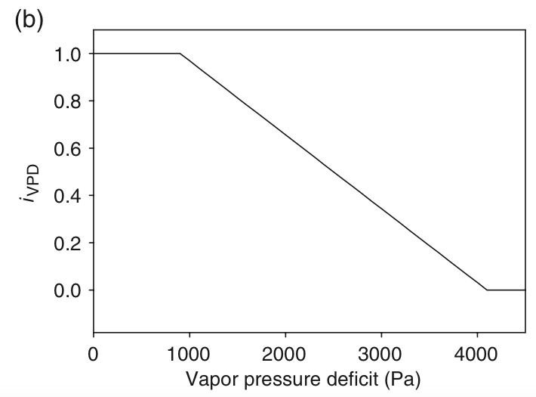
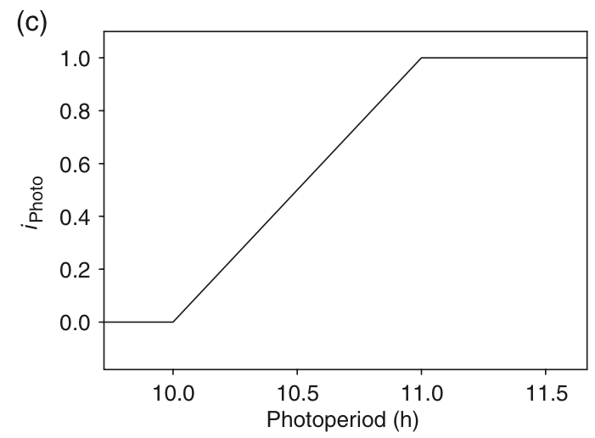
LAI-re: Modelling Climatic Controls
Introduction | Materials & Method | Expected Results | Limitations & Challenges | Timetable
Introduction | Materials & Method | Expected Results | Challenges | Timetable
Jolly’s (2005) Growing Season Index
Based on T_{min}, Vapour Pressure Deficit (VPD) and photoperiod
Simple linear relationships and thresholds
GSI = iT_{min} * iVPD * iPhoto
Jolly et al. 2005

Slide 12
LAI Reanalysed
Introduction | Materials & Method | Expected Results | Limitations & Challenges | Timetable
Introduction | Materials & Method | Expected Results | Challenges | Timetable
Stöckli et al. (2011) modelled LAI based on GSI, Plant Functional Type and elevation classes
Uses reanalysed meteorological data for T, VPD, incoming radiation
Model assimilated with 10 years of MODIS LAI and FPAR data

Slide 13
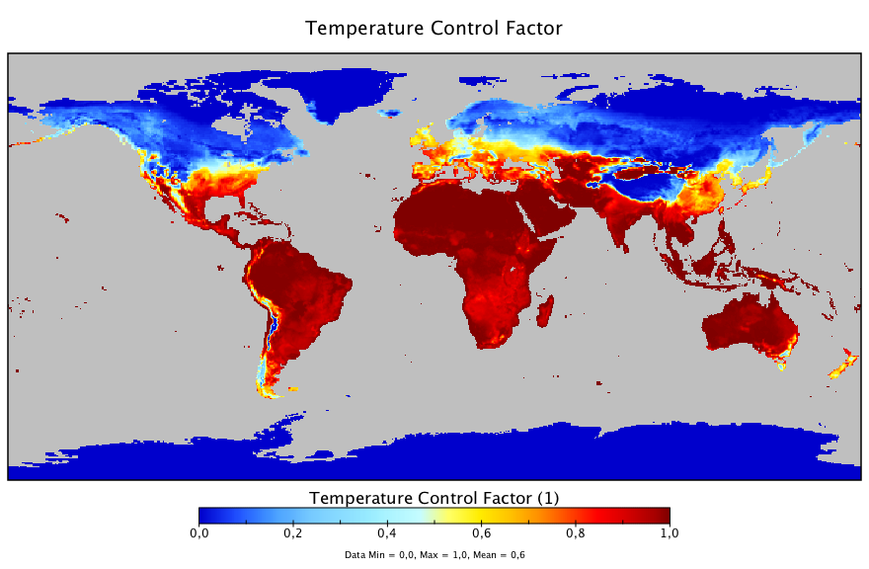
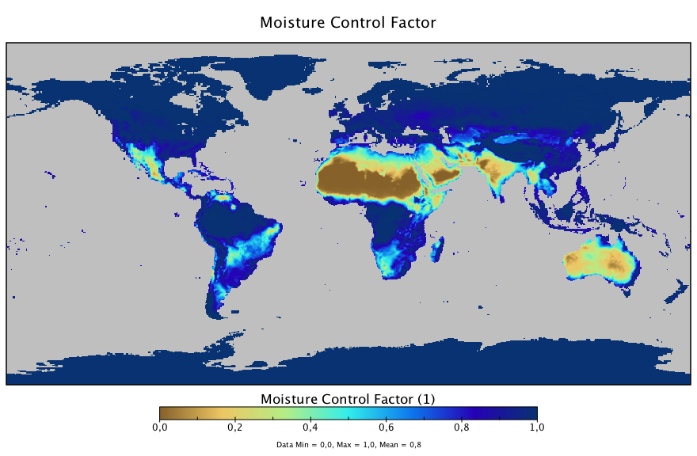
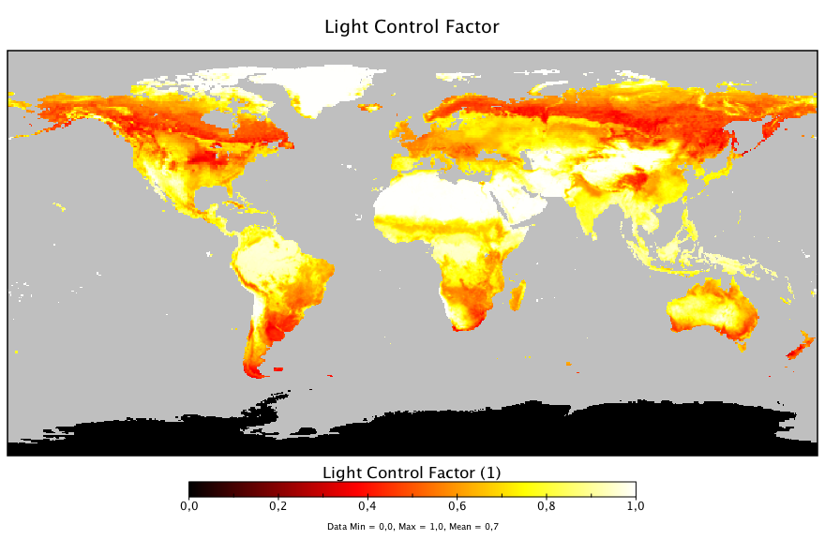
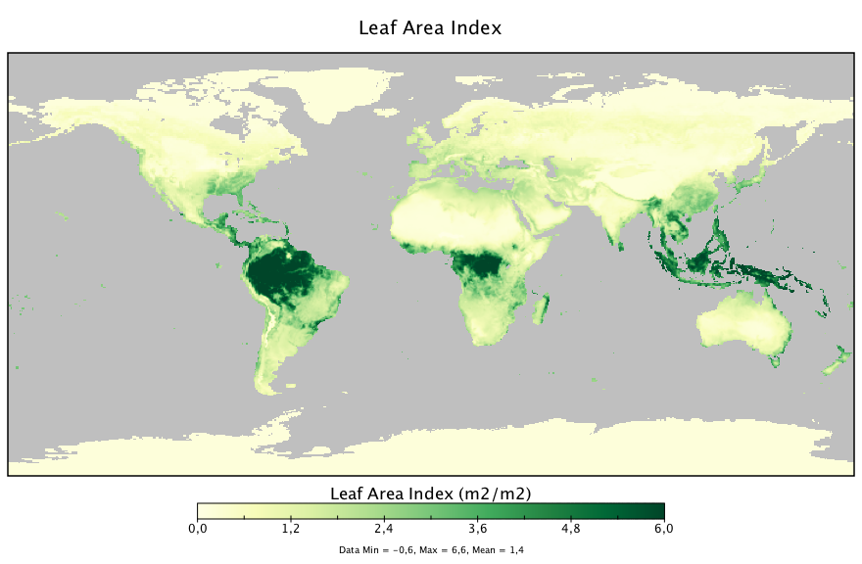
Example: LAI-re for 18 April 2001
Introduction | Materials & Method | Expected Results | Limitations & Challenges | Timetable
Introduction | Materials & Method | Expected Results | Challenges | Timetable

Slide 14
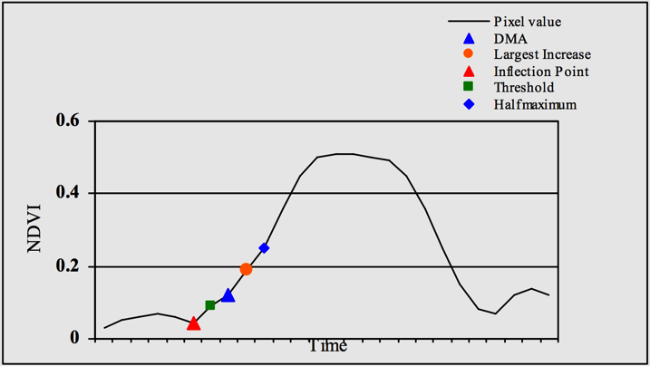
Extracting LSP Indices
Introduction | Materials & Method | Expected Results | Limitations & Challenges | Timetable
Introduction | Materials & Method | Expected Results | Challenges | Timetable
Goal: Get Start of Season, End of Season and Growing Season Length
Harmonic Analysis to get smooth yearly LAI profiles using HANTS-algorithm (Roerink et al. 2000)
Developed for NDVI, but same principle applies for LAI
Several possibilities for definition of SOS/EOS
GSL = EOS - SOS
Reed et al. (2003)

Slide 15
RQ1: Comparing LAI datasets
Introduction | Materials & Method | Expected Results | Limitations & Challenges | Timetable
Introduction | Materials & Method | Expected Results | Challenges | Timetable
Compare LAI averages (monthly, yearly)
Compare extracted LSP indices and trends

Slide 16
RQ2: Analysing the impact of climatic controls over time
Introduction | Materials & Method | Expected Results | Limitations & Challenges | Timetable
Trend analysis for monthly and yearly averages of T_{min} and VPD
Extract and compare onset of changes

Slide 17
RQ3: Compare Climatic Controls to LAI
Introduction | Materials & Method | Expected Results | Challenges | Timetable
Calculate correlation coefficient for climate controls and LSP indices
Different ways to go about it:
Compare SOS to control factors on this day/month
Compare SOS to control factors in the preceding month
Compare GSL to annual mean or monthly means
…

Slide 18
Expected Results
Introduction | Materials & Method | Expected Results | Limitations & Challenges | Timetable
Introduction | Materials & Method | Expected Results | Challenges | Timetable
LAI3g-LAIre comparison
Statistical analysis
Maps showing differences
Climatic Controls
Statistical analysis
Maps showing changes in climatic controls over time
Climatic Controls – LAI comparison
Statistical analysis

Slide 19
Challenges
Introduction | Materials and Method | Expected Results | Challenges | Timetable
Introduction | Materials & Method | Expected Results | Challenges | Timetable
Explorative approach
So many possibilities, very little time
(Almost) no prior work to draw on
Stratification of results (statistics by biome, PFT, pixelwise, …) not yet clear

Slide 20
Timetable
Introduction | Materials and Method | Expected Results | Challenges | Timetable
Introduction | Materials & Method | Expected Results | Challenges | Timetable
T A S K | 2 0 1 4 |  |  | 2 0 1 5
 | 10 | 11 | 12 | 1 | 2 | 3 | 4 | 5 | 6 | 7 | 8 | 9 | 10 | 11 | 12
Literature Review
Processing
Pre-Processing (resizing/resampling)
LSP extraction: HANTS
LSP extraction: Indices
Analysis: LAI comparison
Analysis: Climatic Controls
Analysis: LAI-Climatic Controls
Writing
Concept
Methods
Results
Analysis
Introduction
Layout & finishing touches

Slide 21
Literature
Garonna, I., de Jong, R., de Wit, A. J. W., Mücher, C. a, Schmid, B., & Schaepman, M. E. (2014). Strong contribution of autumn phenology to changes in satellite-derived growing season length estimates across Europe (1982-2011). Global Change Biology, 20(11), 3457–70.
Jolly, W. M., Nemani, R., & Running, S. W. (2005). A generalized, bioclimatic index to predict foliar phenology in response to climate. Global Change Biology, 11(4), 619–632.
Reed, B. C., Michael White, and Jesslyn F. Brown. (2003). “Remote Sensing Phenology.” Pp. 365–81 in Phenology: An Integra3ve Environmental Science SE - 23, vol. 39, edited by MarkD. Schwartz. Springer Netherlands.
Roerink, G. J., Menenti, M., & Verhoef, W. (2000). Reconstructing cloudfree NDVI composites using Fourier analysis of time series. International Journal of Remote Sensing, 21(9), 1911–1917
Stöckli, R., Rutishauser, T., Baker, I., Liniger, M. a., & Denning, a. S. (2011). A global reanalysis of vegetation phenology. Journal of Geophysical Research, 116(G3)

Slide 22
Thank you for your attention!
Question time…

Slide 24
Limitations: LAI datasets
Both datasets connected to MODIS LAI
No absolute verification of LAI-re possible within the scope of thesis
Differences in both datasets could arise for several reasons
LAI3g could be limited by NDVI saturation
LAI-re could be limited by model assumptions or GSI

Slide 25
Limitations: Climatic Controls
Based on linear functions and thresholds
Oversimplified
Analysis constrained by GSI data
No absolute T/VPD data

Slide 26
MODIS! MODIS everywhere!
Why not compare LAI-re to widely used MODIS LAI?
LAI-re and LAI3g both assimilated with MODIS LAI data
MODIS dataset only from year 2000 onwards
MODIS LAI has a much higher resolution – possible scaling effects (introduces more uncertainty)

