Slide 1
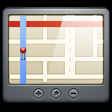





GPS Satellite
Coordinates
Credentials
Access Control
Mobile Device
REST API
Database
Web Server
DB Server

Slide 2
Client
View
Controller
Model
Other Services
REST API Services
Mobile Platform Framework & Libraries

Slide 3
Server
REST API
Presentation Layer (Model <-> DTOs)
Business Layer
Model
Persistence Layer

