Slide 1
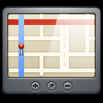





GPS Satellite
Coordinates
Credentials
Access Control
Mobile Device
REST API
Database
Web Server
DB Server

