Slide 1
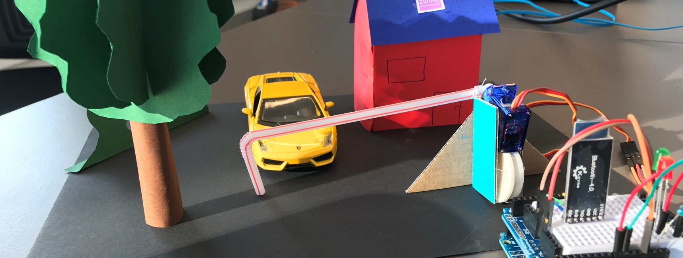
Block Park by Zühlke Blockchain Enthusiasts

Slide 2
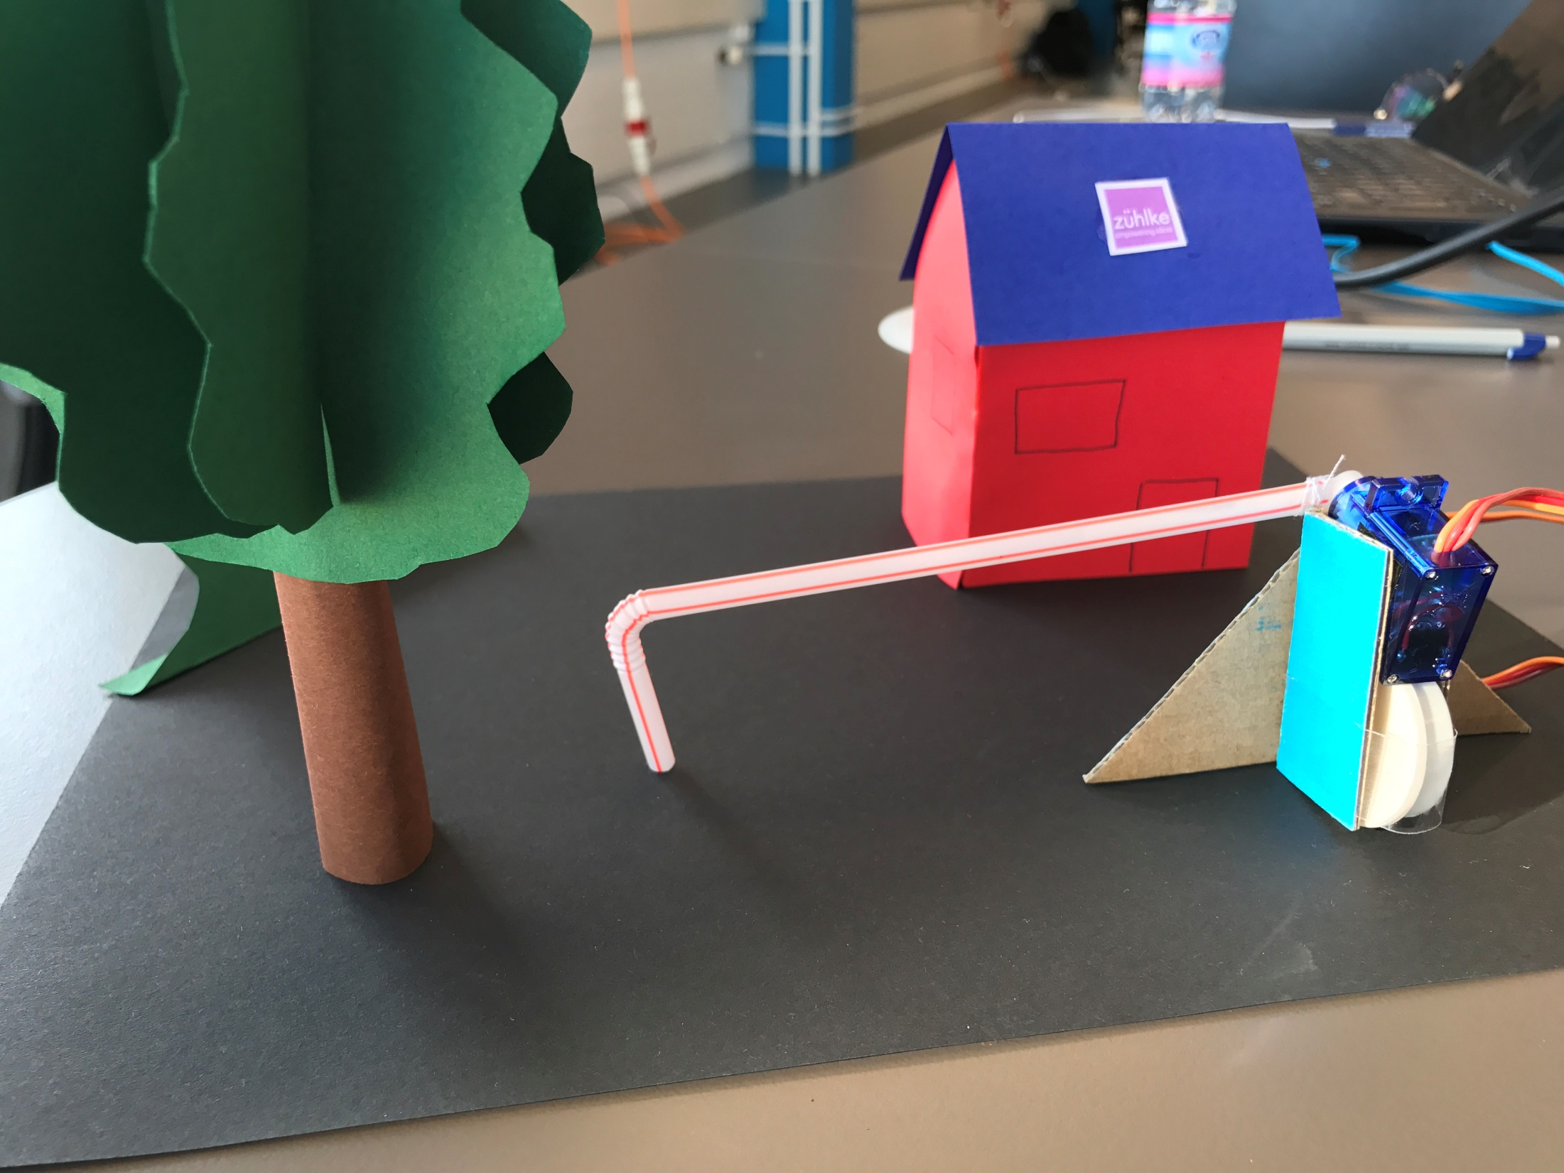

Slide 3
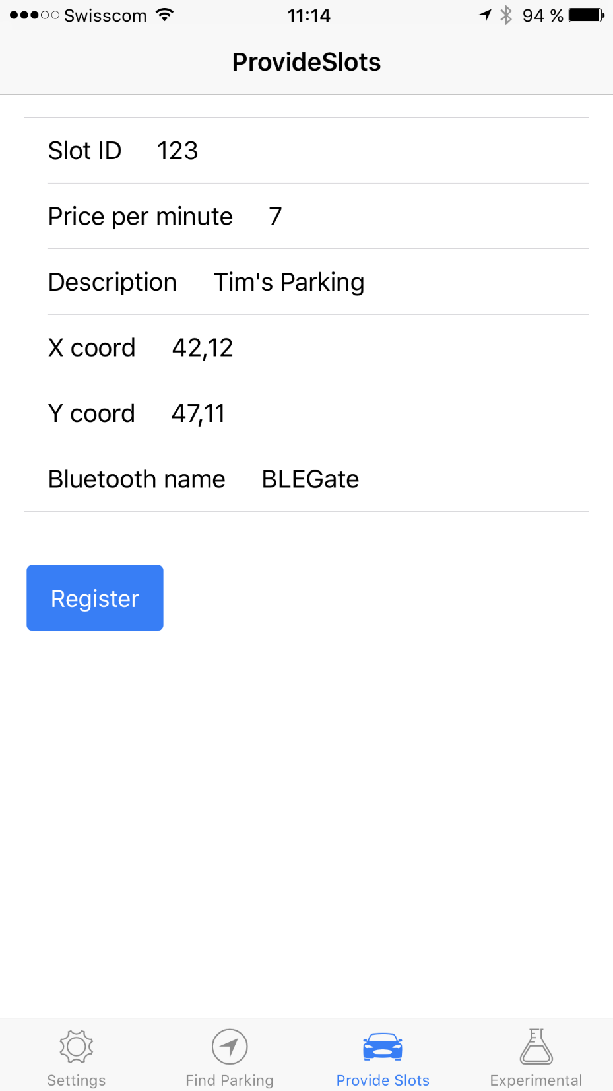
Screenshot «register»

Slide 4
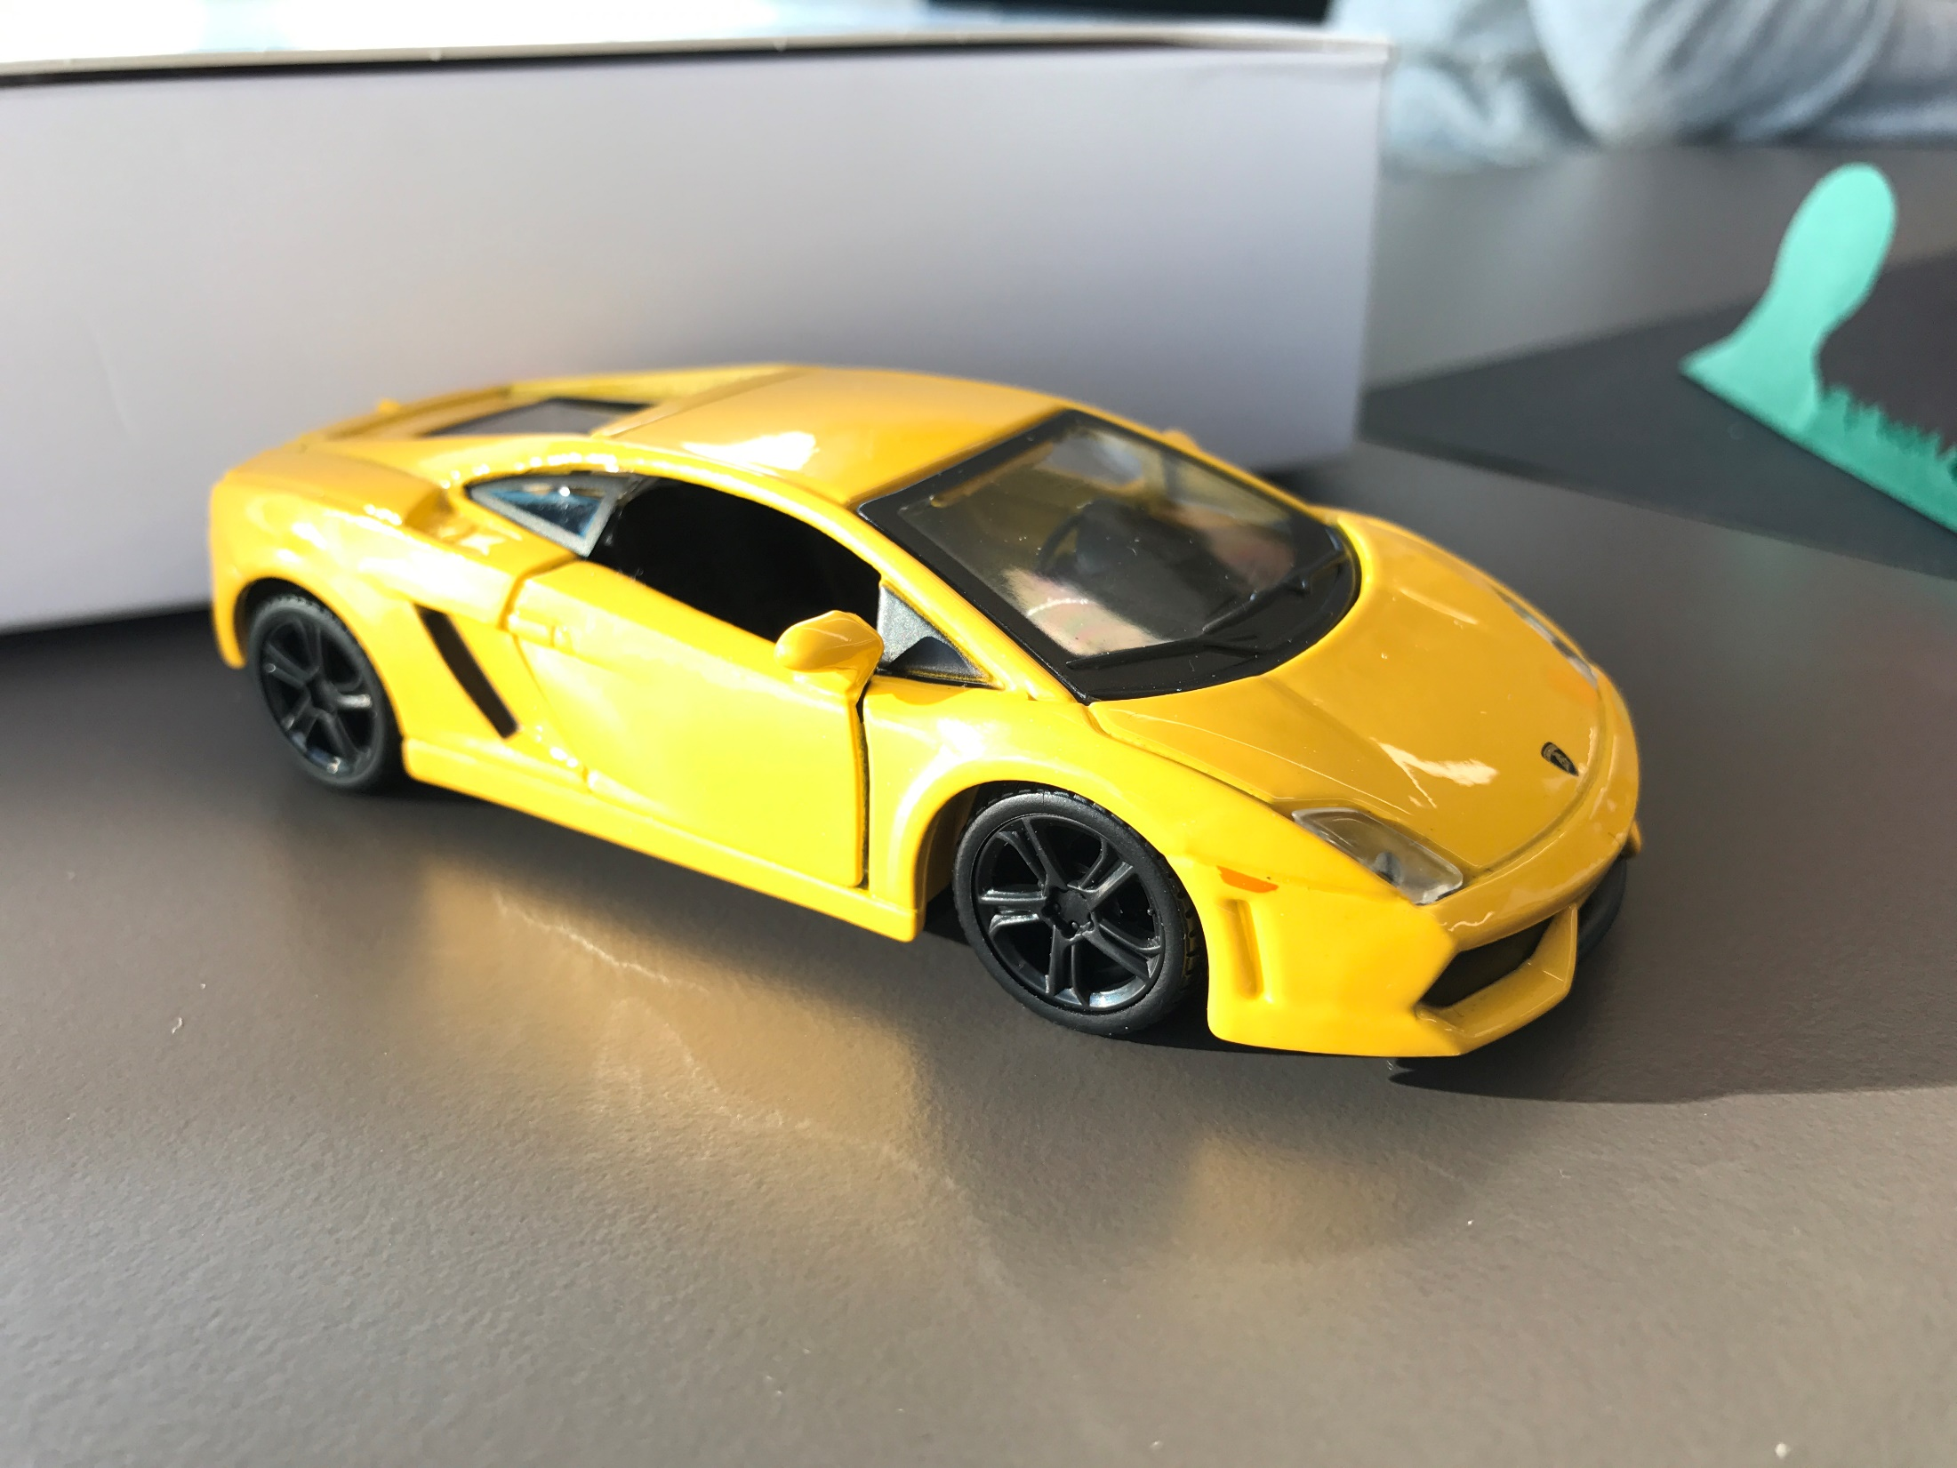

Slide 5
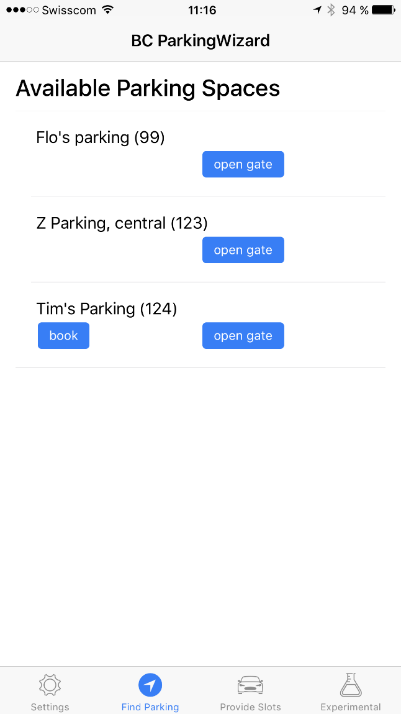
Screenshot «book»

Slide 6
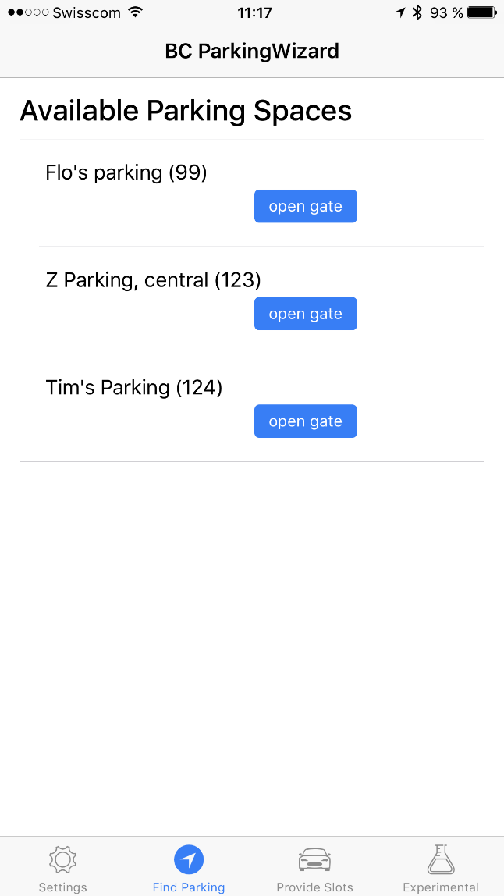
Screenshot «open gate»

Slide 7
Block Park Values
Open to everybody
Shared economy
IoT
Cryptocurrency
Peer to peer business
Save the environment
Blockchain based access control
Instant payment

Slide 8
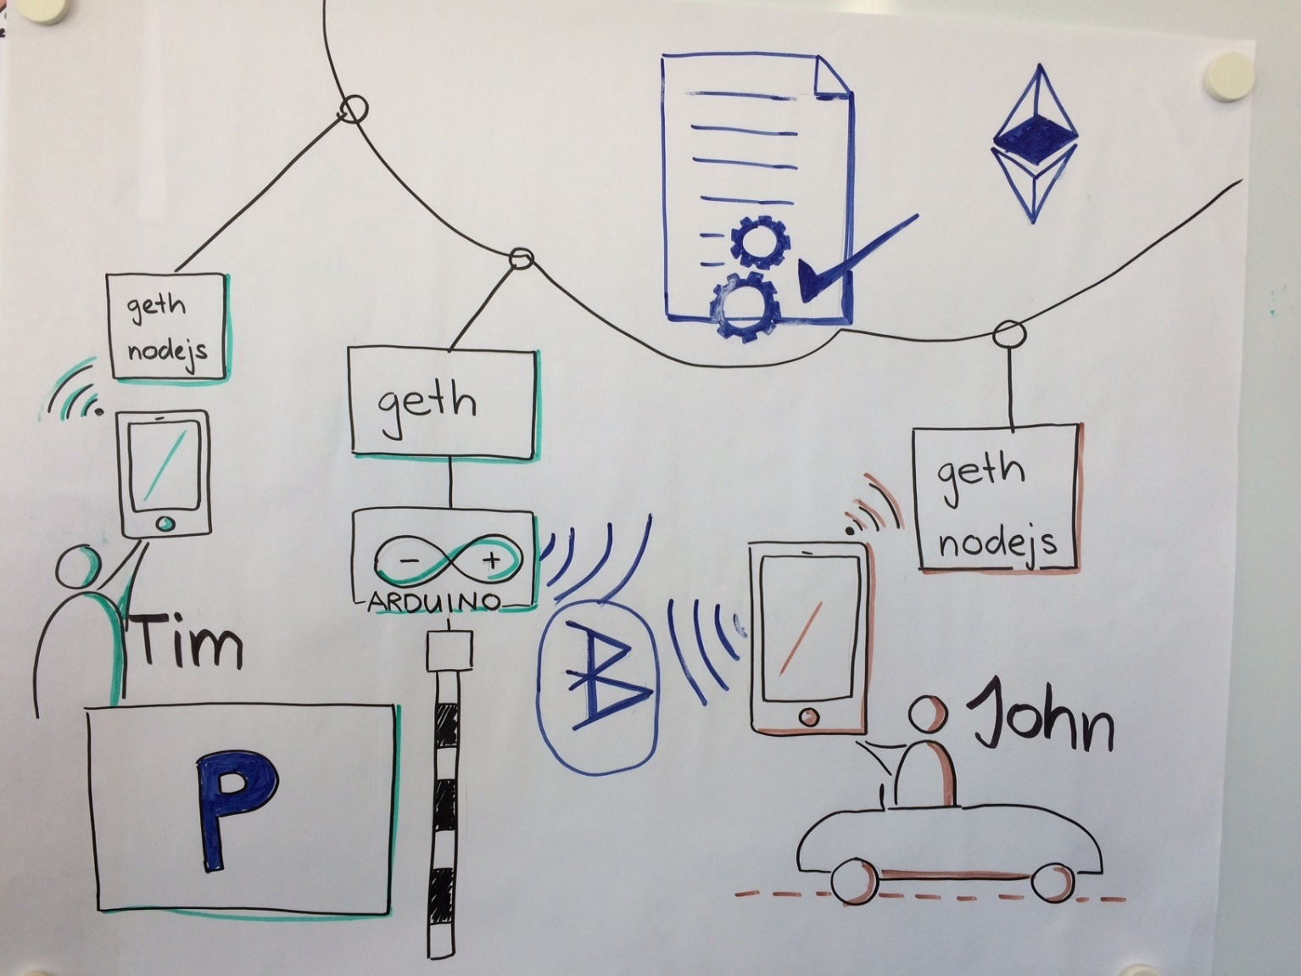
Block Park Architecture

Slide 9


Slide 10
Story
Greeting: Hi everybody, we are the Zuhlke Blockchain enthusiasts and we have approached for the IoT challenge. We hope you had a happy hacking weekend and are proud to present what we assembled in the last two days by telling you a little story:
This is Tim. Tim works as a software developer and lives in the heart of Zurich. Tim travels to work and visits his customers by car and his expensive parking space stays unused most of the time.
This is John. John lives in the countryside but has an important job interview in Zurich today. John is really nervous because he knows that the traffic in Zurich is a hassle, but finding a free parking space seems impossible to him.
Luckily there is Crypto Valley in Switzerland with lots of smart hackers who have smart ideas of how to grow the sharecononomy by using IoT and Blockchain technology. It seems they have a solution for Tim and John. Here is how it works.
Tim: Hi, I am Tim. I am leaving home for the next few days to visit my customer. Now I am using a Dapp called "BlockPark" to offer my parking space to somebody who needs it. If somebody books my parking space, I even get paid in one of those fancy new crypto currencies. How awesome is that!
John: Hi, I am John. To be honest, I am nervous as I have this job interview coming up today in Zurich and I dont't know where to park yet. Maybe this new App has a parking space for me. Let's check. Wow, look at that! There is one right next to the office and its even a garage - perfect for my new Ferrari. I'll book it right now.
Speaker: Sometimes later this day, John arrives at the parking space he booked.
John: That was easy to find and I can even use my Smartphone as a key to open the gate. What a great experience! I will tell all my friends about it.

