Slide 1
City
Green army
Blue army

Slide 2
C
A
P
CA
CP
AP

Slide 3

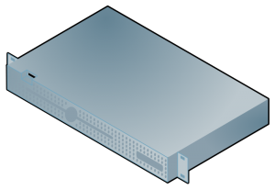
4. nothing
1. Add pen to shopping basket
3. What is inside my shopping basket?
2. OK added

Slide 4
1
2
C

Slide 5
Node 1
Node 2
Node 4
Node 3

Slide 6
Leader self-appoint
1
2
3
4
5
Leader
Announce leader
Ack
Propose new state
Ack
Commit
Leader self-appoint
1
2
3
4
5
Leader
Announce leader
Ack
Propose new state
Ack
Commit

