Slide 1
Immutable Linux
What if you cannot write to /usr
At 15.12.2021 by Daniel Schier

Slide 2
Agenda
Introduction
Immutability
Examples
  CoreOS (Red Hat/Fedora)
  microOS (Suse Linux)
  k3os (Rancher/Suse Linux)
  NixOS
Conclusion

Slide 3
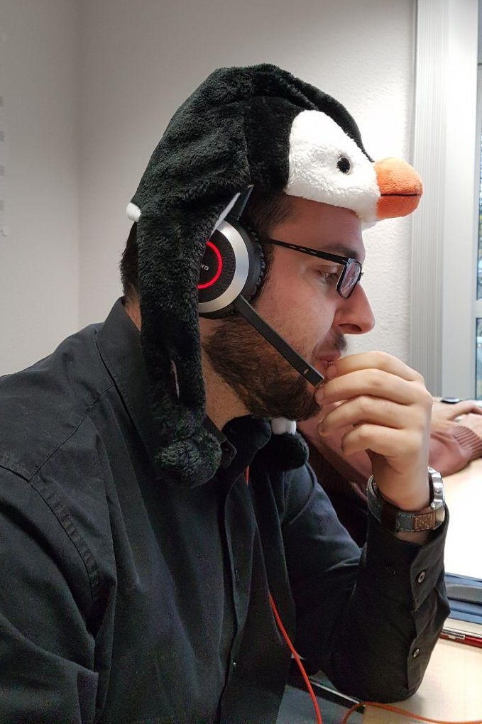
Speaker
Daniel Schier
Founder of while-true-do.io and DDOSUG, with a huge heart for Open Source.
Making Open Source more accessible is my passion.
And... I like penguins, cats and cookies.

Slide 4
Immutability
/usr Read-Only?
/etc often not
Very FS dependent
More secure?
More stable?
More solid?
Build > Configure

Slide 5
Examples
CoreOS
microOS
k3os
NixOS

Slide 6
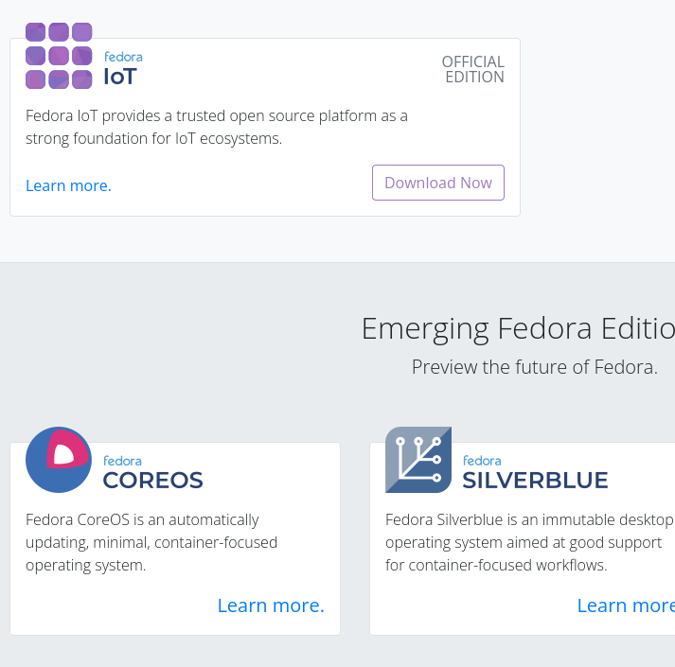
CoreOS
Fedora
  IoT, CoreOS, Silverblue, Kinoite
RHEL
  CoreOS
OSTree based
Deploy, Pin, Rollback
Ignition for unattended installations
Mutable and Immutable parts
Podman and Toolbx (and Docker)
https://getfedora.org/coreos?stream=stable

Slide 7
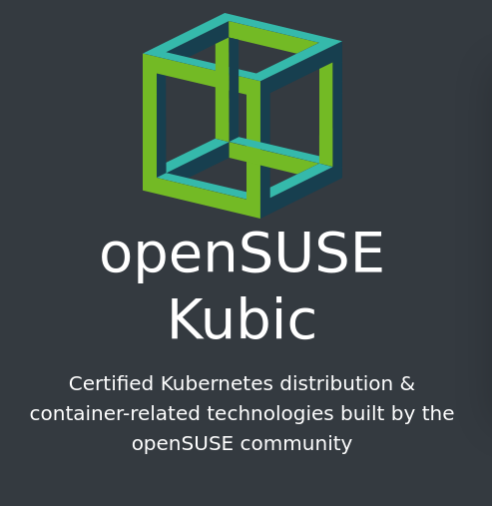
microOS
Suse only
Btrfs based
Deploy, snapshot, rollback
Pretty default Suse Linux
Combustion, ignition and cloud-init for initial deployment
Built with Kubic in mind (Kubernetes distribution)
https://microos.opensuse.org/
https://kubic.opensuse.org/

Slide 8
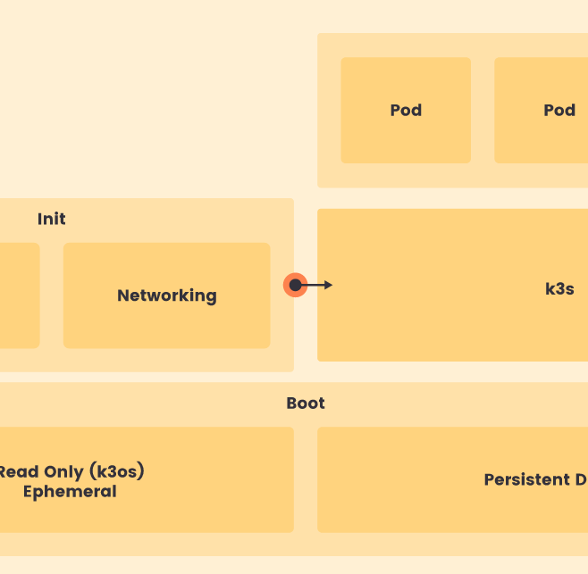
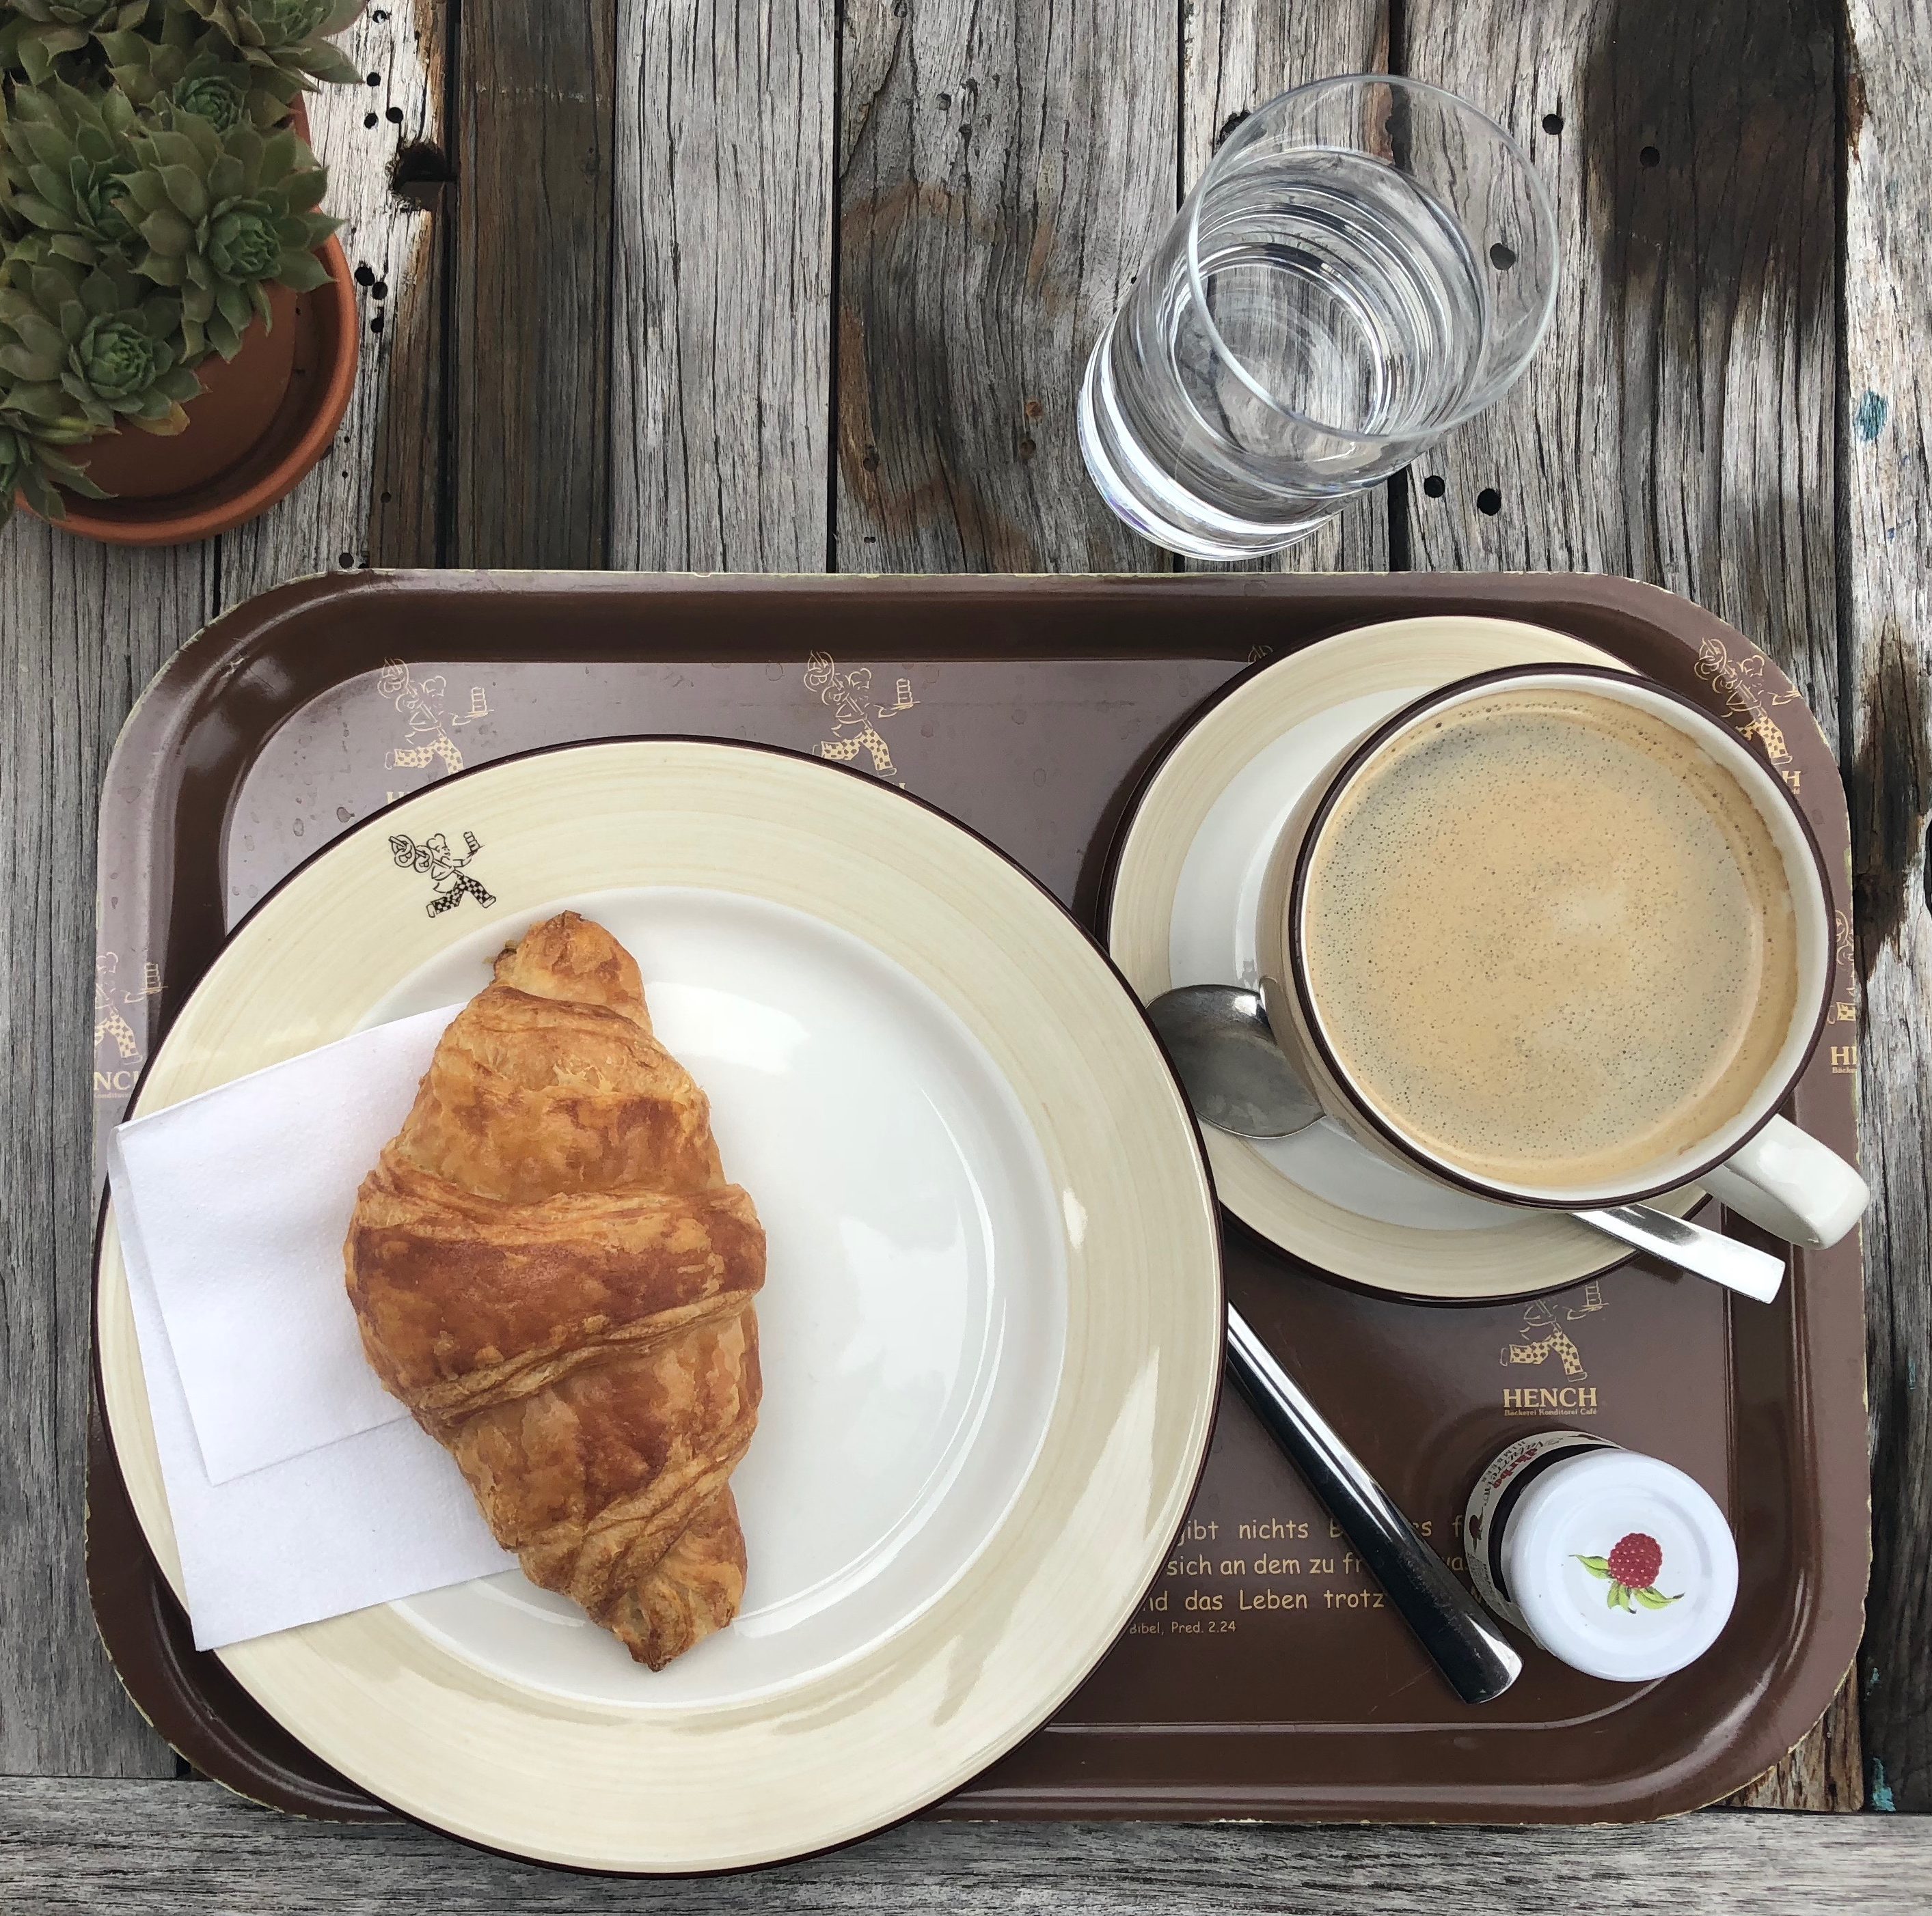
k3os
Made by Rancher/Suse
Built for k3s (Kubernetes distribution)
k3s is PID 1
Based on Alpine + Ubuntu Kernel
No traditional package manager
Kubernetes is the frontend
Configuration and updates done via CRD
https://k3os.io/
https://k3s.io/

Slide 9
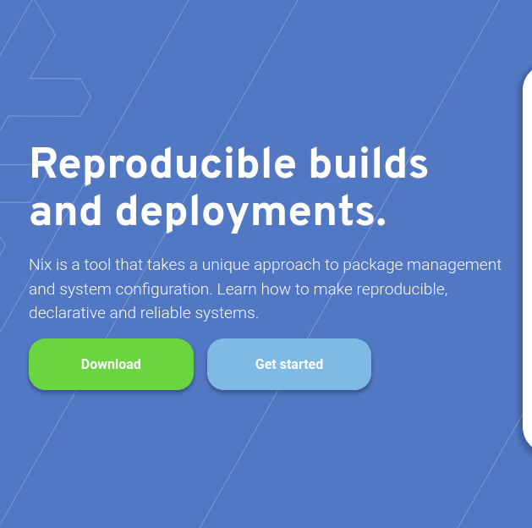
NixOS
Independent
Declarative via JSON config
Nix+NixShell → NixOS
Designed for container/cloud/ISO abstraction
Every (manual) installation is a container, but somewhat hidden
You can start on your own machine
https://nixos.org/

Slide 10
Conclusion
Tested all of them
Worked with 3 of them (4 tbd)
Solving some issues
Applications not ready
Some hoops and loops here and there
CoreOS seems very mature, followed by k3s
None of them are ready:
  “critical production workload”
  being used by general Linux operators
All of them
  Very cloud and container focussed
  Different ideas with the same goal

Slide 11
The future of Linux is immutable, but my answers and opinions not. Please don’t hesitate :)

