Slide 1
Smart Displays and Mirrors
Mirror, Mirror on the wall...
At 10.03.2022 by Daniel Schier

Slide 2
Agenda
Introduction
Part 1
  Topic 1.1
  Topic 1.2
Part 2
Part 3
Part 4

Slide 3
Introduction

Slide 4

Introduction
Daniel Schier
Open Source enthusiast
Ansible since 1.6
Meetups, Conferences, Cats, Penguins, Cookies
Contact:
  twitter.com/dschier_wtd
  linkedin.com/u/dschier
  github.com/dschier-wtd

Slide 5
Project

Slide 6
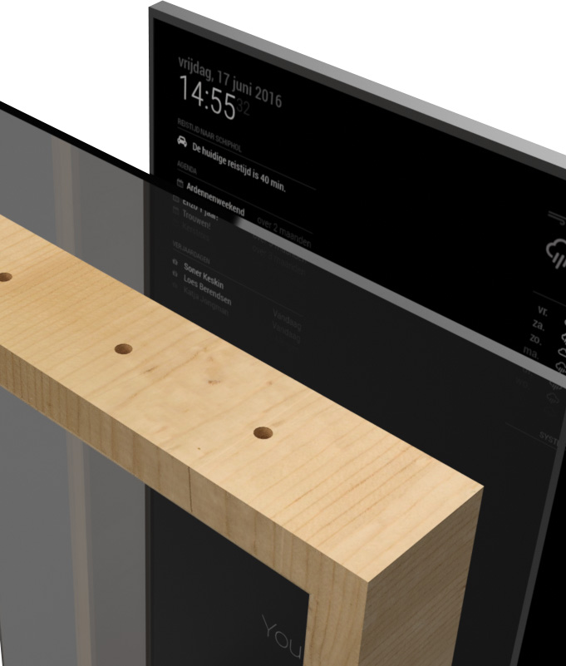
Project
Smart Display/Mirror
Show Date, Calendar
Show Weather, Forecast
Show News
Maybe more

Slide 7
Hardware

Slide 8
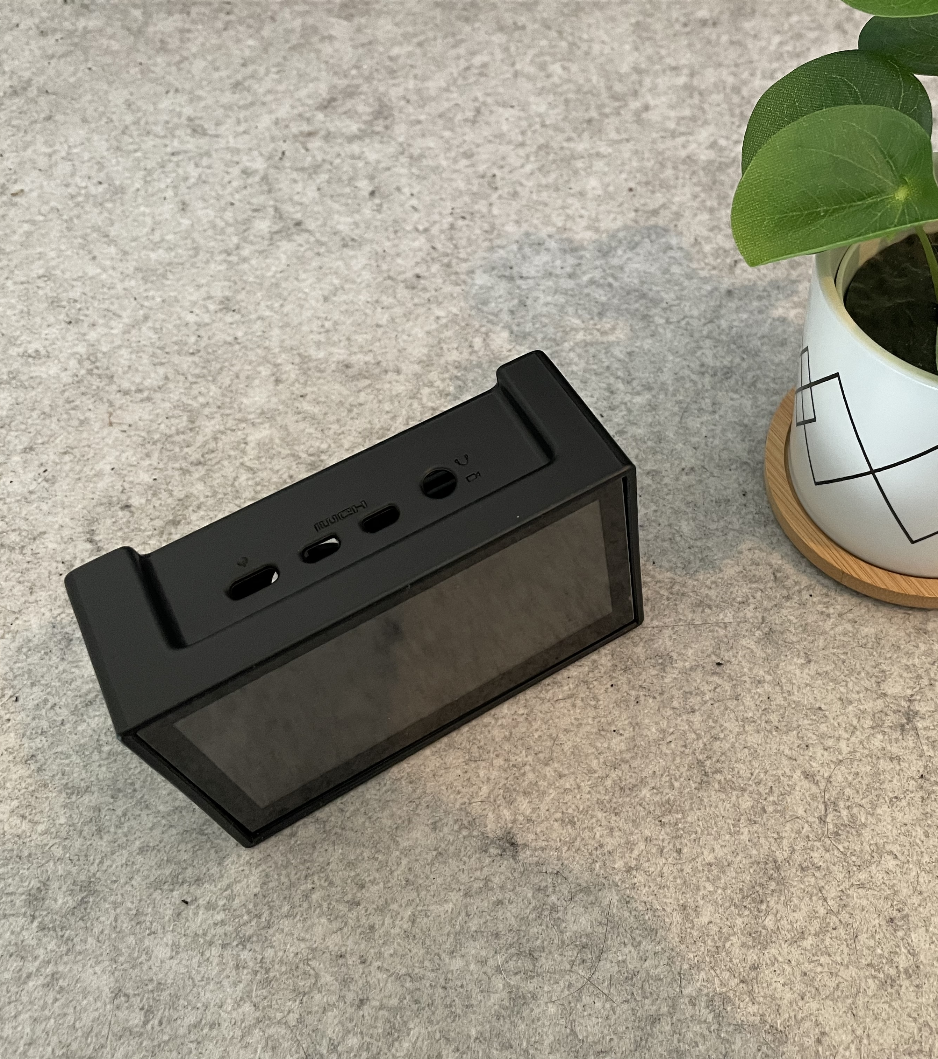
Hardware
Raspberry Pi (30€)
Some Display (5-100€)
Spy Mirror (20-200€)
Cables
Time

Slide 9
Software

Slide 10
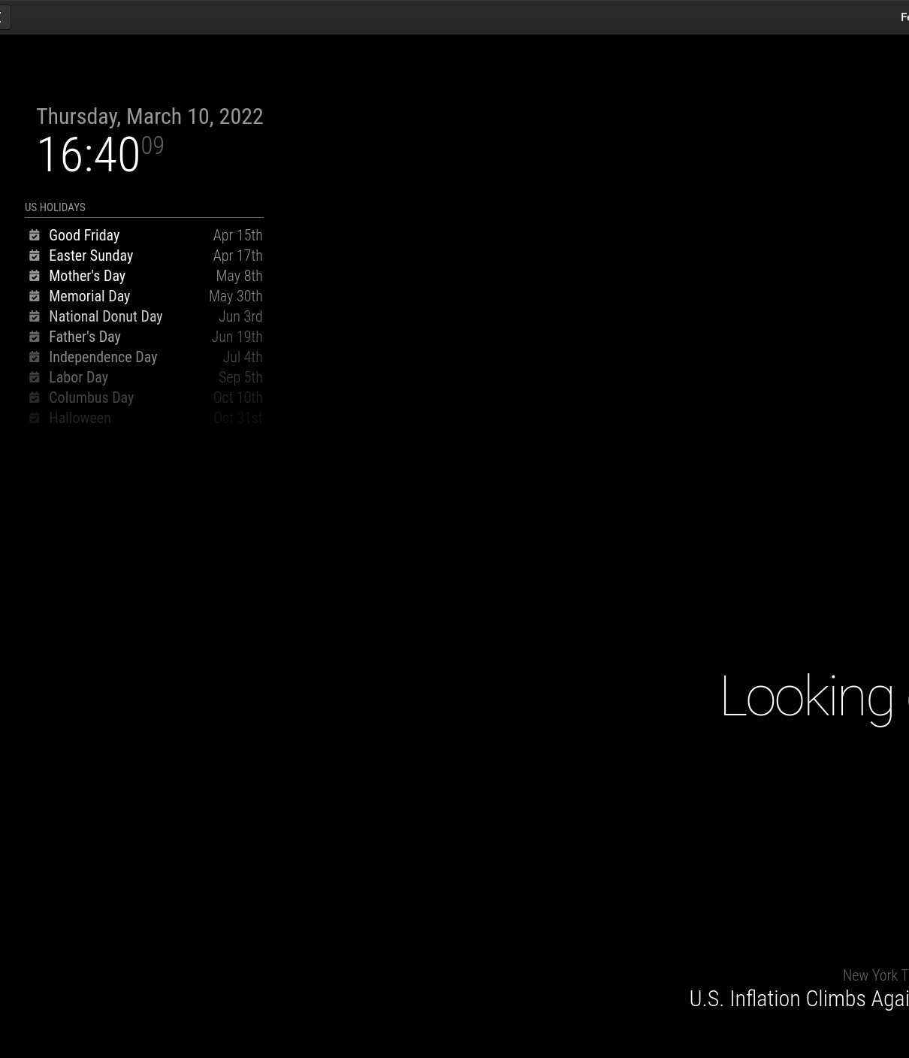
Software
Fedora Minimal
MagicMirror
Cockpit Project
Some Virtualization for testing

Slide 11
Impressions

Slide 12
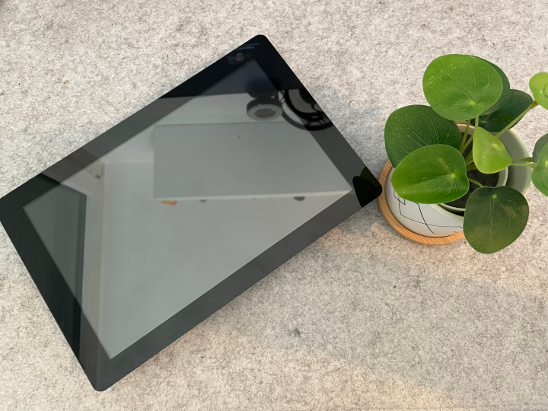

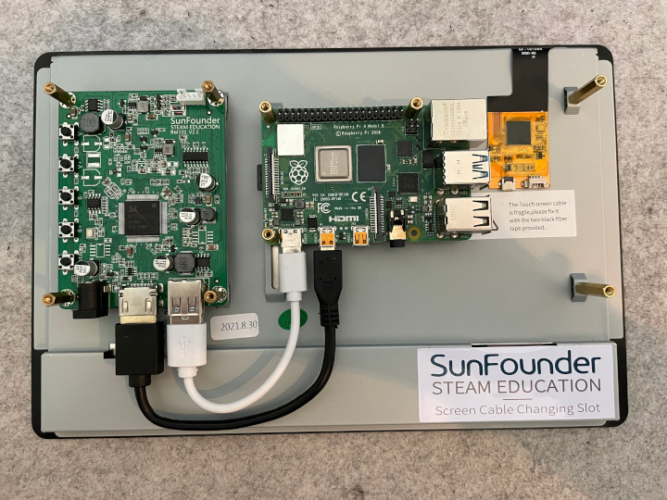
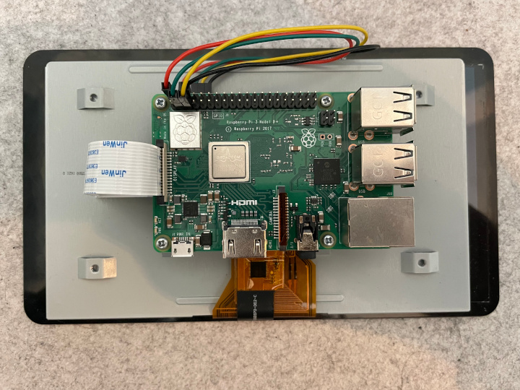
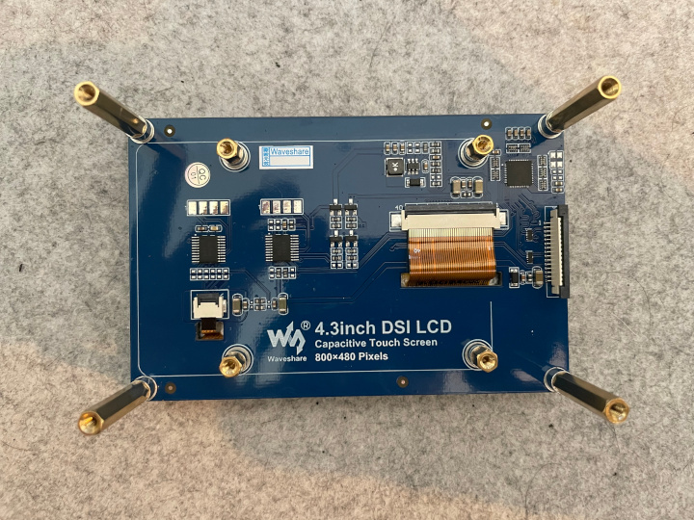
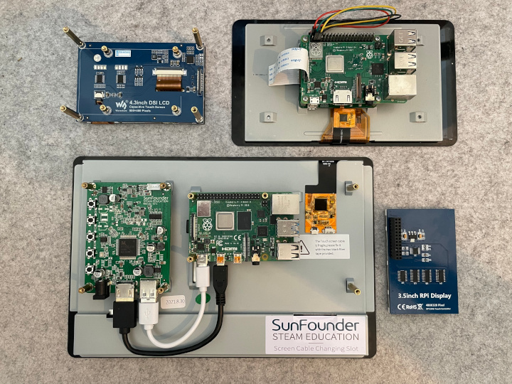
Impressions

Slide 13
Links
https://magicmirror.builders/
https://docs.magicmirror.builders/
https://github.com/topics/magic-mirror-modules
https://github.com/MichMich/MagicMirror
https://getfedora.org/
https://cockpit-project.org/
https://github.com/dschier-wtd/fedora-smartdisplay/

Slide 14
Questions & Answers
Learning something new starts with asking a question.

