Slide 1
Smart Devices

Slide 2
Agenda
Requirements
Preparation
Concept
Programming
  Web Server
  Auto Start Web Server
  Auto Start Browser

Slide 3
Requirements

Slide 4
Requirements
Software
  Raspberry Imager
  Raspberry Pi OS
  Fritzing
  Putty or other SSH client

Slide 5
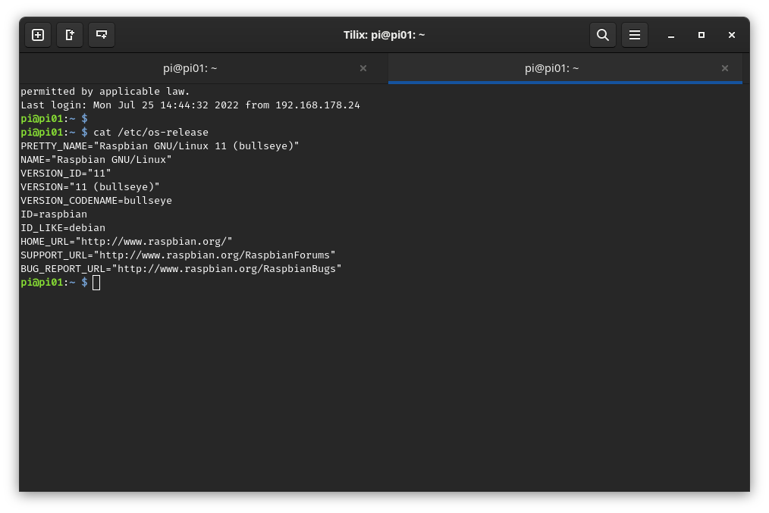
Requirements

Slide 6
Requirements
Hardware
  Raspberry Pi
  Breadboard
  LED
  Resistor
  Cables
  Some Display

Slide 7
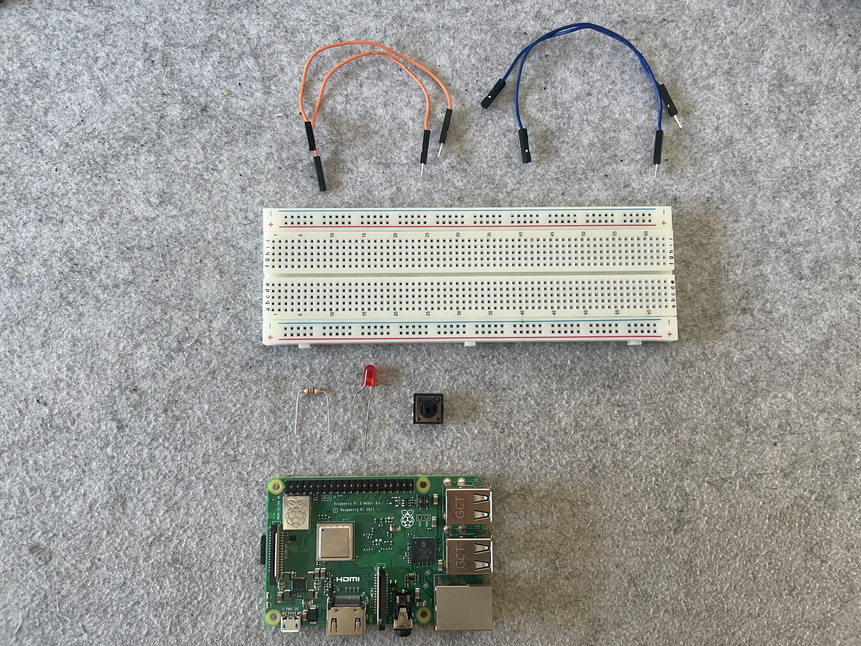
Programming - Preparation

Slide 8
Preparation

Slide 9
Preparation
Manual Install
  Download lite image
  $ wget https://downloads.raspberrypi.org/raspios_lite_armhf_latest
  Download regular image
  $ wget https://downloads.raspberrypi.org/raspios_armhf_latest
  Write SD card
  $ unzip -p <IMAGE> | sudo dd of=/dev/mmcblk0 oflag=sync status=progress bs=4M
Guided Install
  Download Raspberry Imager

Slide 10
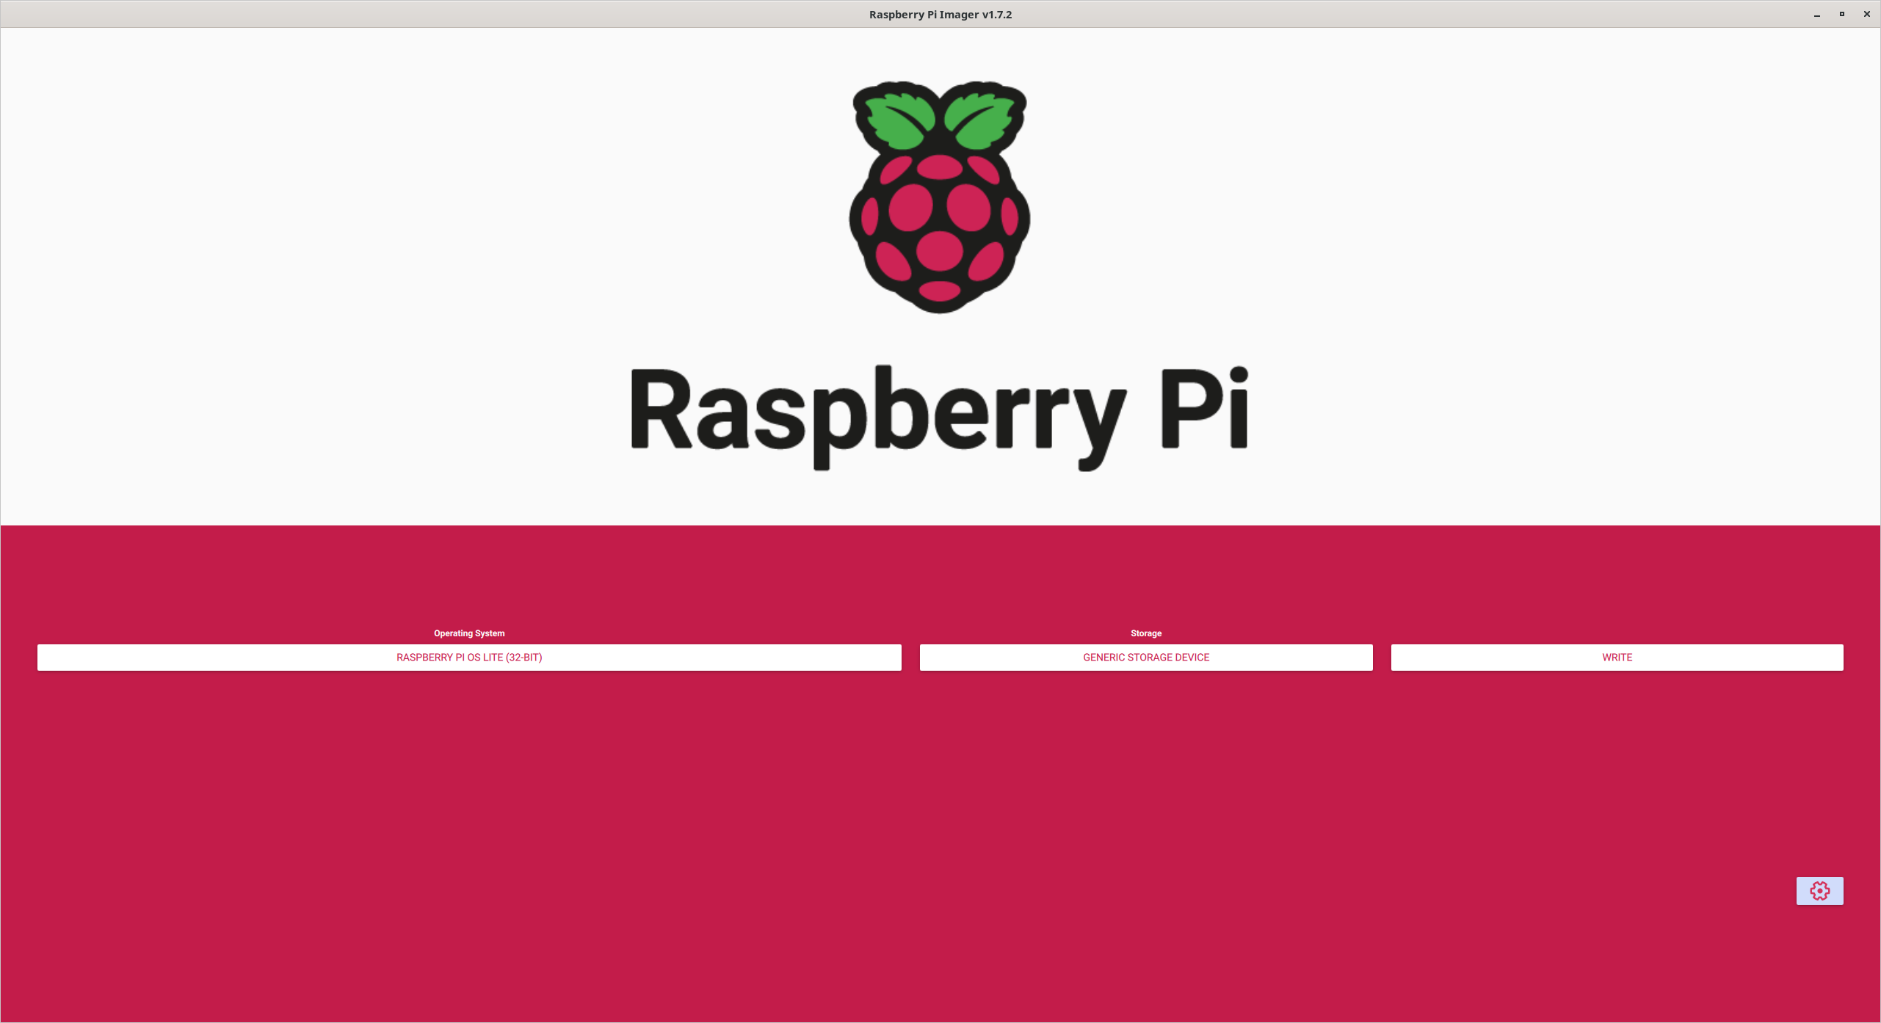
Preparation

Slide 11
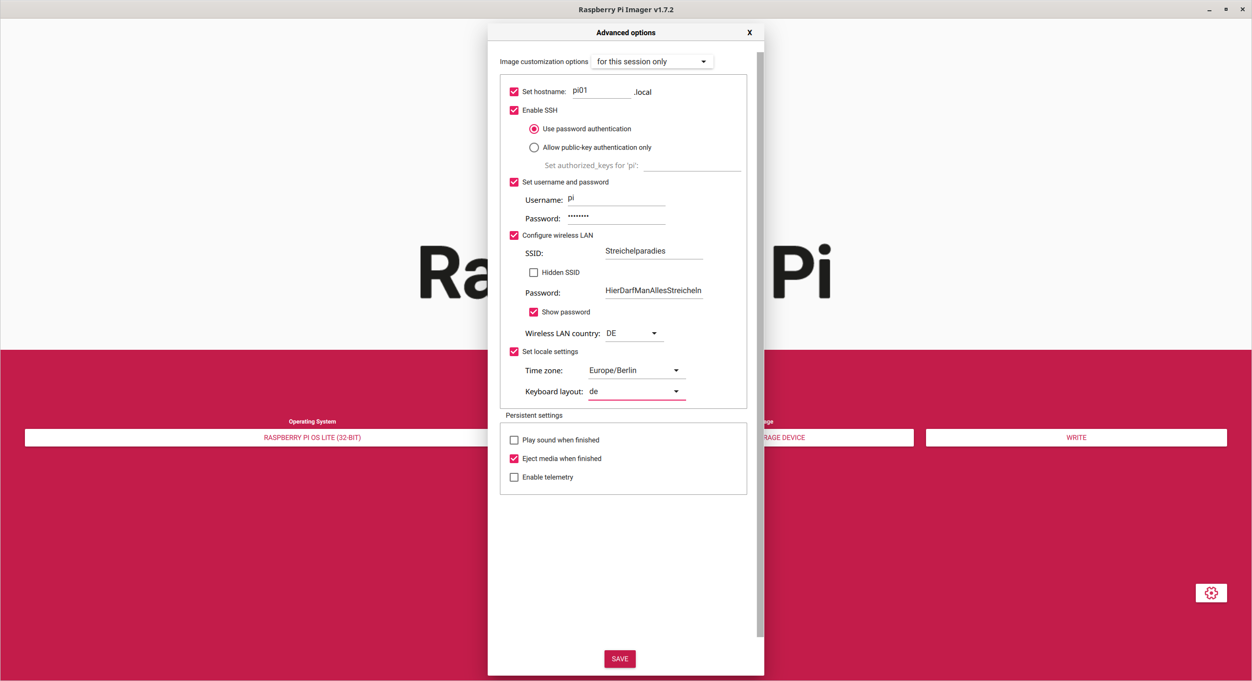
Preparation

Slide 12
Concept

Slide 13
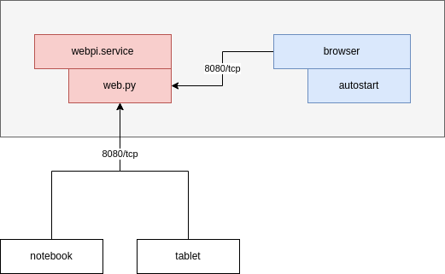
Concept

Slide 14
Programming

Slide 15
Programming - Preparation
Create a working directory
$ mkdir project
Navigate there
$ cd project/
Start a new file
$ nano led_1.py
Continue with the exercises

Slide 16
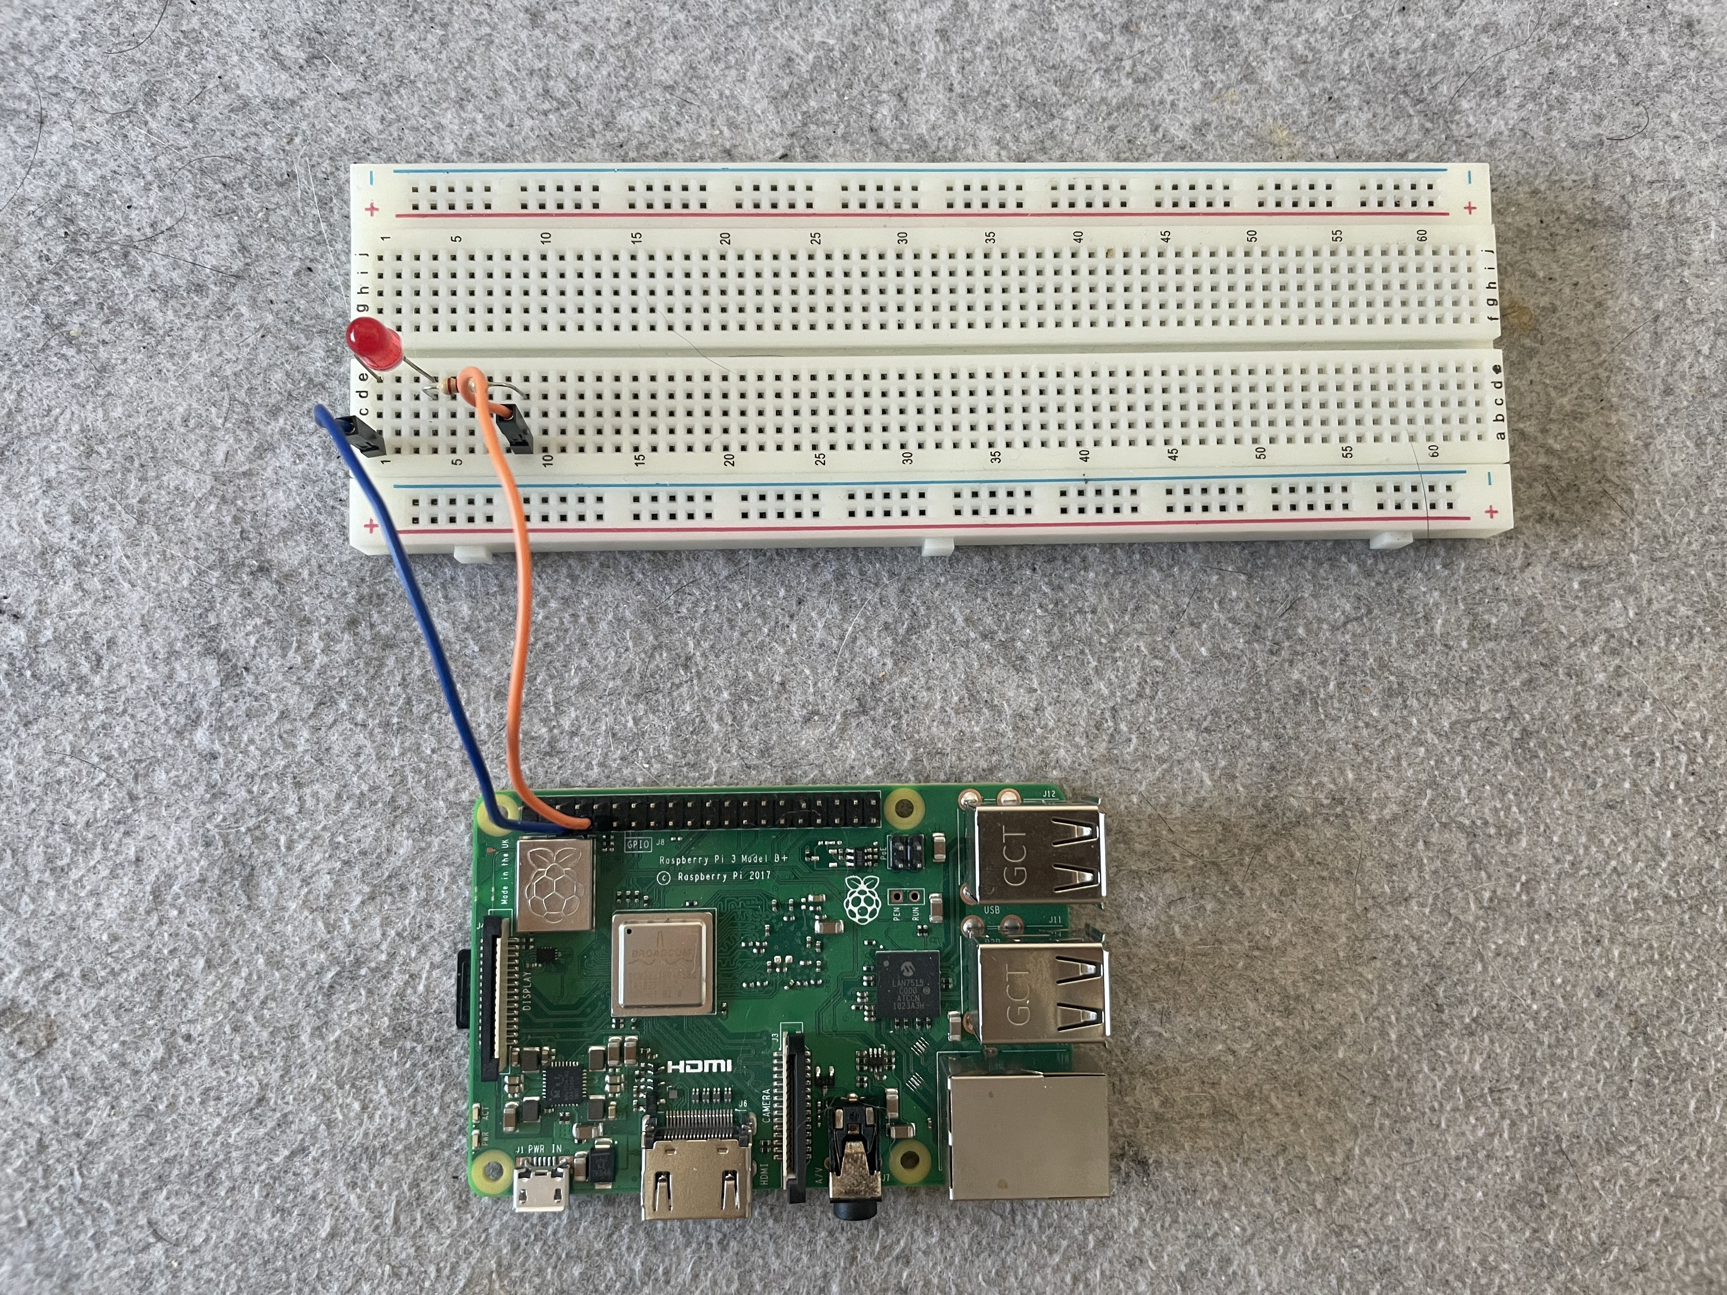
Programming – LED and Web Server

Slide 17
Programming – LED 1
from gpiozero import LED
from time import sleep
led = LED(4)
led.on()
sleep(1)
led.off()

Slide 18
Programming – Web Server 1
from http.server import BaseHTTPRequestHandler, HTTPServer
import time
hostName = ""
serverPort = 8080
class MyServer(BaseHTTPRequestHandler):
def do_GET(self):
self.send_response(200)
self.send_header("Content-type", "text/html")
self.end_headers()
html = '''
<html>
<body
style="width:960px; margin: 20px auto;">
<h1>Welcome to my Raspberry Pi</h1>
<form action="/" method="POST">
Turn LED_1 :
<input type="submit" name="LED_1" value="On">
<input type="submit" name="LED_1" value="Off">
</form>
</body>
</html>
'''
self.wfile.write(html.encode("utf-8"))
### Main ###
if __name__ == "__main__":
webServer = HTTPServer((hostName, serverPort), MyServer)
print("Server started http://%s:%s" % (hostName, serverPort))
try:
webServer.serve_forever()
except KeyboardInterrupt:
pass
webServer.server_close()
print("Server stopped.")

Slide 19
Programming – Web Server 2
...SNIP...
def do_POST(self):
content_length = int(self.headers['Content-Length'])
post_data = self.rfile.read(content_length).decode("utf-8")
print(post_data)
if post_data == 'LED_1=On':
led_1.on()
elif post_data == 'LED_1=Off':
led_1.off()
self._redirect('/')
...SNIP...

Slide 20
Programming – Web Server 3
...SNIP...
def _redirect(self, path):
self.send_response(303)
self.send_header('Content-type', 'text/html')
self.send_header('Location', path)
self.end_headers()
...SNIP...

Slide 21
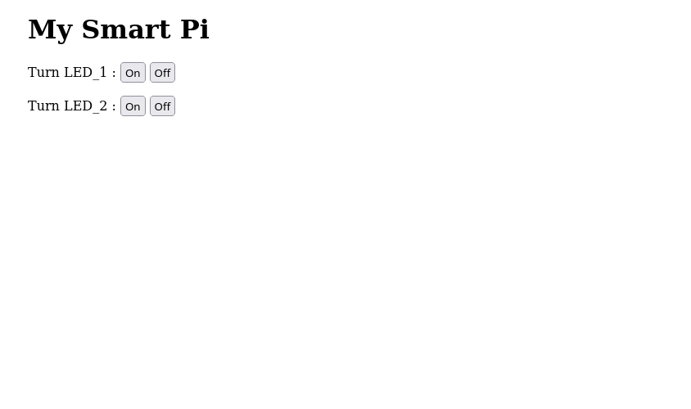
Configuring – Autostart Web Server

Slide 22
Configuring – Autostart Web Server
# Copy your server program
$ sudo cp web_3.py /usr/local/bin/
# Create a new systemd service unit
$ sudo nano /etc/systemd/system/webpi.service
# /etc/systemd/system/webpi.service
[Unit]
Description=A bit about your service
[Service]
Type=simple
ExecStart=python /usr/local/bin/web_3.py
Restart=on-failure
[Install]
WantedBy=multi-user.target

Slide 23
Configuring – Autostart Web Server
# Enable the server
$ sudo systemctl daemon-reload
$ sudo systemctl enable webpi.service
$ sudo systemctl start webpi.service
# Test
$ netstat -tlpn
$ curl localhost:8080

Slide 24
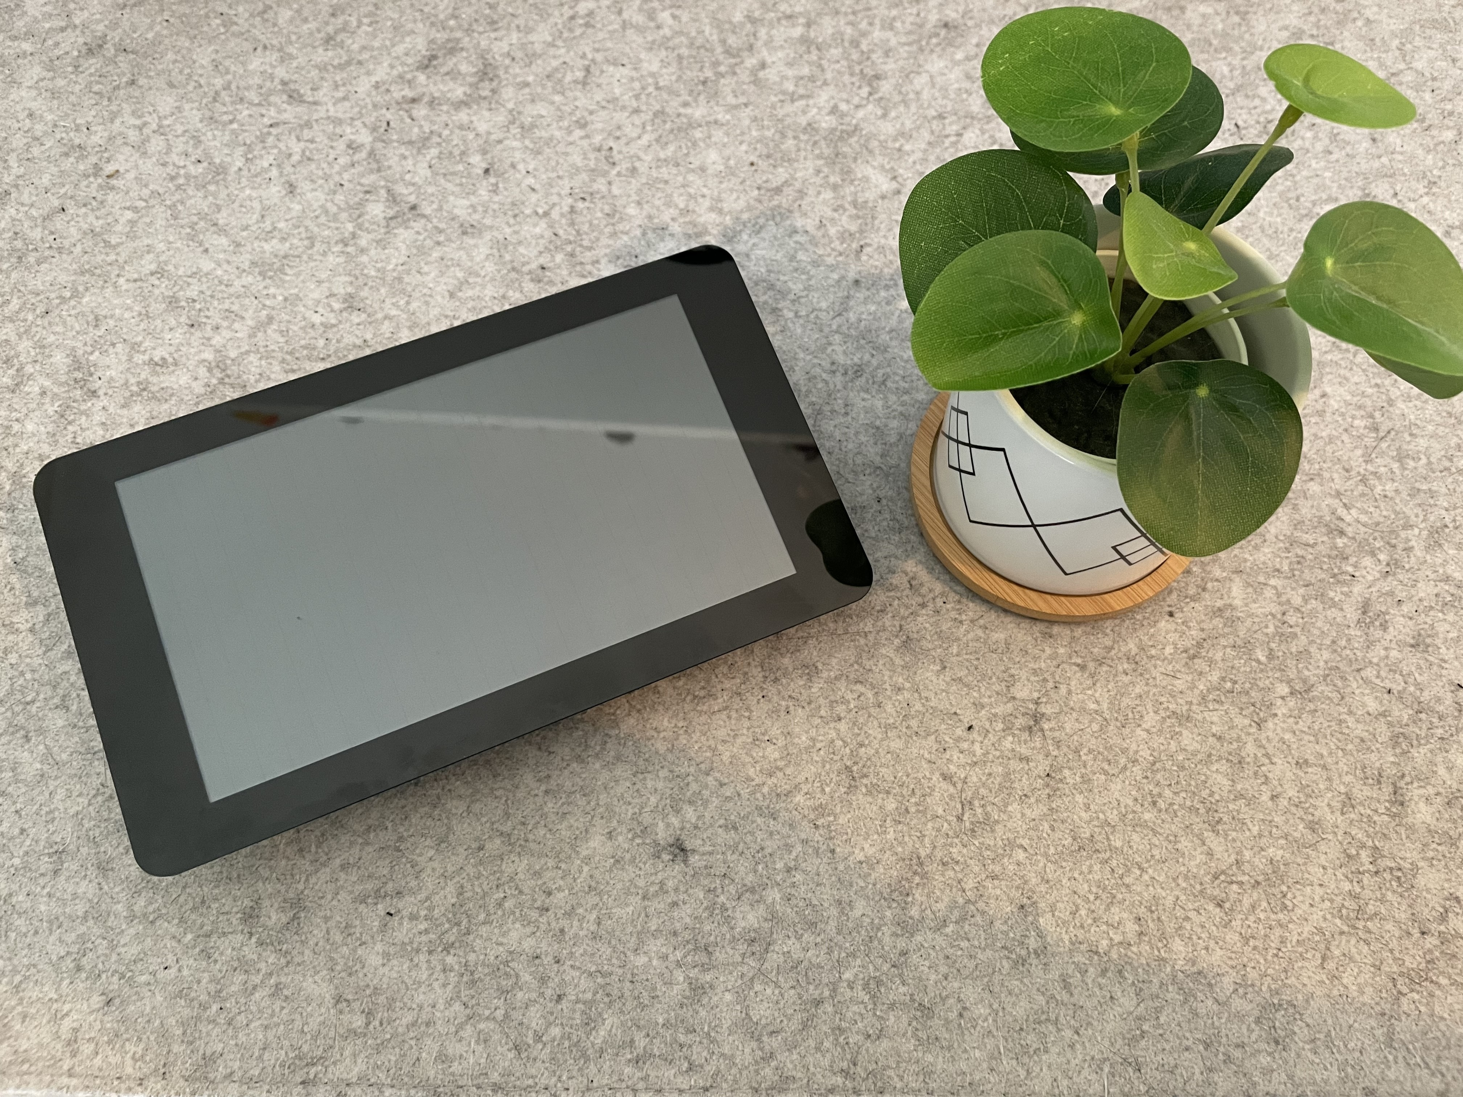
Configuring – Autostart Browser

Slide 25
Configuring – Autostart Browser
# Install (this will take a while)
$ sudo apt-get update
$ sudo apt-get install ttf-mscorefonts-installer \
x11-xserver-utils midori lxsession lightdm
# Configure Autostart Desktop (with automatic login)
$ sudo raspi-config
$ reboot

Slide 26
Configuring – Autostart Browser
# Change Autostart
$ sudo nano .config/lxsession/LXDE/autostart
# .config/lxsession/LXDE/autostart
@midori -e fullscreen -a http://localhost:8080
@xset s noblank
@xset s off
@xset -dpms

Slide 27
Docs & Links
https://www.raspberrypi.org/
https://www.raspberrypi.com/documentation/computers/os.html#gpio-and-the-40-pin-header
https://gpiozero.readthedocs.io/en/stable/
https://github.com/dschier-wtd/presentations/

