Slide 1
Smart Devices

Slide 2
Agenda
Requirements
Preparation
Cabeling
First Boot
Programming
  LEDs
  Buttons
  Web Server
  (Camera)

Slide 3
Requirements

Slide 4
Requirements
Software
  Raspberry Imager
  Raspberry Pi OS
  Fritzing
  Putty or other SSH client

Slide 5
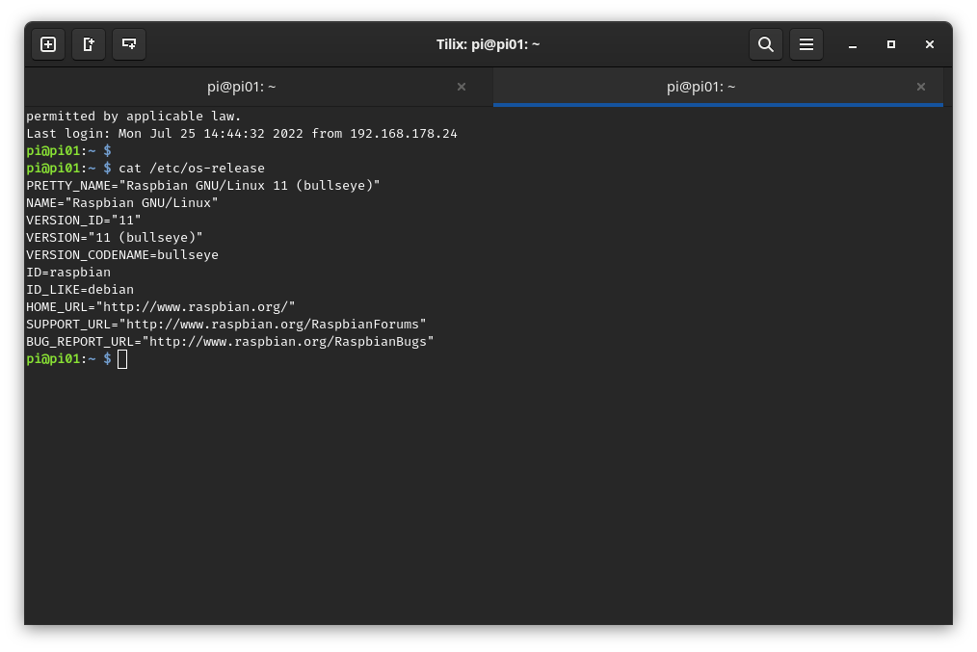
Requirements

Slide 6
Requirements
Hardware
  Raspberry Pi
  Breadboard
  LED
  Button
  Resistor
  Cables

Slide 7
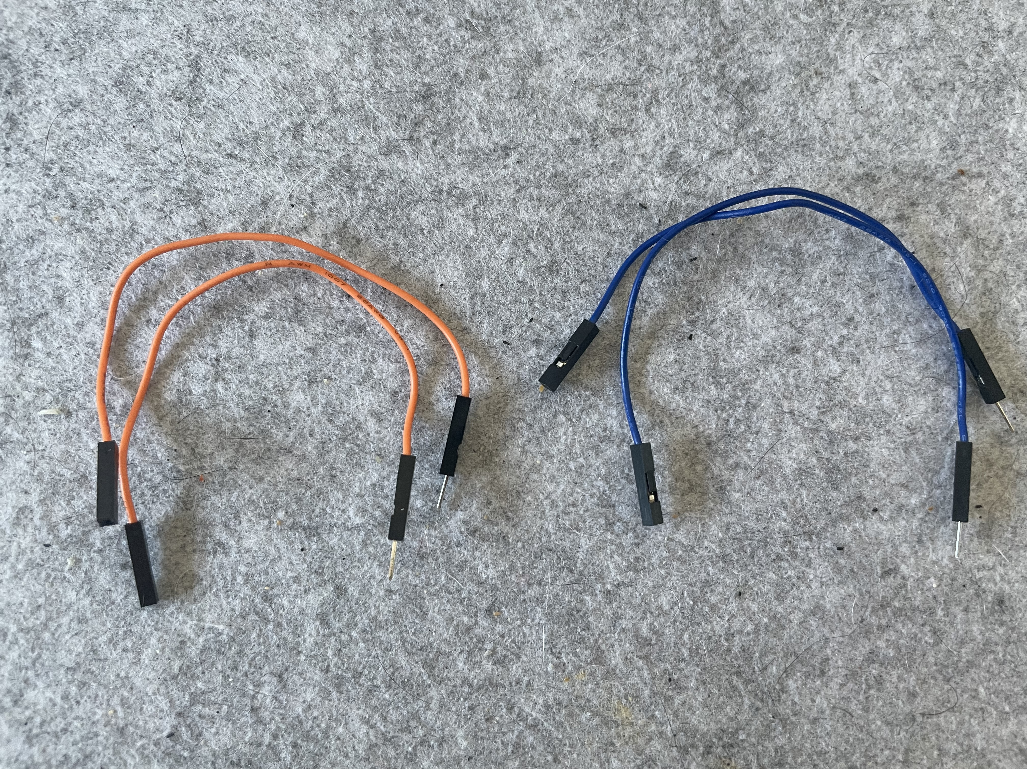
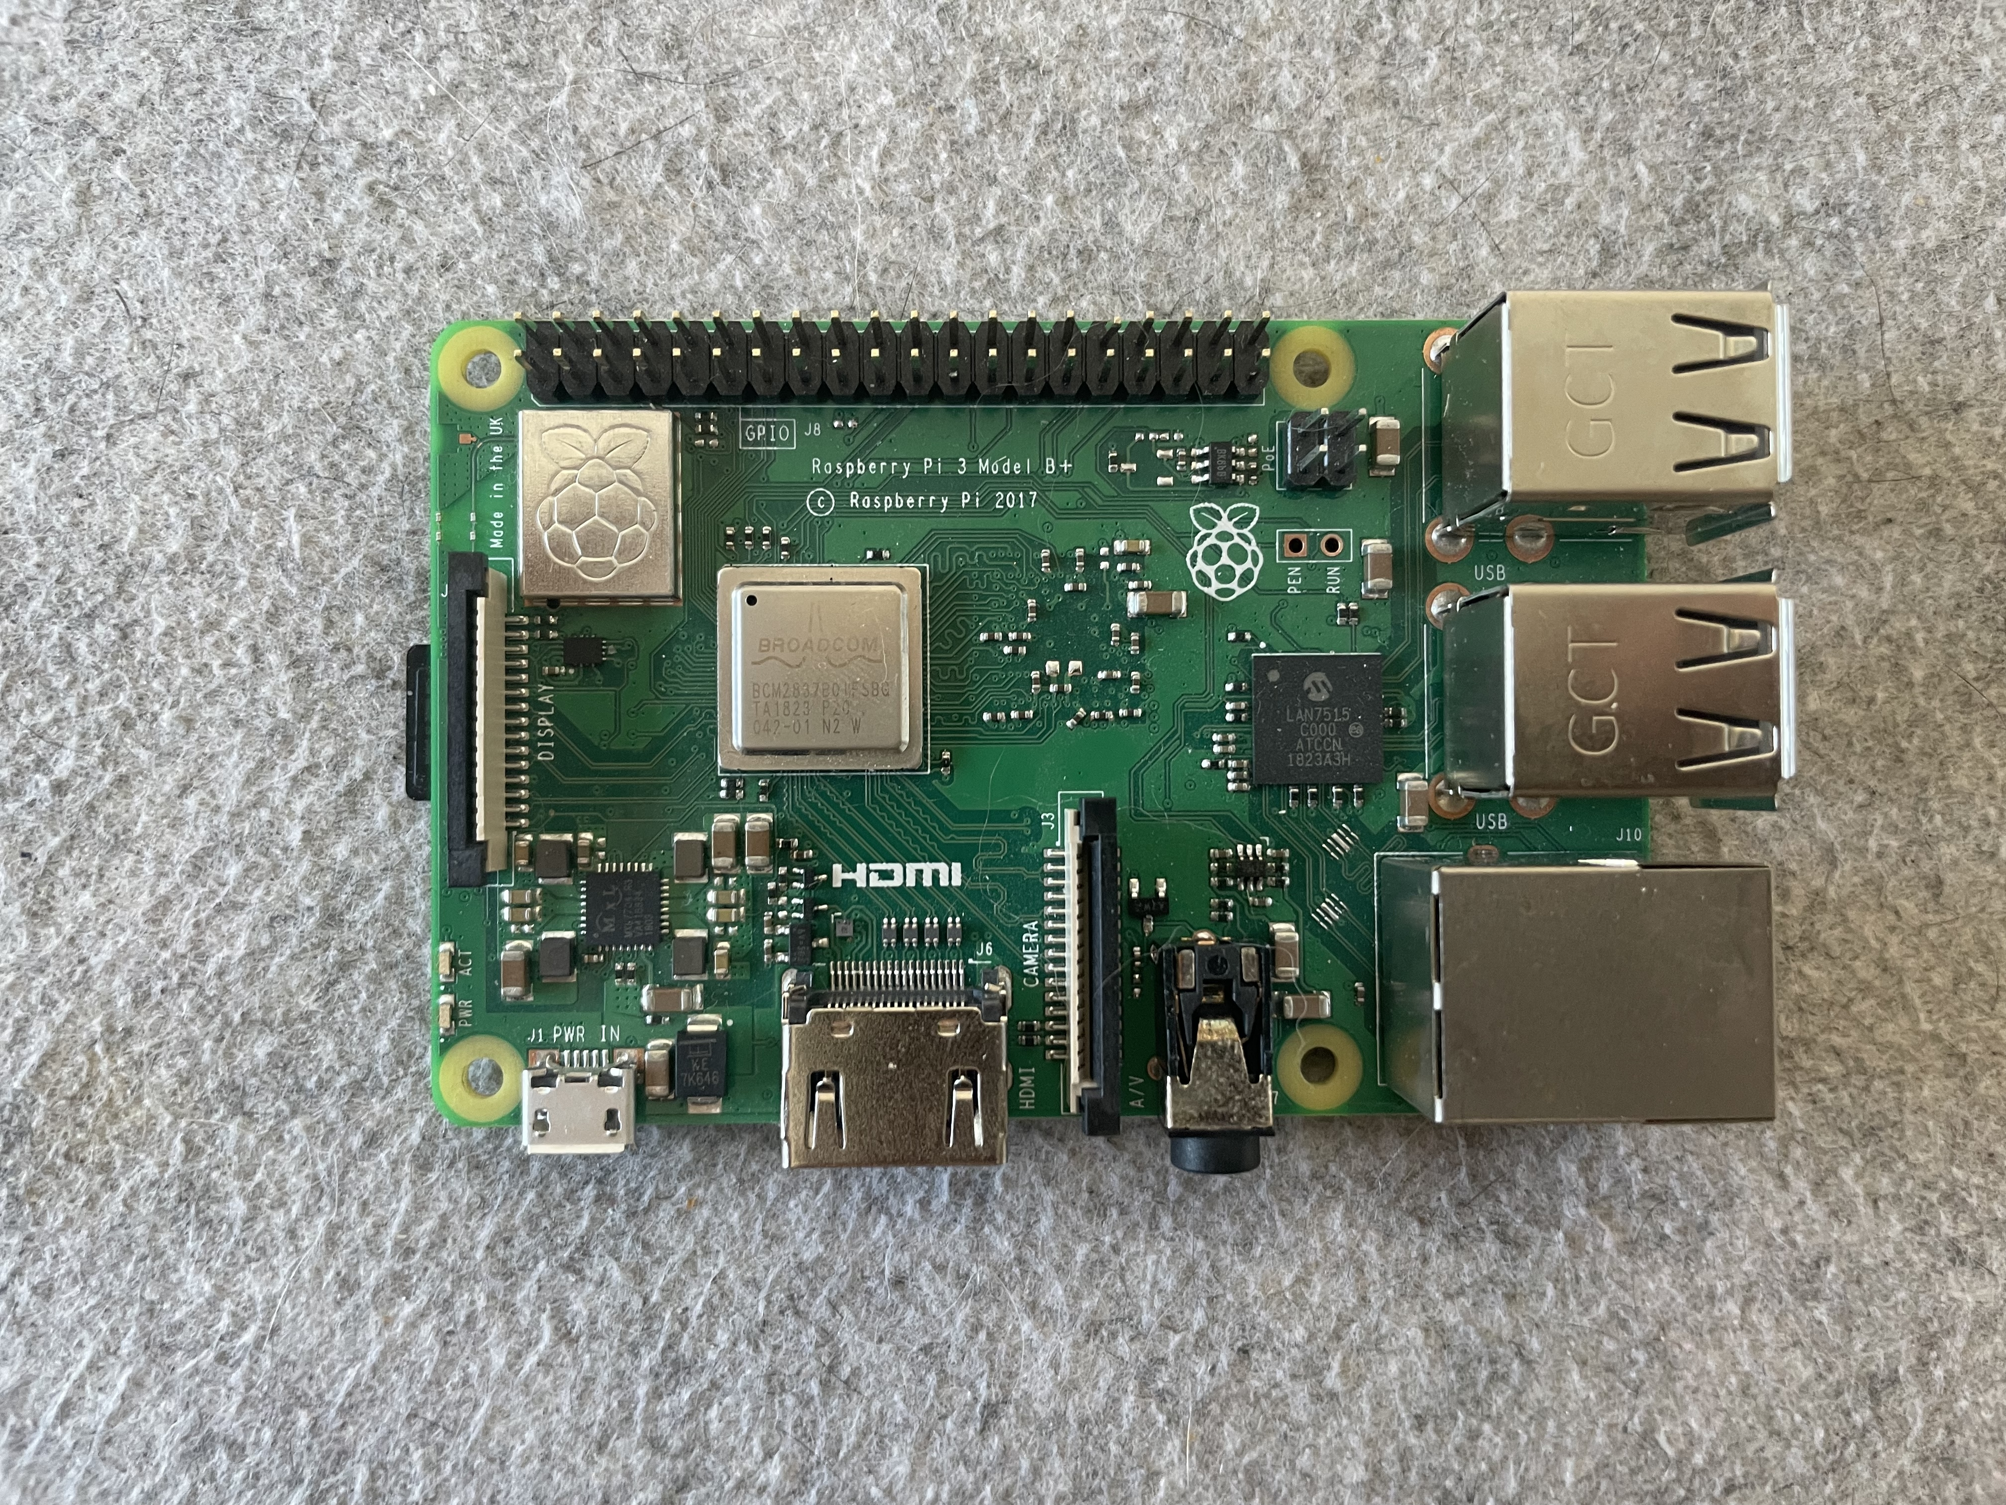
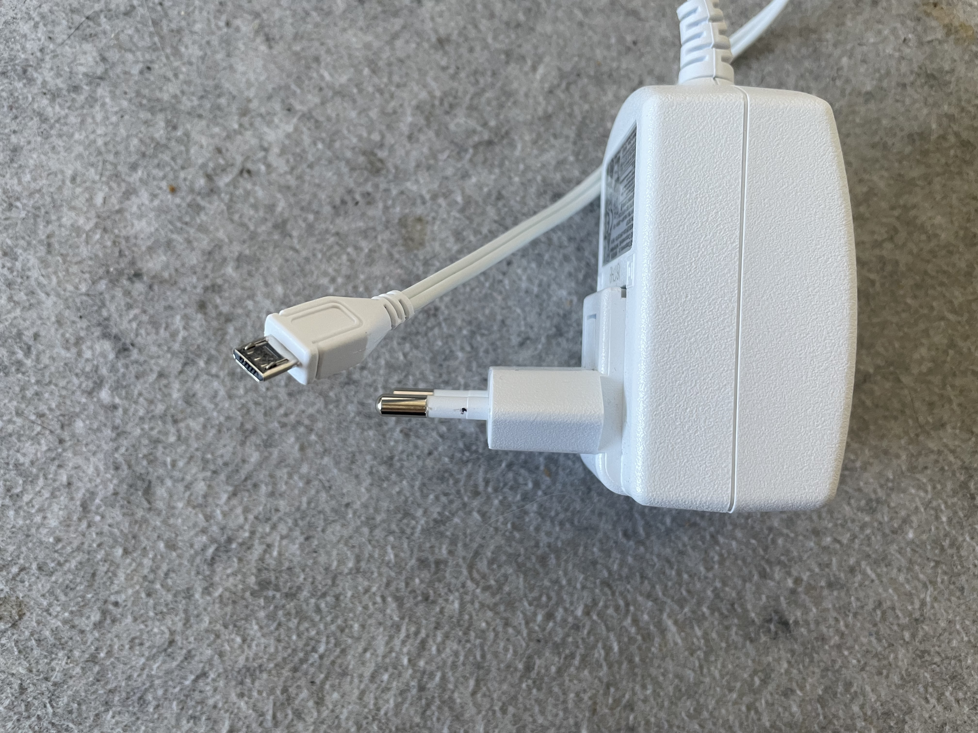
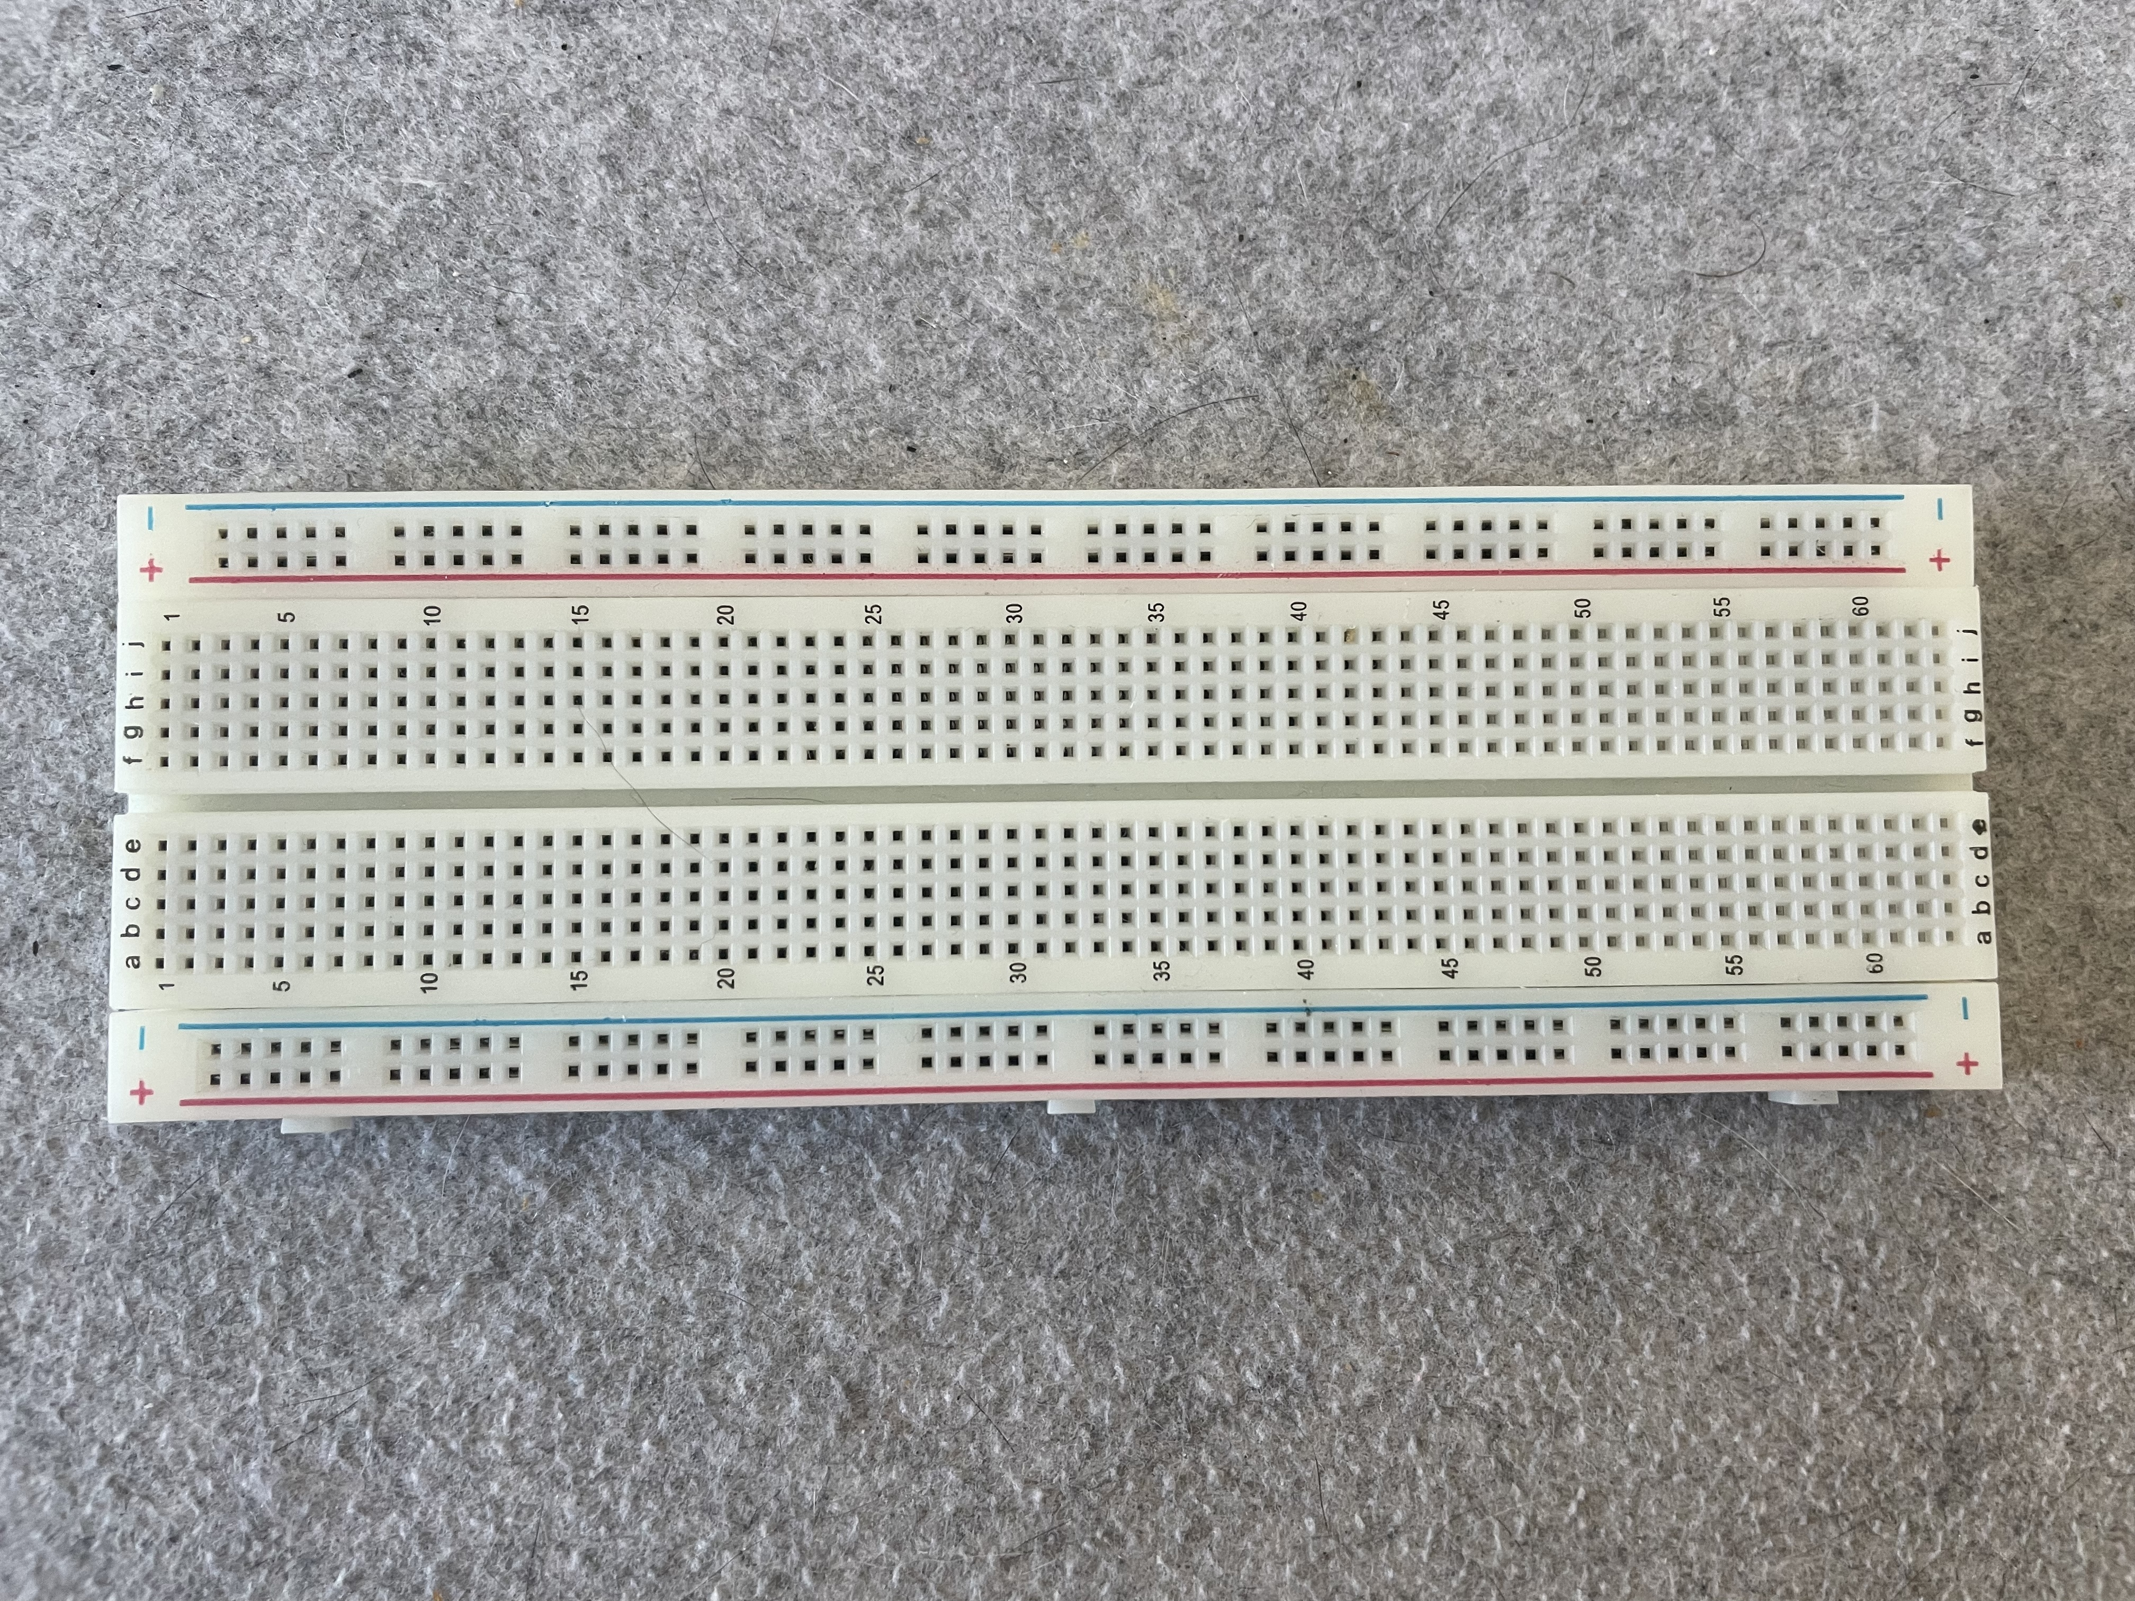
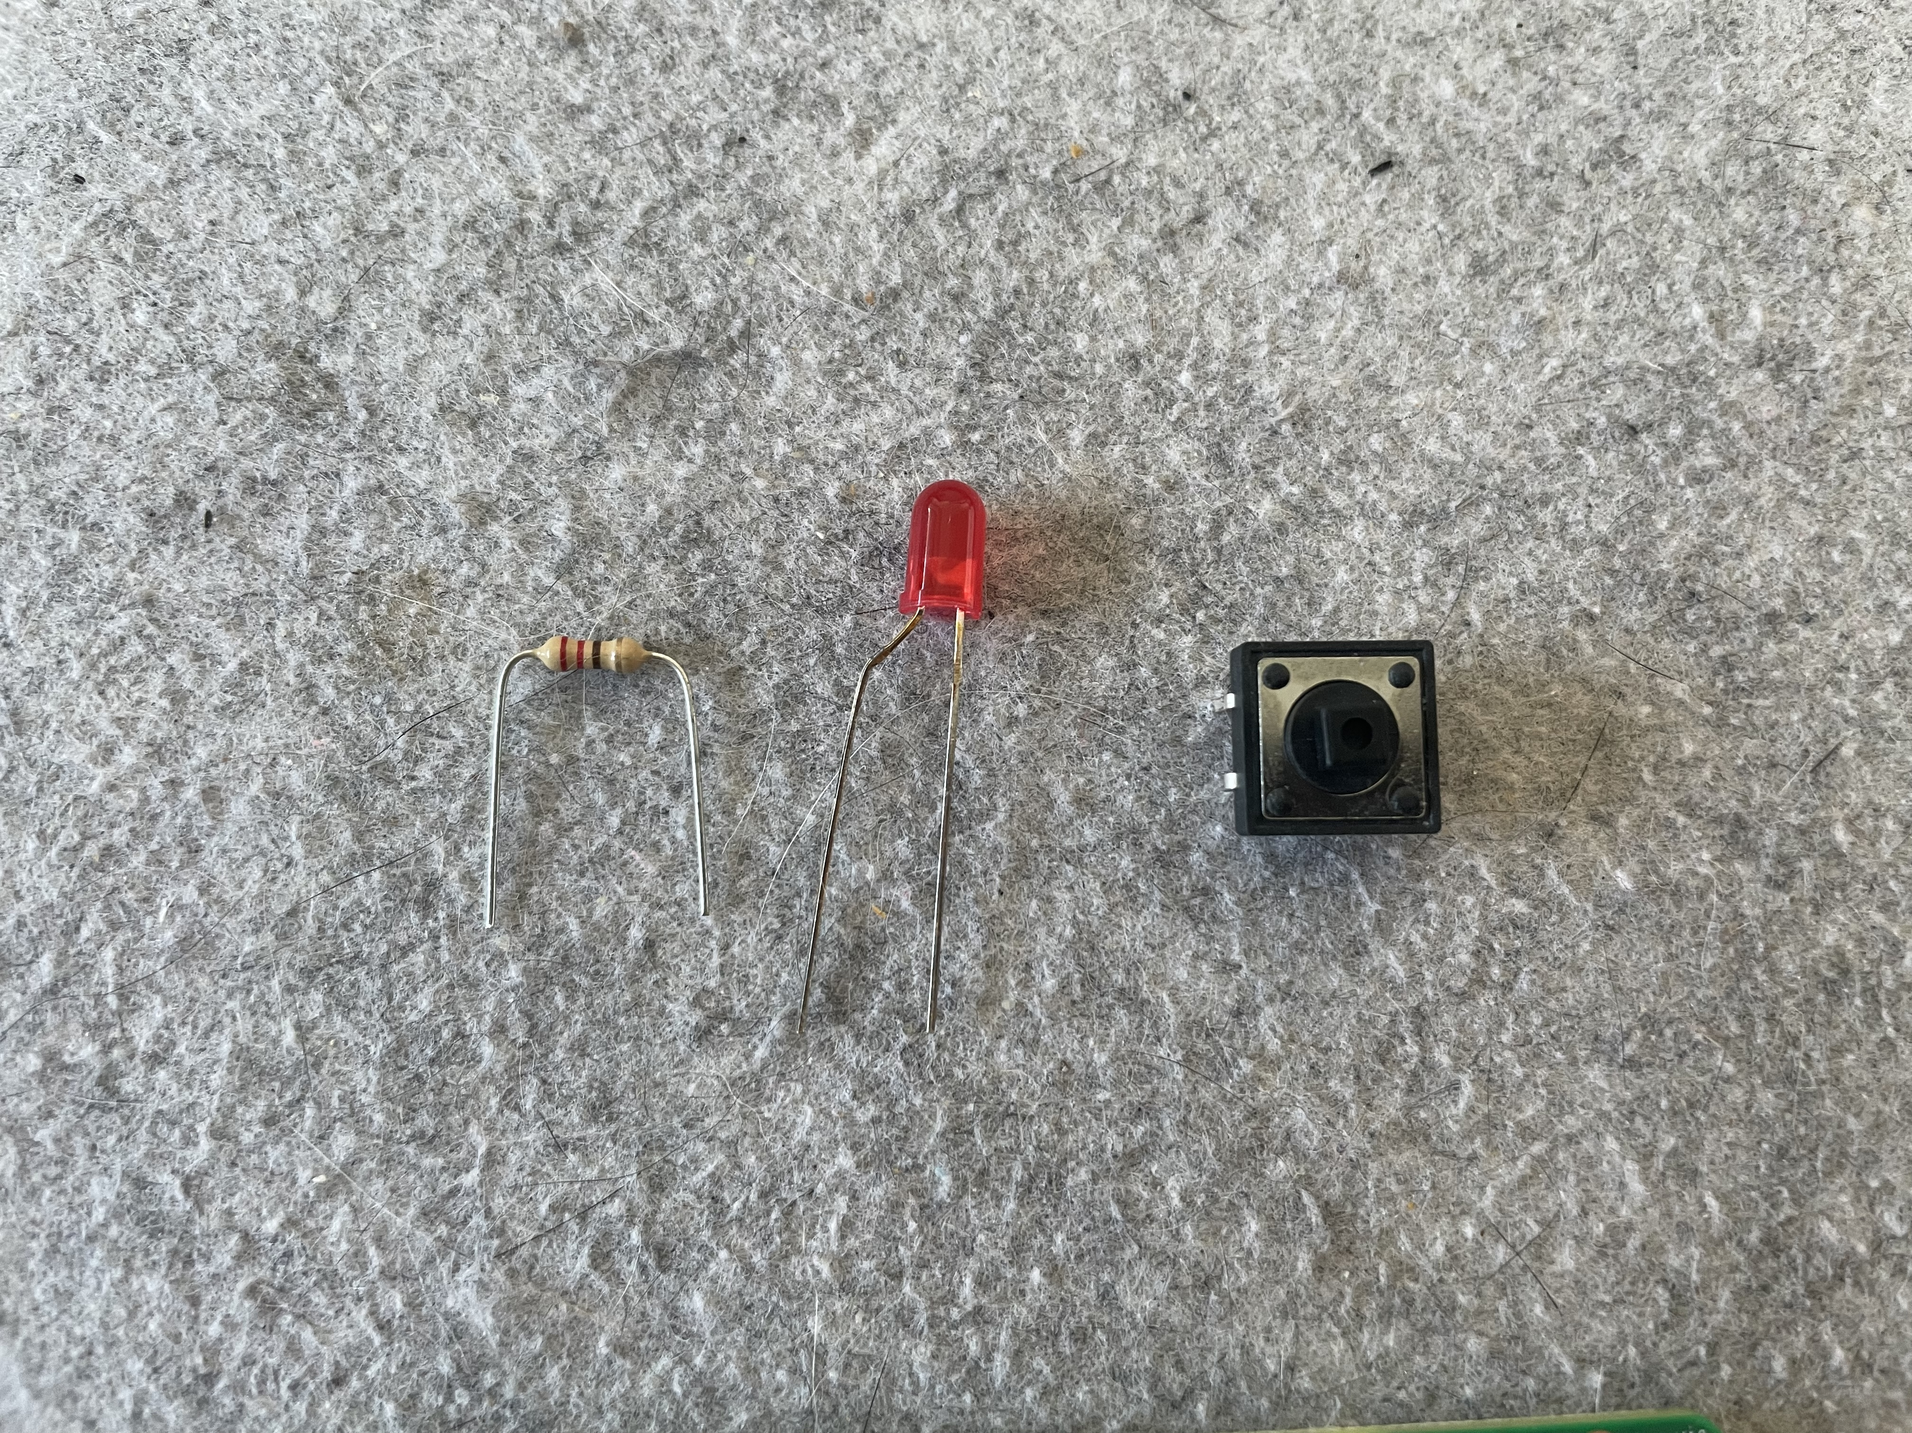
Hardware

Slide 8
Preparation

Slide 9
Preparation
Manual Install
  Download lite image
  $ wget https://downloads.raspberrypi.org/raspios_lite_armhf_latest
  Download regular image
  $ wget https://downloads.raspberrypi.org/raspios_armhf_latest
  Write SD card
  $ unzip -p <IMAGE> | sudo dd of=/dev/mmcblk0 oflag=sync status=progress bs=4M
Guided Install
  Download Raspberry Imager

Slide 10
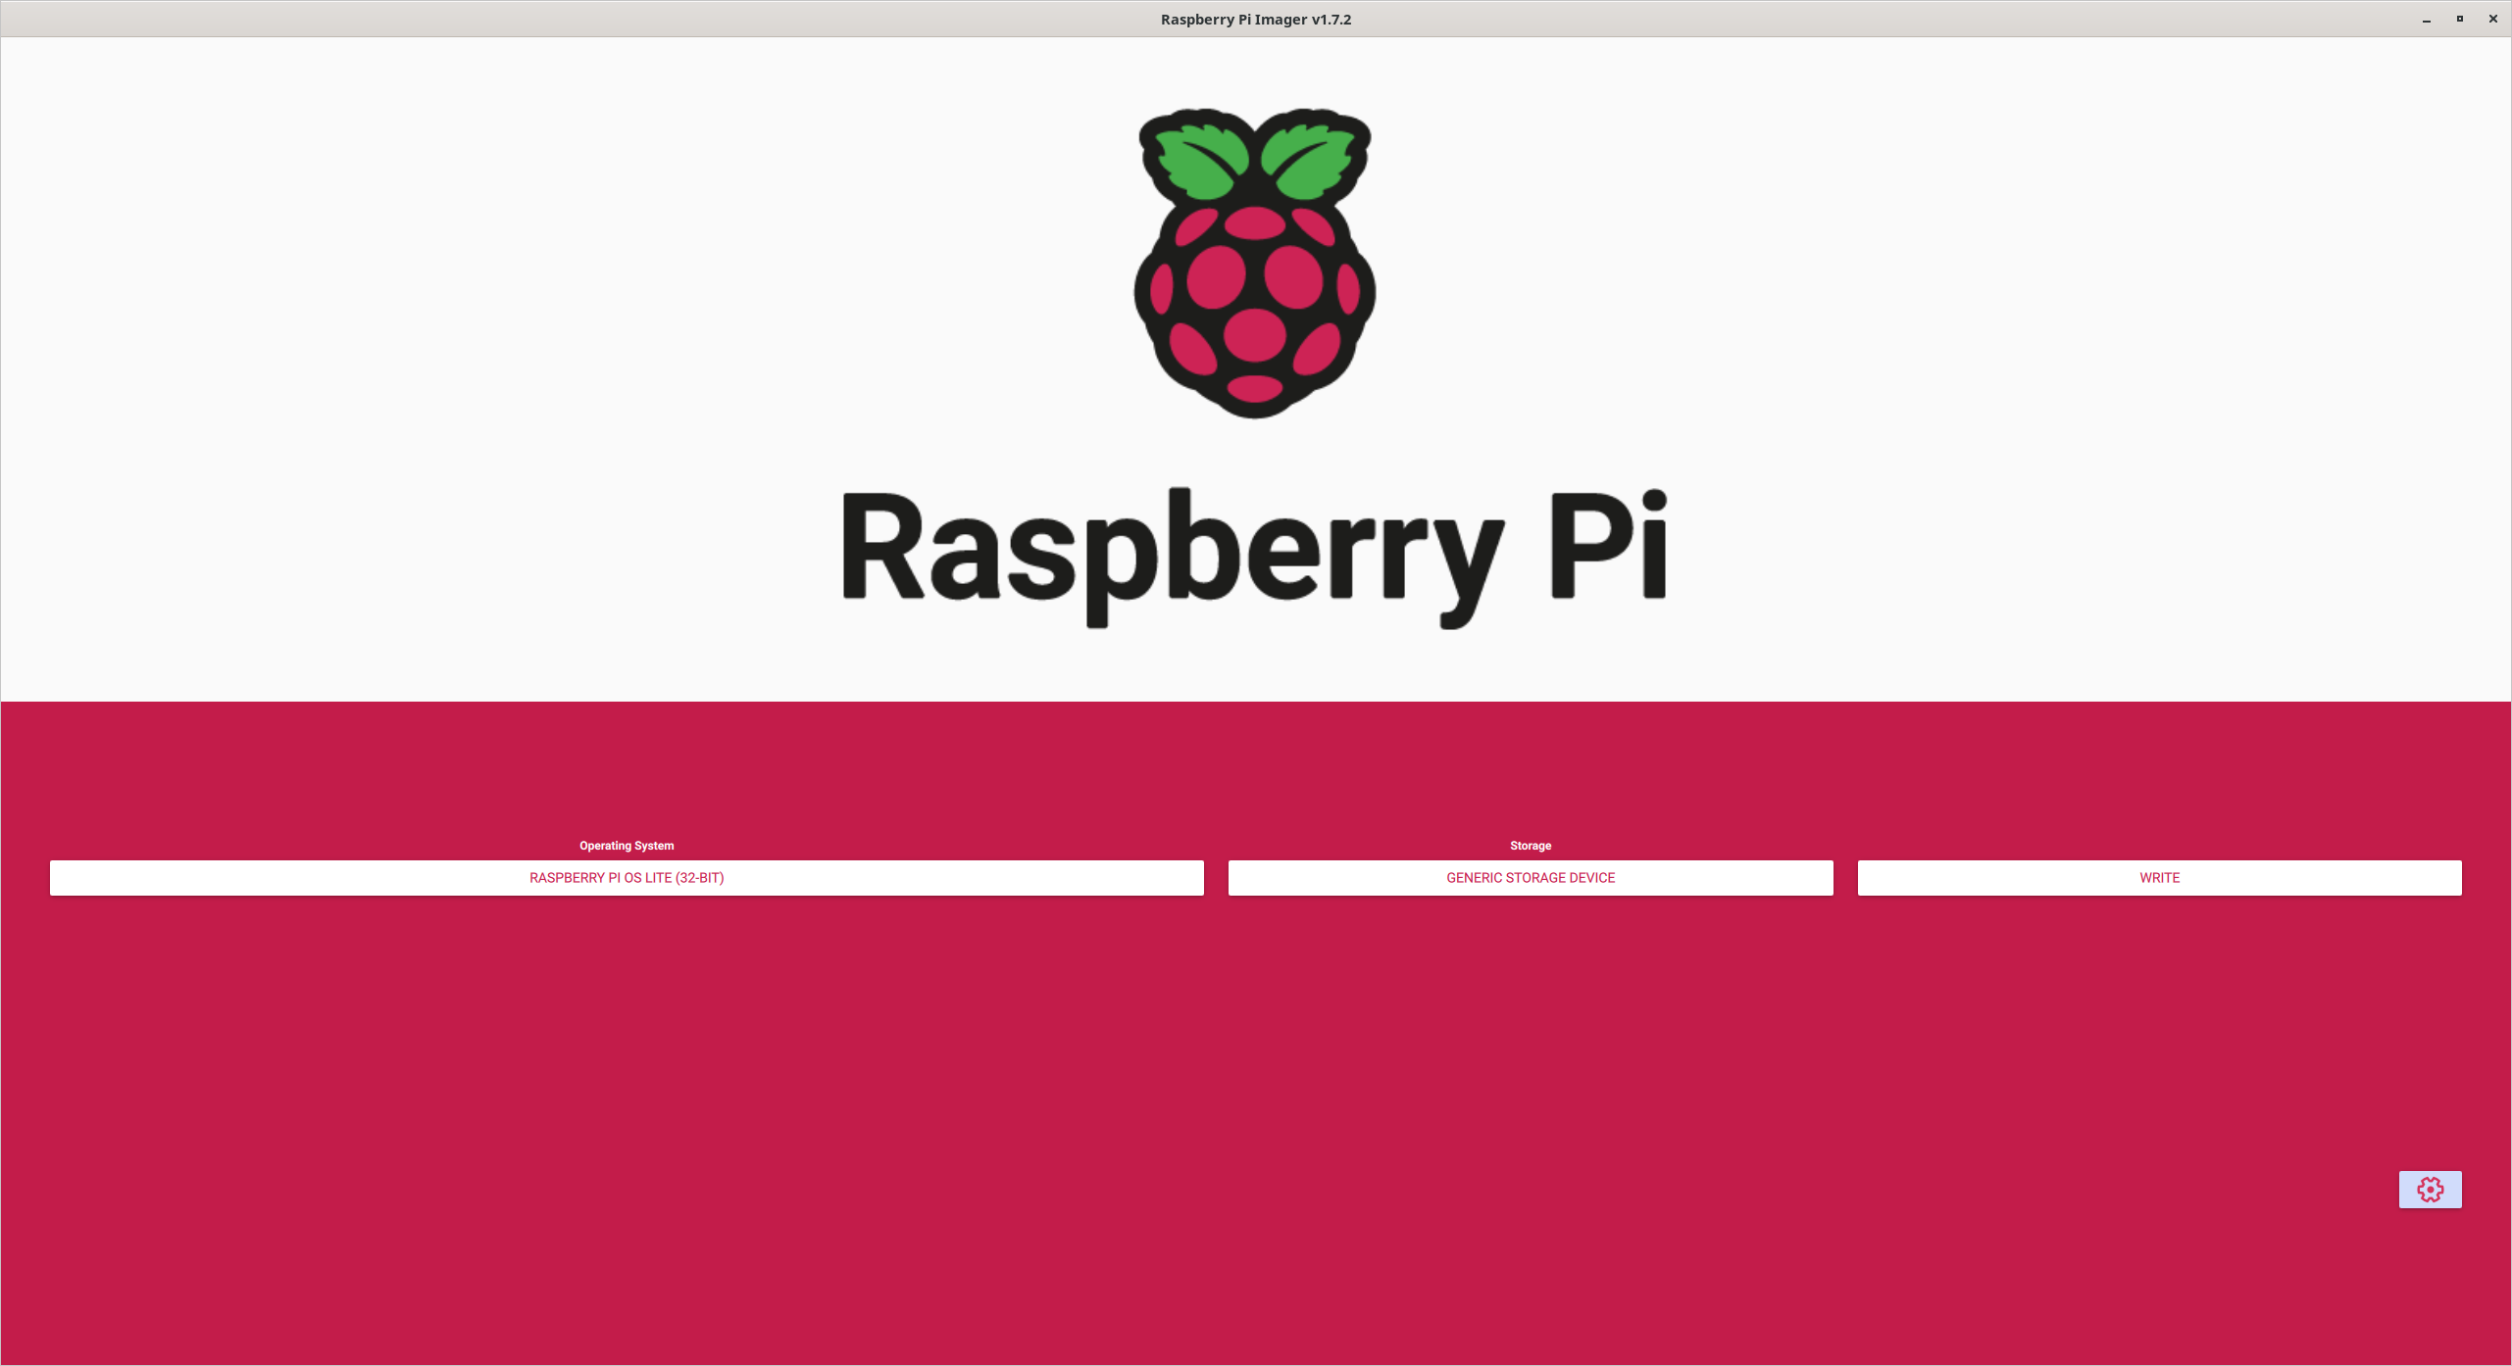
Preparation

Slide 11
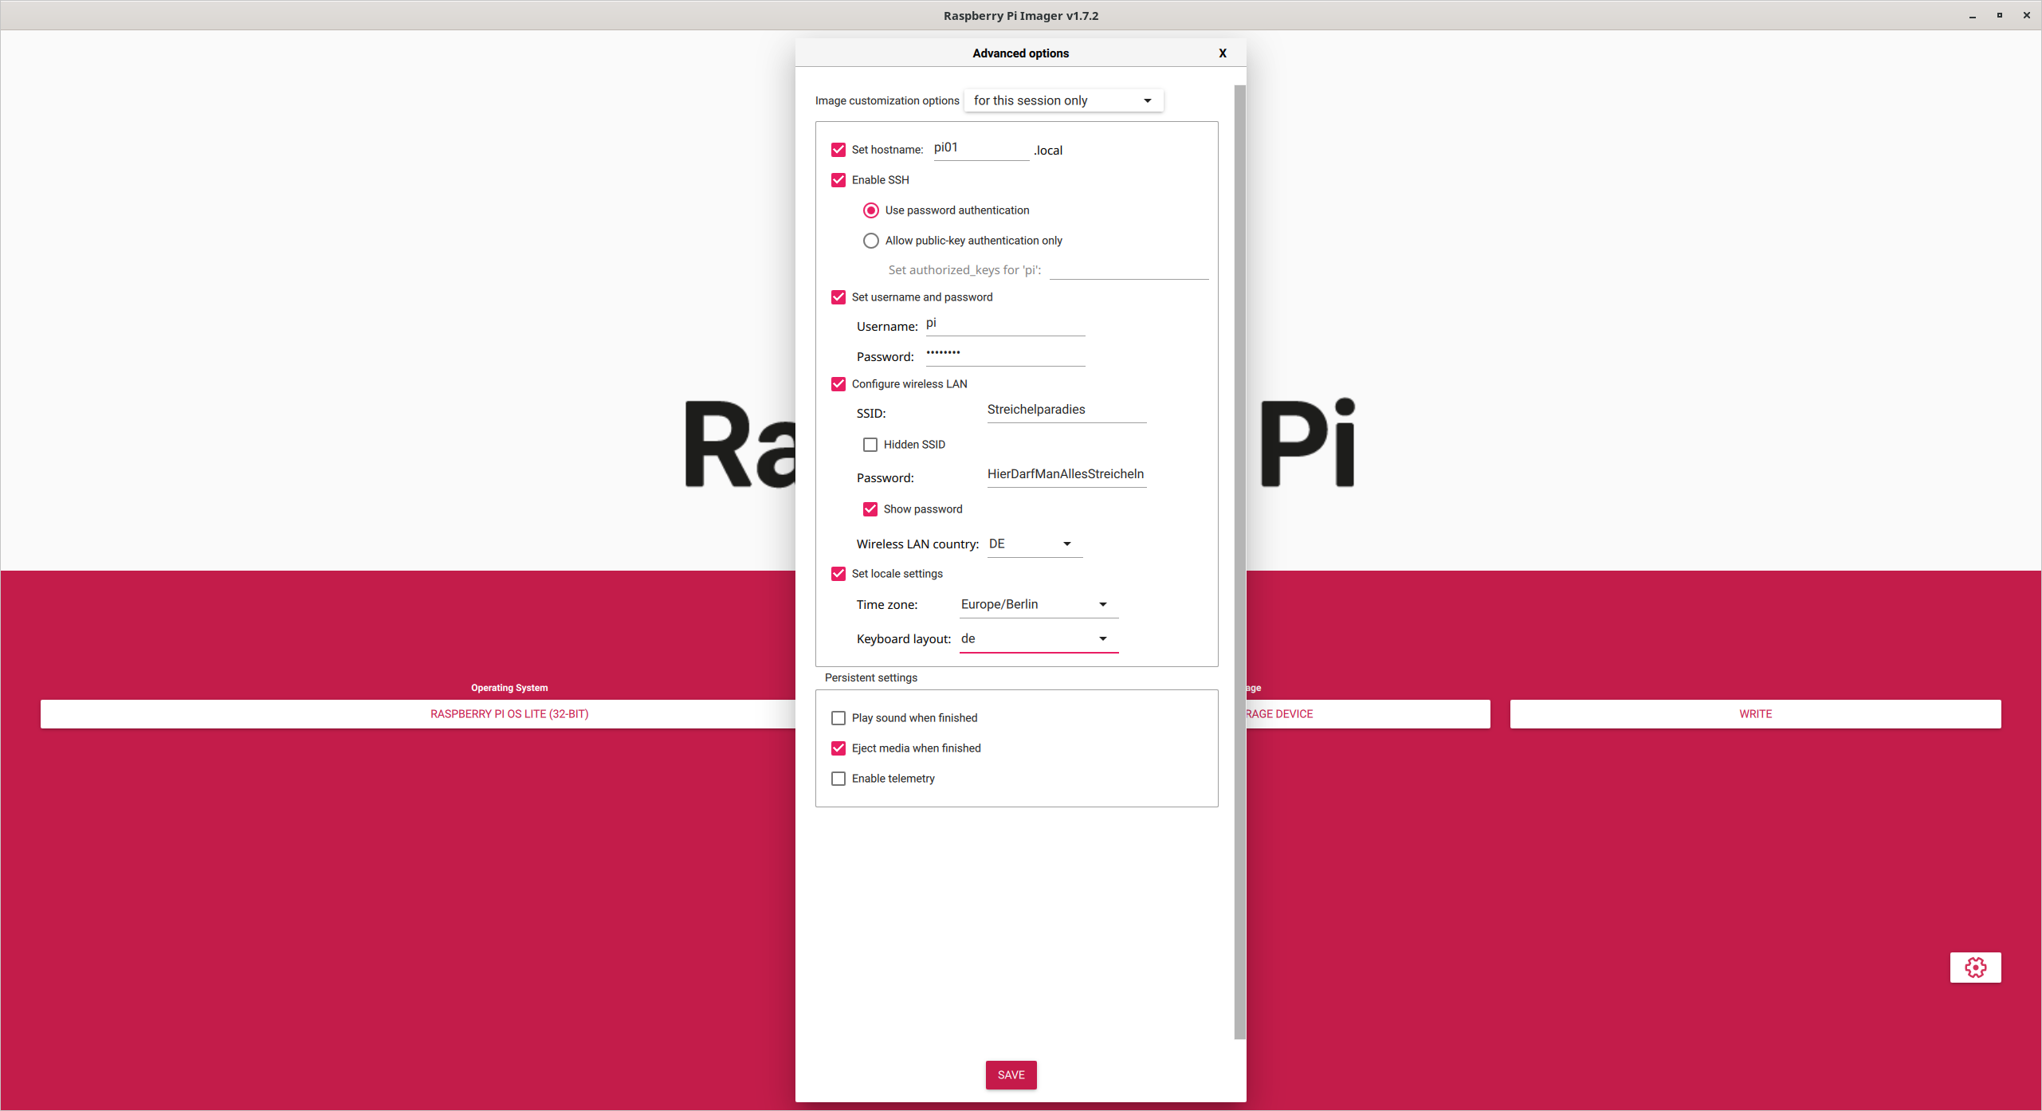
Preparation

Slide 12
First Boot

Slide 13
First Boot
Connect to the Raspberry
  Use SSH or Putty to connect
  $ ssh -l pi <IPADDRESS>
First commands
  Show GPIO Pins
  $ pinout
  Change directory
  $ cd
  List files
  $ ls
  Editor
  $ nano <FILENAME>

Slide 14
Programming

Slide 15
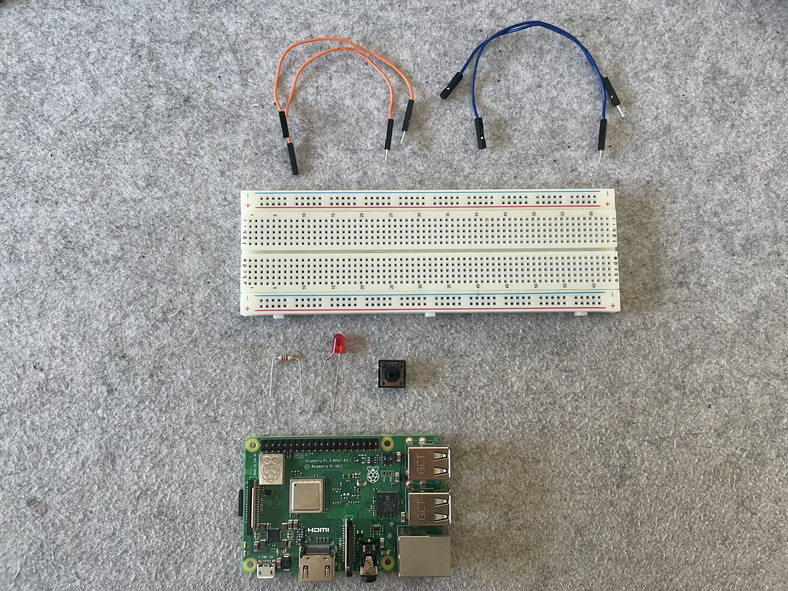
Programming - Preparation

Slide 16
Programming - Preparation
Create a working directory
$ mkdir project
Navigate there
$ cd project/
Start a new file
$ nano led_1.py
Continue with the exercises

Slide 17
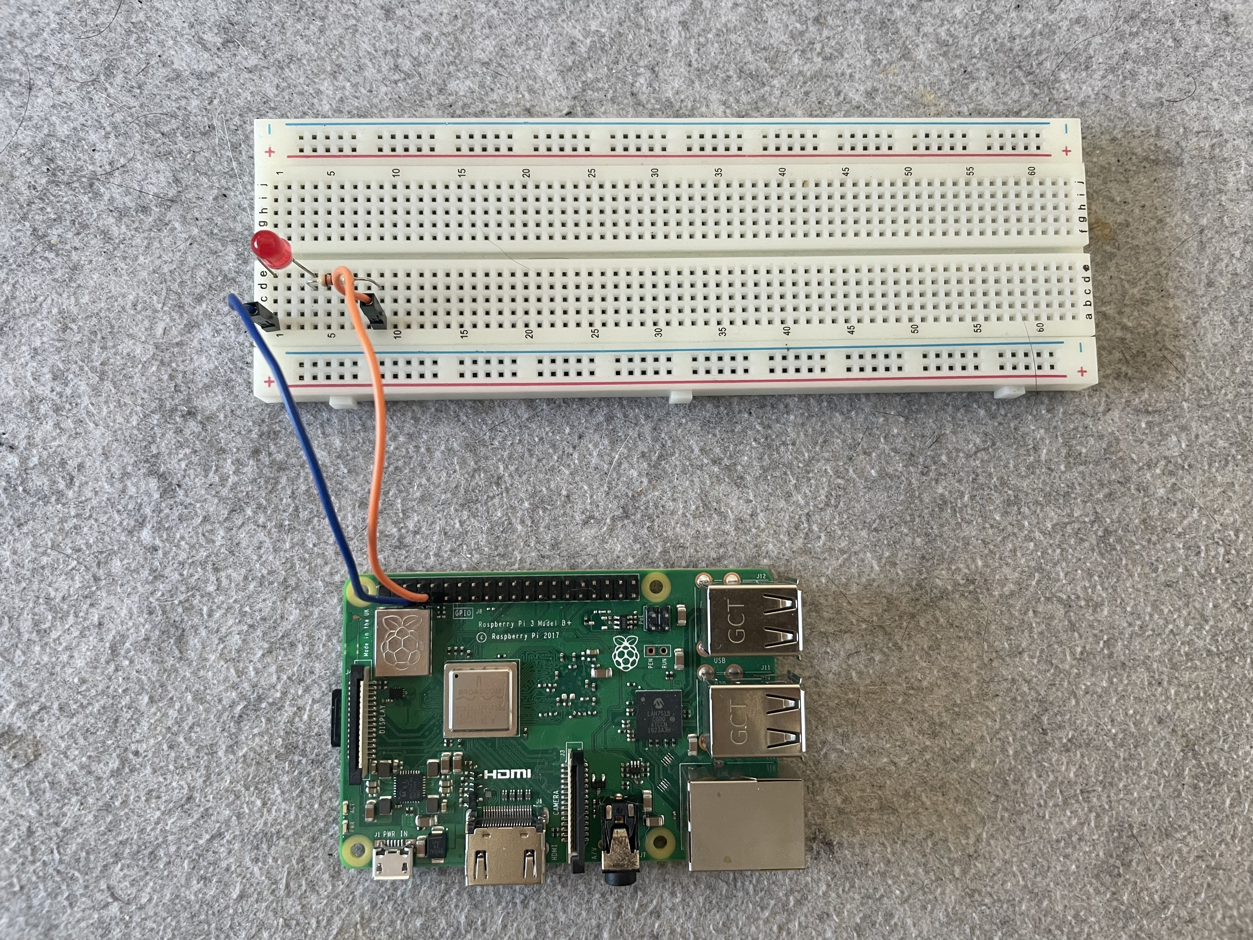
Programming - LED

Slide 18
Programming – LED 1
from gpiozero import LED
from time import sleep
led = LED(4)
led.on()
sleep(1)
led.off()

Slide 19
Programming – LED 2
from gpiozero import LED
from time import sleep
led = LED(4)
while True:
led.on()
sleep(1)
led.off()
sleep(1)

Slide 20
Programming – LED 3
from gpiozero import LED
from signal import pause
led = LED(4)
led.blink()
pause()

Slide 21
Programming – LED 4
from gpiozero import PWMLED
from time import sleep
led = PWMLED(4)
while True:
led.value = 0 # off
sleep(1)
led.value = 0.5 # half brightness
sleep(1)
led.value = 1 # full brightness
sleep(1)

Slide 22
Programming – LED 5
from gpiozero import PWMLED
from signal import pause
led = PWMLED(4)
led.pulse()
pause()

Slide 23
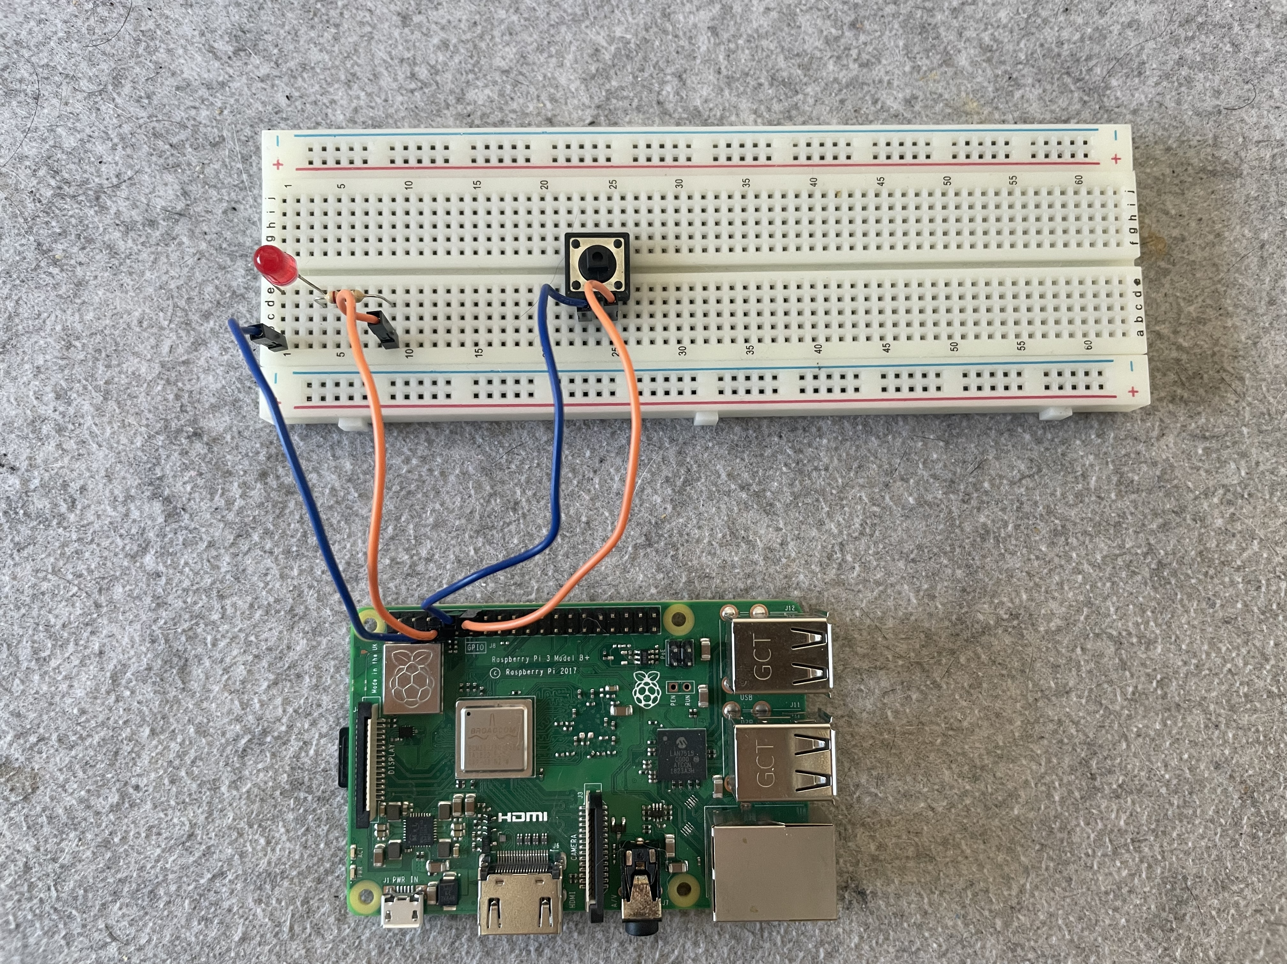
Programming - Button

Slide 24
Programming – Button 1
from gpiozero import Button
button = Button(18)
while True:
if button.is_pressed:
print("Button is pressed")
else:
print("Button is not pressed")

Slide 25
Programming – Button 2
from gpiozero import LED, Button
from signal import pause
led = LED(4)
button = Button(18)
button.when_pressed = led.on
button.when_released = led.off
pause()

Slide 26
Programming – Button 3
from gpiozero import Button
button = Button(18)
button.wait_for_press()
print("Button was pressed")

Slide 27
Programming – Button 4
from gpiozero import Button
from signal import pause
def say_hello():
print("Hello!")
button = Button(18)
button.when_pressed = say_hello
pause()

Slide 28
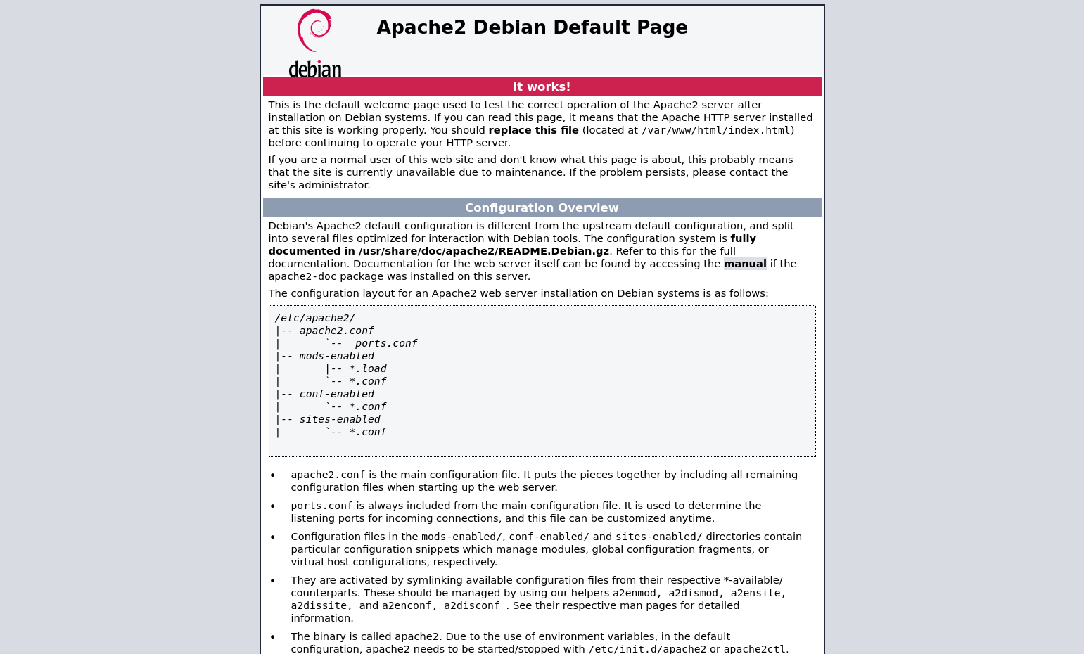
Programming - Webserver

Slide 29
Programming - Webserver
# Install Apache httpd
$ sudo apt-get update && sudo apt-get install apache2
# Enable the server
$ sudo systemctl enable apache2
$ sudo systemctl start apache2

Slide 30
Docs & Links
https://www.raspberrypi.org/
https://www.raspberrypi.com/documentation/computers/os.html#gpio-and-the-40-pin-header
https://gpiozero.readthedocs.io/en/stable/

