Slide 1
Ansible 2.12
A journey to new features
At 12.03.2022 by Daniel Schier

Slide 2
Agenda
Introduction
History
Today
New Tooling

Slide 3
Introduction

Slide 4
Ansible at CLT 2022
Welcome to the Ansible Community!
Sat – 10:00 Ansible 2.12
Sat – 17:00 AMA with Carol Chen
Sun - 10:00 Ansible – The very first steps
Otherwise: Feel free to get in touch! :)

Slide 5
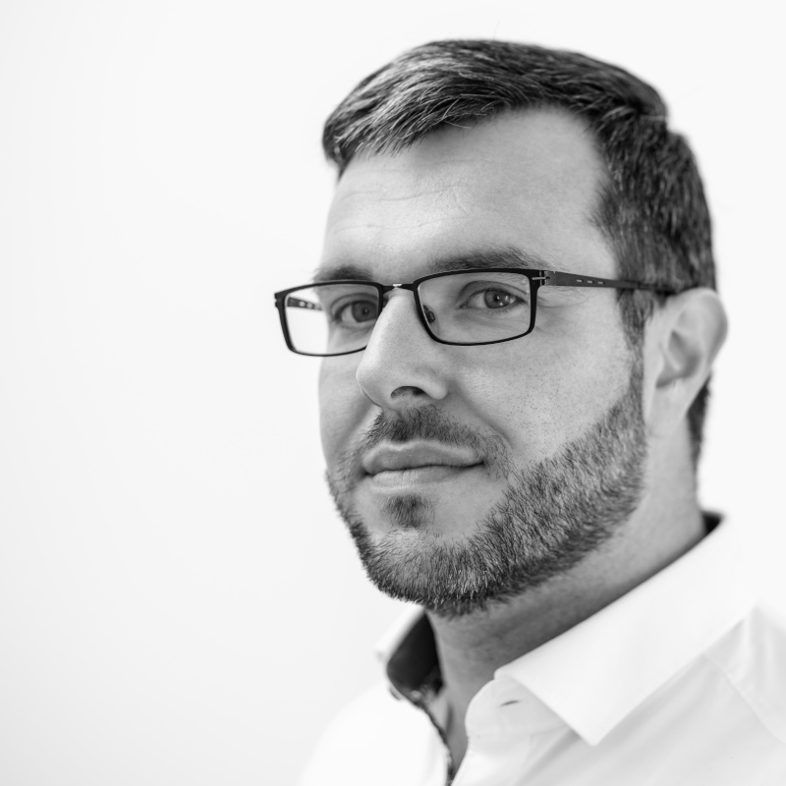
Introduction
Daniel Schier
Open Source enthusiast
Ansible since 1.6
Meetups, Conferences, Cats, Penguins, Cookies
Contact:
  twitter.com/dschier_wtd
  linkedin.com/u/dschier
  github.com/dschier-wtd

Slide 6
History(?!)

Slide 7
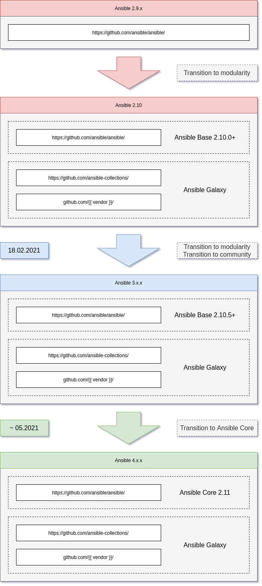
History
Thousands of open Prs
More issues
Major/Minor?
Lots of renaming
Collections
Ansible 3/4/5

Slide 8
Today?

Slide 9
Today?
Ansible 5.x.y
  Ansible Core 2.12
  Collections
Fixed release cycle
SemVer (except core)
Fast(er) development
Still some “pain”

Slide 10
New Tooling

Slide 11
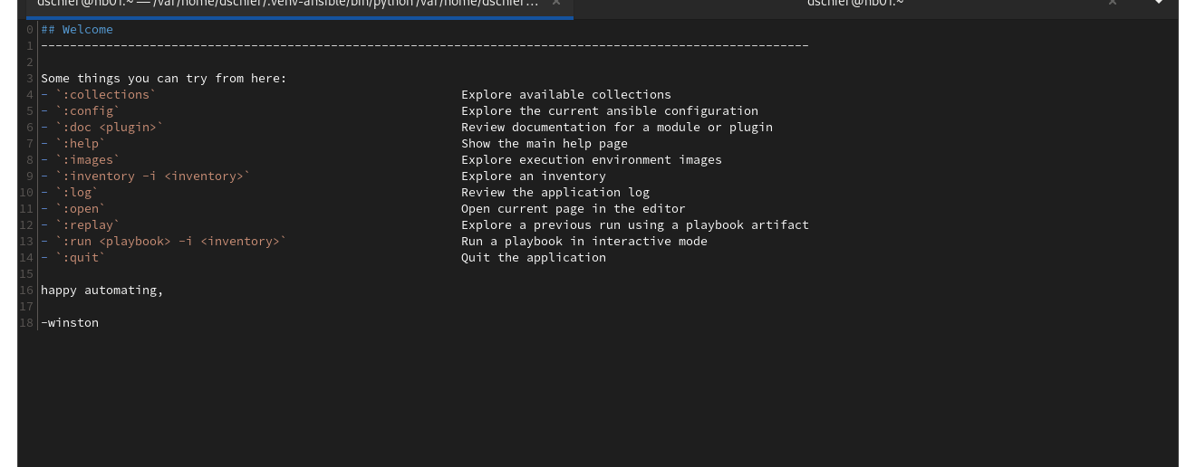
New Tooling
Containers everywhere
  ansible-test
  ansible-navigator
  ansible-runner
  execution environments

Slide 12
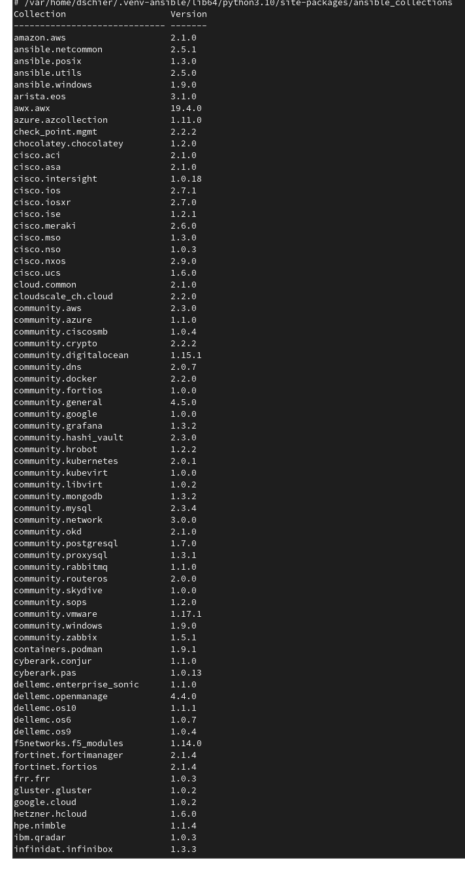
New Tooling
Collections
  Roles
  Playbooks
  Plugins
  Tests
  Docs

Slide 13
Links
https://www.ansible.com/community
https://www.youtube.com/c/AnsibleCommunity
https://www.youtube.com/channel/UCPJo5UY1KsP7J1BuHmiWNzQ
https://www.meetup.com/de-DE/Ansible-Meetup-Dresden/
https://www.meetup.com/de-DE/ddos-usergroup/
https://blog.while-true-do.io/tag/ansible/

Slide 14
Questions & Answers
Learning something new starts with asking a question.

