Slide 1
The perfect SCRUM schedule
A totally biased view on SCRUM optimization that may or may not apply to you...
At 29.03.2022 by Daniel Schier

Slide 2
Introduction

Slide 3

Introduction
Daniel Schier
Open Source enthusiast
Organizer of DDOSUG, Ansible Meetup Dresden
Contributor to various FOSS projects
Meetups, Conferences, Cats, Penguins, Cookies
Contact:
  twitter.com/dschier_wtd
  linkedin.com/u/dschier
  github.com/dschier-wtd

Slide 4
SCRUM (how most do it)

Slide 5
SCRUM (how most do it)
You are doing:
  biweekly sprints
  Daily SCRUM
  Planning
  Reviews
  Refinement
  Retrospective

Slide 6
SCRUM (how most do it)
Most likely these are:
  Mandatory
  Moderated
  Scheduled
  Time-boxed
  Synchronous

Slide 7
Chances are high, that’s an issue!

Slide 8
SCRUM (how I do it)

Slide 9
SCRUM (how I do it)
Bi-Weekly sprints, but:
  Switching Sprint focus between Feature and Refinement/Tech Debt./Bugs
  At least one Story from Retrospective
  EVERY Task is in the sprint
    Yes, the leader tasks, too
    Yes, Job interviews, too
  Events are planned for humans
  Each week is “the same”

Slide 10
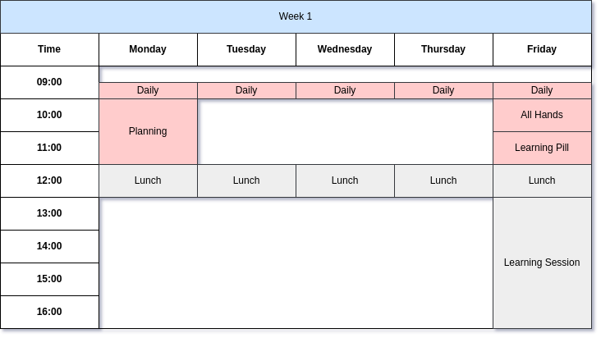
SCRUM (how I do it)

Slide 11

SCRUM (how I do it)

Slide 12
SCRUM (how I do it)
SCRUM Events:
  All events are voluntary
  All events before lunch
  Daily at the start of the day
  Planning at start of the week
  Close Ups at end of the week
  Learning Time included
  …

Slide 13
SCRUM (how I do it)
Daily SCRUM:
  Asynchronous
  Agreed Start of the day
  Talk > Board (in fact, you don’t need the board)

Slide 14
SCRUM (how I do it)
Review:
  Recording
  Public
  Summary via Blog
  Transparent
  Invite ALL peers
  Focus on “what happened”

Slide 15
SCRUM (how I do it)
Learning Pill:
  Learn to train
  Recording
  Summary via Blog
  Invite all users
  Focus on “How to use”

Slide 16
SCRUM (how I do it)
Retrospective:
  Iterate your processes
  Gather real Feedback
  Trust and Play
    Praise game
    Learn about each other
  Teach something new
    3M breaks
    Prioritization
    Speed reading

Slide 17
Last words
SCRUM is not about SCRUM, it’s about the people!

Slide 18
Questions & Answers
Learning something new starts with asking a question.

