Slide 1
Argument Specs + Ansible Test
Validierung und Integration Testing für Ansible Roles und Playbooks
At 15.02.2022 by Daniel Schier

Slide 2
Agenda
Introduction
ansible-core 2.12
Argument Specs
Integration Testing
Q&A

Slide 3
Introduction

Slide 4

Introduction
Daniel Schier
Open Source enthusiast
Ansible since 1.6
Meetups, Conferences, Cats, Penguins, Cookies
Contact:
  twitter.com/dschier_wtd
  linkedin.com/u/dschier
  github.com/dschier-wtd

Slide 5
Introduction
while-true-do.io
Role: Founder
Motivation:
Bringing Open Source Development, Infrastructure and Community together and work on things we like, so others can learn from it.
Activities: articles, code, shared infrastructure
Contact: while-true-do.io

Slide 6

Introduction
Dresden OpenSource UserGroup
Role: Founder
Motivation:
We want to connect Open Source beginners, experts and enthusiasts and establish a healthy Open Source community.
Activities: monthly meetups
Contact: ddosug.org

Slide 7
Introduction
Wandelbots GmbH
Role: DevOps Engineer
Motivation:
Making robots helpful companions for everyone.
Contact: wandelbots.com

Slide 8
ansible-core 2.12

Slide 9
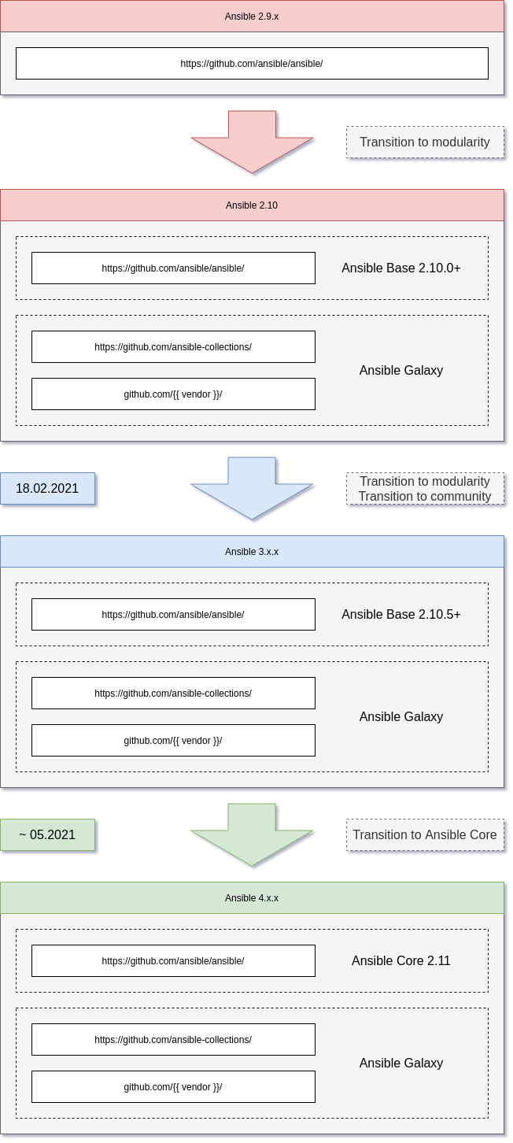
ansible-core 2.12
Renaming… phew
ansible-test
ansible-navigator
ansible-runner
collections
argument specs for roles
moving stuff around

Slide 10
Argument Specs

Slide 11
Argument Specs
Role development is easy.
Using roles wrong is easy, too.
Fixing issues after using it wrong?
Is there a way to check the correct usage of roles?

Slide 12
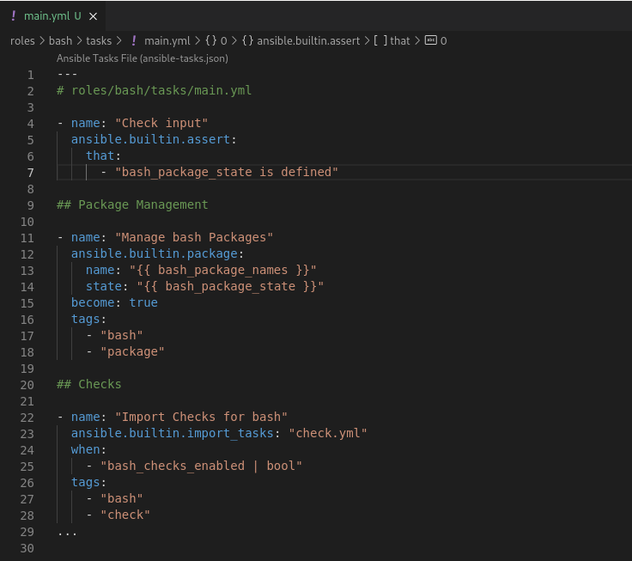
Argument Specs
The old way
Check each variable individually
Check for type, content, definition, etc.
Documentation?

Slide 13
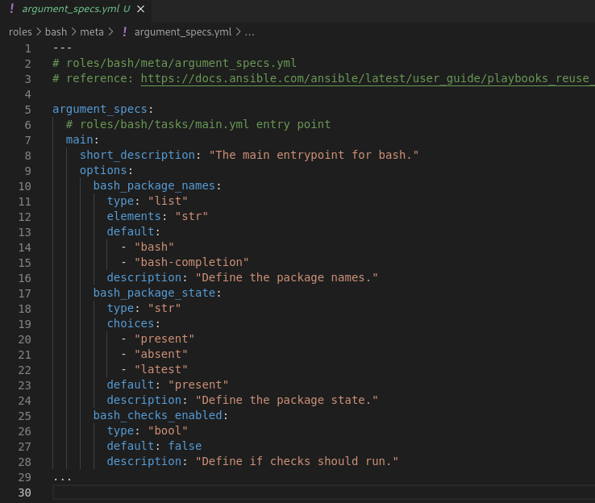
Argument Specs
The new way
Similar to modules
  Type
  Elements
  Defaults
  Description
  More

Slide 14
Argument Spec Demo

Slide 15
Integration Tests

Slide 16
Integration Tests
The old way
Use a different tool for
  Sanity
  Integration
Run a playbook
Maybe Molecule?

Slide 17
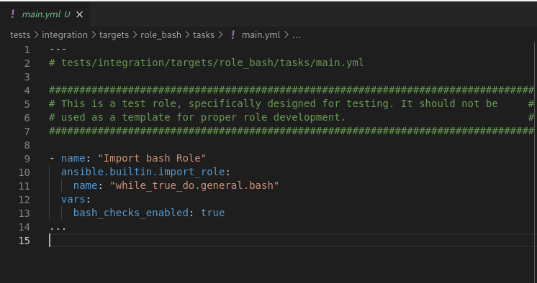
Integration Tests
The new way
ansible-test
  containerized
  sanity + integration
  roles, modules, more

Slide 18
Integration Test Demo

Slide 19
Links
https://docs.ansible.com/ansible/devel/dev_guide/developing_collections_structure.html#meta-directory
https://docs.ansible.com/ansible/latest/dev_guide/developing_collections_structure.html#playbooks-directory
https://docs.ansible.com/ansible/latest/dev_guide/developing_collections_structure.html#plugins-directory
https://docs.ansible.com/ansible/latest/dev_guide/developing_collections_structure.html#roles-directory
https://docs.ansible.com/ansible/latest/dev_guide/developing_collections_testing.html#testing-collections
https://docs.ansible.com/ansible/latest/dev_guide/developing_collections_structure.html#tests-directory
https://docs.ansible.com/ansible/latest/user_guide/playbooks_reuse_roles.html#role-argument-validation

Slide 20
Questions & Answers
Learning something new starts with asking a question.

