Slide 1
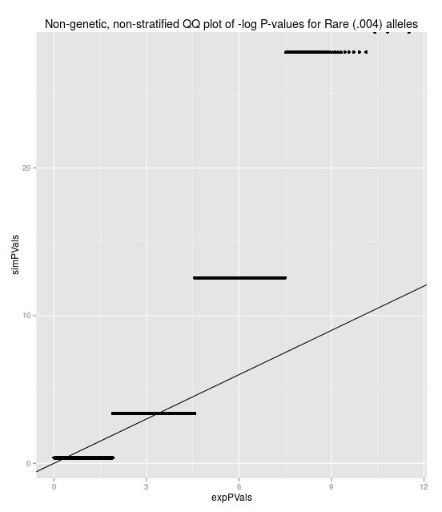
Inflation issues
Distribution of non-genetic, non-stratified armitage trend test is not chi-sq(1) for rare alleles.
E(ATT)=1
Var(ATT)!=2
For example, with no population stratification:
MAF=.004, PhenoFreq=.01
mean(ATT)=.997
Var(ATT)=3.1

Slide 2
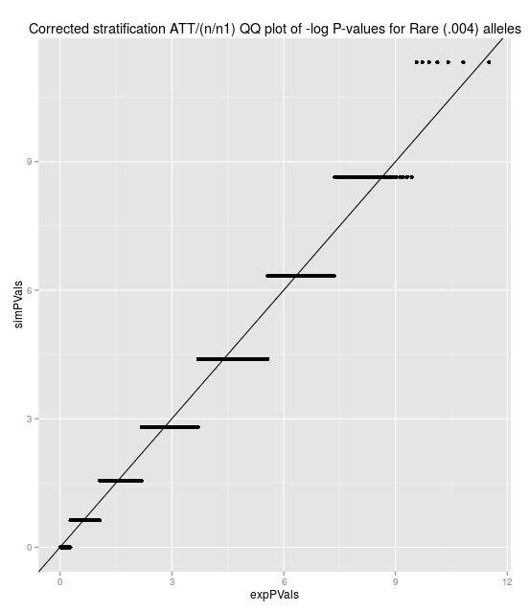
Additionally, even after a perfect correction for stratification, for a genotype and phenotype that appear in only one subpopulation, for a non-genetic risk, ATT~n/n1*chi-sq(1)

Slide 3
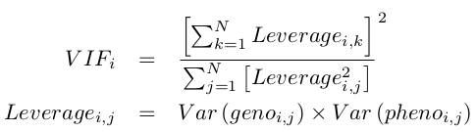
Individual SNP variance inflation
So we have a variance inflation factor of 1/n1 for that particular SNP.
Generalizing this we have
Where the leverage is the product of variance of genotype(i,j) and the variance of phenotype(i,j).
The variances are found by p(1-p) where p is the fitted value from the population correction.

Slide 4
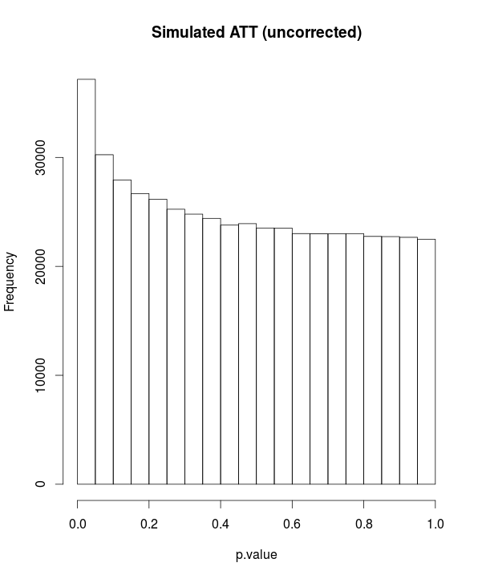
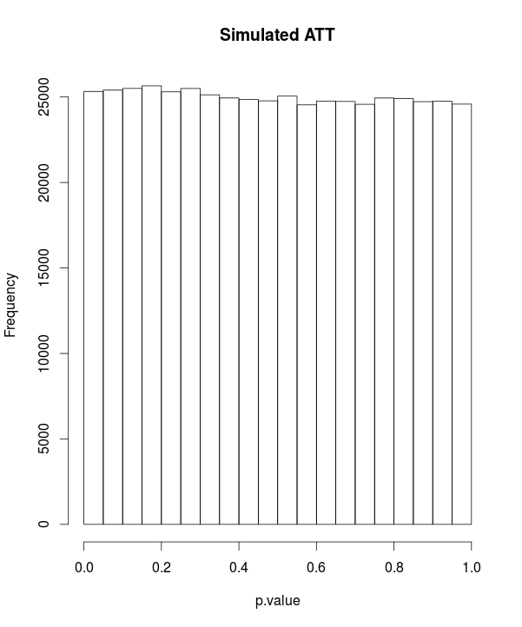
Simulated variance inflation correction
z <- (1:100)/200
zvar <- z*(1-z)
sumviSq <- sum(zvar)^2
sumSqvi <- sum(zvar^2)
vFactor <- 1/(sumSqvi/sumviSq)
hist(replicate(500000, {
x <- rbinom(100,1,prob=z)-z
y <- rbinom(100,1,prob=z)-z
1-pchisq(vFactor*cor(x,y)^2, 1)
vFactor*cor(x,y)^2
}))

Slide 5
Phenotypes
Binary
3 types
  Uniformly random phenotype
  Gradual phenotype risk determined by superpop and subpop membership
    X~Uniform(0,.5) for each superpop
    Y~Uniform(0,.2) for each subpop
    Risk=X+Y
  Sharp phenotype risk
    Risk=I[randomly chosen subgroup]*.2

Slide 6
Corrections
4 types
  Uncorrected
  Superpop
    Take residuals of regression of genotype and phenotype on superpopulation matrix
  Superpop
    Take residuals of regression of genotype and phenotype on subpopulation matrix
  Jaccard
    Take residuals of regression of genotype and phenotype on top X eigenvectors of jaccard matrix

Slide 7
Simulations
Simulated 100 of each type of phenotype (300 total
Used each of the correction methods to get corrected phenotypes for each of the 300.
Read in each SNP and corrected it.
Calculated “variance-factor” for each phenotype-genotype pair.
Calculated R^2 for each phenotype-genotype pair.
Determined test statistic for each phenotype-genotype pair.
Plotted observed distribution against expected: chisq(1)
  Note: All simulations were run on subsets of ~100k-400k loci on a single chromosome in the interest of time. Takes about 10 minutes per 200k loci. May take a long time to do whole genome.

Slide 8
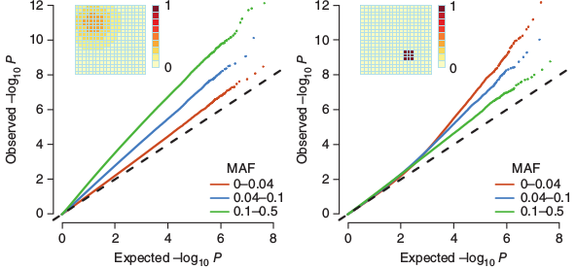
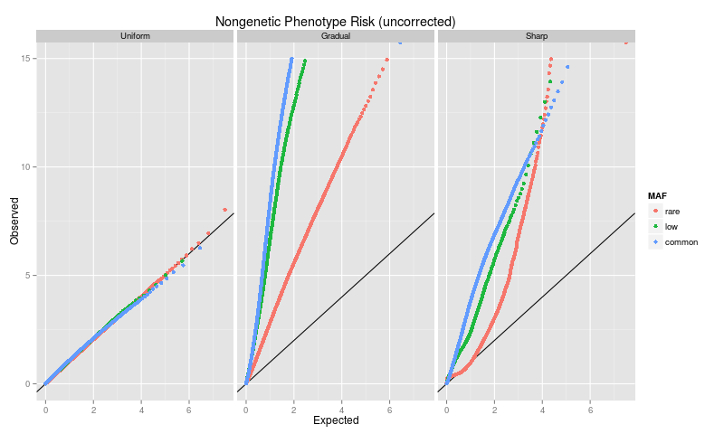
1000GP data -Uncorrected variance inflation
Mathieson
1000GP

Slide 9
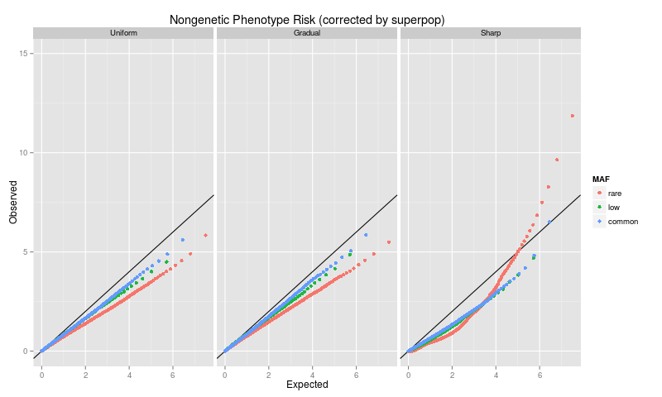
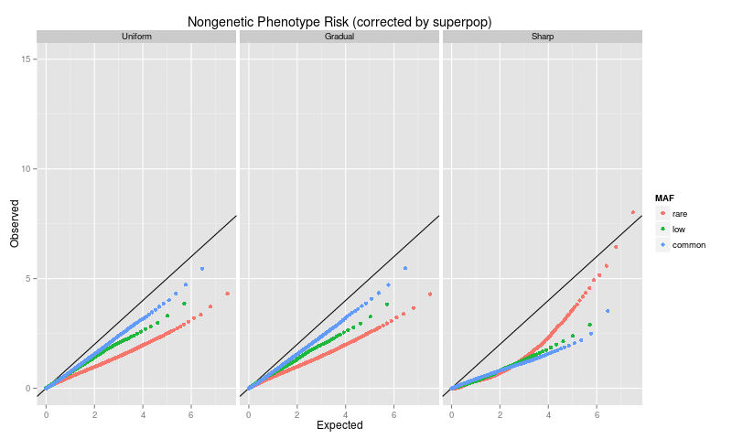
1000GP data - Corrected by Superpop label
ATT
Individual VIF

Slide 10
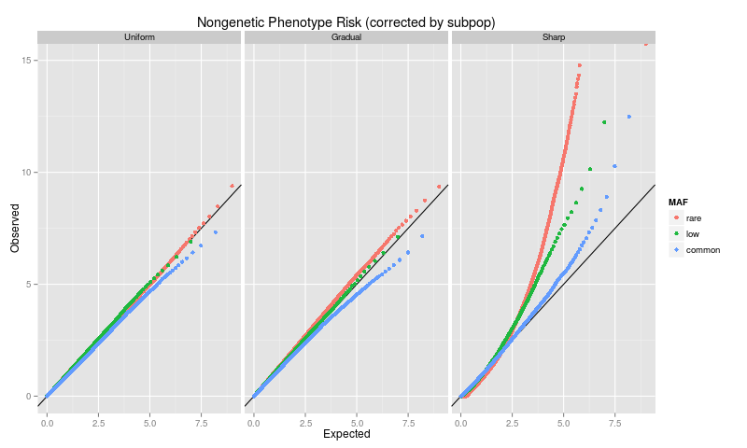
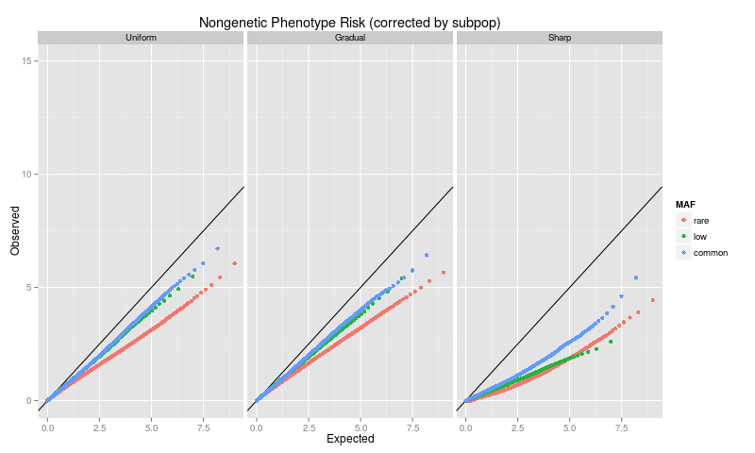
1000GP data - Corrected by Subpop label
ATT
Individual VIF

Slide 11
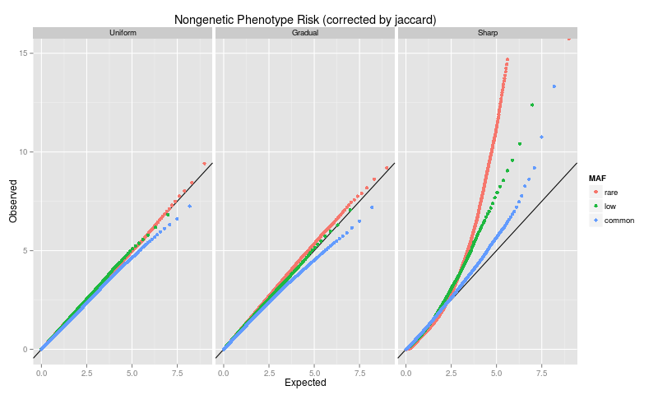
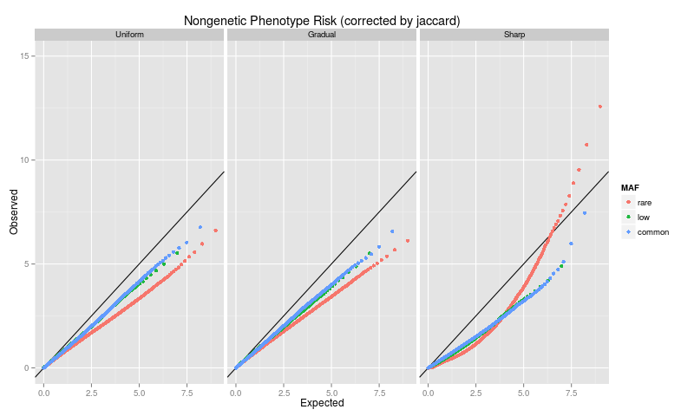
1000GP data - Corrected by Jaccard eigenvectors(10)
ATT
Individual VIF

Slide 12
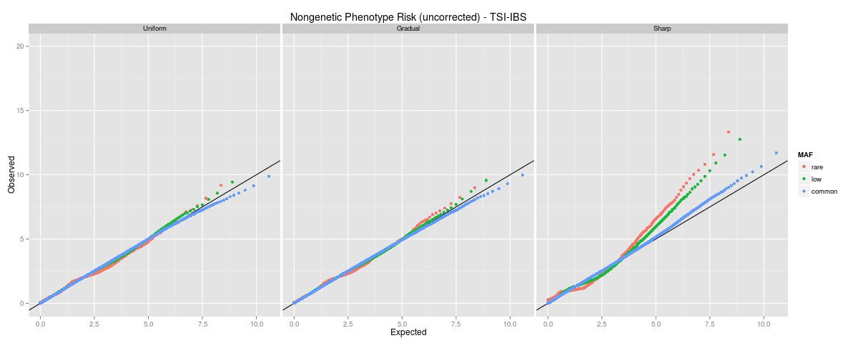
TSI vs IBS uncorrected
ATT

Slide 13
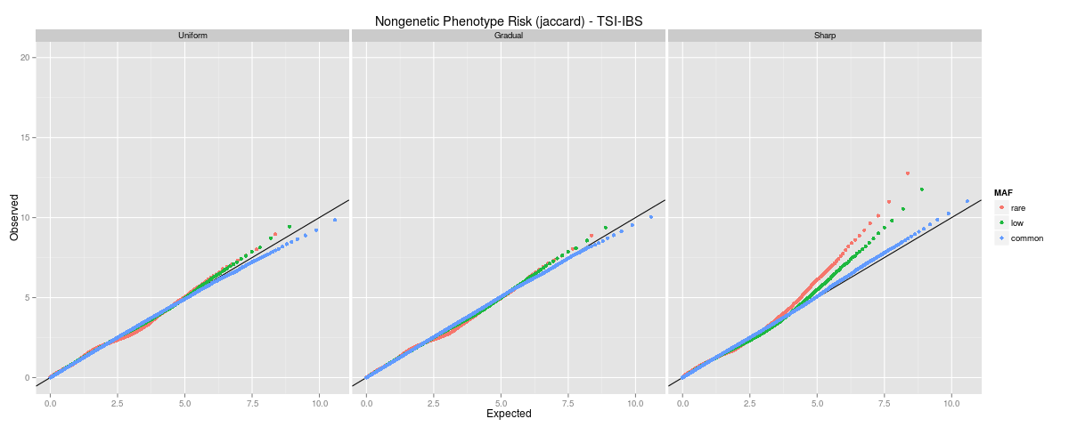
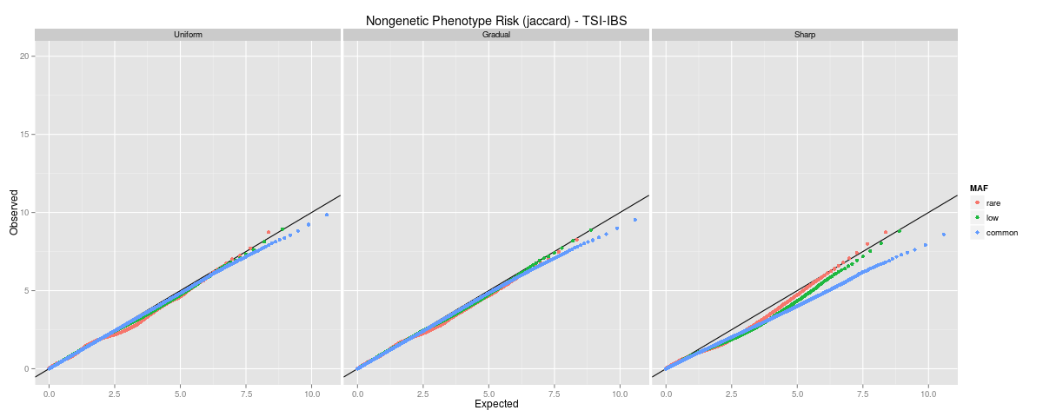
TSI vs IBS corrected by Jaccard eigenvectors(2)
ATT
Individual VIF

Slide 14
What we need
Comparison to PCA
  This will take awhile unless there is a pre-run result somewhere online (couldn't find one)
Demonstrate ability to find causal SNPs
  Next step in simulations

