Slide 1
To discuss
Listgarten paper
  FaST LMM
New test statistic scaling estimate
  See pdf
  This is key for controlling type I error for rare variants. See comparison of Gold standard with scaling vs without scaling.
  Still using asymptotics
Plots: Key points
  Uncorrected < PCA < Jaccard < GoldStandard
  Jaccard still not controlling type I error as well as Gold standard, but outperforming (very slightly) PCA

Slide 2
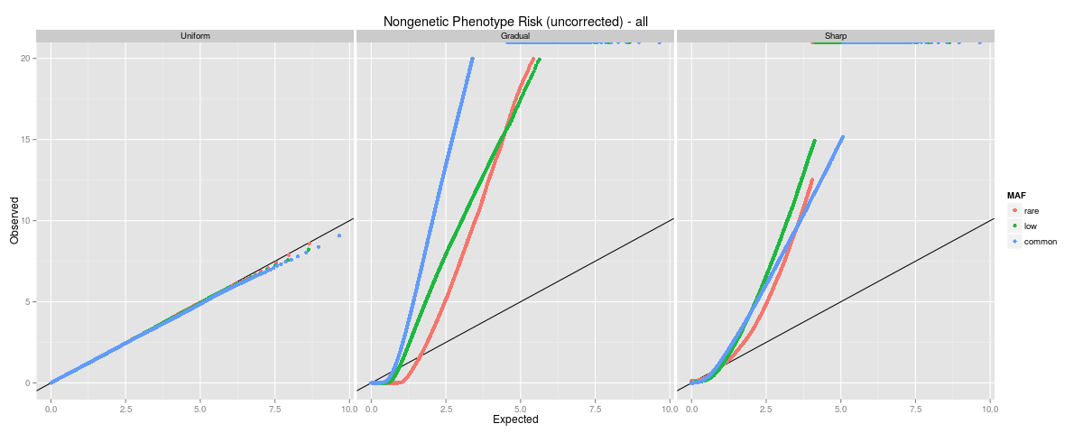
Uncorrected

Slide 3
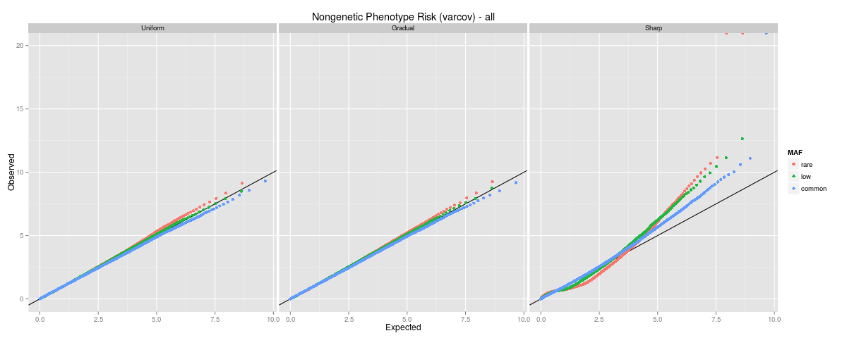
PCA

Slide 4
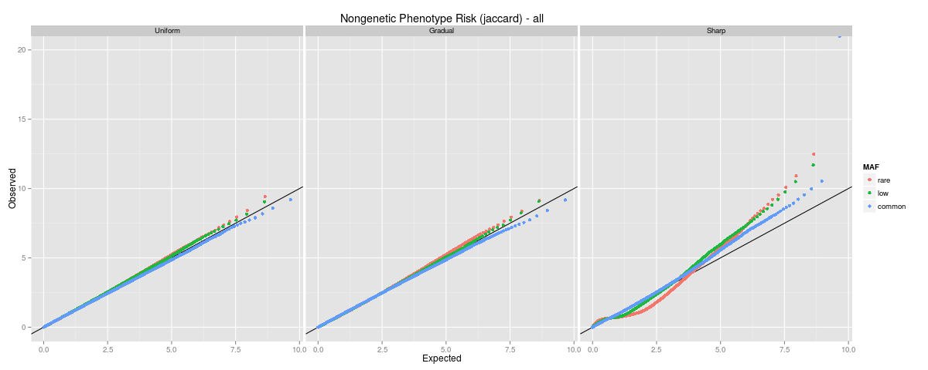
Jaccard

Slide 5
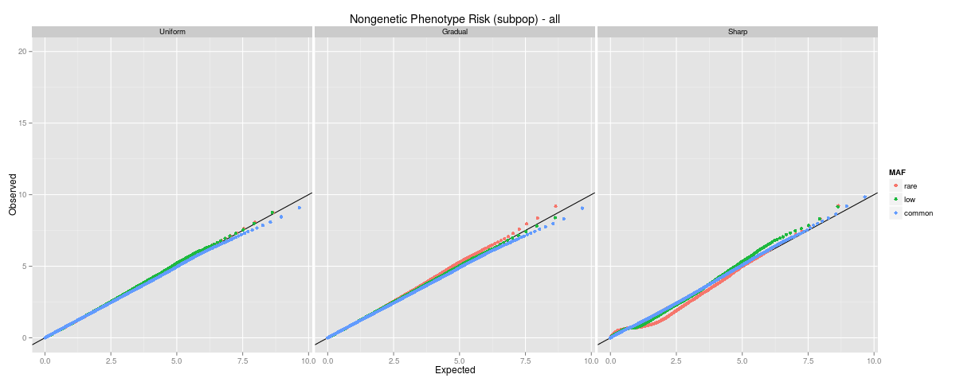
Subpop label (gold standard)

Slide 6
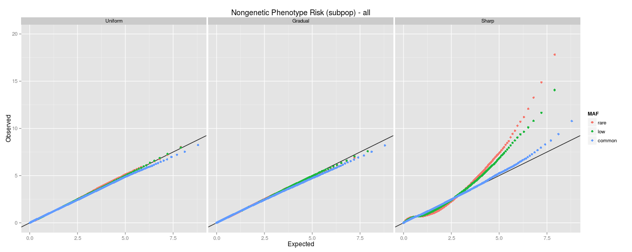
Subpop label (gold standard) (unscaled test statistic)

