Slide 1
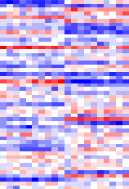
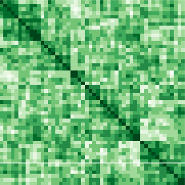
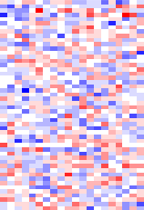
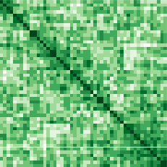
Raw Gene
Expression Data
Raw Gene
Expression Data
Batch Information
Overall
Variance-covariance
Batch corrected
Expression
Covariance
Standard
Batch Correction
Eigendecomposition
Batch and
Covariate data
MLE
Overall Eigendecomposition
Covariate-dependent estimates
D
Q
D*
Q
CMA
Fitted values
Batch-corrected
Variance-covariance
Corrected Co-
expression

