Slide 1
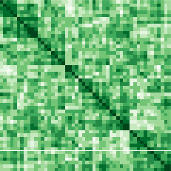
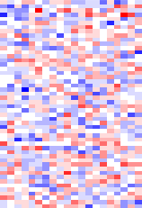
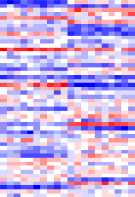
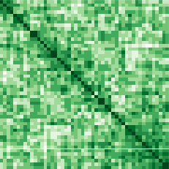
Overall
Variance-covariance
Batch corrected
Expression
Raw Gene
Expression Data
Batch-corrected
Variance-covariance
Covariance
Batch Data
START
Eigendecomposition
Batch and
Covariate data
MLE
Overall Eigendecomposition
Covariate-dependent estimates
D
Q
D*
Q
Fitted values

