Slide 1
March 17, 2017
Agenda:
1.) Dissertation defense date
2.) Figures 1,2,3
3.) Method name
4.) Demo data options:
a.) ENCODE
b.) Yeast
c.) Immuno-navigator
(>3500 samples, PNAS 2016, coexpression focus, Combat used)
5.) Thesis

Slide 2
Manuscript outline
(See Overleaf for progress)
Abstract
Introduction
  Focus on widespread application of ComBat
  Dive into general utility of coexpression (GRN, coexpression hubs, etc.)
  Describe coexpression scene
  Describe the lack of attention paid to controlling for batch impacting coexpression
  Show that WGCNA Modules in GTEx depend on Batch Proportion (Maybe belongs in Results?)
Methods
  Present theoretical framework for method
  Quick derivation (Full derivation in supplement)
  Describe Pipeline
    Figure 1
  Statistical implications of method, interpret-ability of results, general framework allows for use of continuous/categorical confounders
Results
  Application to in Silico data
    Demonstrate “residual batch” effect after ComBat
    Compare to naïve approach
    Figure 3 (Including expression heatmap, ROC plot, coexpression)
  Application to Immuno-Navigator data
    Demonstrate “different results” compared to those published in PNAS
Discussion
  TODO
Supplement
  Computational analysis
    Analysis should run in O(N^3) time, (In theory, faster, O(N^2.3))
    In Practice, algorithm runs in very reasonable time: seconds (400 x 2000) to hours (>1000 x 40,000)
  Full derivation of estimate
  GTEx results: WGCNA results differ by batch.
  Example plots

Slide 3
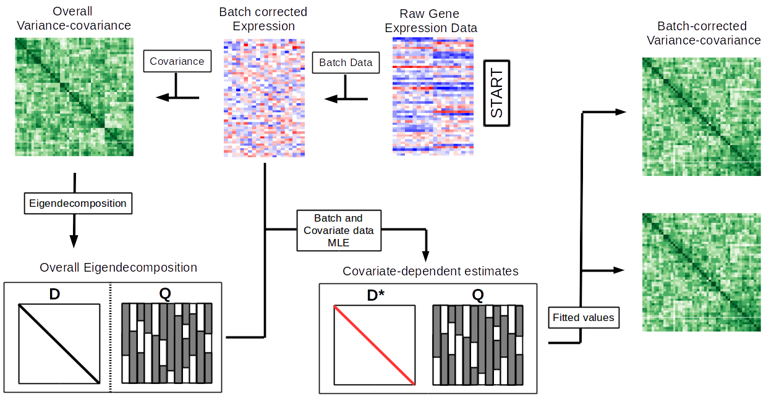
Figure 1 (Option 1)

Slide 4
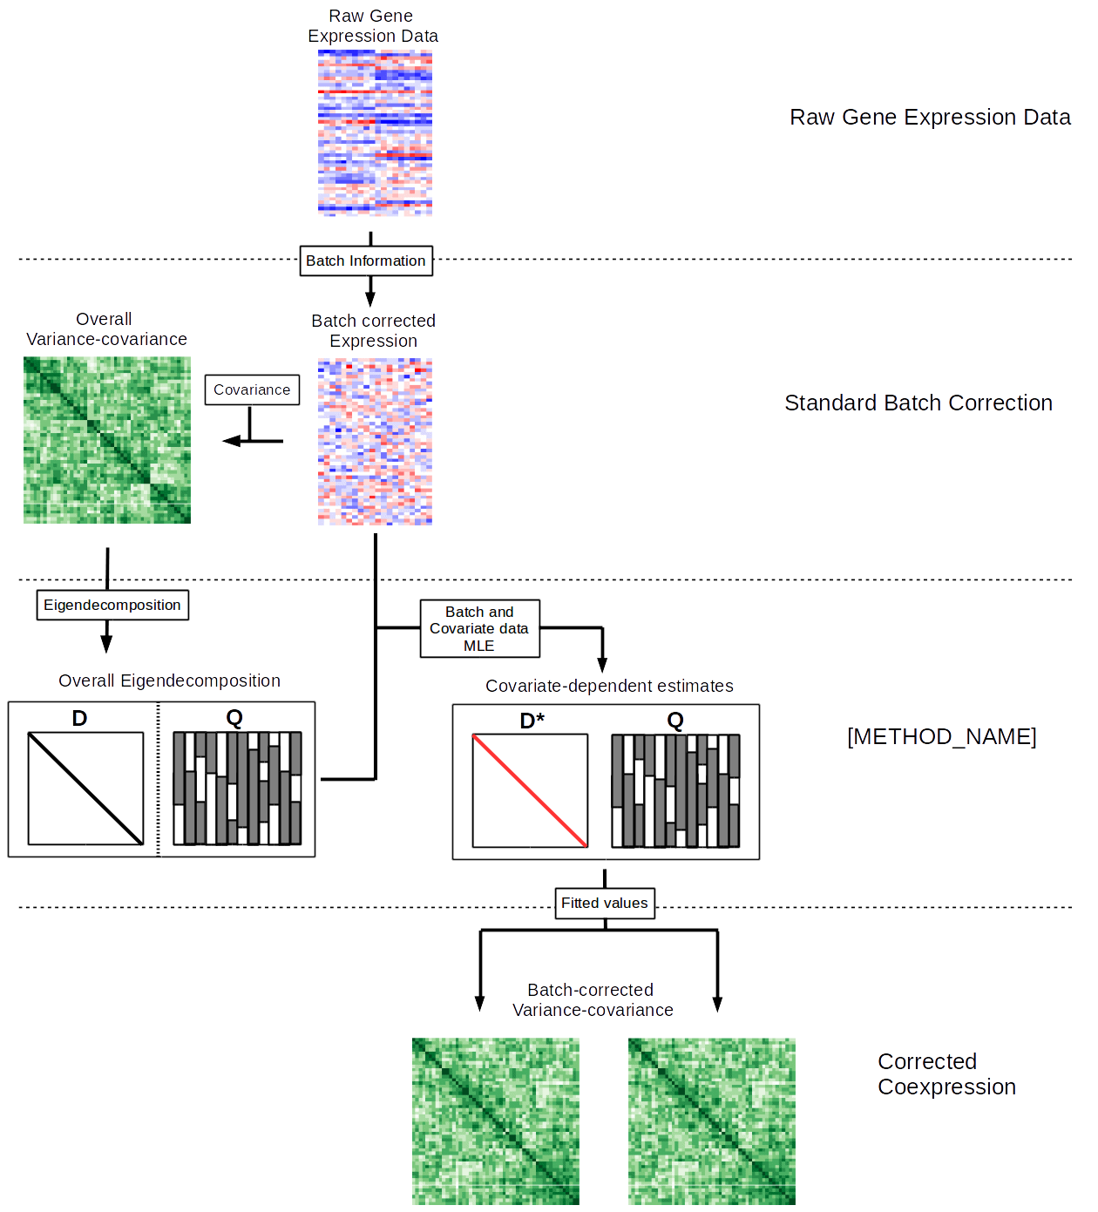
Figure 1 (Option 2)

Slide 5
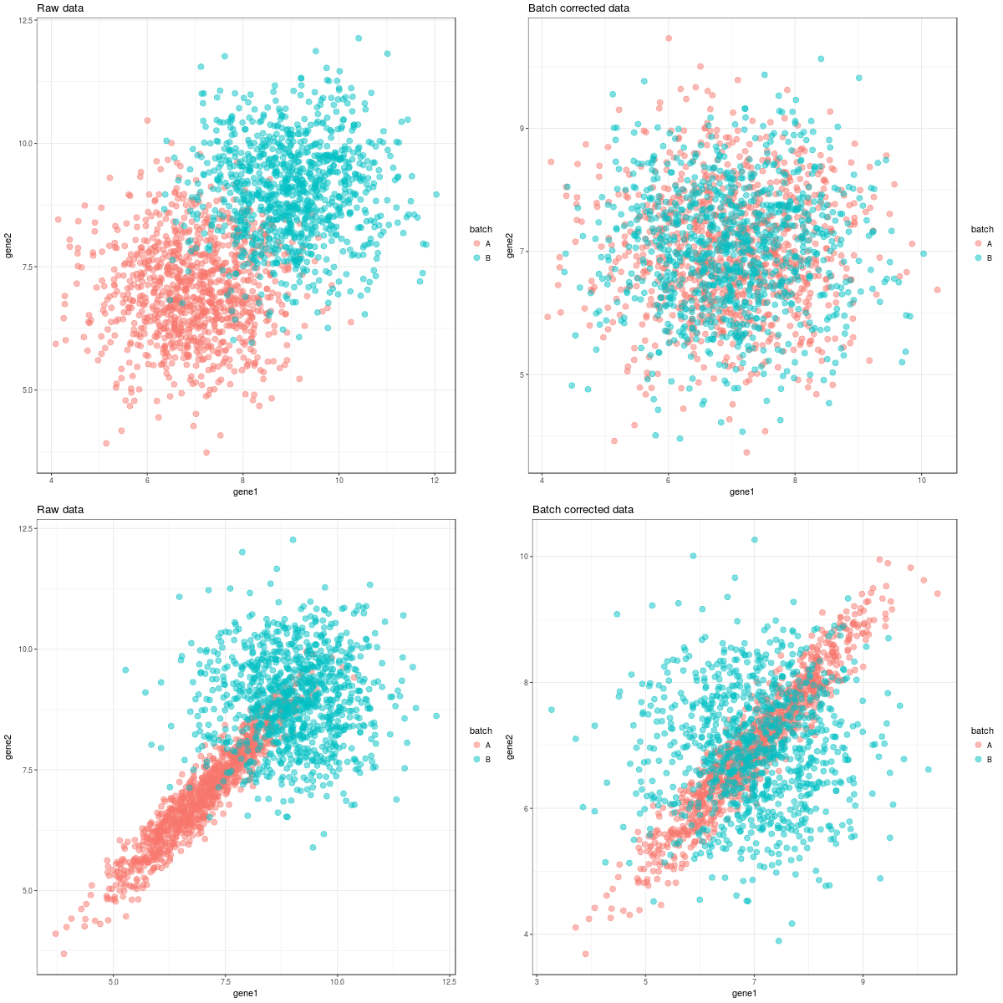
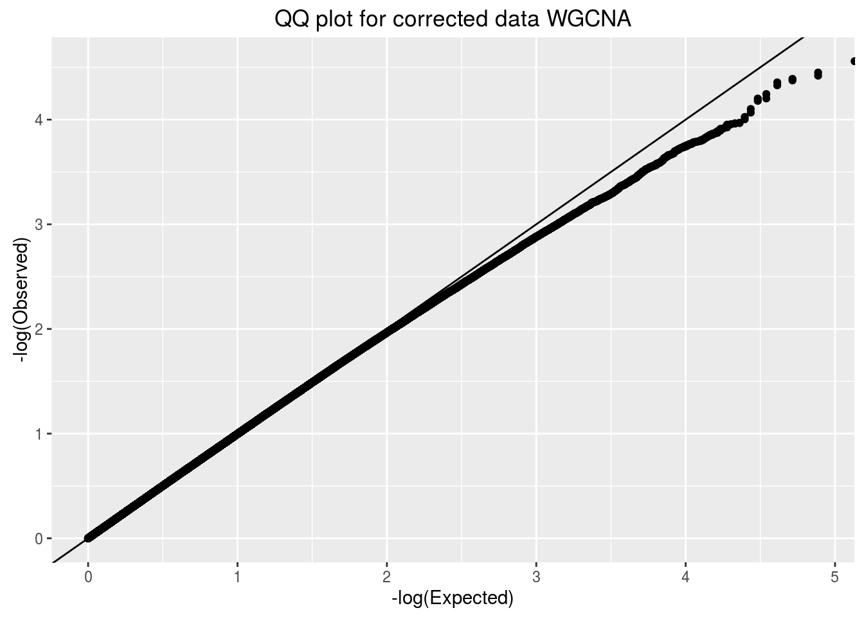
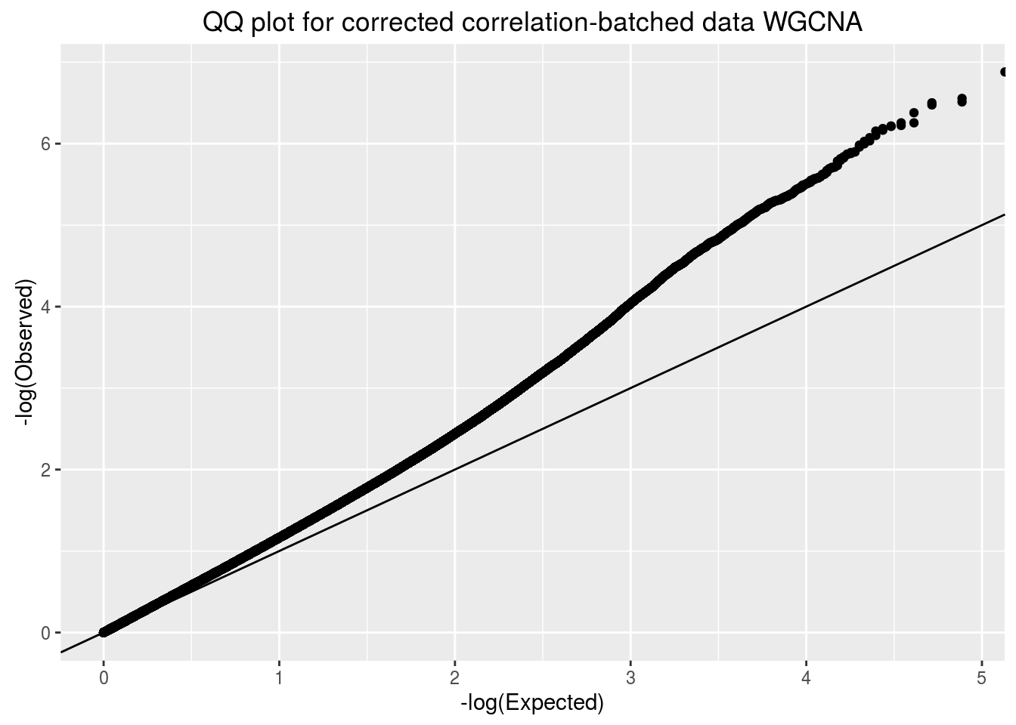
Figure 2
A
B
E
C
D
F
In this toy example, we demonstrate which artifacts standard batch correction is capable of correcting and which artifacts will remain. In A-D, we show plots of two example genes before (left) and after (right) correction, colored by their batch. In the top row (A,B), we show a comparison of two genes which are conditionally independent, and illustrate that batch correction appropriately removes the marginal dependence between the genes. In the bottom row (C,D), we show two genes that are conditionally coexpressed and demonstrate that batch correction may help mitigate the measured coexpression, but the resulting coexpression is a function of the batch membership. Importantly when comparing coexpression matrices, differing batch proportions will bias the differential coexpression. In simulations (See Supp) we demonstrate that in the absence of batched differential coexpression, ComBat sufficiently controls the type I error. However, when coexpression differs by batch, our false positive rate increases above the expectation of the null model.
Toy example of what existing batch correction methods are capable of.
Motivates the need to correct the coexpression matrix, not the gene expression.

Slide 6
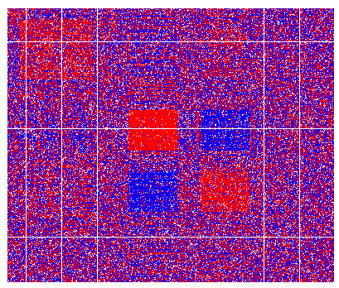
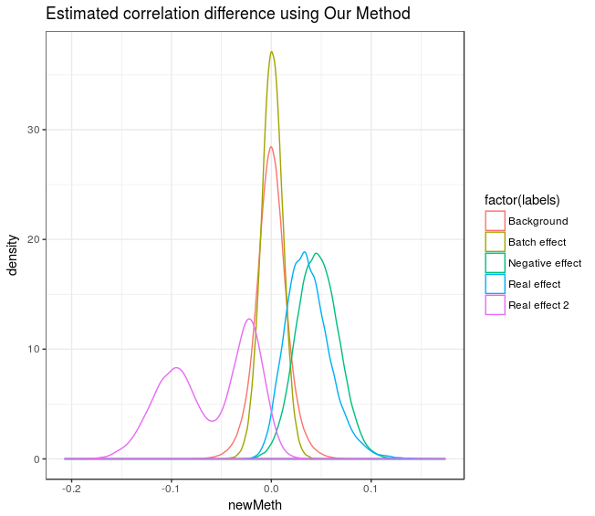
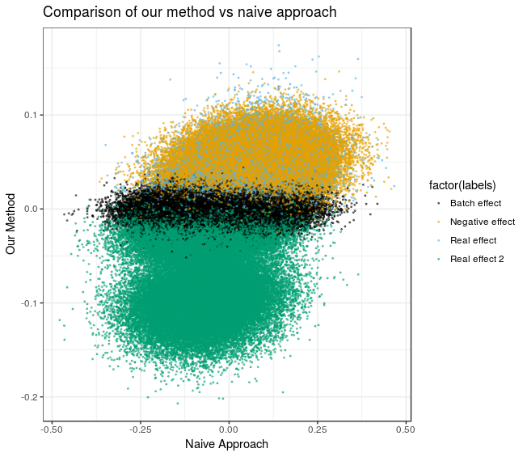
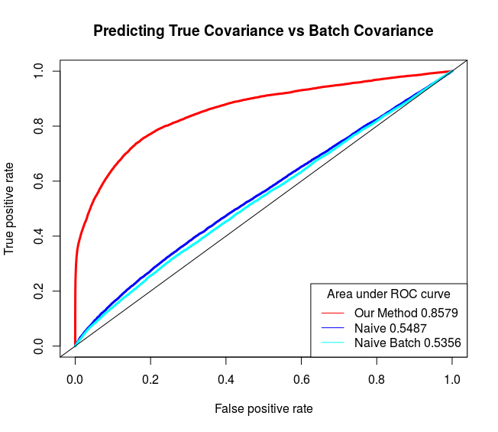
Figure 3
A
C
B
D
In Silico results

Slide 7
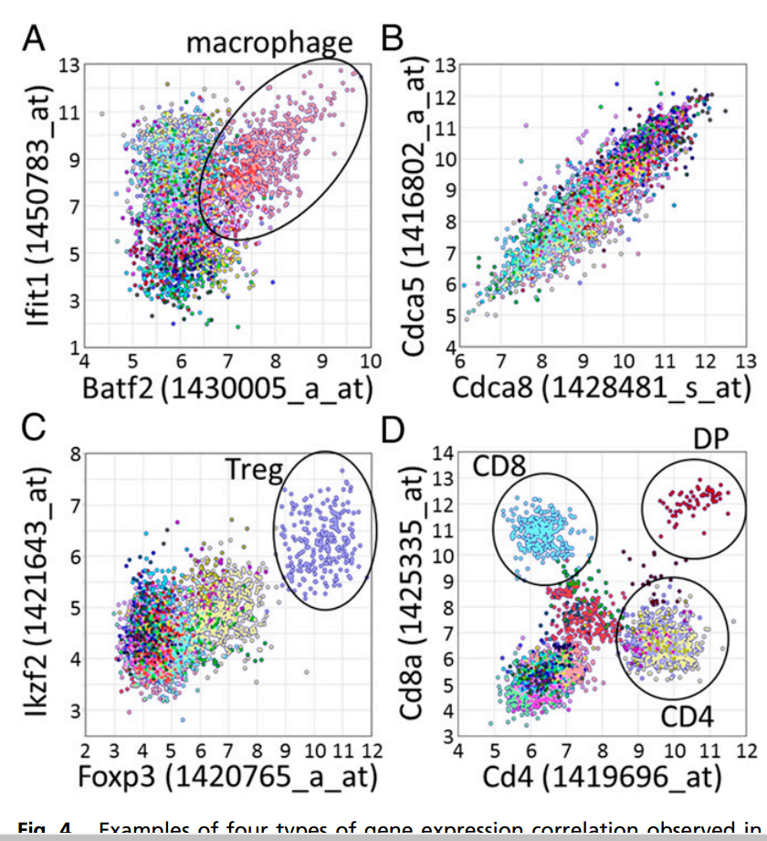
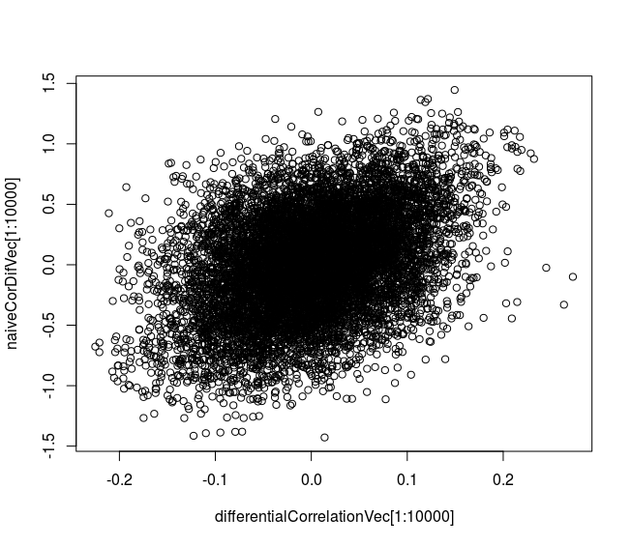
Yeast vs ImmunoNavigator
Published differential coexpression
analyses?
Fig 4, I-N paper, 2016 PNAS
Batches appear to be subsets of cell types
Yeast – Our method (X-axis) vs diff coex

Slide 8
Method Name
Ideas:
  Batch Effect Adjusted Re-estimation (BEAR)
    Doesn't mention co-expression
    ComBat-BEAR has a nice ring to it...
  Batch, Confounders, Coexpression/Covariance/Correlation, Estimating, Adjusted/Modified, Eigenvector, Eigendecompostion, Module-driven

