Slide 1



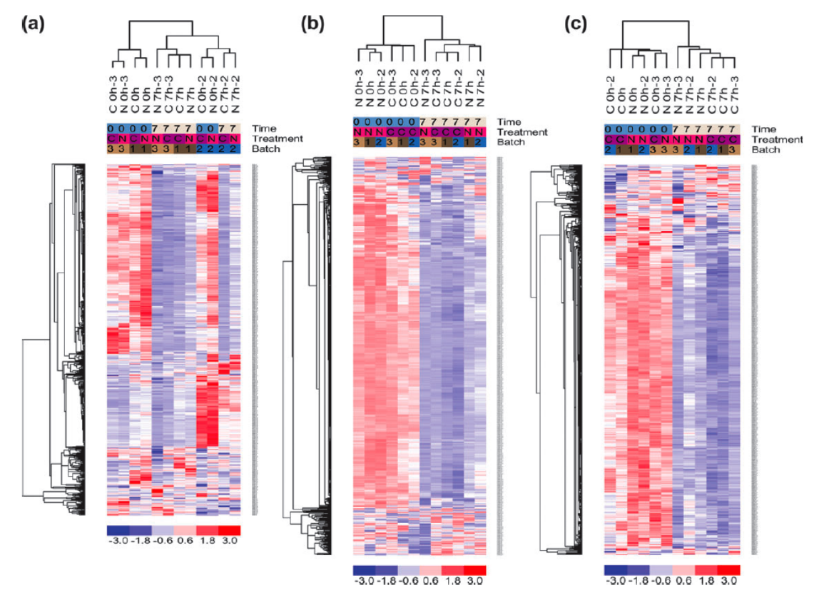
Batches
Experimental Conditions

