Slide 1
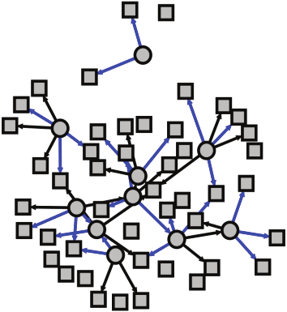
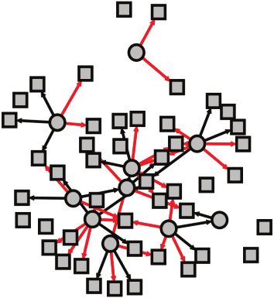
Control Network
Cases Network
TFs
TFs
X
~
Transition Matrix
Genes
Genes

