Slide 1

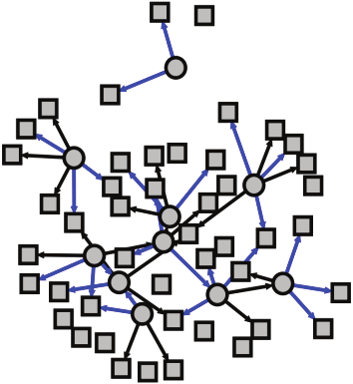
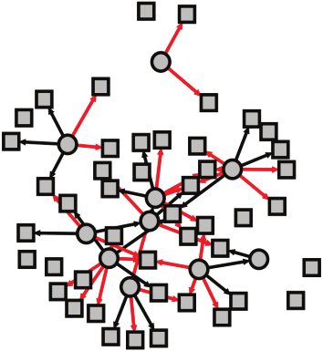
Control Samples
Case Samples
BERE-TM
Gene expression
Gene expression
Control Network
Cases Network
Transition Matrix

