Slide 1

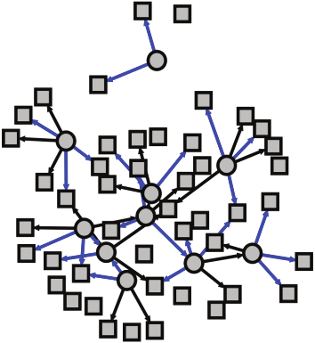
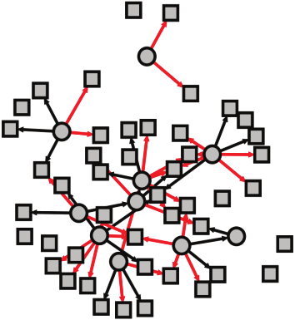
Smokers
COPD Subjects
[Analysis Name]
Gene expression
Gene expression
Smokers Network
COPD Network
Transition Matrix

