Slide 1
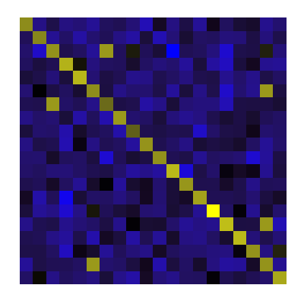

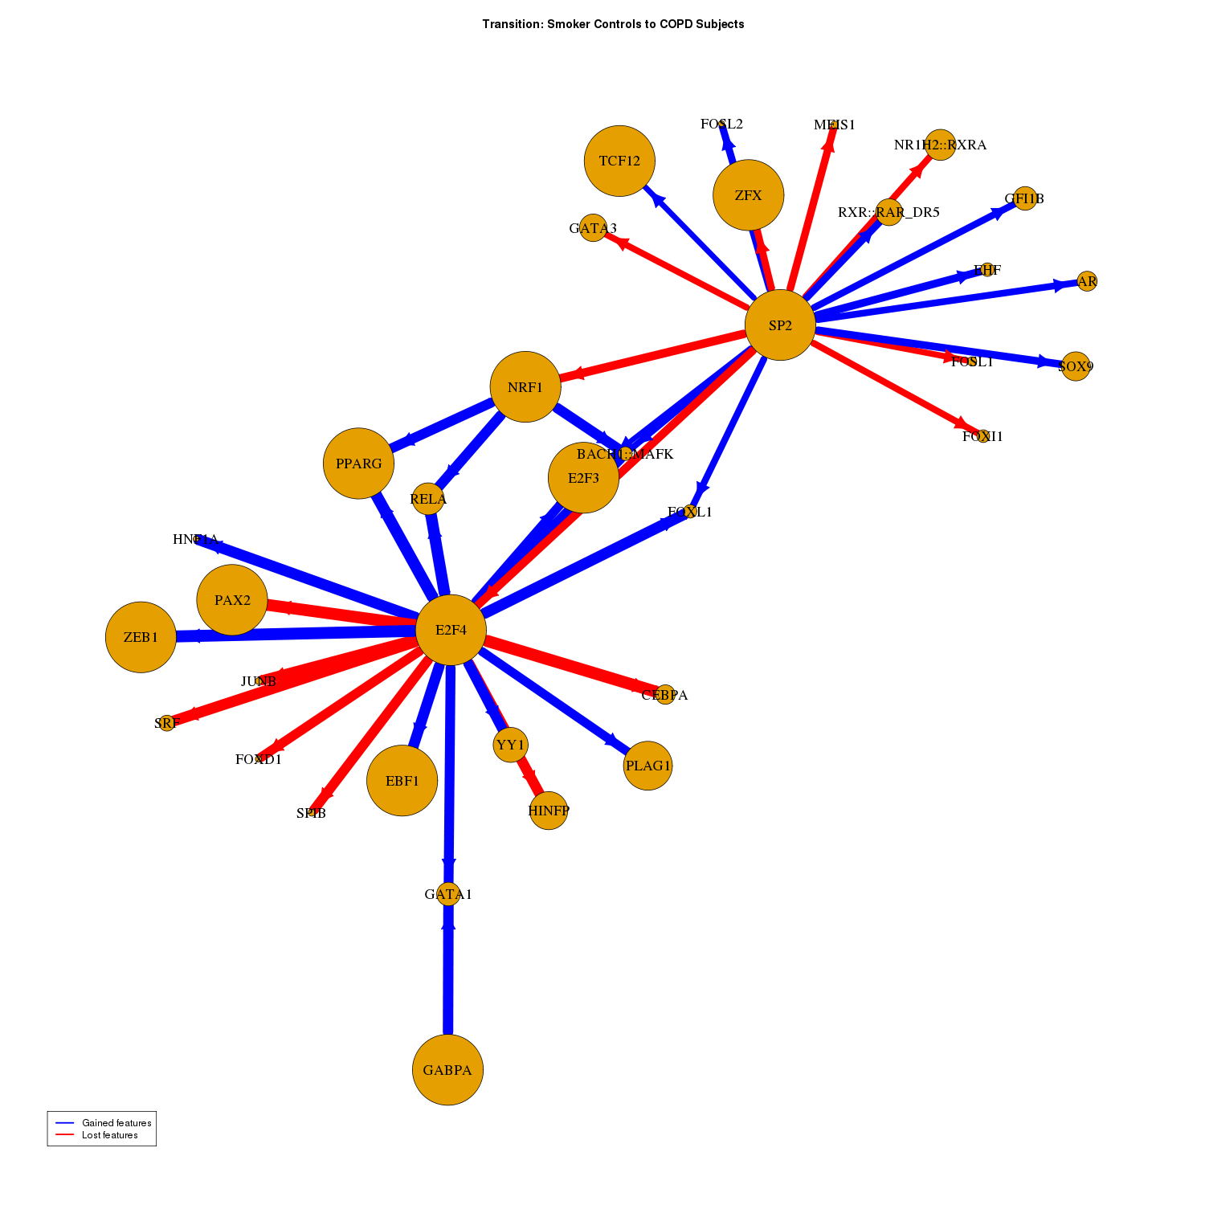
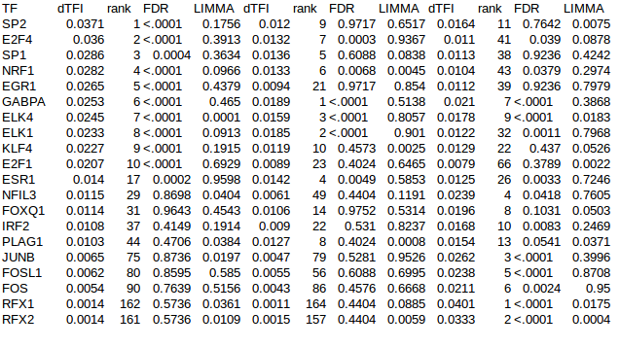
Gene expression Sequence Motifs
Observed Partition
Cases vs Controls
Random Partitions
Null x 1000
Network Inference
}
Observed
Controls
Network
Observed
Cases
Network
Null
Controls
Network
Null
Cases
Network
X 1000
Transition Matrix Calculation
}
X 1000
Transition Matrix Analysis

