Slide 1
GTEx data – Transition analysis
Evaluating “transitions” from cell lines to tissue:
- 2 separate comparisons:
1.) “cells_ebv-transformed_lymphocytes” vs ”whole_blood”
n1=132 n2=445
2.) “cells_transformed_fibroblasts” vs “skin”
n1=306 n2=663
- 29,000 genes, filtered to 19,000 by variance
- 625 Transcription factors
- Ran pandaM, 200 null permutations per analysis
Need to map TFs back to proper identifier
Interesting results summary:
Highly significant results... many differentially involved TFs characterize transition from cell line to tissue.
Low concordance between tissue types... the TFs defining cell line to tissue transition for skin compared to blood have little agreement.

Slide 2
Recall: Transition Matrix Approach
Cell line
Tau
Tissue
X
~

Slide 3
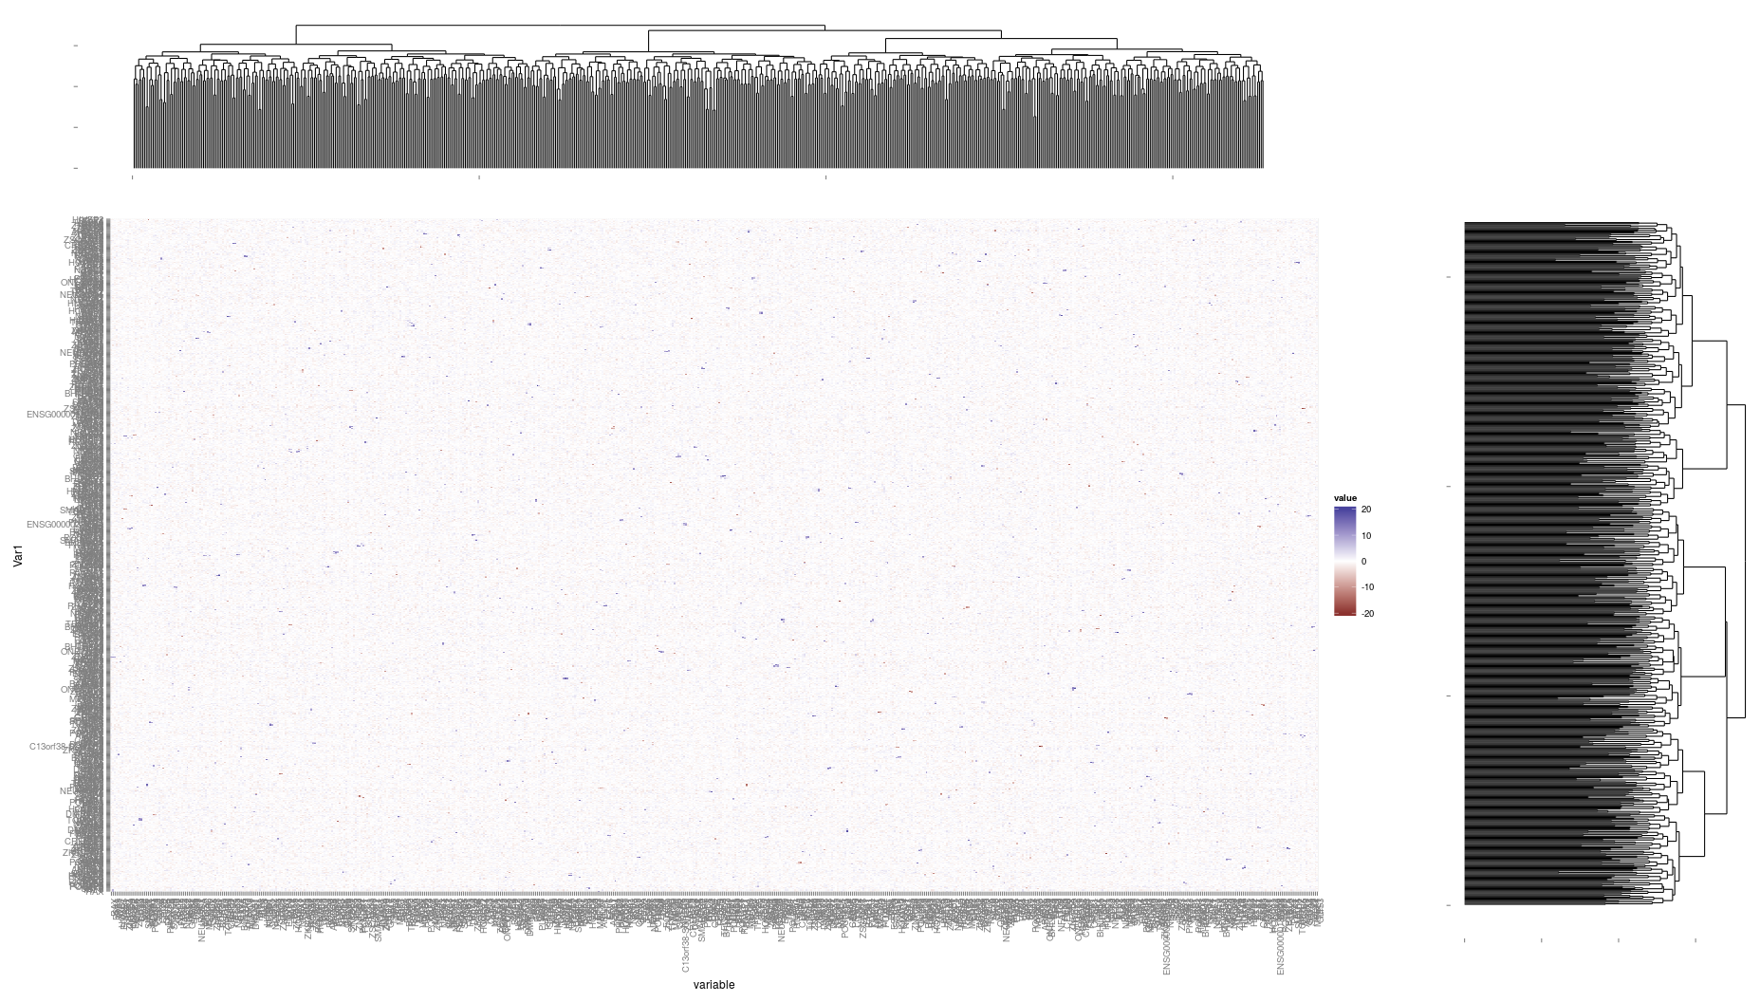
Transition matrix – Cell line to Tissue (Blood)

Slide 4
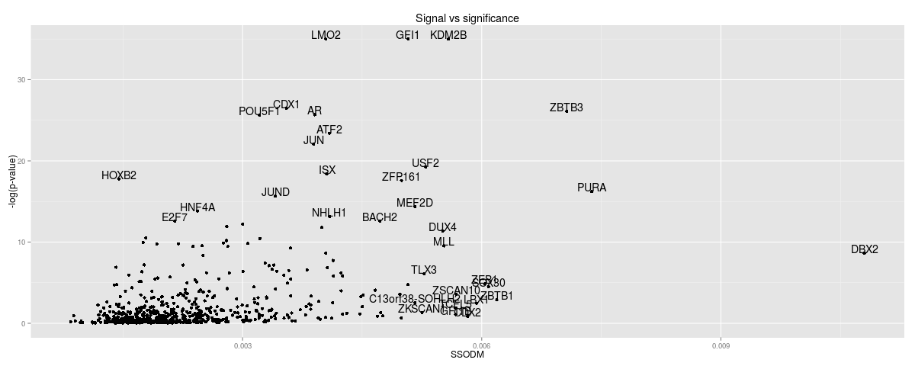
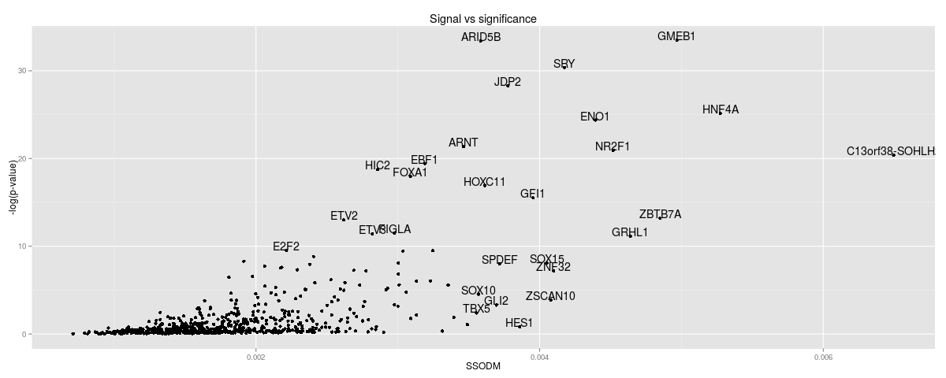
GTEx data
Highly significant results for both comparisons
Blood
Skin

Slide 5
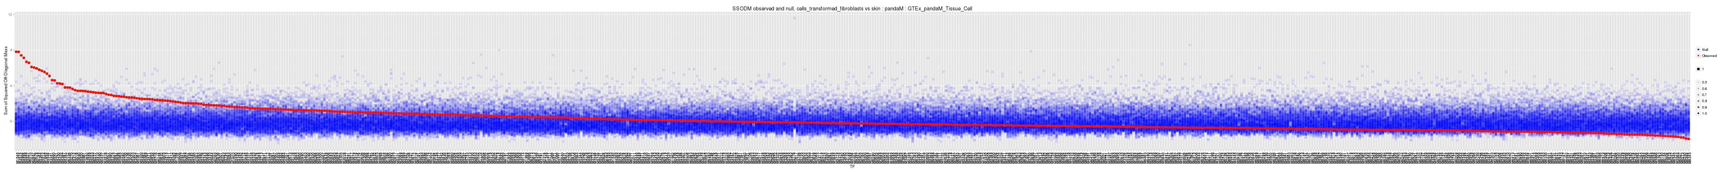
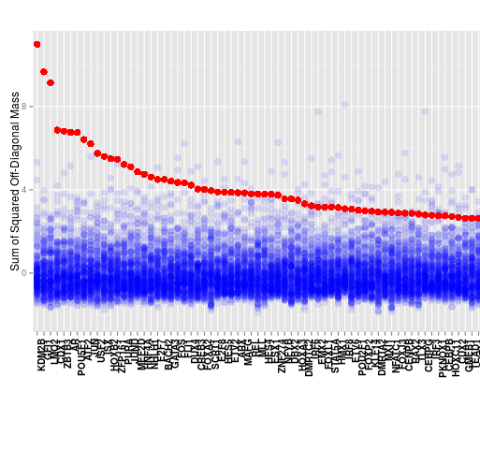
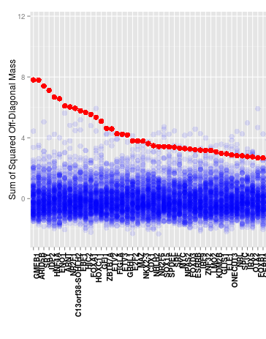
GTEx data
Blood
Effectively independent set of driver TFs for blood compared to skin.
Each analysis had >10 TFs found at FDR<.01
What are these TFs?
Skin

Slide 6
Top differentially involved TFs
Cell line to Tissue
Blood
Skin
Rank | TF | Magnitude
1 | KDM2B | 0.0056
2 | GFI1 | 0.0051
3 | LMO2 | 0.0040
4 | CDX1 | 0.0036
5 | ZBTB3 | 0.0071
6 | AR | 0.0039
7 | POU5F1 | 0.0032
8 | ATF2 | 0.0041
9 | JUN | 0.0039
10 | USF2 | 0.0053
11 | ISX | 0.0041
12 | HOXB2 | 0.0015
13 | ZFP161 | 0.0050
14 | PURA | 0.0074
15 | JUND | 0.0034
 | Magnitude
GMEB1 | 0.004967972
ARID5B | 0.0035837379
SRY | 0.0041735983
JDP2 | 0.0037764129
HNF4A | 0.0052749029
ENO1 | 0.0043939602
ARNT | 0.0034624085
NR2F1 | 0.0045191668
C13orf38-SOHLH2 | 0.0064960371
EBF1 | 0.0031899499
HIC2 | 0.0028565361
FOXA1 | 0.0030886264
HOXC11 | 0.0036117532
GFI1 | 0.0039538974
ZBTB7A | 0.0048494209
Pearson correlation (all TFs) = 0.0485 (p=0.2164)
Top 15 results all significant at FDR<.01

Slide 7
