Slide 1
Meeting 10/5/15

Slide 2
Work in progress
1.) Evaluation of TM of published NI algorithms
  Pearson
  WGCNA (with differing beta parameters)
  Topological Overlap Measure
  CLR
  ARACNE
  PANDA
2.) Comparison to direct edge difference to find TF-TF interaction.
  Pearson
  WGCNA (with differing beta parameters)
  Topological Overlap Measure
  CLR
  ARACNE

Slide 3
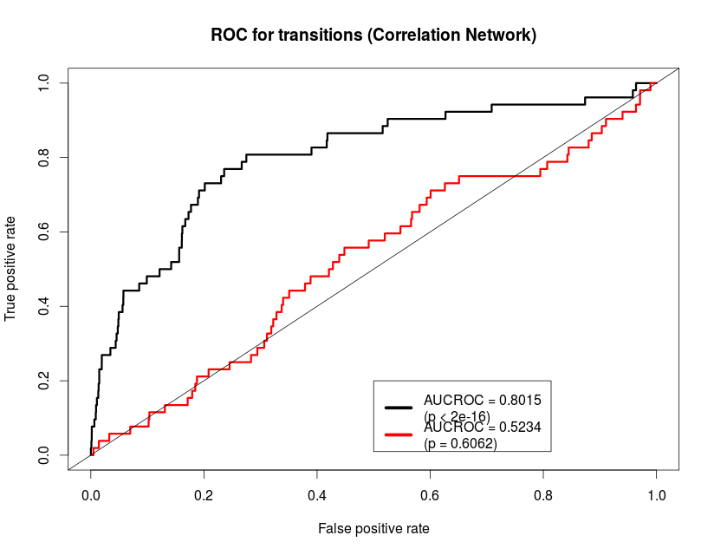

Slide 4
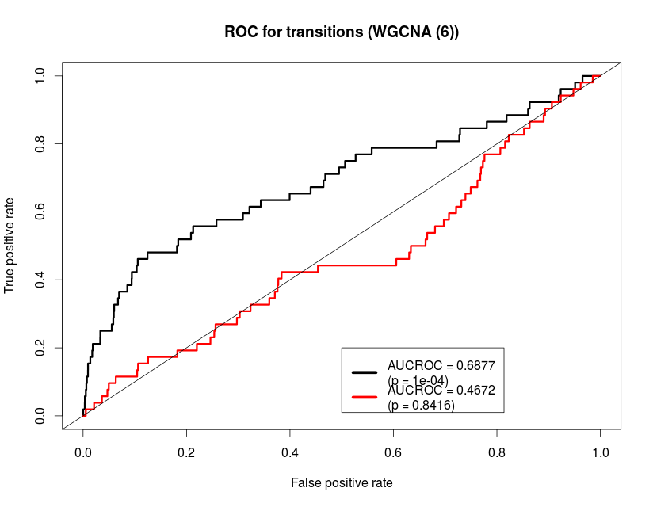

Slide 5
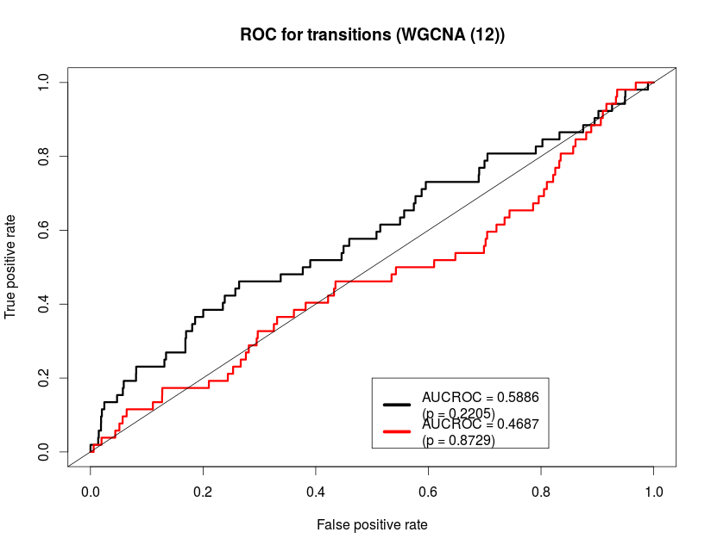

Slide 6
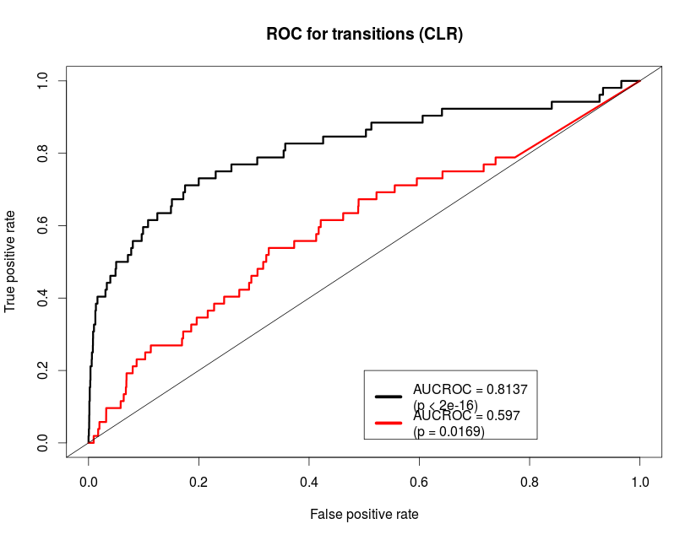

Slide 7
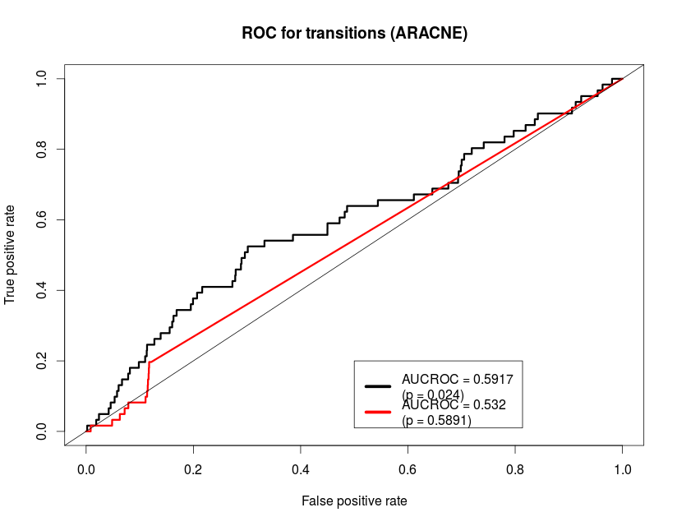

Slide 8
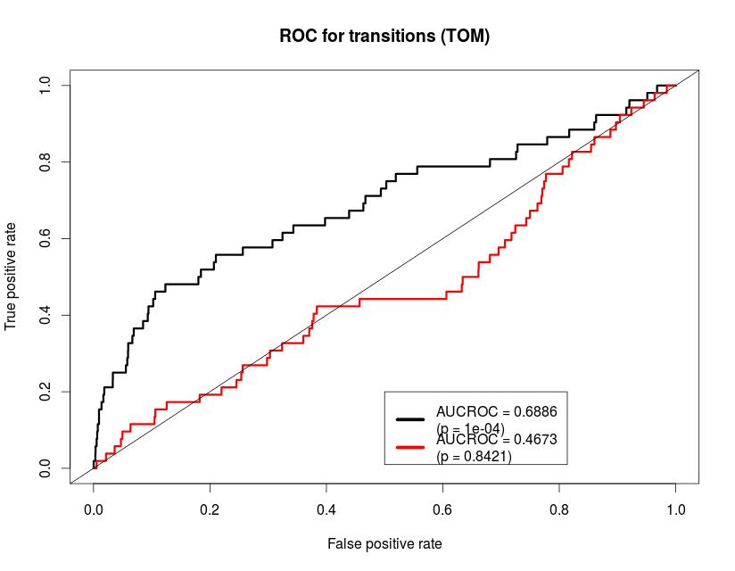

Slide 9
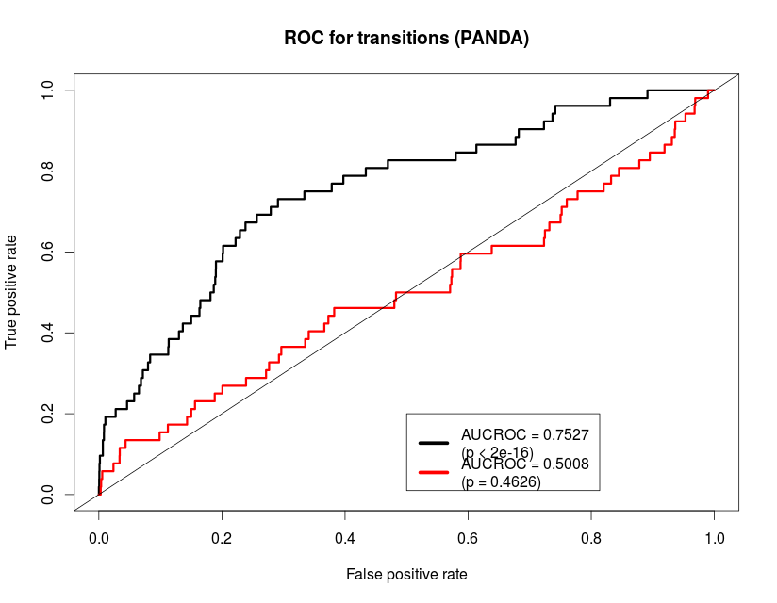

Slide 10
Comparison of NI methods
 | Pearson | WGCNA(6) | WGCNA(12) | ARACNE | CLR | TOM | PANDA1 | PANDA2
Network AUC | .701 (p<.0001) | .701 (p<.0001) | .701 (p<.0001) | .515 (p<.0001) | .691 (p<.0001) | .700 (p<.0001) | .740 Motif=.570 (p<.0001) | .676 Motif = .547 (p<.0001)
Direct AUC | .510 (p=.72) | .512 (p=.61) | .52 (p=.10) | .523 (p=.58) | .57 (p=.19) | .51 (p=.62) | .520 (p<.13) | .509 (p<.43)
Transition AUC | .802 (p<.0001) | .688 (p<.0001) | .589 (p=.02) | .566 (p=.09) | .814 (p<.0001) | .689 (p<.0001) | .793 (p<.0001) | .66 (p<.0001)

Slide 11
ECLIPSE results, top TF-TF interactions
Changing TF | Trainer TF | Gain/Loss | p-value | FDR
GABPA | SPIB | Loss | 1.07E-009 | 3.82E-005
E2F4 | PAX2 | Loss | 1.22E-008 | 2.17E-004
ELK4 | SPIB | Loss | 1.83E-008 | 2.18E-004
E2F4 | SPIB | Loss | 3.53E-008 | 3.15E-004
E2F4 | ZEB1 | Gain | 4.70E-008 | 3.36E-004
E2F4 | YY1 | Gain | 6.76E-008 | 4.02E-004
E2F4 | SREBF2 | Gain | 1.46E-007 | 7.46E-004
NRF1 | SPIB | Loss | 3.64E-007 | 1.63E-003
E2F4 | FOXL1 | Gain | 4.10E-007 | 1.63E-003
E2F1 | YY1 | Gain | 4.23E-007 | 1.51E-003
E2F4 | FOXD1 | Loss | 5.07E-007 | 1.65E-003
NRF1 | BACH1::MAFK | Gain | 5.39E-007 | 1.61E-003
E2F4 | BACH1::MAFK | Gain | 6.25E-007 | 1.72E-003
E2F4 | PPARG | Gain | 8.24E-007 | 2.10E-003
NRF1 | YY1 | Gain | 1.26E-006 | 3.00E-003
NRF1 | PPARG | Gain | 1.46E-006 | 3.27E-003
E2F4 | GABPA | Gain | 1.62E-006 | 3.40E-003
ELK4 | MYOG | Loss | 2.11E-006 | 4.19E-003
GABPA | ZEB1 | Gain | 2.24E-006 | 4.22E-003
GABPA | MYOG | Loss | 3.27E-006 | 5.83E-003
Checking this list for differential methylation may be our best hope for biological validation in humans.

Slide 12
Conclusions
The transition matrix approach finds TF-TF interactions dramatically better than using pairwise NI approaches.
Effectiveness of TM does depend on network inference method, but is always superior to pairwise approach.

Slide 13
Story
1.) Method works?
  TM approach has strong theoretical basis with clearly defined assumptions and conditions.
    Can be proven to be most efficient unbiased estimator of our defined transitions for any edge distribution.
  TM approach validates in in silico, E. coli, and Yeast datasets
2.) Method replicates?
  TM approach finds dramatic and significant improvement upon TF-TF edge prediction in all tested NI methods.
    Pearson, WGCNA(6 and 12), TOM, CLR, ARACNE, PANDA
  Method finds highly concordant results in different datasets studying the same disease.
    COPDGene, ECLIPSE, LGRC (note, this fact does depend on NI method)
3.) Method is useful?
  Method predicts TF-TF targeting substantially better than existing methods in Yeast and in silico datasets.
  Method predicts many TF interactions as well as TFs which have non-specified behavioral changes
Yes, yes and yes?

