Slide 1
GTEx data
Evaluating “transitions” from cell lines to tissue:
- 2 separate comparisons:
1.) “cells_ebv-transformed_lymphocytes” vs ”whole_blood”
2.) “cells_transformed_fibroblasts” vs “skin”
- 29,000 genes, filtered to 19,000 by variance
- 625 Transcription factors
- Ran pandaM, 200 null permutations per analysis
Need to map TFs back to proper identifier
Interesting results summary:
Highly significant results... many differentially involved TFs characterize transition from cell line to tissue.
Low concordance between tissue types... the TFs defining cell line to tissue transition for skin compared to blood have little agreement.

Slide 2
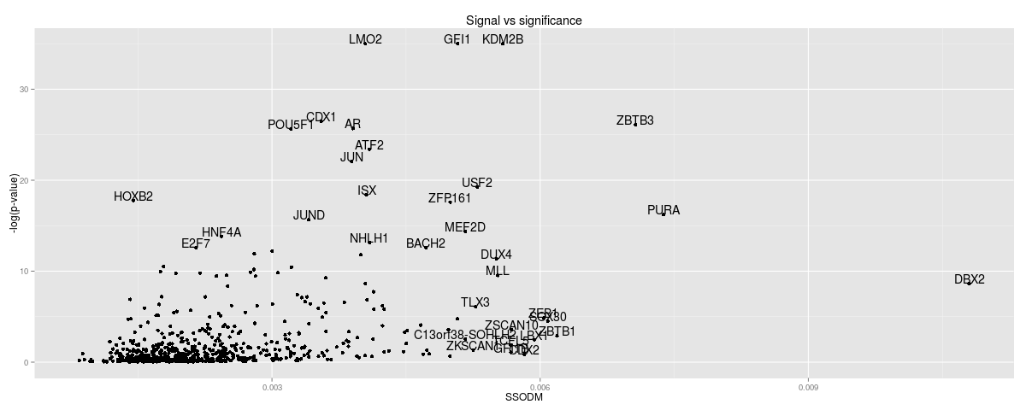
GTEx data
Highly significant results for both comparisons
Blood
Skin

Slide 3
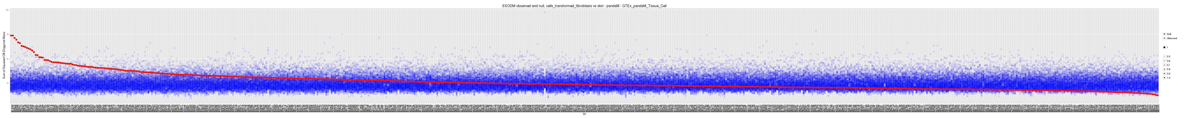
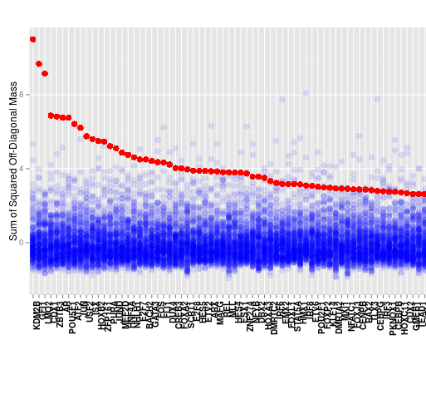
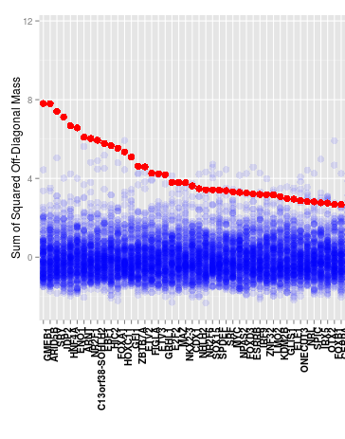
GTEx data
Blood
Effectively independent set of driver TFs for blood compared to skin.
Each analysis had >10 TFs found at FDR<.01
What are these TFs?
Skin

Slide 4
GTEx data
 | Magnitude | dTFI uncorrected p-value | dTFI FDR
KDM2B | 0.0056 | 0.0000 | 0.0000
GFI1 | 0.0051 | 0.0000 | 0.0000
LMO2 | 0.0040 | 0.0000 | 0.0000
CDX1 | 0.0036 | 0.0000 | 0.0000
ZBTB3 | 0.0071 | 0.0000 | 0.0000
AR | 0.0039 | 0.0000 | 0.0000
POU5F1 | 0.0032 | 0.0000 | 0.0000
ATF2 | 0.0041 | 0.0000 | 0.0000
JUN | 0.0039 | 0.0000 | 0.0000
USF2 | 0.0053 | 0.0000 | 0.0000
ISX | 0.0041 | 0.0000 | 0.0000
HOXB2 | 0.0015 | 0.0000 | 0.0000
ZFP161 | 0.0050 | 0.0000 | 0.0000
PURA | 0.0074 | 0.0000 | 0.0000
JUND | 0.0034 | 0.0000 | 0.0000
MEF2D | 0.0052 | 0.0000 | 0.0000

