Slide 1
Meeting 2/9/15

Slide 2
Items
PandaR update, memory issues
Cluster access
TF clustering of TM
K-means, HCL
R optimization tcrossprod

Slide 3
Randomization approaches
Within gene
Results: very weak SSODM due to weak correlations. IE, networks look similar in both groups. Don’t support.
By gene
Results: Better null SSODM distribution
Across conditions
With or without condition-standardization

Slide 4
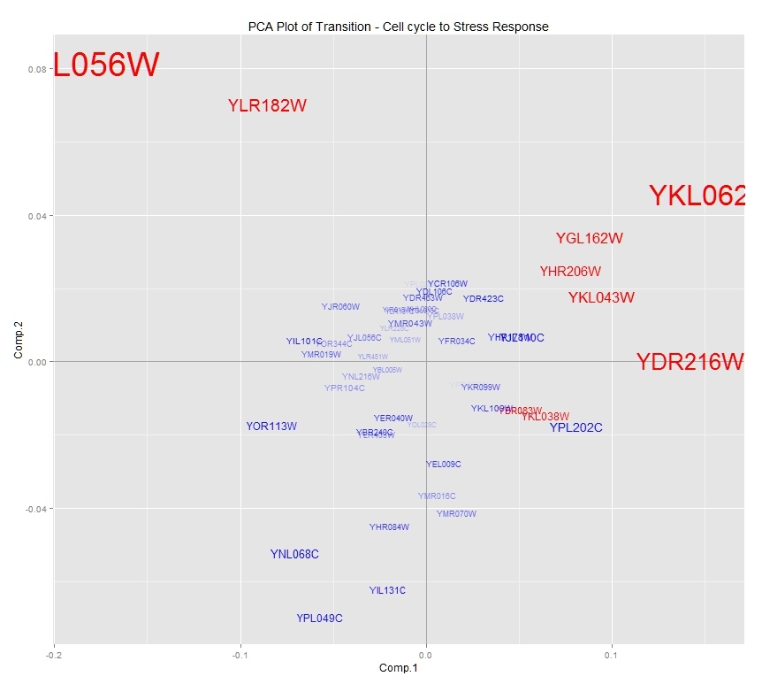
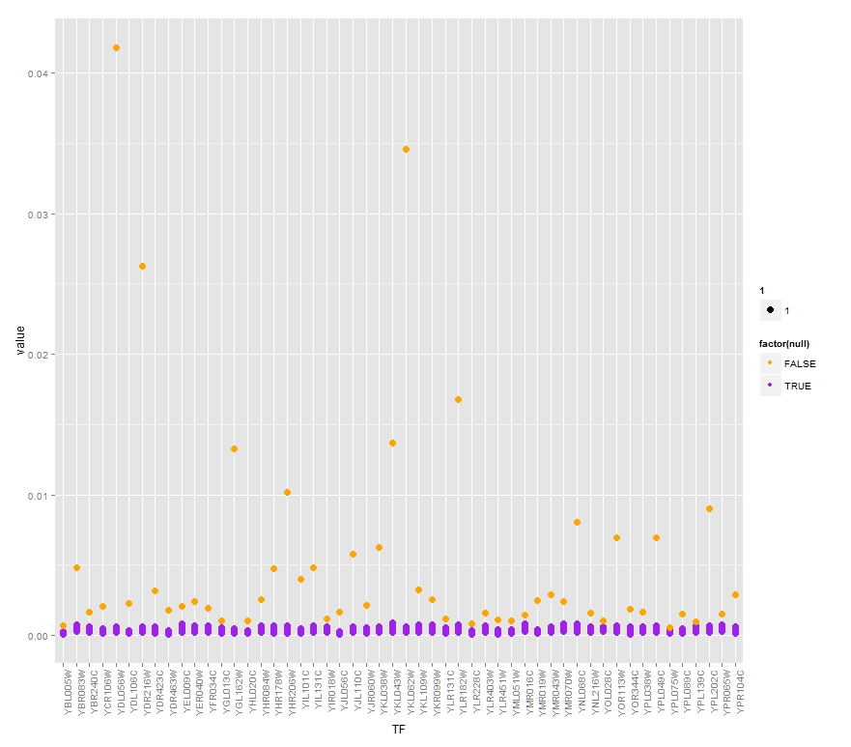
Visualizations of Yeast

Slide 5
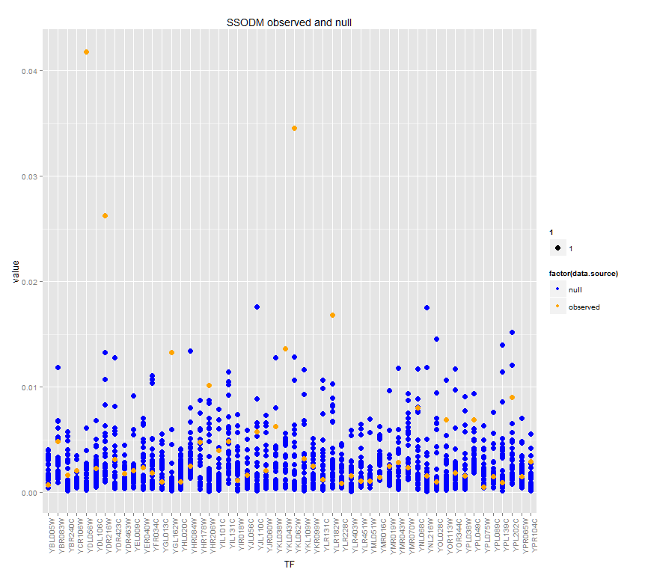
Visualizations of Yeast

Slide 6
Eclipse results
M vs F
Findings… what should we expect?
NFIC, TLX1
GABPA, ELK1, ELK4
Smoker vs Non
Run C++ version 2
Comparison to gene expression analysis

Slide 7
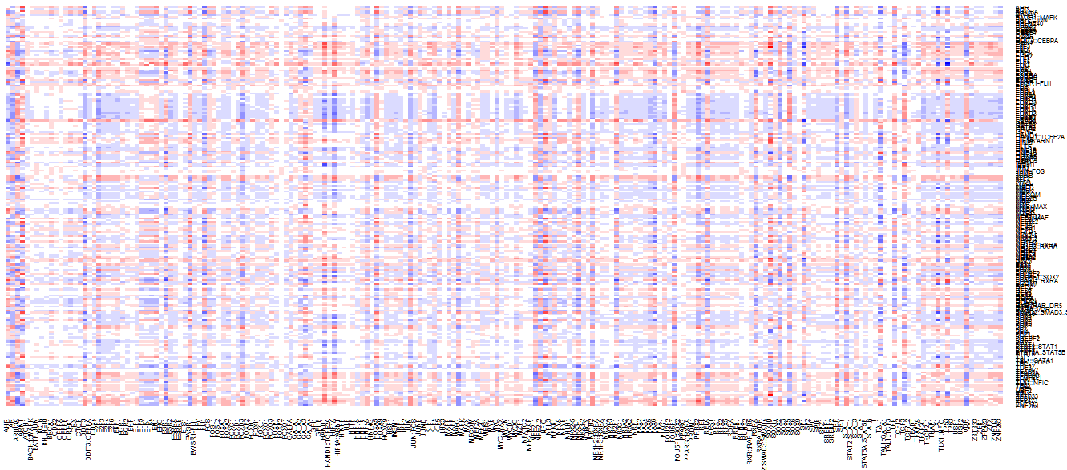
Transition Matrix (M vs F)

Slide 8
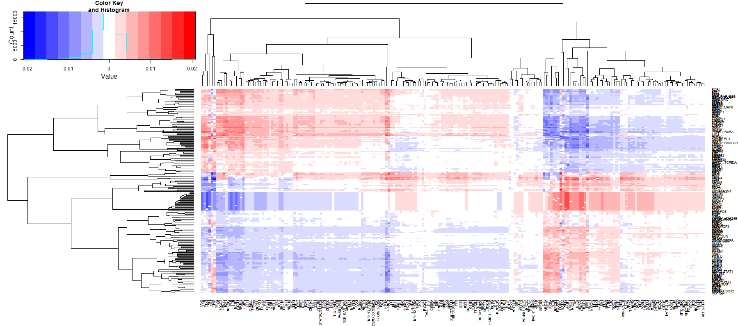
Transition Matrix (M vs F)

Slide 9
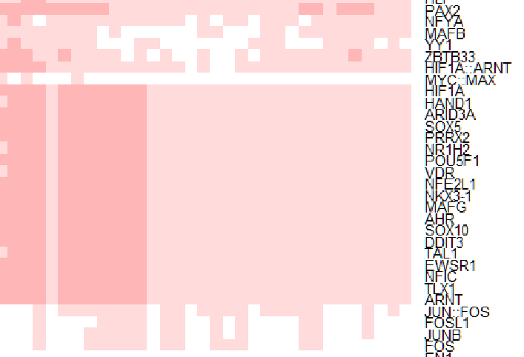
Transition Matrix (M vs F)

Slide 10
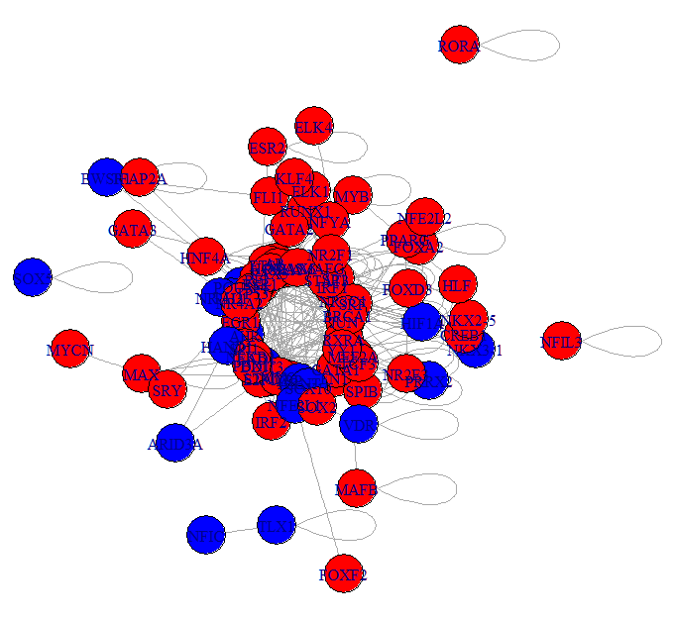
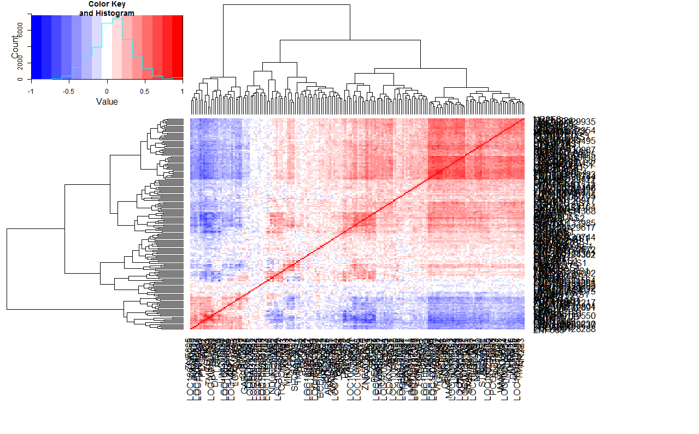
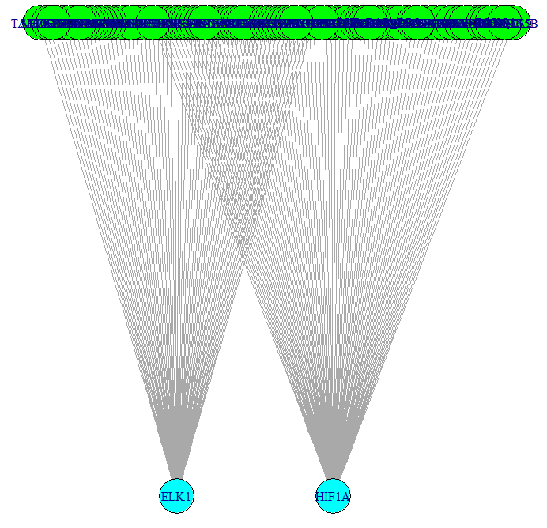
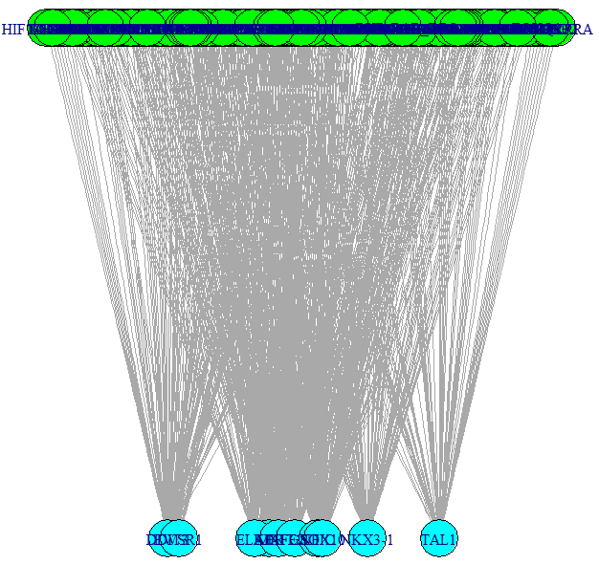
Strange correlated TFs
EXPR
PPI
HIF1A
HAND1
ARID3A
SOX5
PRRX2
NR1H2
POU5F1
VDR
NFE2L1
NKX3-1
MAFG
AHR
SOX10
DDIT3
TAL1
EWSR1
NFIC
TLX1
ARNT
MOTIF
Normal Suspect

Slide 11
Strange correlated TFs
HIF1A
HAND1
ARID3A
SOX5
PRRX2
NR1H2
POU5F1
VDR
NFE2L1
NKX3-1
MAFG
AHR
SOX10
DDIT3
TAL1
EWSR1
NFIC
TLX1
ARNT
UPDATE: These TFs do NOT in fact have motif structure, the motif structure on previous slide is for gene names of the same name
Perhaps we should remove as we have evidence that the results are unreliable and determined to be the same for each…

Slide 12
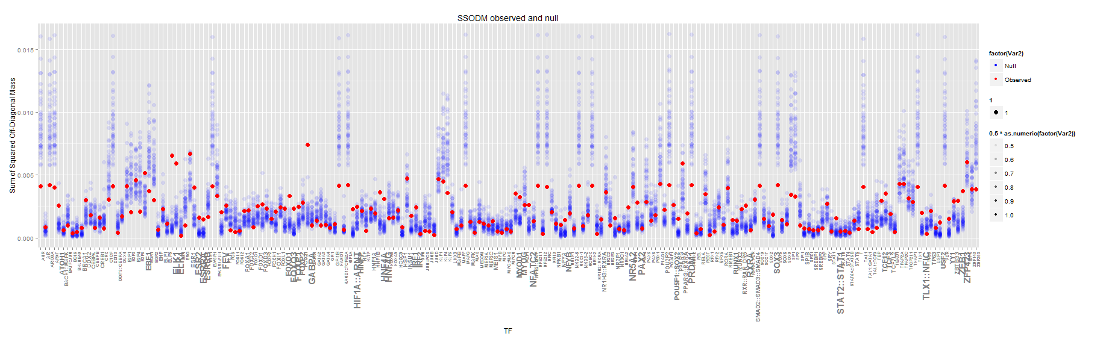
Differentially involved TFs (M vs F)

Slide 13
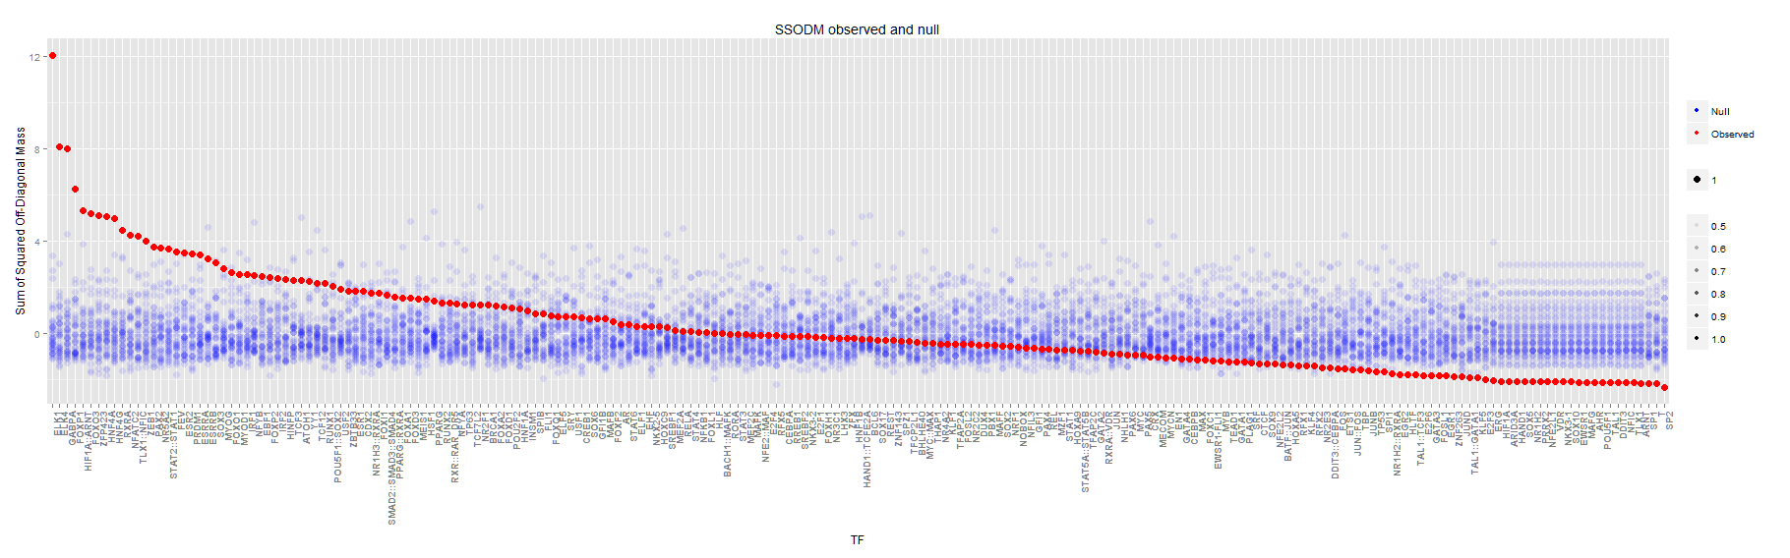
Differentially involved TFs (M vs F)

Slide 14
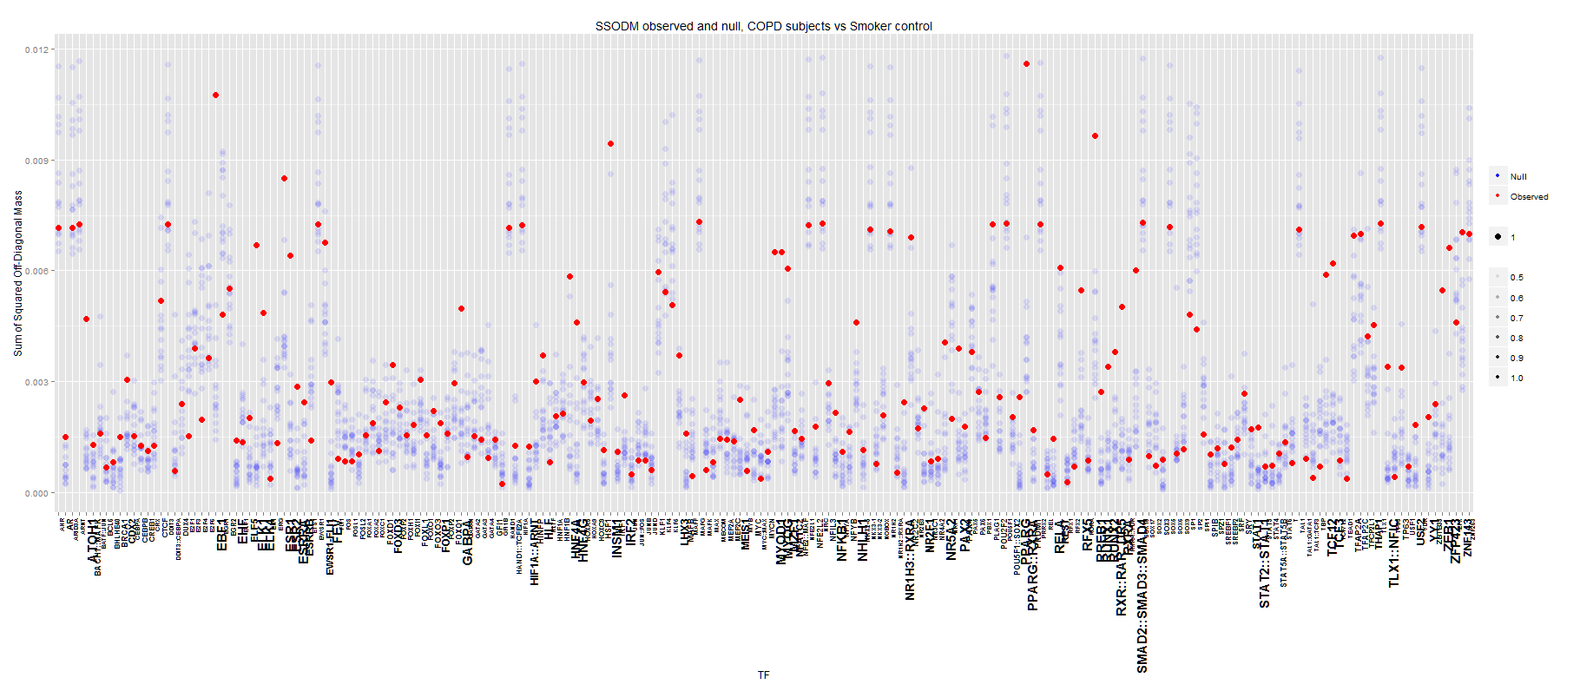
Differentially involved TFs (COPD vs smoker control)

Slide 15
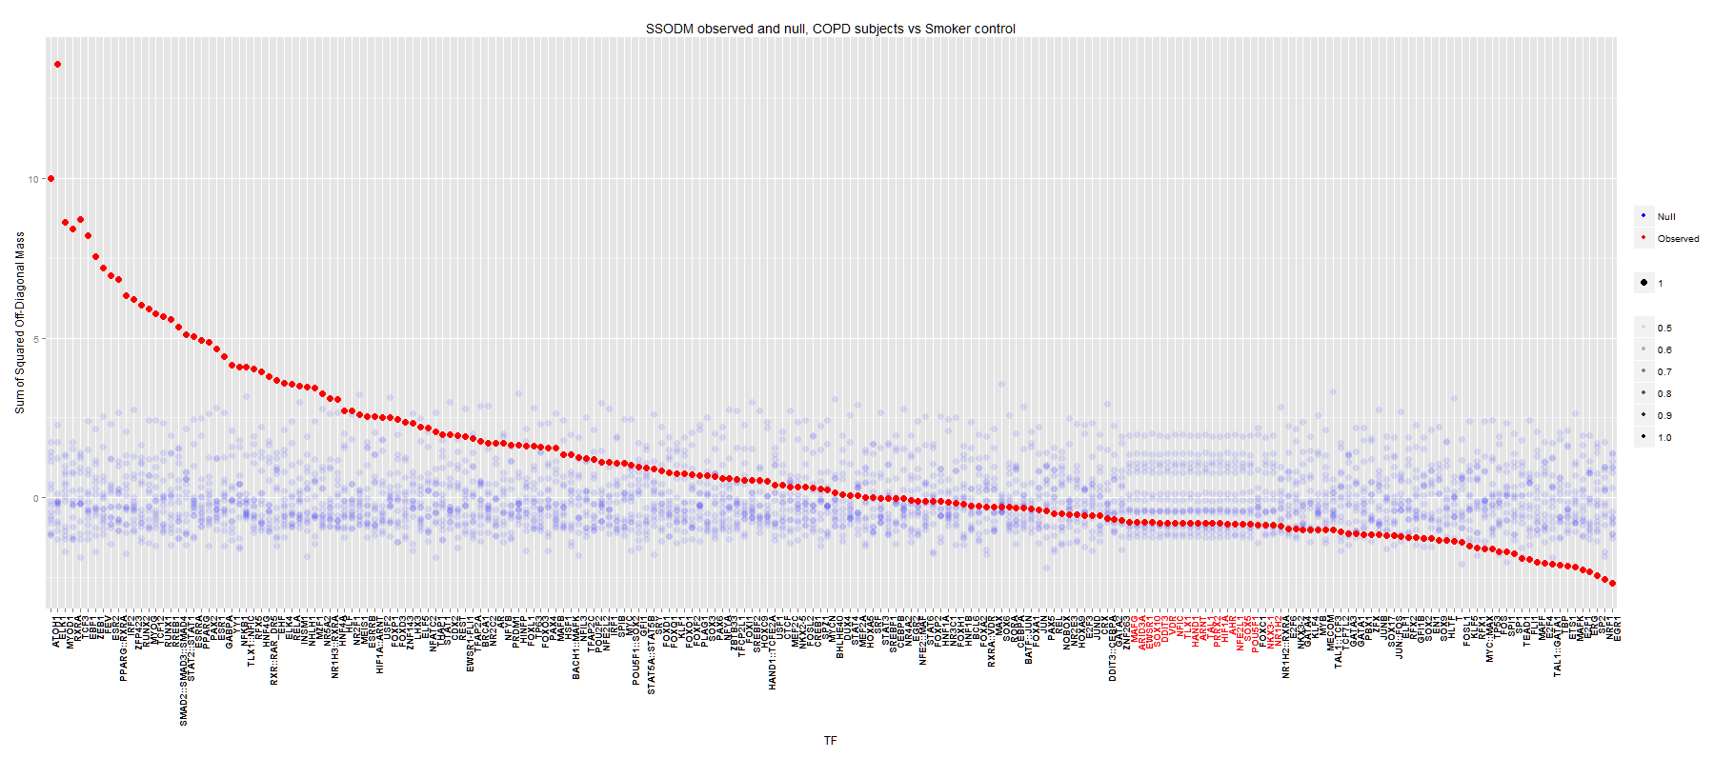
Differentially involved TFs (COPD vs smoker control)

Slide 16
Top COPD vs Smoker Controls
ATOH1 Transcriptional regulator. Activates E box-dependent transcription in collaboration with TCF3/E47, but the activity is completely antagonized by the negative regulator of neurogenesis HES1. Plays a role in the differentiation of subsets of neural cells by activating E box-dependent transcription (By similarity)
ELK1 Stimulates transcription. Binds to purine-rich DNA sequences. Can form a ternary complex with the serum response factor and the ETS and SRF motifs of the fos serum response element
MYOD1 Acts as a transcriptional activator that promotes transcription of muscle-specific target genes and plays a role in muscle differentiation. Together with MYF5 and MYOG, co-occupies muscle-specific gene promoter core region during myogenesis. Induces fibroblasts to differentiate into myoblasts. Interacts with and is inhibited by the twist protein. This interaction probably involves the basic domains of both proteins (By similarity)
RXRA Receptor for retinoic acid. Retinoic acid receptors bind as heterodimers to their target response elements in response to their ligands, all-trans or 9-cis retinoic acid, and regulate gene expression in various biological processes.
TCF3 Transcriptional regulator. Involved in the initiation of neuronal differentiation. Heterodimers between TCF3 and tissue-specific basic helix-loop-helix (bHLH) proteins play major roles in determining tissue-specific cell fate during embryogenesis, like muscle or early B-cell differentiation. Dimers bind DNA on E-box motifs: 5'-CANNTG-3'. Binds to the kappa-E2 site in the kappa immunoglobulin gene enhancer. Binds to IEB1 and IEB2, which are short DNA sequences in the insulin gene transcription control region
EBF1
ZEB1
FEV
ESR2
PPARG::RXRA
IRF2
ZFP423

Slide 17
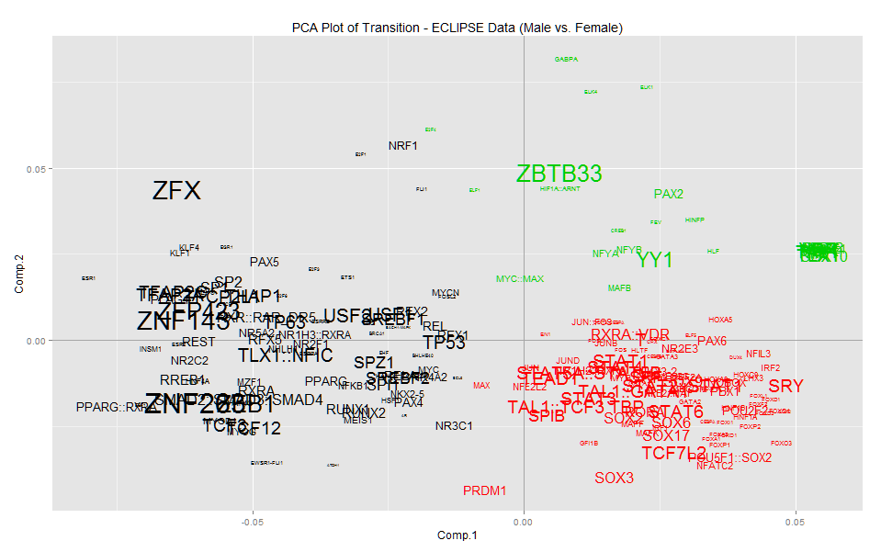
PCA of transition

Slide 18
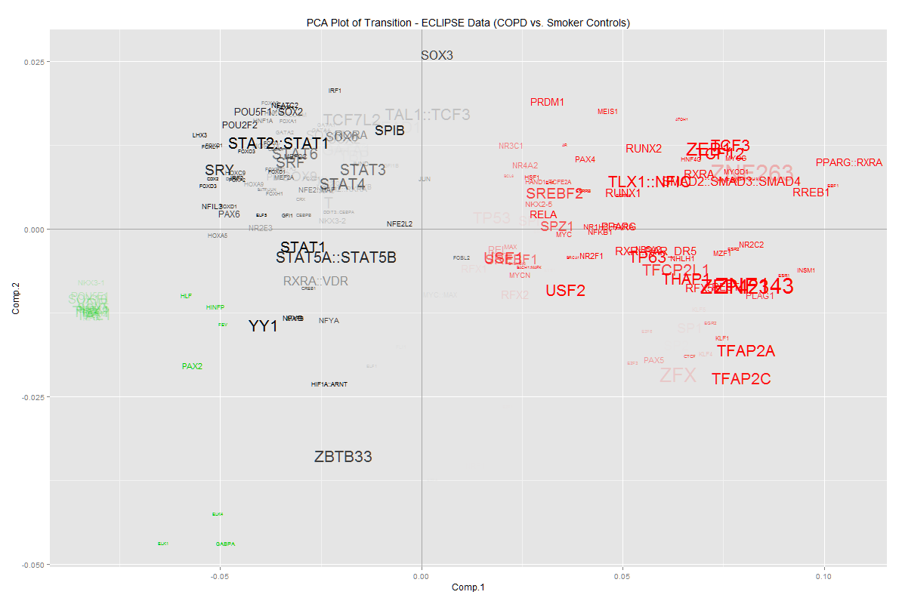
PCA of transition

Slide 19
Comparison of results to gene expression analysis (Top DI results)
Gene/TF | Sig diff involvement | Sig diff expression
ATOH1 | 0.00E+00 | 0.925171
ELK1 | 0.00E+00 | 0.079714
MYOD1 | 0.00E+00 | 0.675077
RXRA | 0.00E+00 | 0.21628
TCF3 | 0.00E+00 | 0.000586
EBF1 | 1.11E-16 | 0.000281
ZEB1 | 2.01E-14 | 0.784888
FEV | 3.40E-13 | 0.529187
ESR2 | 1.84E-12 | 0.422034
IRF2 | 1.29E-10 | 0.287961
RUNX2 | 7.70E-10 | 0.084992
MYOG | 1.60E-09 | 0.415626
TCF12 | 4.17E-09 | 0.013961
RUNX1 | 7.05E-09 | 0.291401
RREB1 | 1.14E-08 | 0.758432

