Slide 1
Meeting 3/2/15

Slide 2
Items
PandaR paper
PandaR bioconductor?
Download motif/ppi data from public repositories?
Transition update. Kabsch algorithm, Procrustes analysis, error measurement.
‘BERE’ method
pronounced “bear” (working name)
Uses Rcpp, parallel R

Slide 3
Transition Matrix
AKA Transformation/Transition/Operator/Translation/Rotation Matrix
Why TM? As opposed to higher definition edgeweight analysis.
Similar to Wahba's problem from 1965 http://en.wikipedia.org/wiki/Wahba%27s_problem
Kabsch algorithm
See latex writeup
Problems with using TM approach for analyzing genes. n>>m yields infinitely many equivalent “best” solutions
So, better solutions for gene level “transition” analysis?

Slide 4
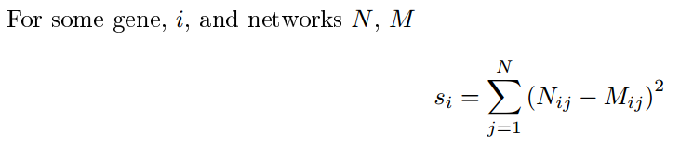
Gene alternative to TM
A simple proposal gene statistic-
Scaling not necessary due to z-score normalization in PANDA.
null distribution? Can’t be derived, differs depending on motif structure, must use resampling approach. Similar to TM approach.

Slide 5
Top genes with this approach
 | score
XPNPEP1 | 955.8662
SYT7 | 895.0878
ZNF397 | 889.0098
LOC401324 | 878.574
OR8G1 | 877.6873
MGC16275 | 876.773
HNRNPC | 874.054
LIM2 | 871.7196
LOC374443 | 868.505
CPSF3L | 856.2021
GRAMD2 | 853.0428
PAGR1 | 850.3527
HIST1H2BG | 831.9306
SPRR2G | 831.4982
USO1 | 829.1369
DHRS11 | 828.3305
HEPACAM2 | 828.1605
AQP1 | 826.7235
ZNF134 | 820.9132
CFB | 817.5185
All significant at p < 0.02
Need to run more permutations to get more precision. Or derive the null distribution.

Slide 6
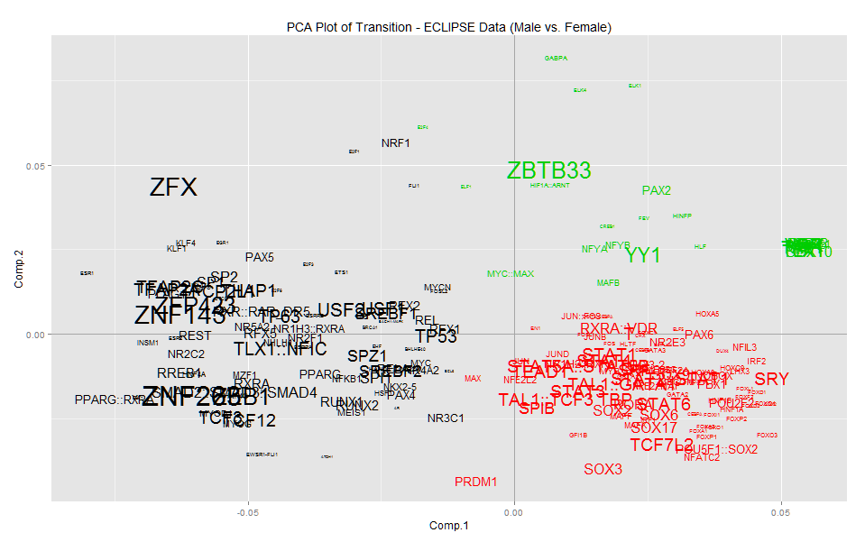
PCA of transition

Slide 7
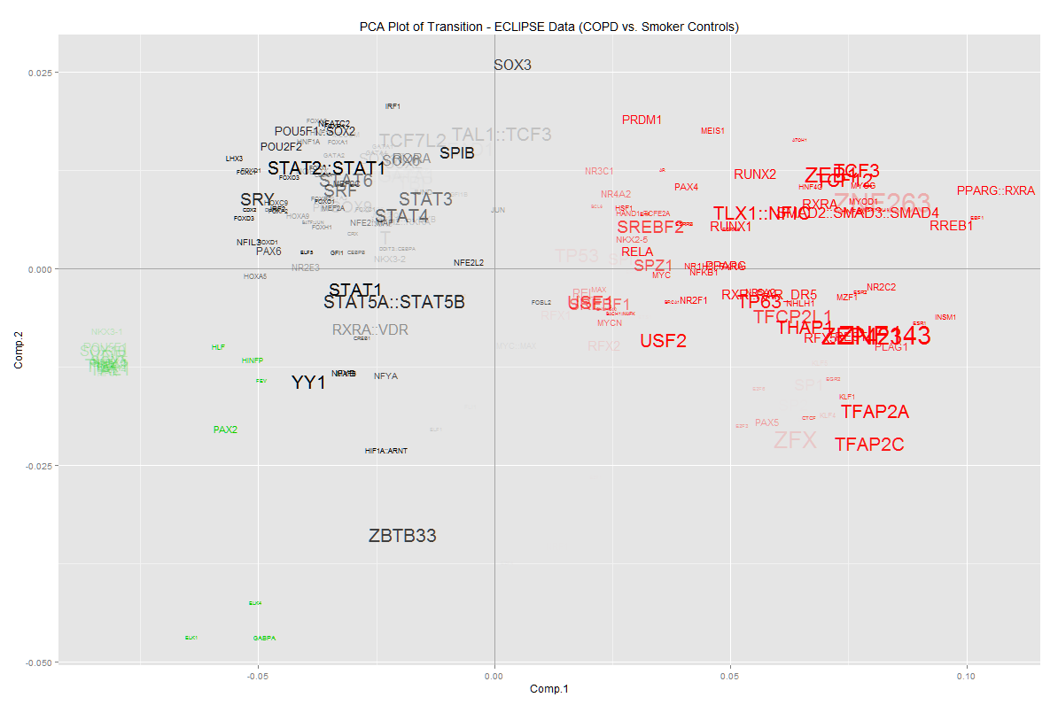
PCA of transition

Slide 8
BERE
Similar approach PANDA
Still represents regulatory network as bipartite
Still uses idea of “information passing”
But different
Calculates scores for each TF-Gene which quantifies how strongly correlated each gene is with children of each TF.
Scores for edgeweights are independent of the Motif. I.e. edges are scored solely based on other edges and correlation structure. Useful for interpretation…
Calculation does not involve any updating procedure.

Slide 9
BERE
Running R package: 8GB RAM, 2.40Ghz | Time
Yeast KO(2555 genes, 53 TF, 106 samples) | 1s
Yeast KO(2555 genes, 53 TF, 106 samples) w/o C++ | 2s
ECLIPSE(17342 genes, 189 TF, 226 samples) | 360s
ECLIPSE(17342 genes, 189 TF, 226 samples) w/o C++ | 470s

Slide 10
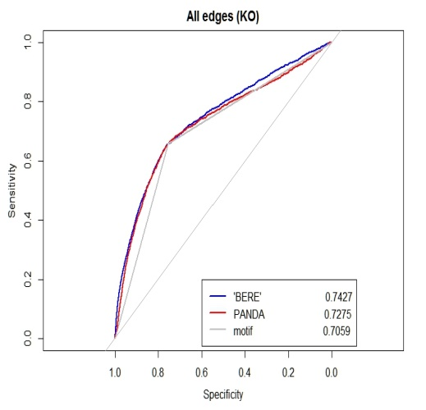
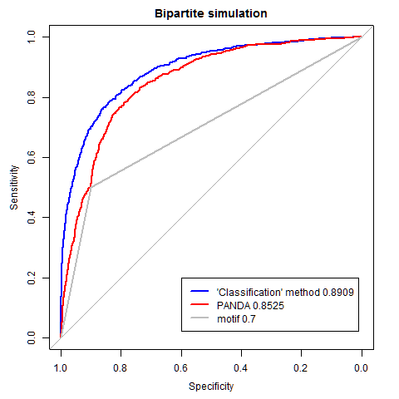
Validation
Simulation (expression data generated from MVN with covariance matrix defined as bipartite matching from Motif)
3 Yeast datasets against ChIP-chip.
Dataset | PANDA | BERE | Motif
MVN | .8525 | .8909 | .7000
Yeast KO | .7275 | .7427 | .7059
Yeast SR | .717 | .727 | .7059
Yeast CC | .7059 | .7278 | .7059

