Slide 1
Meeting 3/16/15

Slide 2
Items
Transition matrix update/results/validation
BERE method
Putting together committee
PandaR bioconductor/paper
Further development in progress (S3/S4 classes, vignette, integration with existing packages, etc.)

Slide 3
Transition Matrix
Problem: I made a mistake at last meeting.
The Kabsch algorithm does NOT find the optimal transition matrix as measured by least squares error.
It finds optimal rotation by LS.
Was the solution to the wrong (or at least unnecessarily constrained) problem (sorry!)
What do we really want? The optimal transformation matrix, not bound by a rotation constraint and optimal by least squares error (or something similar)
Solution (This will be a continuous work in progress):
Treat the columns of the mxm transition matrix as the m coefficients of m independent regressions (of any kind) of Network A adj. on the m columns of Network B adj.

Slide 4
Transition Matrix
Continued…
Benefits of a regression based approach
Provides framework for a clearly defined problem, can be approached in many ways-
minimize LS with OLS
Apply LASSO, ridge, elastic net or other penalized regression depending on our goals
We have a specified null hypothesis – H0: TM=I
This approach can be viewed as a dimension reduction problem, where the dimensions that we are reducing to are the observed edgeweights in the baseline network.
Intuition (see pdf)

Slide 5

Lasso/Elastic net for Transition Matrix
Regularization methods
Find
Effective for sparse datasets in the sense that most coefficients are actually 0
EN may perform better for highly correlated data (due to LASSO somewhat arbitrarily choosing one variable of a correlated group)
Simultaneously does model fitting and model selection. (ie, many coefficients go to zero)

Slide 6
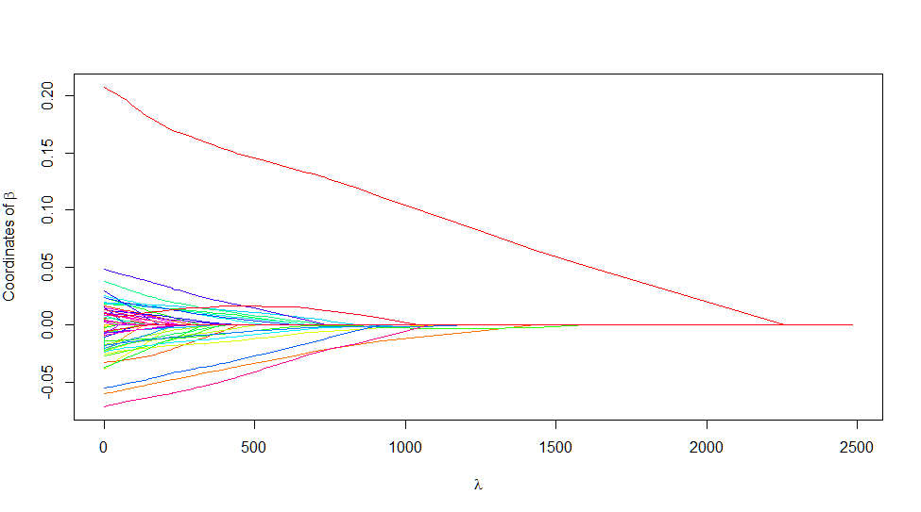
Lasso/Elastic net for Transition Matrix
Penalty term
Choosing a lambda makes algorithm a bit more complex
Some cross validation is typically used to reduce error
Can perhaps use the same lambda for each of the m lasso calculations

Slide 7
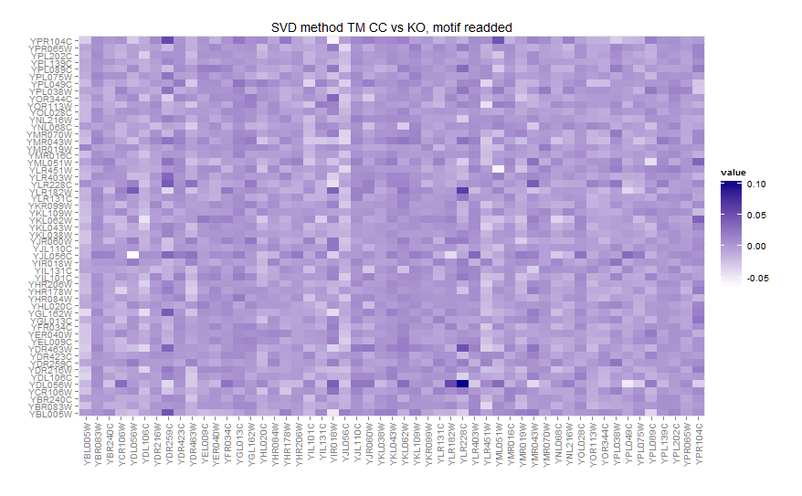
Results (Yeast)

Slide 8
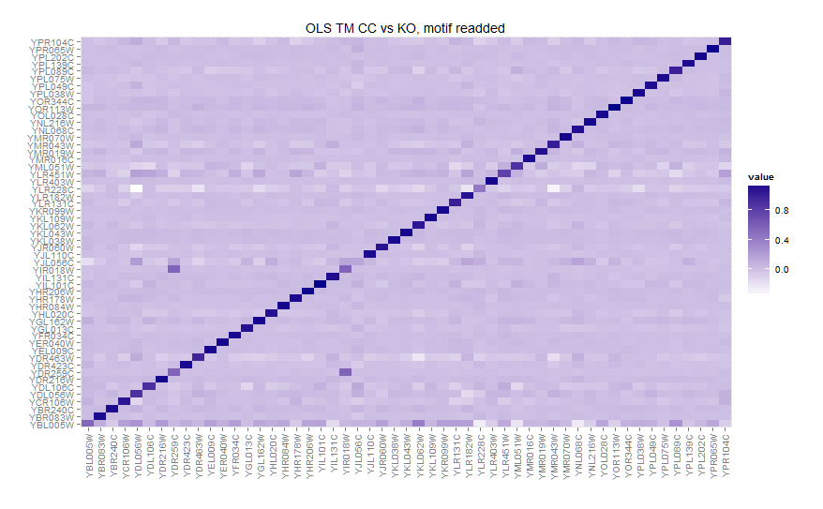
Results (Yeast)

Slide 9
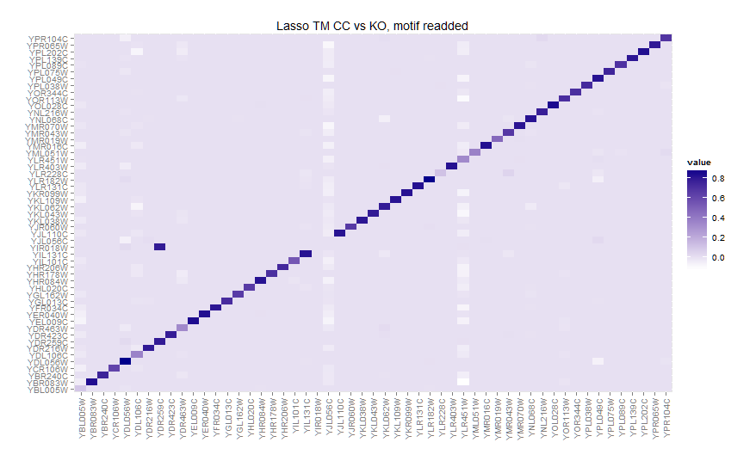
Results (Yeast)

Slide 10
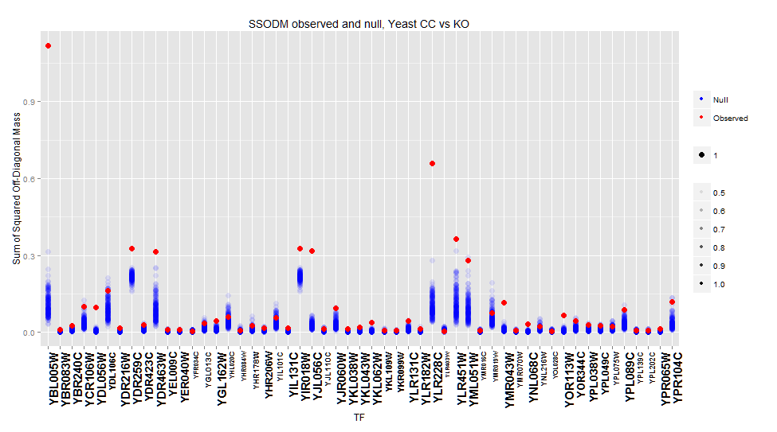
Results (Yeast)

Slide 11
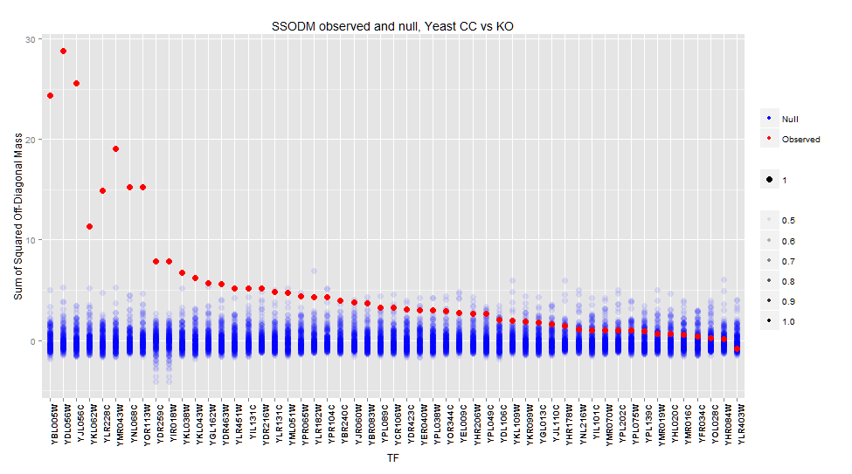
Results (Yeast)

Slide 12
BERE
Current approach
signal-to-noise ratio for m->i of Beta1 estimate for model
CORR(i,j)=Beta0 + Beta1*Motif(j) + e
Better ideas?
Introduce positivity constraint for edgeweights?
PCA or other dimension reduction method?
R^2? Do we want to keep or exclude negatively correlated?
Classification? LDA? LDA is too slow (also probably not necessary as it is equivalent to OLS for k=2 groups.)

Slide 13
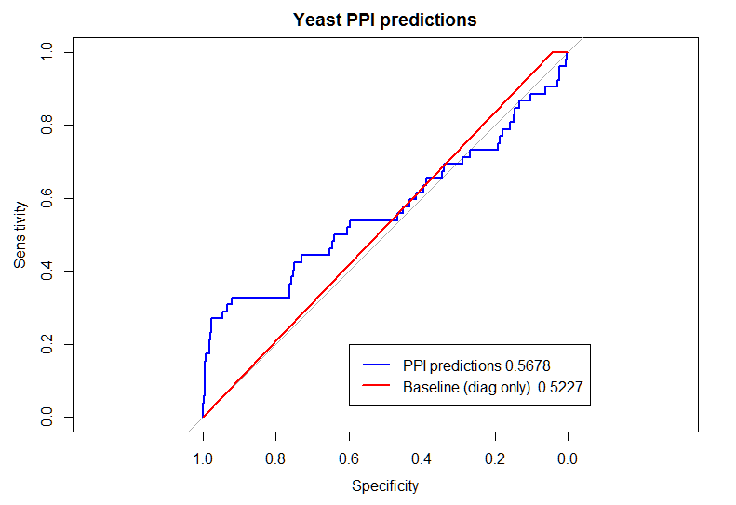
BERE
Validation options
ChIP chip
PPI?
Reliability?
Biases?

