Slide 1
Meeting 3/30/15

Slide 2
Items
PandaR bioconductor package (Accepted after n iterations)
Bioinformatics note paper (Comments, is the next step submission?)
Putting together dissertation committee. Oral quals timeline.
Transition matrix update/results/validation
BERE method

Slide 3
Transition Matrix
Problem: I made a mistake at last meeting.
The Kabsch algorithm does NOT find the optimal transition matrix as measured by least squares error.
  It finds optimal rotation by LS.
  Was the solution to the wrong (or at least unnecessarily constrained) problem (sorry!)
What do we really want? The optimal transformation matrix, not bound by a rotation constraint and optimal by least squares error (or something similar)
Solution (This will be a continuous work in progress):
  Treat the columns of the mxm transition matrix as the m coefficients of m independent regressions (of any kind) of Network A adj. on the m columns of Network B adj.

Slide 4
Transition Matrix
Continued…
Benefits of a regression based approach
  Provides framework for a clearly defined problem, can be approached in many ways-
    minimize LS with OLS
    Apply LASSO, ridge, elastic net or other penalized regression depending on our goals
  We have a specified null hypothesis – H0: TM=I
  This approach can be viewed as a dimension reduction problem, where the dimensions that we are reducing to are the observed edgeweights in the baseline network.
  Intuition (see pdf)

Slide 5

Lasso/Elastic net for Transition Matrix
Regularization methods
  Find
  Effective for sparse datasets in the sense that most coefficients are actually 0
  EN may perform better for highly correlated data (due to LASSO somewhat arbitrarily choosing one variable of a correlated group)
Simultaneously does model fitting and model selection. (ie, many coefficients go to zero)

Slide 6
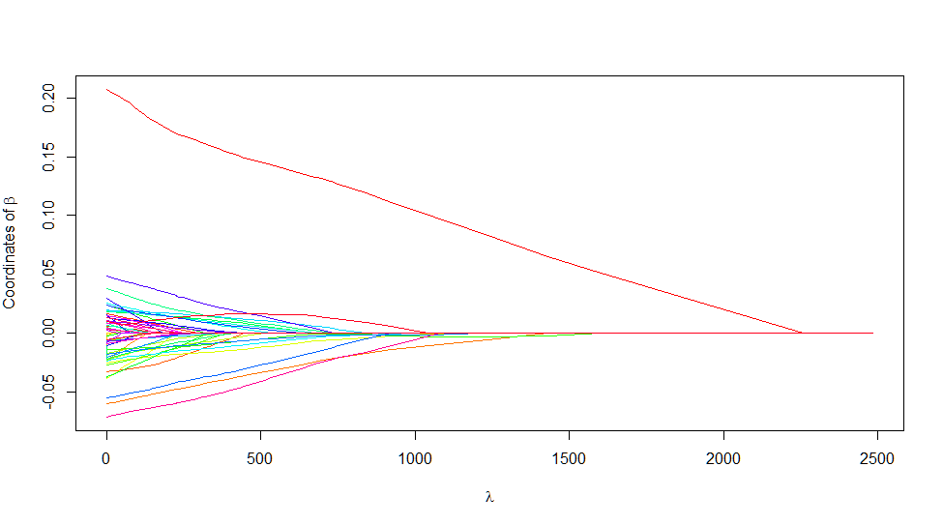
Lasso/Elastic net for Transition Matrix
Penalty term
Choosing a lambda makes algorithm a bit more complex
  Some cross validation is typically used to reduce error
  Can perhaps use the same lambda for each of the m lasso calculations

Slide 7
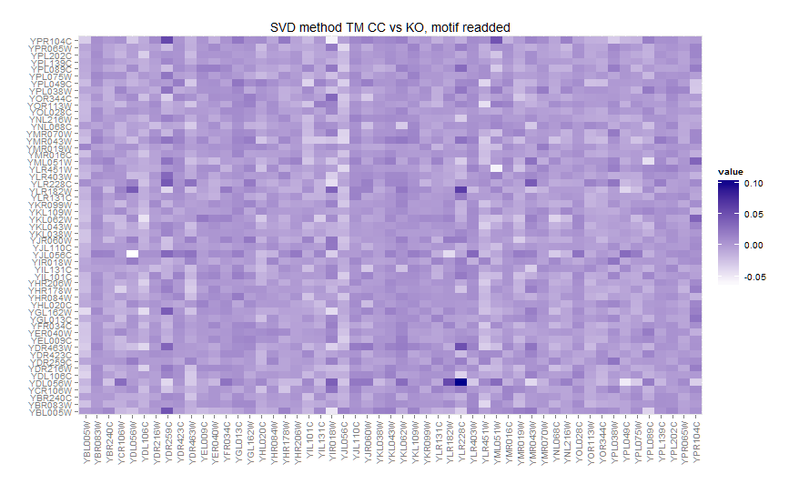
Results (Yeast)

Slide 8

Results (Yeast)

Slide 9
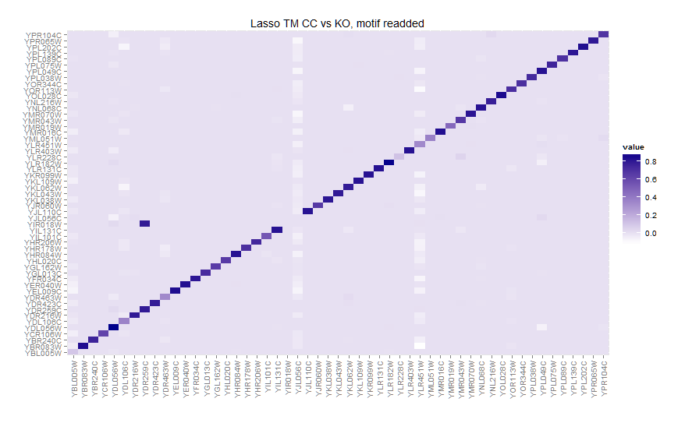
Results (Yeast)
YIR018W
+
YDR463

Slide 10
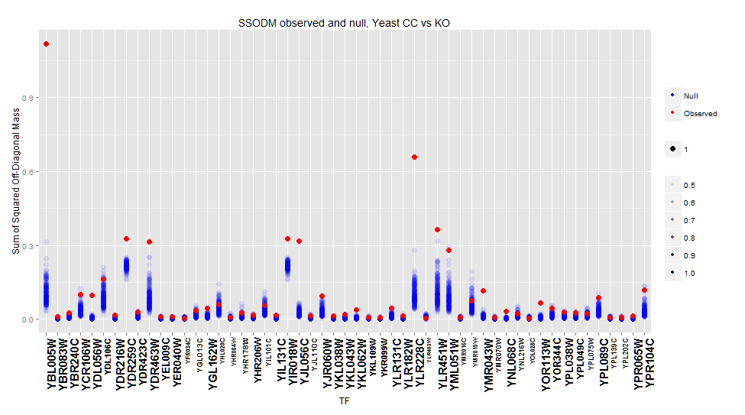
Results (Yeast)

Slide 11
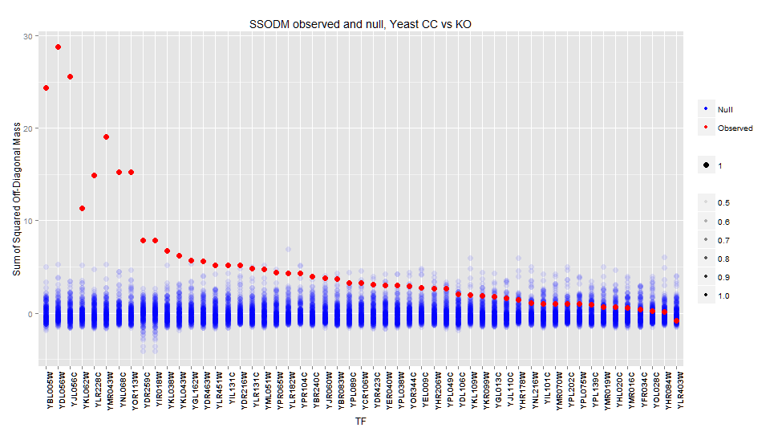
Results (Yeast)

Slide 12
BERE
Current approach
  signal-to-noise ratio for m->i of Beta1 estimate for model
    CORR(i,j)=Beta0 + Beta1*Motif(j) + e
  Better ideas?
    Introduce positivity constraint for edgeweights?
    PCA or other dimension reduction method?
    R^2? Do we want to keep or exclude negatively correlated?
    Classification? LDA? LDA is too slow (also probably not necessary as it is equivalent to OLS for k=2 groups.)

Slide 13
BERE
As a classification problem
TF A targets
Samples
Genes
Gene X

Slide 14
Results (Yeast)

Slide 15
Results (Yeast)

Slide 16
So, what's the story?
?
A
B
C
D
1
2
3
4
5
6
7
8
TM =

Slide 17
So, what's the story?
Suggested mechanism #1:
Differential methylation of the gene for TF C?
-CH₃
A
B
C
D
1
2
3
4
5
6
7
8

Slide 18
So, what's the story?
Suggested mechanism #2:
Protein complex of A-B-? with unknown 3rd protein?
?
A
B
C
D
1
2
3
4
5
6
7
8

Slide 19
How to differentiate/verify approach?
For mechanism #1: We could examine methylation data to see if TM approach accurately identifies differential methylation of TF binding site.
  This does not appear possible with ECLIPSE methylation data? i.e. we need TF motif specific binding info, not gene-level methylation.
  Perhaps even ChIP-Seq is not appropriate? Would need DNA methlyation sequencing.
For mechanism #2: This suggest a sort of “differential Protein-Protein interaction” between treatment-control.
  It does suggest that a PPI exists, if that is the case. See results.
  It may be difficult to identify the existence of a hidden protein (one that is not a TF) in a protein complex.
    We could look at differential gene expression for proteins known to bind to both TF B and TF C.

Slide 20
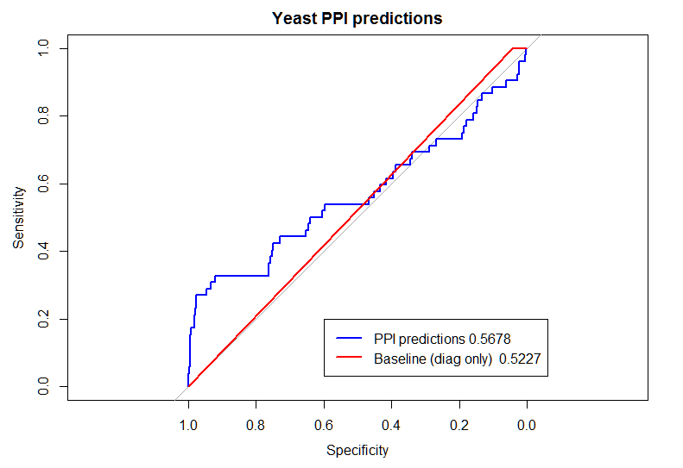
Transition Matrix
  Validation options
  ChIP chip
  PPI?
    Reliability?
    Biases?

