Slide 1
Meeting 4/13/15

Slide 2
Items
PandaR bioconductor package (Submitted, accepted after n iterations. Will be available in the next BioC version 3.1, April 16)
Bioinformatics note paper. Figure updated with suggestions. (Comments? Is the next step submission?)
Putting together dissertation committee. Oral quals timeline.

Slide 3

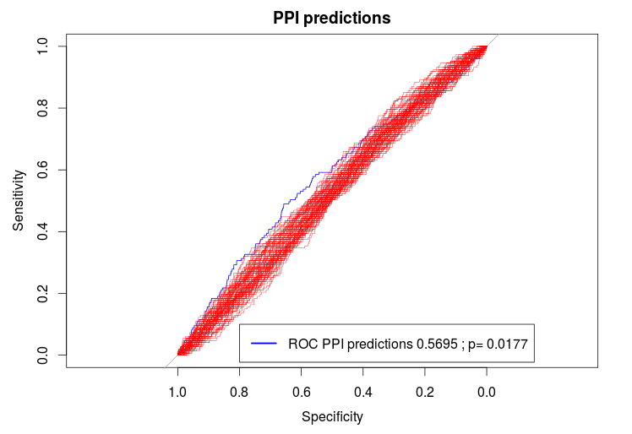

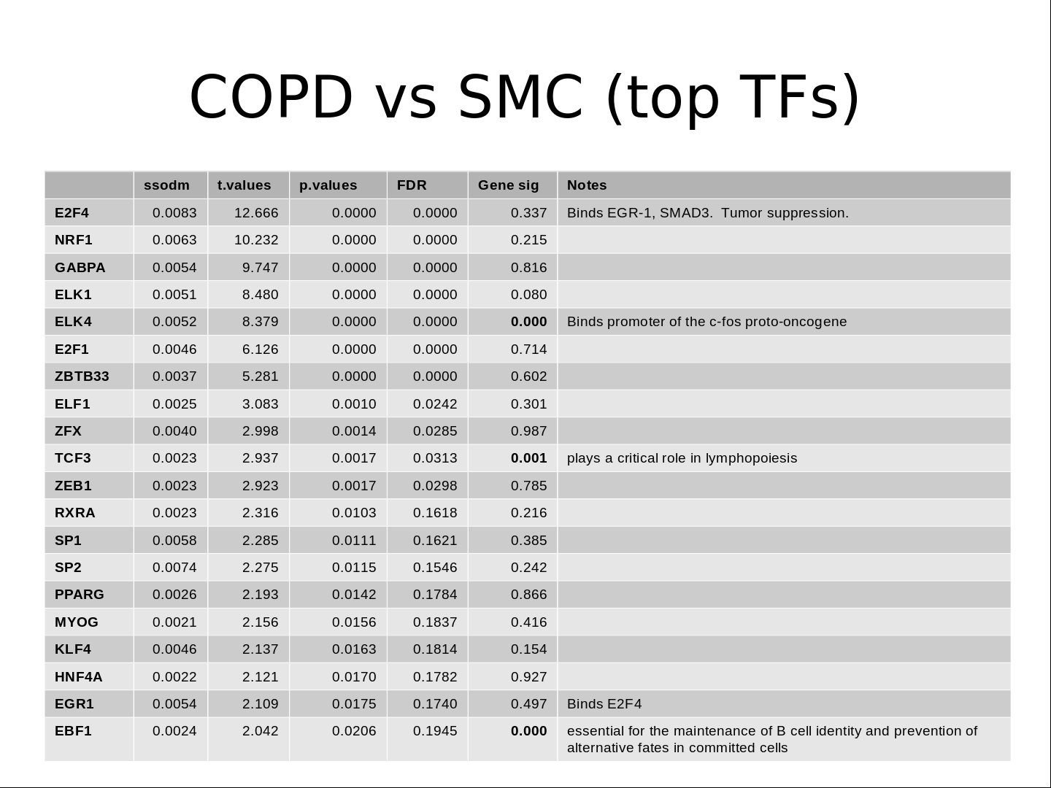
Eclipse Data Motif Data
Observed Partition
COPD vs SMC
Random Partitions
Null x 100
PANDA / BERE
}
Observed
COPD
Network
Observed
SMC
Network
Null
NetworkA
Null
NetworkB
X 100
Transition Matrix calculation (Iterative OLS)
}
X 100
Transition Matrix analysis

Slide 4
BERE
Latest algorithm updates
Algorithm now takes two distinct approaches (not clear which is superior at this point)
  Correlation matrix approach
    Background noise found to be similar across TFs, so now estimating single background. (This sped up algorithm and did not affect results in a meaningful way)
    Introduced positivity constraint. True edgeweights should theoretically never be negative. Previously, due to noise negative edgeweights occurred.
  Linear Discriminant Analysis approach
    Newer implementation. Same general idea, but a clearer classification approach.
    Edges are posterior probabilities. Priors are taken to be proportion of genes targeted by motif.

Slide 5
BERE
TF A
TF B
TF C
Motif
Data
TF C targets
-.2
TF A targets
TF B targets
.7
Targets?
.1
Expr
Data
Samples
Genes
Gene X

Slide 6
BERE
Scoring an edgeweight: Approach 1
Example: Calculating TF 1 to gene X
Expression R² for
Gene X ~ all other genes
-Background genes
-Targets of TF1
0
1
Background
mean
Target
mean
Equivalently, calculate
CORR(i,j)=Beta0 + Beta1*Motif(j) + e
Edgeweight = max(0,Beta1/sd(background))
Difference
Edgeweight = max(0, Difference/sd(background))
Perform this for each pair (189*17k > 3 million edges)

Slide 7
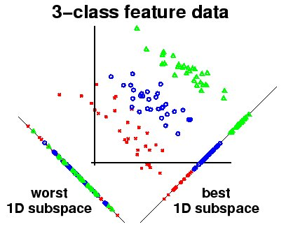
BERE
Scoring an edgeweight. Approach 2
Example: Calculating TF 1 to gene X
Evidence for Blue TF targeting
Perform this for each pair (189*17k > 3 million edges)

Slide 8
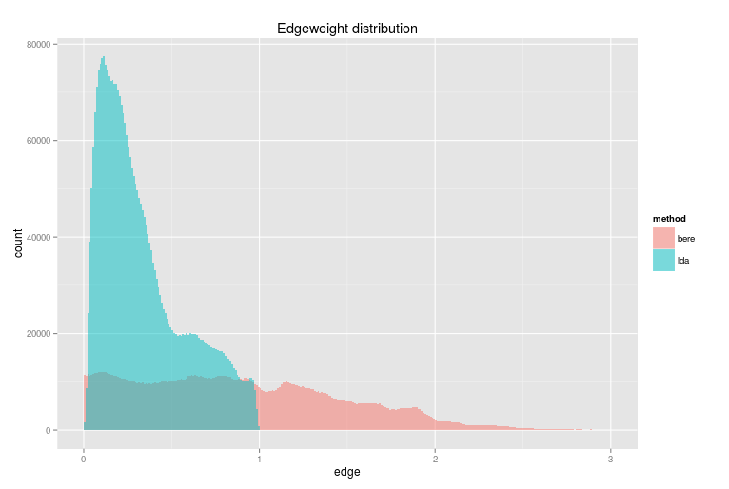
BERE
Comparison of methods

Slide 9
TM Results
COPD results
  Identifying DI TFs in COPD
  Exploring evidence for PPI in COPD

Slide 10
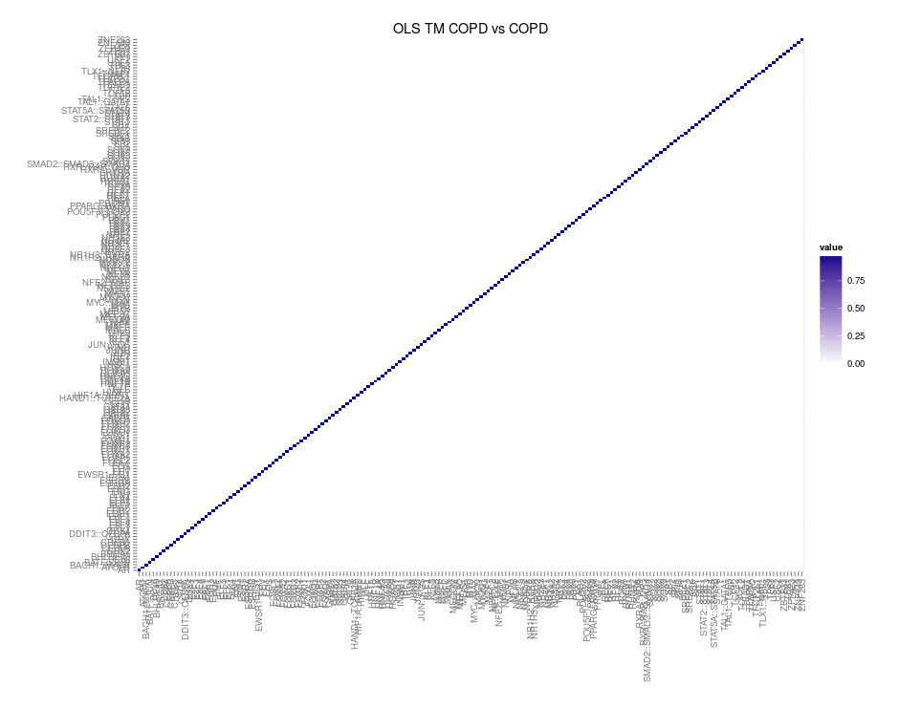
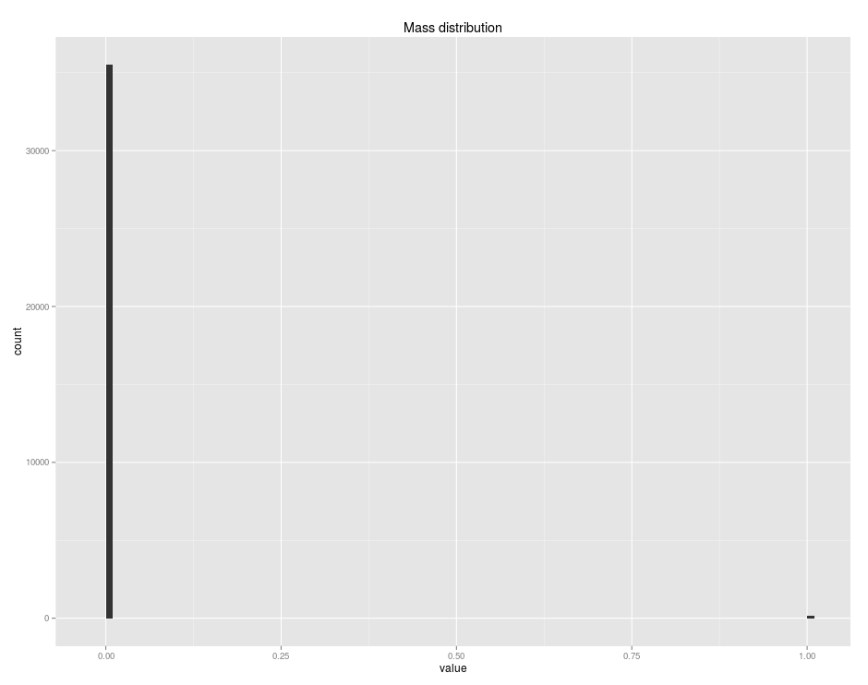
Eclipse Data: COPD vs COPD
As expected, the two-step OLS (and also the simple OLS) approach
yields 100% of mass to be on diagonal.

Slide 11
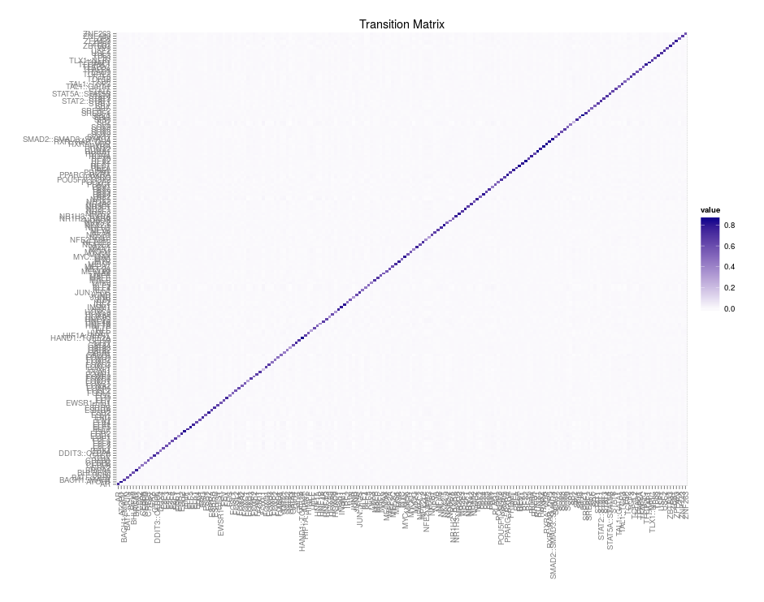
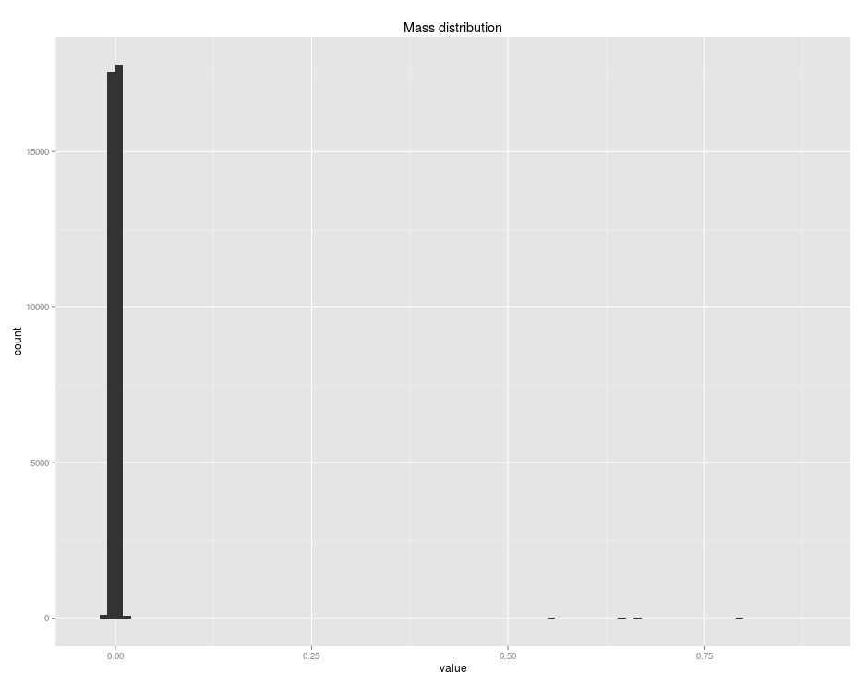
Eclipse Data: COPD vs SMC
Two-step OLS approach results in a surprisingly high proportion
of mass to be on diagonal. (Surprising to me)

Slide 12
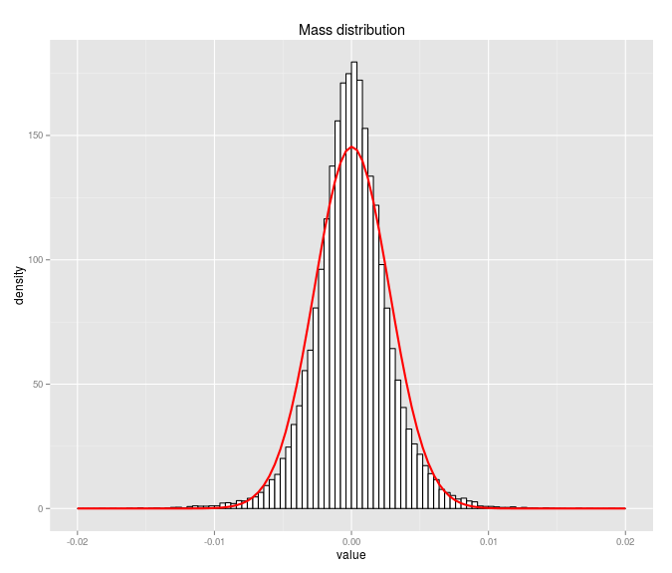
Eclipse Data: COPD vs SMC
Distribution of off-diagonal mass is strikingly Gaussian.
Perhaps with thicker tails.

Slide 13
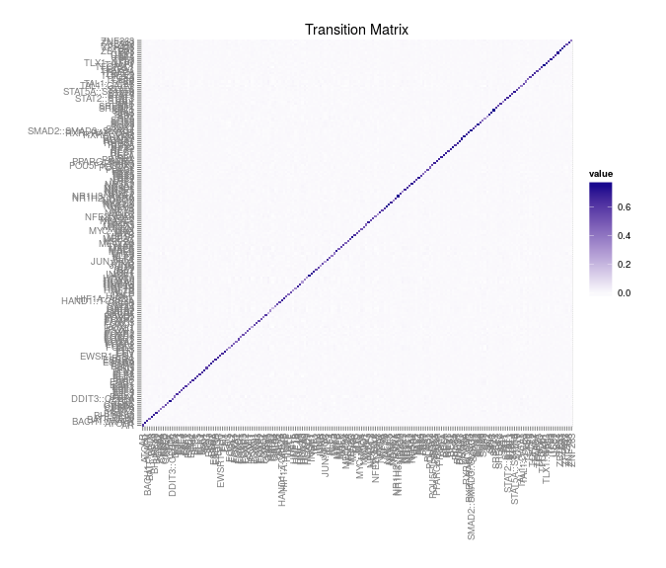
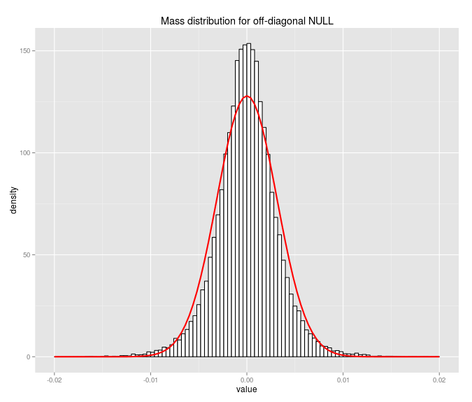
Eclipse Data: random partition
Distribution of off-diagonal mass is similar to that of the COPD Smoker control at the large scale level.

Slide 14
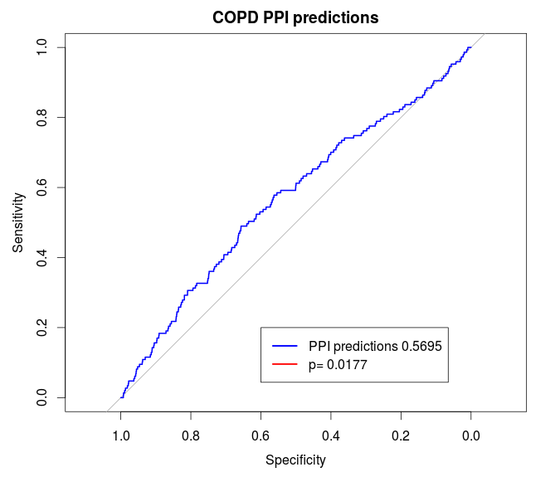
Eclipse Data: predicting PPI
COPD vs Smoker Control networks compared to randomly generated partition
FWIW, high ODM pairs do seem to be more likely to have a known PPI.
This is based on only 223 PPI (out of 189*189=35,000 possible interactions)

Slide 15
Eclipse Data: predicting PPI
Also used human data from BioGRID (updated 3/25/15), which contained 410 interactions. Of which 111 overlap with other PPI set.
BioGrid ROCAUC = .5355, p<.001
Not particularly impressive effect sizes, but strong evidence that this approach is measuring a biologically meaningful interaction.
Conclusion: The transition from COPD network to SMC network yields statistically significant predictions of PPI compared to null networks.
But, this does not have very much clinical/biological value (as far as I can tell), it merely shows that what we're measuring via TM has been independently observed elsewhere.

Slide 16
COPD vs SMC

Slide 17
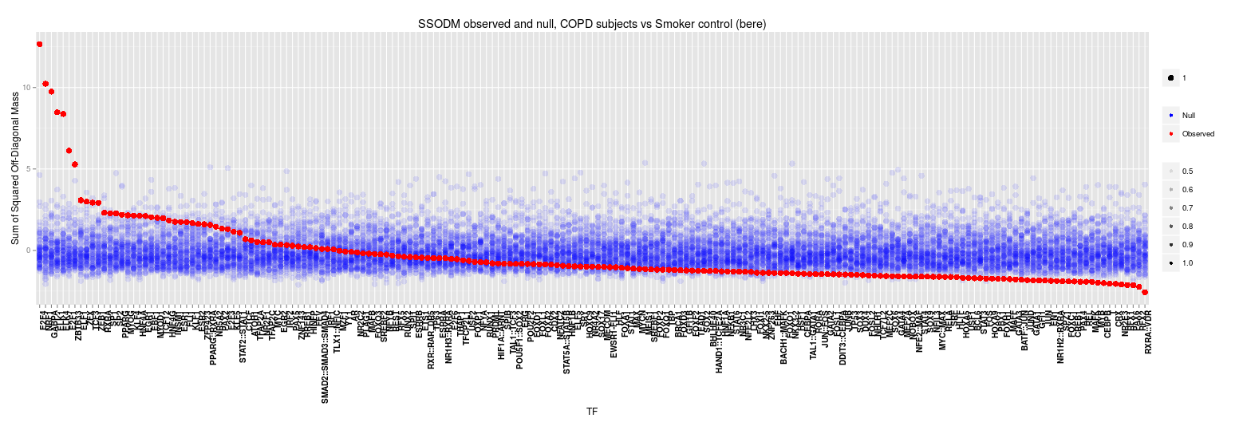
COPD vs SMC

Slide 18
COPD vs SMC (top TFs)
 | ssodm | t.values | p.values | FDR | Gene sig | Notes
E2F4 | 0.0083 | 12.666 | 0.0000 | 0.0000 | 0.337 | Binds EGR-1, SMAD3. Tumor suppression.
NRF1 | 0.0063 | 10.232 | 0.0000 | 0.0000 | 0.215 | acts on nuclear genes encoding respiratory subunits and components of the mitochondrial transcription and replication machinery.
GABPA | 0.0054 | 9.747 | 0.0000 | 0.0000 | 0.816 | Related to NRF1, involved in activation of cytochrome oxidase expression and nuclear control of mitochondrial function
ELK1 | 0.0051 | 8.480 | 0.0000 | 0.0000 | 0.080
ELK4 | 0.0052 | 8.379 | 0.0000 | 0.0000 | 0.000 | Binds promoter of the c-fos proto-oncogene
E2F1 | 0.0046 | 6.126 | 0.0000 | 0.0000 | 0.714 | E2F family...
ZBTB33 | 0.0037 | 5.281 | 0.0000 | 0.0000 | 0.602 | shown to interact with HDAC3, Nuclear receptor co-repressor 1
ELF1 | 0.0025 | 3.083 | 0.0010 | 0.0242 | 0.301 | primarily expressed in lymphoid cells
ZFX | 0.0040 | 2.998 | 0.0014 | 0.0285 | 0.987
TCF3 | 0.0023 | 2.937 | 0.0017 | 0.0313 | 0.001 | plays a critical role in lymphopoiesis
ZEB1 | 0.0023 | 2.923 | 0.0017 | 0.0298 | 0.785
RXRA | 0.0023 | 2.316 | 0.0103 | 0.1618 | 0.216
SP1 | 0.0058 | 2.285 | 0.0111 | 0.1621 | 0.385
SP2 | 0.0074 | 2.275 | 0.0115 | 0.1546 | 0.242
PPARG | 0.0026 | 2.193 | 0.0142 | 0.1784 | 0.866
MYOG | 0.0021 | 2.156 | 0.0156 | 0.1837 | 0.416
KLF4 | 0.0046 | 2.137 | 0.0163 | 0.1814 | 0.154
HNF4A | 0.0022 | 2.121 | 0.0170 | 0.1782 | 0.927
EGR1 | 0.0054 | 2.109 | 0.0175 | 0.1740 | 0.497 | Binds E2F4
EBF1 | 0.0024 | 2.042 | 0.0206 | 0.1945 | 0.000 | essential for the maintenance of B cell identity and prevention of alternative fates in committed cells

Slide 19
COPD vs SMC
How do we analyze this list?
How do we validate these findings?
DAVID unsurprisingly return entirely DNA binding results.

Slide 20
COPD vs SMC
Ideas for further development:
- A measure of TF target “cohesiveness”.
How strongly does the sequence motif predict edgeweight?
This could be useful in identifying mechanism. For example a TF that is inhibited will likely show a reduced cohesivess compared to one that is active.

